Slide 1
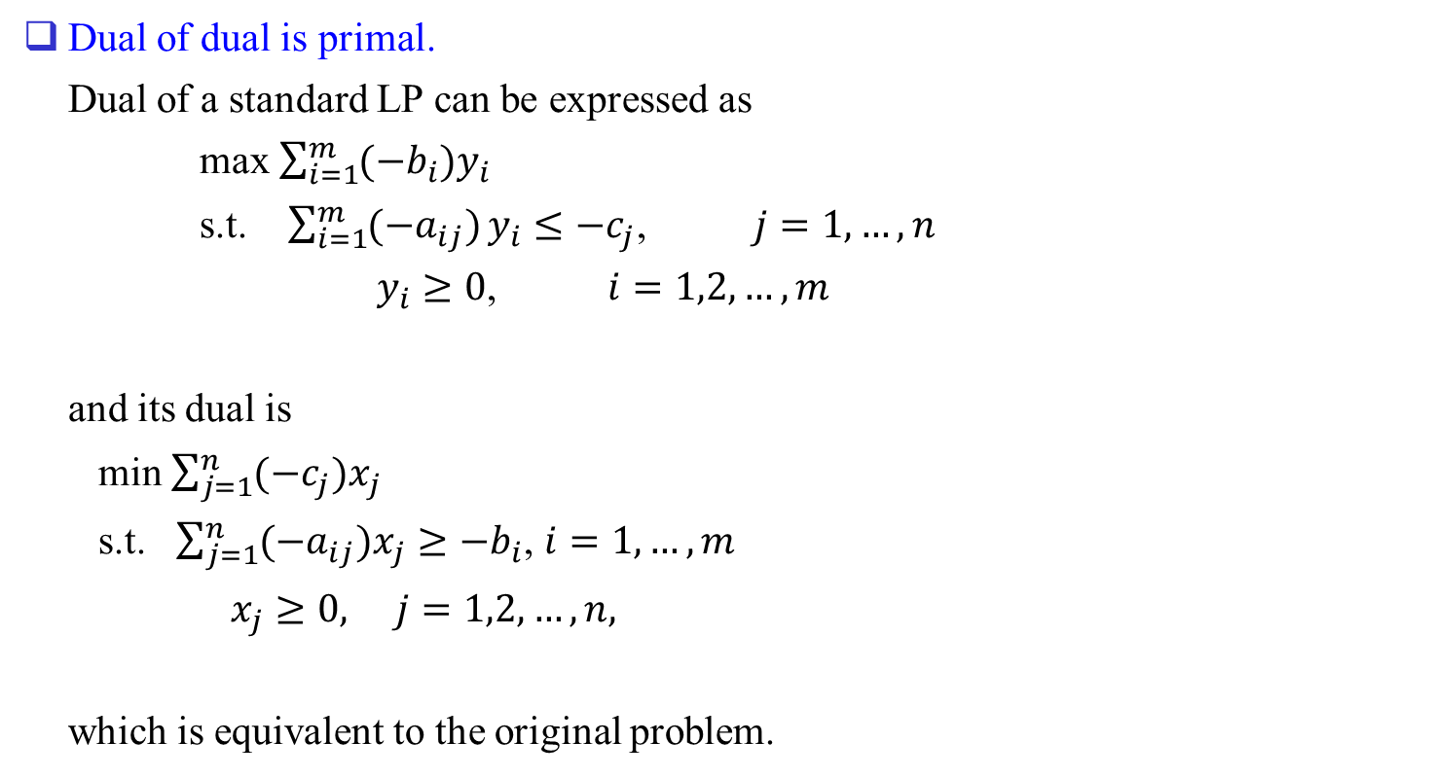
Relation between (P) & (D)
Dual of dual is primal.
Dual of a standard LP can be expressed as
max $\sum_{i=1}^{m}{(−b_{i})y_{i}}$
s.t. $\sum_{i=1}^{m}{(−a_{ij})}y_{i}≤−c_{j}$, $j=1,…,n$
$y_{i}≥0$, $i=1,2,…,m$
and its dual is
min $\sum_{j=1}^{n}{(−c_{j})x_{j}}$
s.t. $\sum_{j=1}^{n}{(−a_{ij})x_{j}}≥−b_{i}$, $i=1,…,m$
$x_{j}≥0, j=1,2,…,n,$
which is equivalent to the original problem.

Slide 2
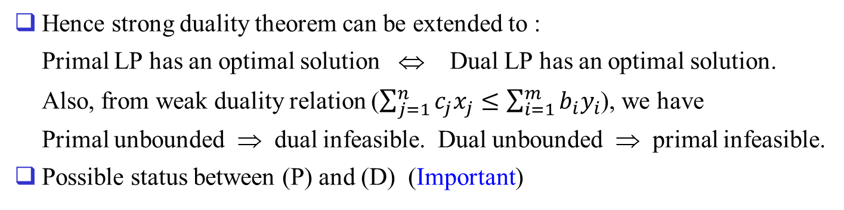
Hence strong duality theorem can be extended to :
Primal LP has an optimal solution ⇔ Dual LP has an optimal solution.
Also, from weak duality relation ($\sum_{j=1}^{n}{c_{j}x_{j}}≤\sum_{i=1}^{m}{b_{i}y_{i}}$), we have
Primal unbounded ⇒ dual infeasible. Dual unbounded ⇒ primal infeasible.
Possible status between (P) and (D) (Important)
(D)
 | optimal solution | Infeasible | Unbounded
Optimal solution | O | X | X
Infeasible | X | ( O ) | O
Unbounded | X | O | X
(P)

Slide 3
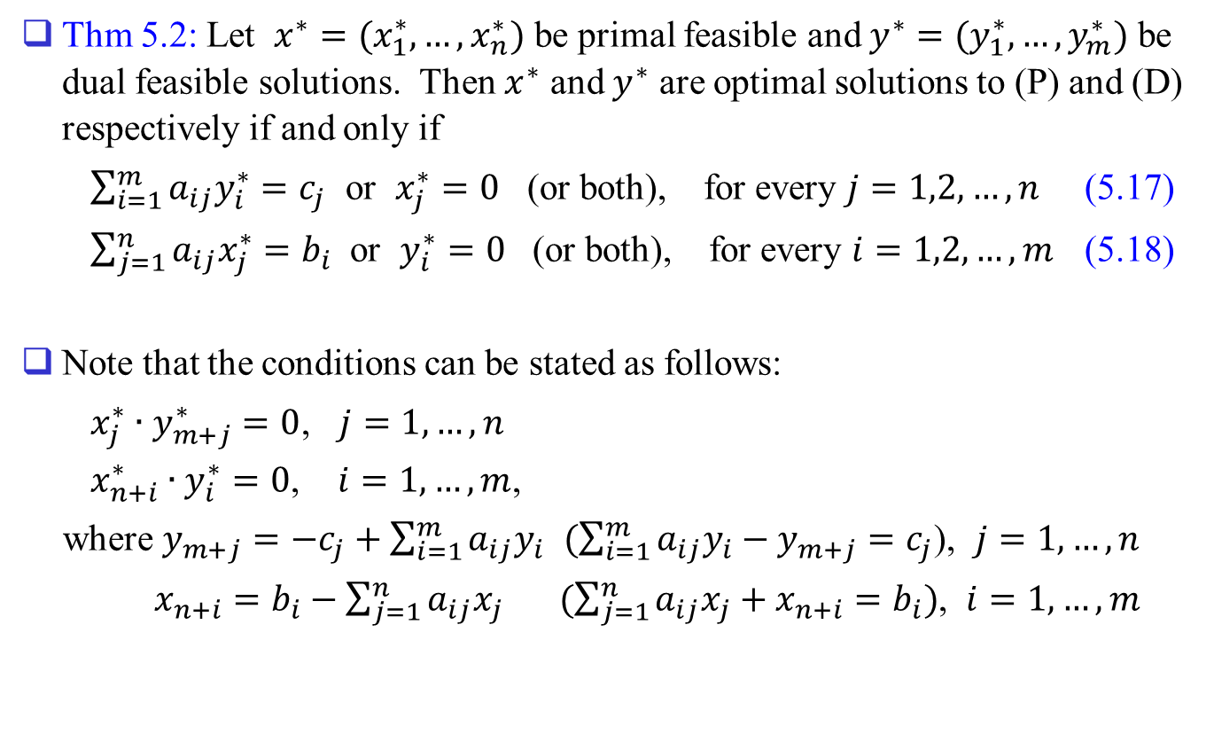
Complementary Slackness Theorem
Thm 5.2: Let $x^{∗}=(x_{1}^{∗},…,x_{n}^{∗})$ be primal feasible and $y^{∗}=(y_{1}^{∗},…,y_{m}^{∗})$ be dual feasible solutions. Then $x^{∗}$ and $y^{∗}$ are optimal solutions to (P) and (D) respectively if and only if
$\sum_{i=1}^{m}{a_{ij}y_{i}^{∗}}=c_{j}$ or $x_{j}^{∗}=0$ (or both), for every $j=1,2,…,n$ (5.17)
$\sum_{j=1}^{n}{a_{ij}x_{j}^{∗}}=b_{i}$ or $y_{i}^{∗}=0$ (or both), for every $i=1,2,…,m$ (5.18)
Note that the conditions can be stated as follows:
$x_{j}^{∗}∙y_{m+j}^{∗}=0$, $j=1,…,n$
$x_{n+i}^{∗}∙y_{i}^{∗}=0$, $i=1,…,m$,
where $y_{m+j}=−c_{j}+\sum_{i=1}^{m}{a_{ij}y_{i}}$ $(\sum_{i=1}^{m}{a_{ij}y_{i}}−y_{m+j}=c_{j}$), $j=1,…,n$
$x_{n+i}=b_{i}−\sum_{j=1}^{n}{a_{ij}x_{j}}$ $(\sum_{j=1}^{n}{a_{ij}x_{j}}+x_{n+i}=b_{i})$, $i=1,…,m$

Slide 4
The conditions say that if one of the primal (dual) variable is positive, then the corresponding dual (primal) constraint must hold at equality in an optimal solution. (primal, dual variables must be feasible, respectively)
Similarly, if one of the primal (dual) constraint hold at strict inequality, then the corresponding dual (primal) variable should be zero.

Slide 5
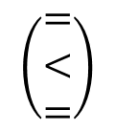
ex)
$$\left(\begin{matrix}= \\ < \\ =\end{matrix}\right)$$
Negative of dual surplus variables (later)
Negative of dual (structural) variables

Slide 6
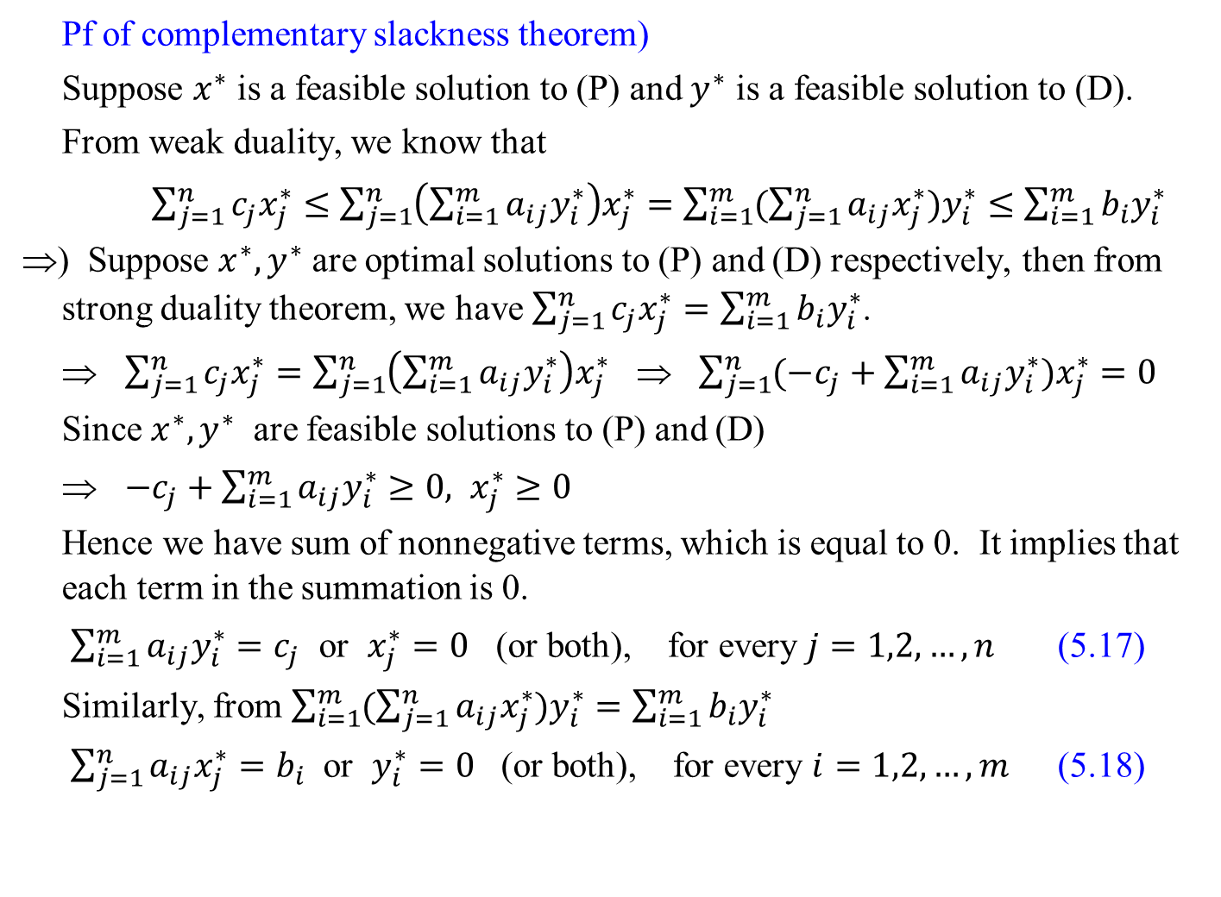
Pf of complementary slackness theorem)
Suppose $x^{∗}$ is a feasible solution to (P) and $y^{∗}$ is a feasible solution to (D).
From weak duality, we know that
$\sum_{j=1}^{n}{c_{j}x_{j}^{∗}}≤\sum_{j=1}^{n}{\left(\sum_{i=1}^{m}{a_{ij}y_{i}^{∗}}\right)x_{j}^{∗}}=\sum_{i=1}^{m}{(\sum_{j=1}^{n}{a_{ij}x_{j}^{∗}})y_{i}^{∗}}≤\sum_{i=1}^{m}{b_{i}y_{i}^{∗}}$
⇒) Suppose $x^{∗}, y^{∗}$ are optimal solutions to (P) and (D) respectively, then from strong duality theorem, we have $\sum_{j=1}^{n}{c_{j}x_{j}^{∗}}=\sum_{i=1}^{m}{b_{i}y_{i}^{∗}}$.
⇒ $\sum_{j=1}^{n}{c_{j}x_{j}^{∗}}=\sum_{j=1}^{n}{\left(\sum_{i=1}^{m}{a_{ij}y_{i}^{∗}}\right)x_{j}^{∗}}$ ⇒ $\sum_{j=1}^{n}{(−c_{j}+\sum_{i=1}^{m}{a_{ij}y_{i}^{∗}})x_{j}^{∗}}=0$
Since $x^{∗}, y^{∗}$ are feasible solutions to (P) and (D)
⇒ $−c_{j}+\sum_{i=1}^{m}{a_{ij}y_{i}^{∗}}≥0, x_{j}^{∗}≥0$
Hence we have sum of nonnegative terms, which is equal to 0. It implies that each term in the summation is 0.
$\sum_{i=1}^{m}{a_{ij}y_{i}^{∗}}=c_{j}$ or $x_{j}^{∗}=0$ (or both), for every $j=1,2,…,n$ (5.17)
Similarly, from $\sum_{i=1}^{m}{(\sum_{j=1}^{n}{a_{ij}x_{j}^{∗}})y_{i}^{∗}}=\sum_{i=1}^{m}{b_{i}y_{i}^{∗}}$
$\sum_{j=1}^{n}{a_{ij}x_{j}^{∗}}=b_{i}$ or $y_{i}^{∗}=0$ (or both), for every $i=1,2,…,m$ (5.18)

Slide 7
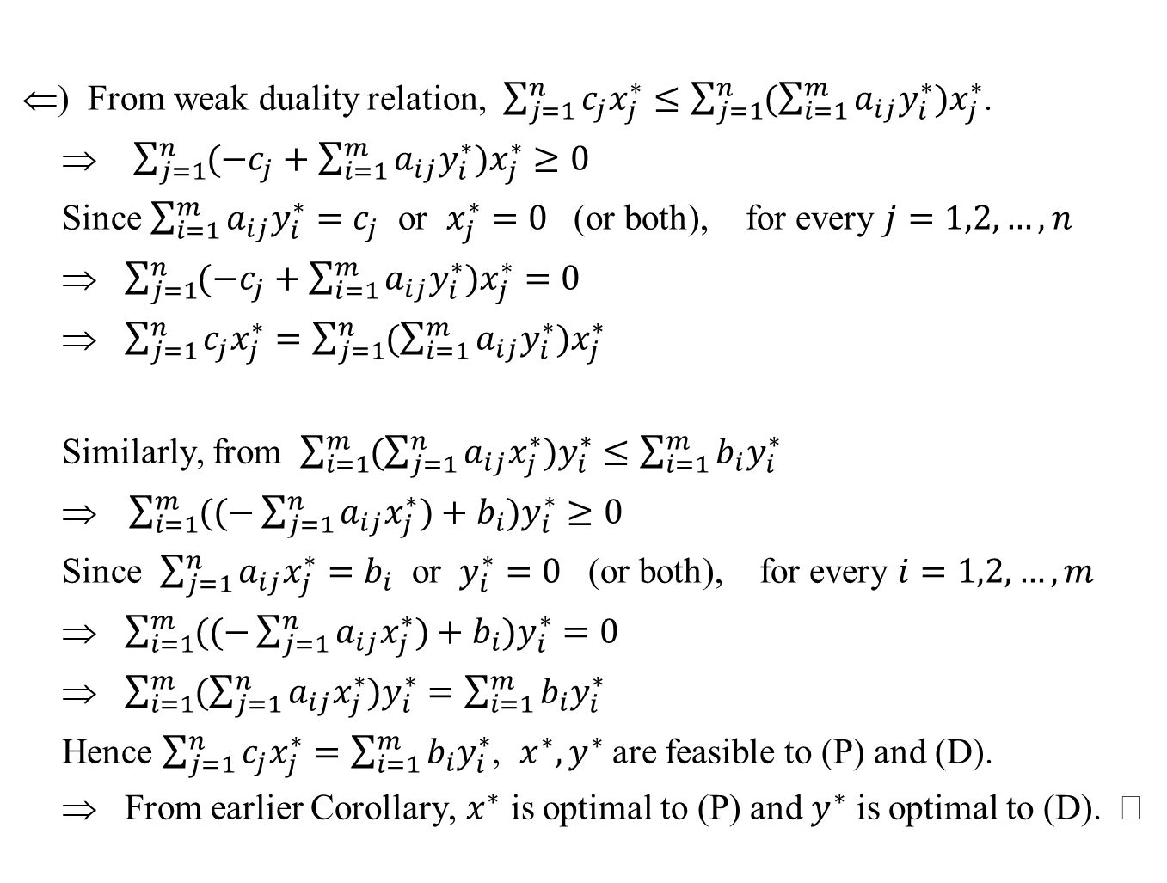
⇐) From weak duality relation, $\sum_{j=1}^{n}{c_{j}x_{j}^{∗}}≤\sum_{j=1}^{n}{(\sum_{i=1}^{m}{a_{ij}y_{i}^{∗}})x_{j}^{∗}}$.
⇒ $\sum_{j=1}^{n}{(−c_{j}+\sum_{i=1}^{m}{a_{ij}y_{i}^{∗}})x_{j}^{∗}}≥0$
Since $\sum_{i=1}^{m}{a_{ij}y_{i}^{∗}}=c_{j}$ or $x_{j}^{∗}=0$ (or both), for every $j=1,2,…,n$
⇒ $\sum_{j=1}^{n}{(−c_{j}+\sum_{i=1}^{m}{a_{ij}y_{i}^{∗}})x_{j}^{∗}}=0$
⇒ $\sum_{j=1}^{n}{c_{j}x_{j}^{∗}}=\sum_{j=1}^{n}{(\sum_{i=1}^{m}{a_{ij}y_{i}^{∗}})x_{j}^{∗}}$
Similarly, from $\sum_{i=1}^{m}{(\sum_{j=1}^{n}{a_{ij}x_{j}^{∗}})y_{i}^{∗}}≤\sum_{i=1}^{m}{b_{i}y_{i}^{∗}}$
⇒ $\sum_{i=1}^{m}{((−\sum_{j=1}^{n}{a_{ij}x_{j}^{∗})+b_{i}})y_{i}^{∗}}≥0$
Since $\sum_{j=1}^{n}{a_{ij}x_{j}^{∗}}=b_{i}$ or $y_{i}^{∗}=0$ (or both), for every $i=1,2,…,m$
⇒ $\sum_{i=1}^{m}{((−\sum_{j=1}^{n}{a_{ij}x_{j}^{∗})+b_{i}})y_{i}^{∗}}=0$
⇒ $\sum_{i=1}^{m}{(\sum_{j=1}^{n}{a_{ij}x_{j}^{∗}})y_{i}^{∗}}=\sum_{i=1}^{m}{b_{i}y_{i}^{∗}}$
Hence $\sum_{j=1}^{n}{c_{j}x_{j}^{∗}}=\sum_{i=1}^{m}{b_{i}y_{i}^{∗}}$, $x^{∗}, y^{∗}$ are feasible to (P) and (D).
⇒ From earlier Corollary, $x^{∗}$ is optimal to (P) and $y^{∗}$ is optimal to (D).

Slide 8
Remarks
CS conditions are necessary and sufficient conditions for optimality. But the condition that the coefficients in the z-row are nonpositive in the simplex tableau is only a sufficient condition for optimality, but not necessary.
CS optimality conditions also hold for more general forms of primal, dual pair of problems if dual is defined appropriately. (more on this later in Chap. 9)
In the CS theorem, the solutions x* and y* need not be basic solutions (in equality form LP). Any primal and dual feasible solutions that satisfy the CS conditions are optimal.
CS conditions can be used to design algorithms for LP or network problems.
Most powerful form of interior point method tries to find solutions that satisfy the CS conditions with some modifications. (Logic to derive the conditions is different though)

Slide 9
Interior point method and CS conditions
CS conditions
Interior Point Method

Slide 10
Characteristics of the Interior Point Method
  Interior point method finds a solution to the system iteratively with μ → 0. (path following method)
  Solve system of nonlinear equations.
  Newton’s method is used to find the solution.
  Try to find solution that satisfies the equations and positivity of the points examined is always maintained.
  Strict positivity is maintained and 0 is obtained as small positive number. Hence obtained solution is not a basic feasible solution (We do not know the basis).
  To identify a basic feasible solution, a post-processing stage is needed.
  Although we mentioned the path following method, there are other types of the interior point methods.

Slide 11
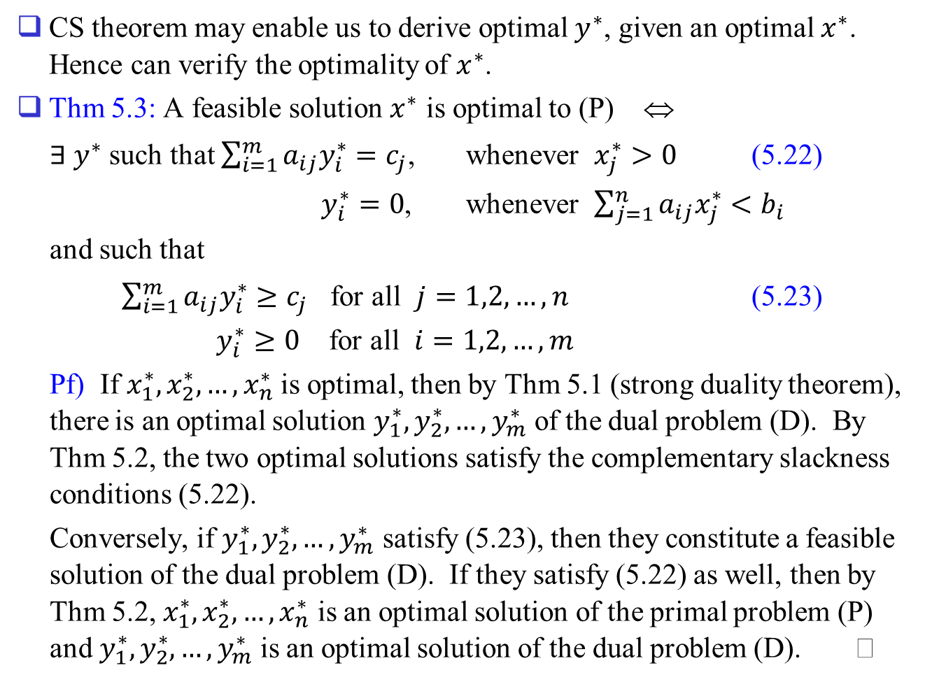
CS theorem may enable us to derive optimal $y^{∗}$, given an optimal $x^{∗}$. Hence can verify the optimality of $x^{∗}$.
Thm 5.3: A feasible solution $x^{∗}$ is optimal to (P) ⇔
$∃ y^{∗}$ such that $\sum_{i=1}^{m}{a_{ij}y_{i}^{∗}}=c_{j}$, whenever $x_{j}^{∗}>0$ (5.22)
$y_{i}^{∗}=0$, whenever $\sum_{j=1}^{n}{a_{ij}x_{j}^{∗}}<b_{i}$
and such that
$\sum_{i=1}^{m}{a_{ij}y_{i}^{∗}}≥c_{j}$ for all $j=1,2,…,n$ (5.23)
$y_{i}^{∗}≥0$ for all $i=1,2,…,m$
Pf) If $x_{1}^{∗},x_{2}^{∗},…,x_{n}^{∗}$ is optimal, then by Thm 5.1 (strong duality theorem), there is an optimal solution $y_{1}^{∗},y_{2}^{∗},…,y_{m}^{∗}$ of the dual problem (D). By Thm 5.2, the two optimal solutions satisfy the complementary slackness conditions (5.22).
Conversely, if $y_{1}^{∗},y_{2}^{∗},…,y_{m}^{∗}$ satisfy (5.23), then they constitute a feasible solution of the dual problem (D). If they satisfy (5.22) as well, then by Thm 5.2, $x_{1}^{∗},x_{2}^{∗},…,x_{n}^{∗}$ is an optimal solution of the primal problem (P) and $y_{1}^{∗},y_{2}^{∗},…,y_{m}^{∗}$ is an optimal solution of the dual problem (D).

Slide 12
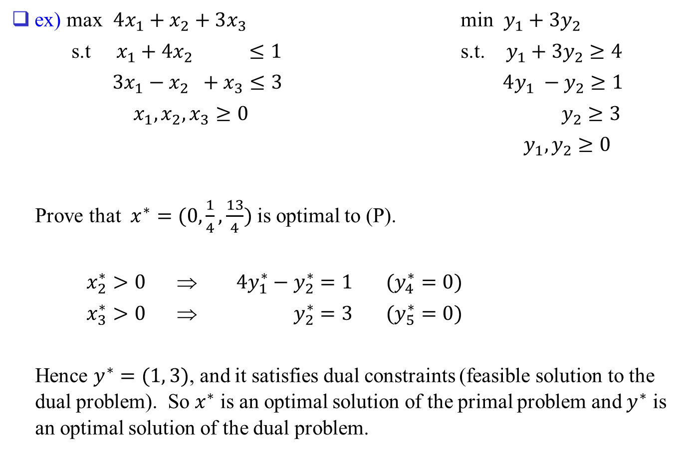
ex) max $4x_{1}+x_{2}+3x_{3}$ min $y_{1}+3y_{2}$
s.t $x_{1}+4x_{2} ≤1$ s.t. $y_{1}+3y_{2}≥4$
$3x_{1}−x_{2} +x_{3}≤3$ $4y_{1} −y_{2}≥1$
$x_{1},x_{2},x_{3}≥0$ $y_{2}≥3$
$y_{1},y_{2}≥0$
Prove that $x^{∗}=(0,\frac{1}{4},\frac{13}{4})$ is optimal to (P).
$x_{2}^{∗}>0$ ⇒ $4y_{1}^{∗}−y_{2}^{∗}=1$ $(y_{4}^{∗}=0)$
$x_{3}^{∗}>0$ ⇒ $y_{2}^{∗}=3$ $(y_{5}^{∗}=0)$
Hence $y^{∗}=(1, 3)$, and it satisfies dual constraints (feasible solution to the dual problem). So $x^{∗}$ is an optimal solution of the primal problem and $y^{∗}$ is an optimal solution of the dual problem.

Slide 13
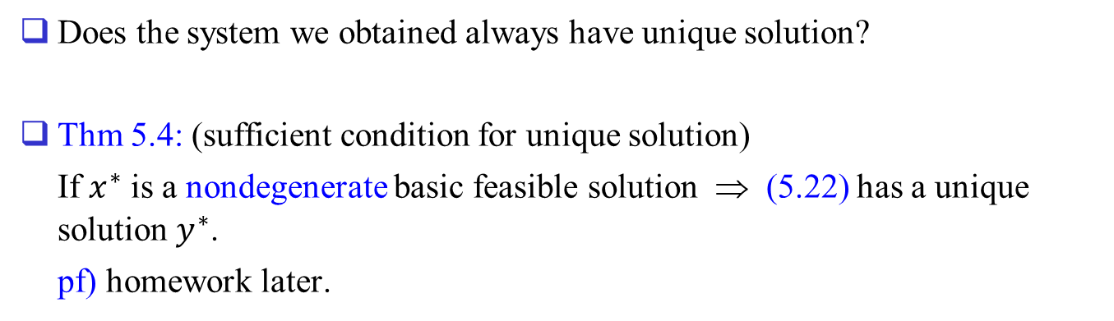
Does the system we obtained always have unique solution?
Thm 5.4: (sufficient condition for unique solution)
If $x^{∗}$ is a nondegenerate basic feasible solution ⇒ (5.22) has a unique solution $y^{∗}$.
pf) homework later.

Slide 14
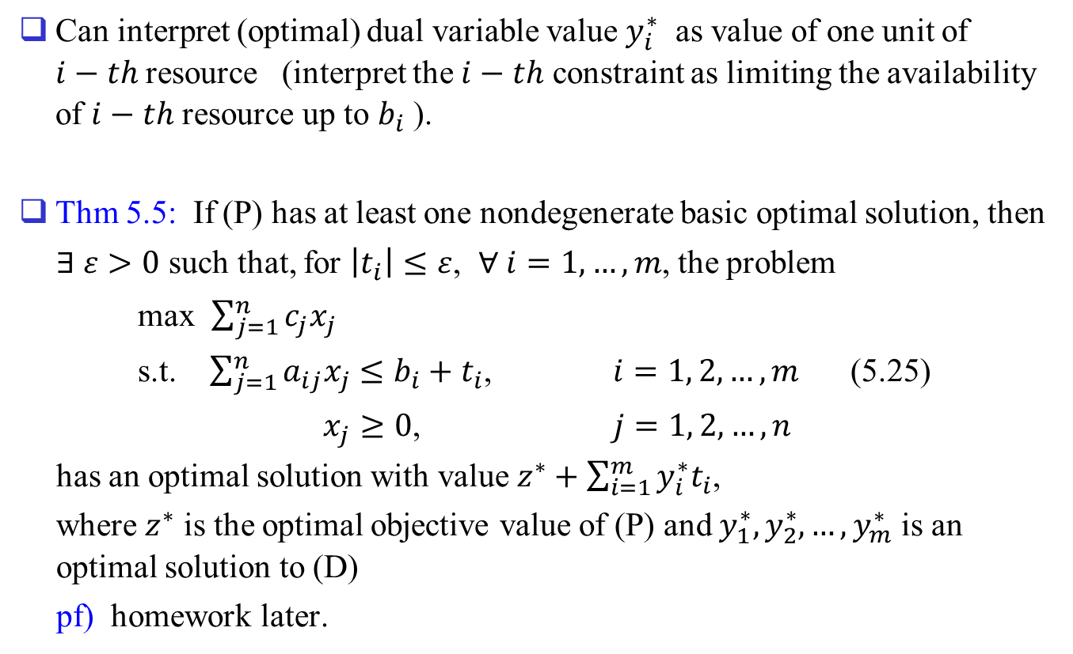
Economic significance of dual variables
Can interpret (optimal) dual variable value $y_{i}^{∗}$ as value of one unit of $i−th$resource (interpret the $i−th$ constraint as limiting the availability of $i−th$ resource up to $b_{i}$ ).
Thm 5.5: If (P) has at least one nondegenerate basic optimal solution, then
$∃ ε>0$ such that, for $\left|t_{i}\right|≤ε$, $∀ i=1,…,m$, the problem
max $\sum_{j=1}^{n}{c_{j}x_{j}}$
s.t. $\sum_{j=1}^{n}{a_{ij}x_{j}}≤b_{i}+t_{i}$, $i=1, 2,…,m$ (5.25)
$x_{j}≥0$, $j=1, 2,…,n$
has an optimal solution with value $z^{∗}+\sum_{i=1}^{m}{y_{i}^{∗}t_{i}}$,
where $z^{∗}$ is the optimal objective value of (P) and $y_{1}^{∗},y_{2}^{∗},…,y_{m}^{∗}$ is an optimal solution to (D)
pf) homework later.

Slide 15
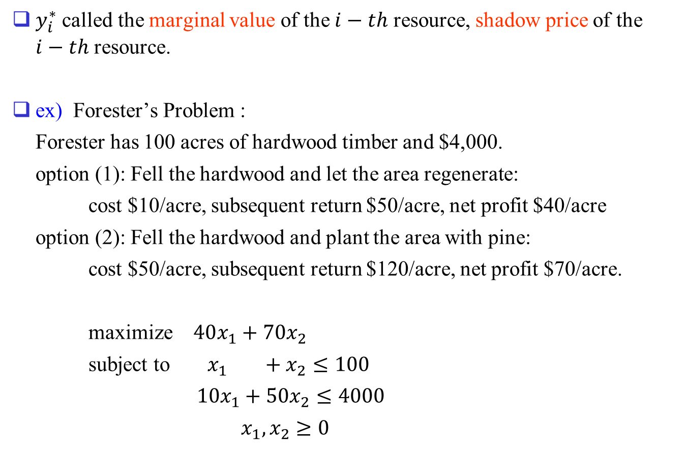
$y_{i}^{∗}$ called the marginal value of the $i−th$ resource, shadow price of the $i−th$ resource.
ex) Forester’s Problem :
Forester has 100 acres of hardwood timber and $4,000.
option (1): Fell the hardwood and let the area regenerate:
cost $10/acre, subsequent return $50/acre, net profit $40/acre
option (2): Fell the hardwood and plant the area with pine:
cost $50/acre, subsequent return $120/acre, net profit $70/acre.
maximize $40x_{1}+70x_{2}$
subject to $x_{1} +x_{2}≤100$
$10x_{1}+50x_{2}≤4000$
$x_{1},x_{2}≥0$

Slide 16
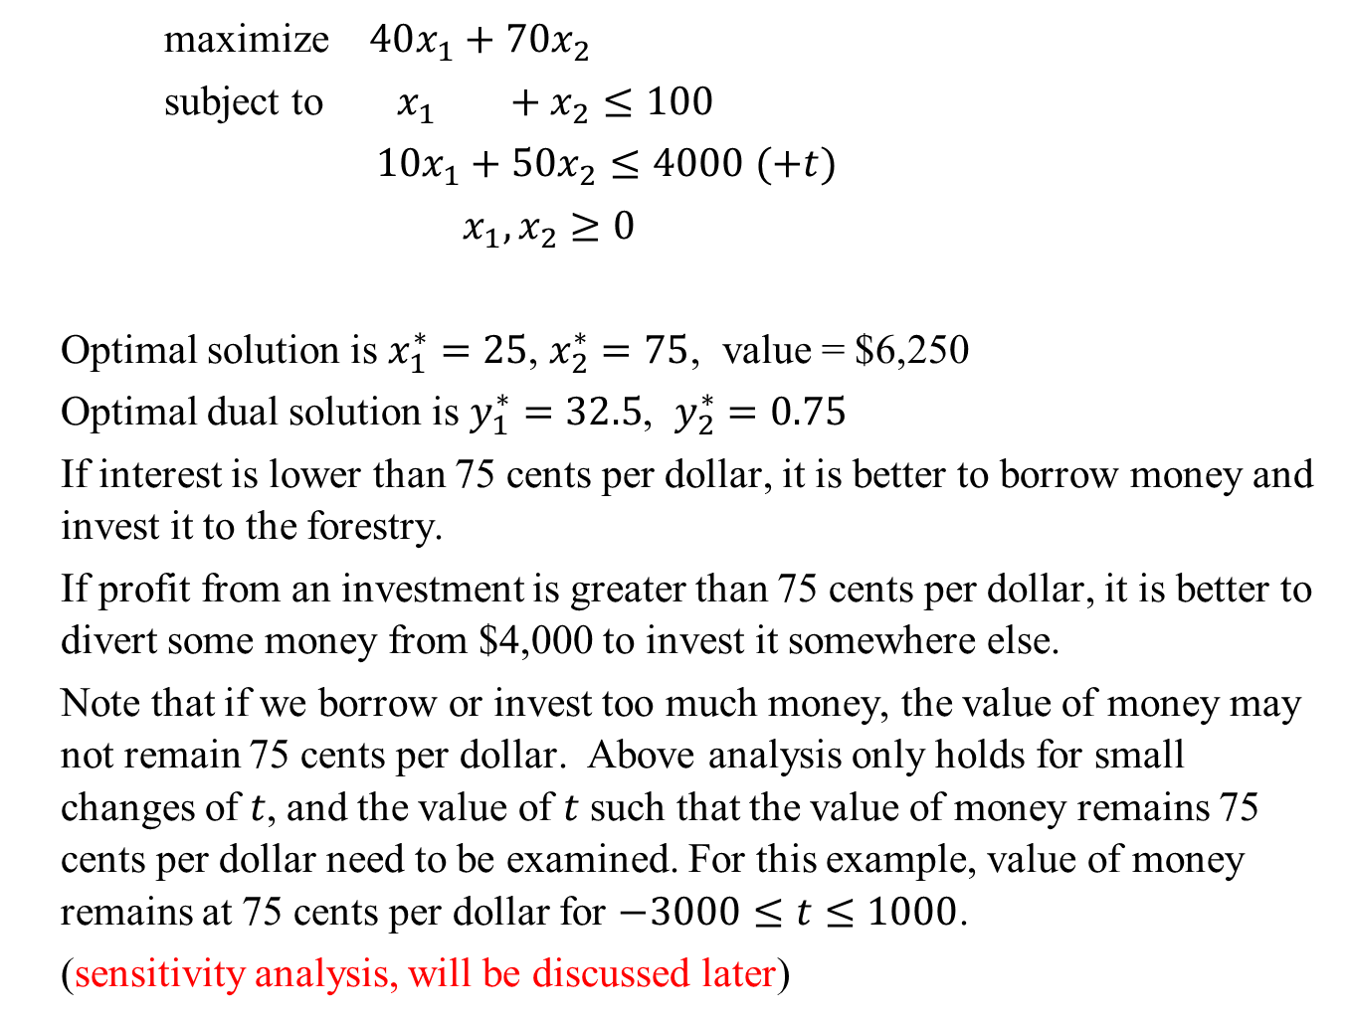
maximize $40x_{1}+70x_{2}$
subject to $x_{1} +x_{2}≤100$
$10x_{1}+50x_{2}≤4000$ $(+t)$
$x_{1},x_{2}≥0$
Optimal solution is $x_{1}^{∗}=25$, $x_{2}^{∗}=75$, value = $6,250
Optimal dual solution is $y_{1}^{∗}=32.5$, $y_{2}^{∗}=0.75$
If interest is lower than 75 cents per dollar, it is better to borrow money and invest it to the forestry.
If profit from an investment is greater than 75 cents per dollar, it is better to divert some money from $4,000 to invest it somewhere else.
Note that if we borrow or invest too much money, the value of money may not remain 75 cents per dollar. Above analysis only holds for small changes of $t$, and the value of $t$ such that the value of money remains 75 cents per dollar need to be examined. For this example, value of money remains at 75 cents per dollar for $−3000≤t≤1000$.
(sensitivity analysis, will be discussed later)

Slide 17
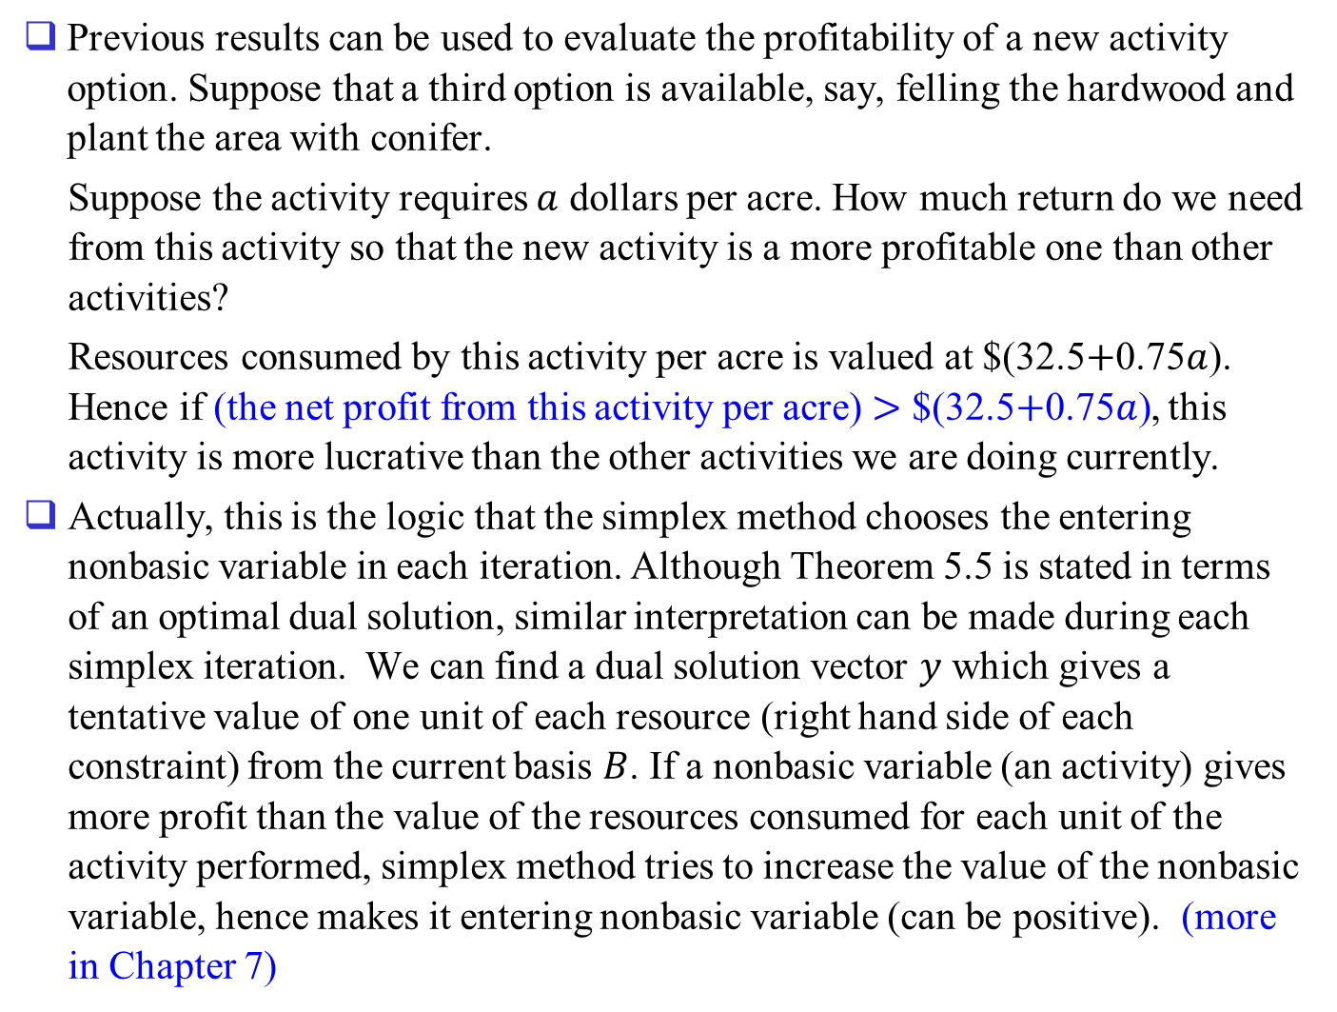
Previous results can be used to evaluate the profitability of a new activity option. Suppose that a third option is available, say, felling the hardwood and plant the area with conifer.
Suppose the activity requires $a$ dollars per acre. How much return do we need from this activity so that the new activity is a more profitable one than other activities?
Resources consumed by this activity per acre is valued at $(32.5$+$0.75$a$). Hence if (the net profit from this activity per acre) $>$ $(32.5$+$0.75$a$), this activity is more lucrative than the other activities we are doing currently.
Actually, this is the logic that the simplex method chooses the entering nonbasic variable in each iteration. Although Theorem 5.5 is stated in terms of an optimal dual solution, similar interpretation can be made during each simplex iteration. We can find a dual solution vector $y$ which gives a tentative value of one unit of each resource (right hand side of each constraint) from the current basis $B$. If a nonbasic variable (an activity) gives more profit than the value of the resources consumed for each unit of the activity performed, simplex method tries to increase the value of the nonbasic variable, hence makes it entering nonbasic variable (can be positive). (more in Chapter 7)

Slide 18
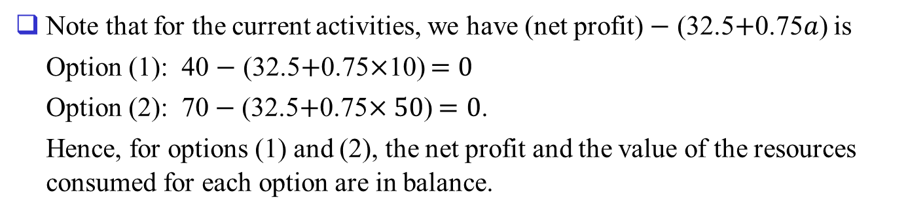
Note that for the current activities, we have (net profit) $−$ (32.5$+$0.75$a$) is
Option (1): 40 $−$ (32.5$+$0.75$×$10) $=0$
Option (2): 70$−$ (32.5$+$0.75$×50$) $=0$.
Hence, for options (1) and (2), the net profit and the value of the resources consumed for each option are in balance.

