Slide 1
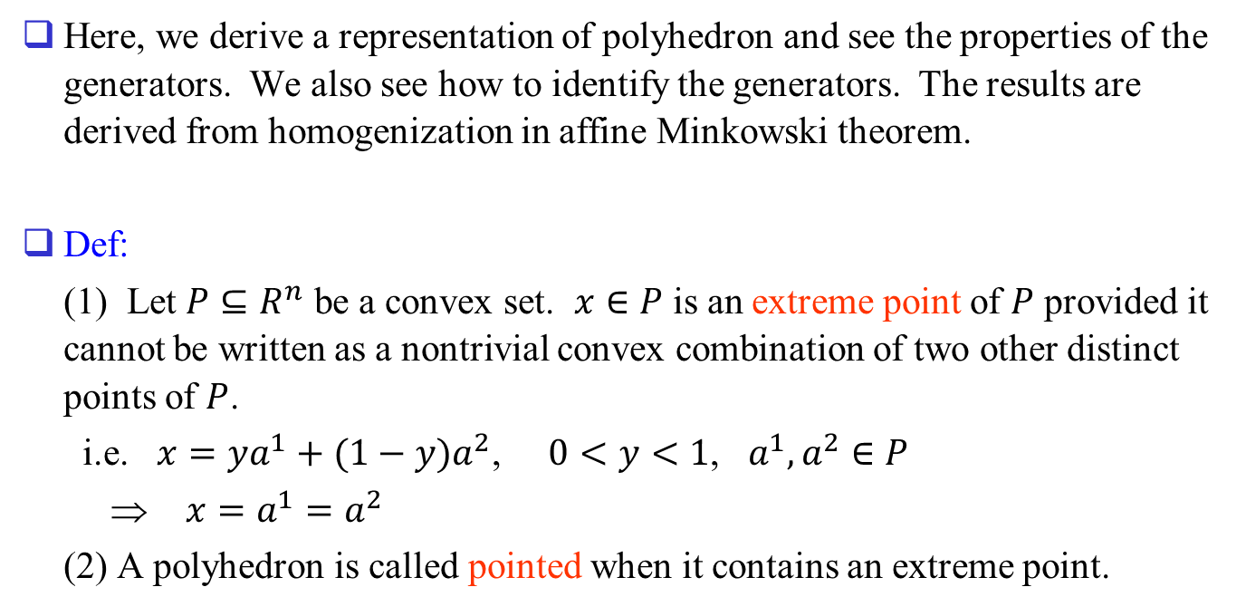
Polyhedron
Here, we derive a representation of polyhedron and see the properties of the generators. We also see how to identify the generators. The results are derived from homogenization in affine Minkowski theorem.
Def:
(1) Let $P⊆R^{n}$ be a convex set. $x∈P$ is an extreme point of $P$ provided it cannot be written as a nontrivial convex combination of two other distinct points of $P$.
i.e. $x=ya^{1}+(1−y)a^{2}$, $0<y<1$, $a^{1}, a^{2}∈P$
⇒ $x=a^{1}=a^{2}$
(2) A polyhedron is called pointed when it contains an extreme point.

Slide 2
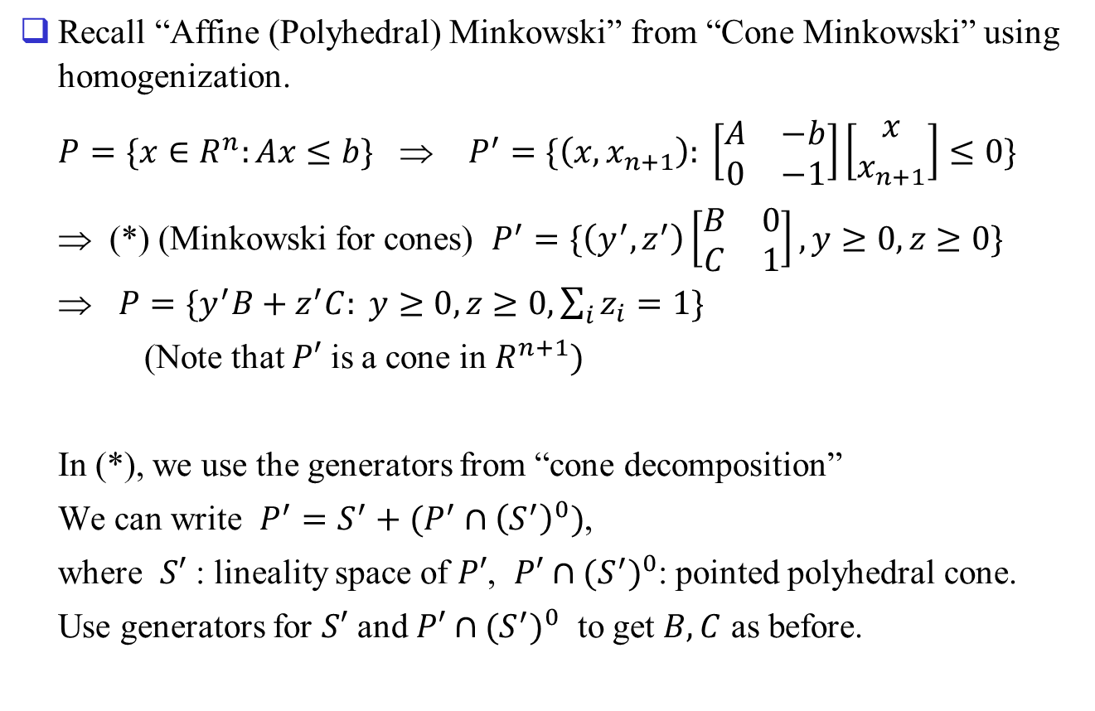
Recall “Affine (Polyhedral) Minkowski” from “Cone Minkowski” using homogenization.
$P=\{x∈R^{n}:Ax≤b\}$ ⇒ $P^{′}=\{\left(x, x_{n+1}\right): \left[\begin{matrix}A & −b \\ 0 & −1\end{matrix}\right]\left[\begin{matrix}x \\ x_{n+1}\end{matrix}\right]≤0\}$
⇒ (*) (Minkowski for cones) $P^{′}=\{\left(y^{′}, z^{′}\right)\left[\begin{matrix}B & 0 \\ C & 1\end{matrix}\right], y≥0, z≥0\}$
⇒ $P=\{y^{′}B+z^{′}C: y≥0, z≥0, \sum_{i}{z_{i}}=1\}$
(Note that $P′$ is a cone in $R^{n+1})$
In (*), we use the generators from “cone decomposition”
We can write $P^{′}=S^{′}+(P^{′}∩{\left(S^{′}\right)}^{0})$,
where $S′$ : lineality space of $P′$, $P′∩{(S^{′})}^{0}$: pointed polyhedral cone.
Use generators for $S′$ and $P′∩{(S^{′})}^{0}$ to get $B, C$ as before.

Slide 3
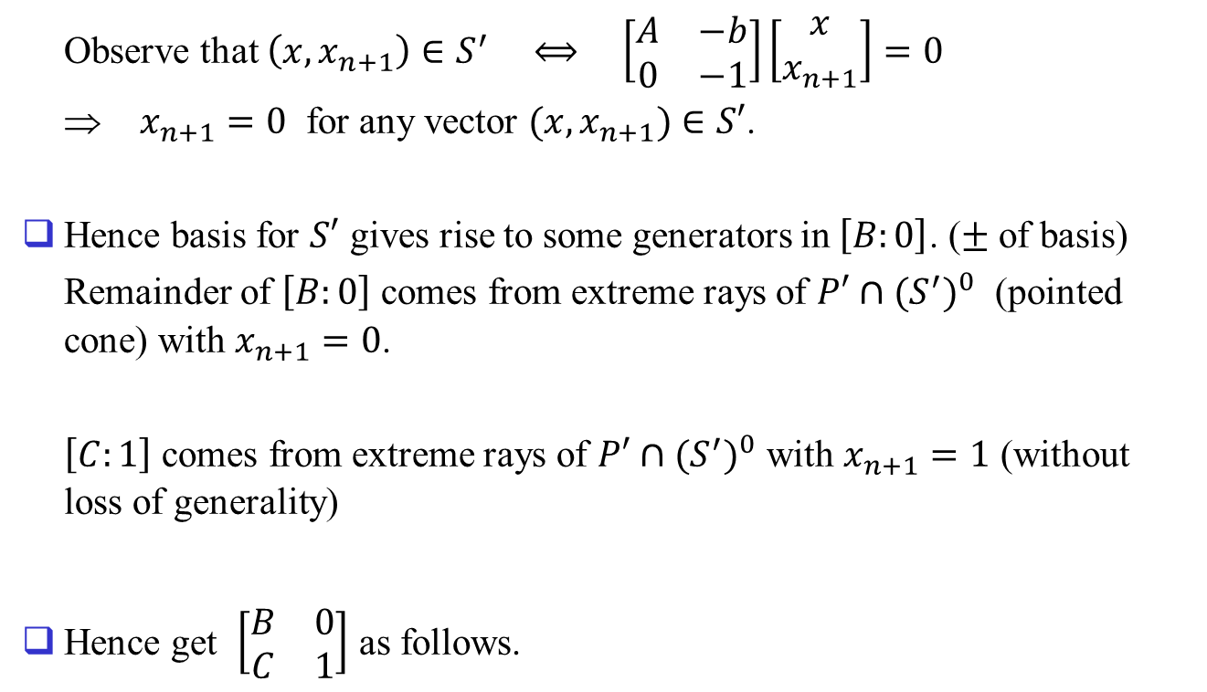
Observe that $\left(x, x_{n+1}\right)∈S^{′} ⟺ \left[\begin{matrix}A & −b \\ 0 & −1\end{matrix}\right]\left[\begin{matrix}x \\ x_{n+1}\end{matrix}\right]=0$
⇒ $x_{n+1}=0$ for any vector $(x, x_{n+1})∈S′$.
Hence basis for $S′$ gives rise to some generators in $\left[B:0\right]$. ($±$ of basis)
Remainder of $\left[B:0\right]$ comes from extreme rays of $P′∩{(S^{′})}^{0}$ (pointed cone) with $x_{n+1}=0$.
$\left[C:1\right]$ comes from extreme rays of $P′∩{(S^{′})}^{0}$ with $x_{n+1}=1$ (without loss of generality)
Hence get $\left[\begin{matrix}B & 0 \\ C & 1\end{matrix}\right]$ as follows.

Slide 4
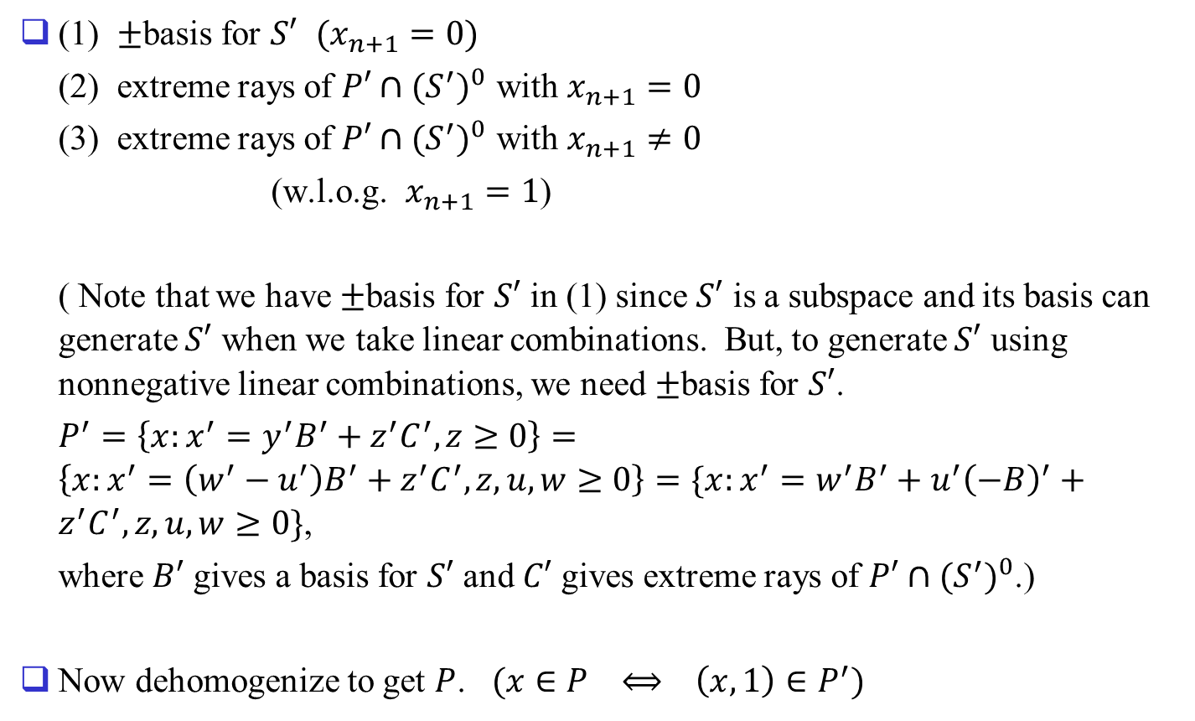
(1) $±$basis for $S′$ $(x_{n+1}=0)$
(2) extreme rays of $P′∩{(S^{′})}^{0}$ with $x_{n+1}=0$
(3) extreme rays of $P′∩{(S^{′})}^{0}$ with $x_{n+1}≠0$
(w.l.o.g. $x_{n+1}=1$)
( Note that we have $±$basis for $S′$ in (1) since $S′$ is a subspace and its basis can generate $S′$ when we take linear combinations. But, to generate $S′$ using nonnegative linear combinations, we need $±$basis for $S′$.
$P^{′}=\left\{x:x^{′}=y^{′}B^{′}+z^{′}C^{′}, z≥0\right\}=\left\{x:x^{′}=\left(w^{′}−u^{′}\right)B^{′}+z^{′}C^{′}, z, u, w≥0\right\}=\{x:x^{′}=w^{′}B^{′}+u^{′}{\left(−B\right)}^{′}+z^{′}C^{′}, z, u, w≥0\}$,
where $B′$ gives a basis for $S′$ and $C′$ gives extreme rays of $P′∩{(S^{′})}^{0}$.)
Now dehomogenize to get $P$. $(x∈P ⟺ \left(x,1\right)∈P^{′})$
[B : 0]
[C : 1]

Slide 5

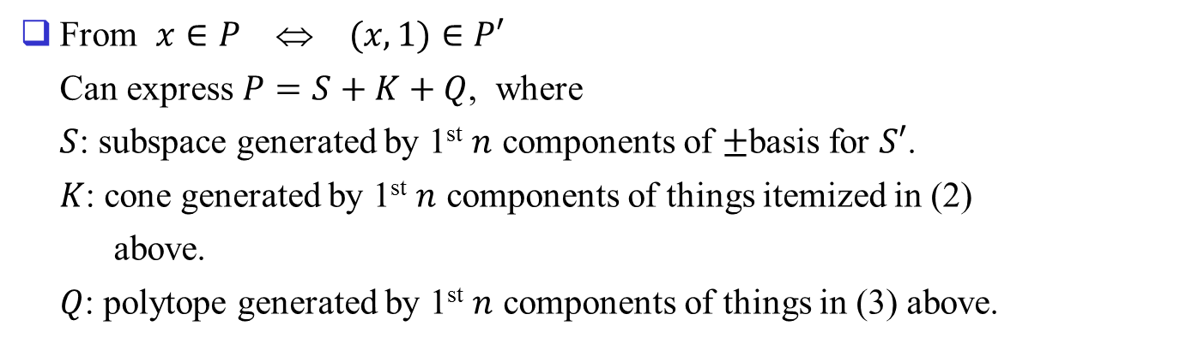



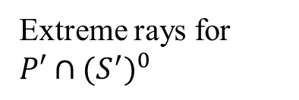


From $x∈P$ ⇔ $(x, 1)∈P′$
Can express $P=S+K+Q$, where
$S$: subspace generated by 1st $n$ components of $±$basis for $S′$.
$K$: cone generated by 1st $n$ components of things itemized in (2)
above.
$Q$: polytope generated by 1st $n$ components of things in (3) above.
0..0
$$S$$
$±$ Generators for $S′$
$$B$$
0..0
$$K$$
Extreme rays for
$$P′∩{(S^{′})}^{0}$$
1...1
$$Q$$
$$C$$

Slide 6
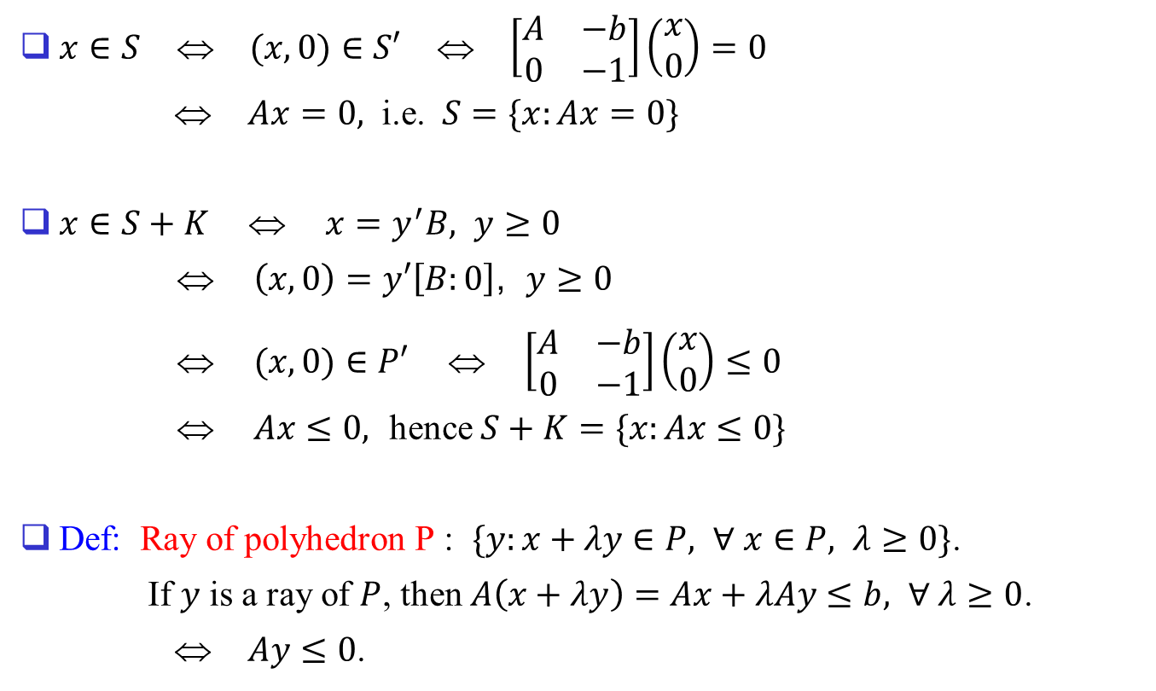
Properties of $S, K, Q$
$x∈S$ ⇔ $(x, 0)∈S′$ ⇔ $\left[\begin{matrix}A & −b \\ 0 & −1\end{matrix}\right]\left(\begin{matrix}x \\ 0\end{matrix}\right)=0$
⇔ $Ax=0,$ i.e. $S=\{x:Ax=0\}$
$x∈S+K$ ⇔ $x=y^{′}B, y≥0$
⇔ $\left(x, 0\right)=y′\left[B:0\right]$, $y≥0$
⇔ $(x,0)∈P′$ ⇔ $\left[\begin{matrix}A & −b \\ 0 & −1\end{matrix}\right]\left(\begin{matrix}x \\ 0\end{matrix}\right)≤0$
⇔ $Ax≤0,$ hence $S+K=\{x:Ax≤0\}$
Def: Ray of polyhedron P : $\{y:x+λy∈P, ∀ x∈P, λ≥0\}$.
If $y$ is a ray of $P$, then $A\left(x+λy\right)=Ax+λAy≤b, ∀ λ≥0$.
⇔ $Ay≤0$.

Slide 7
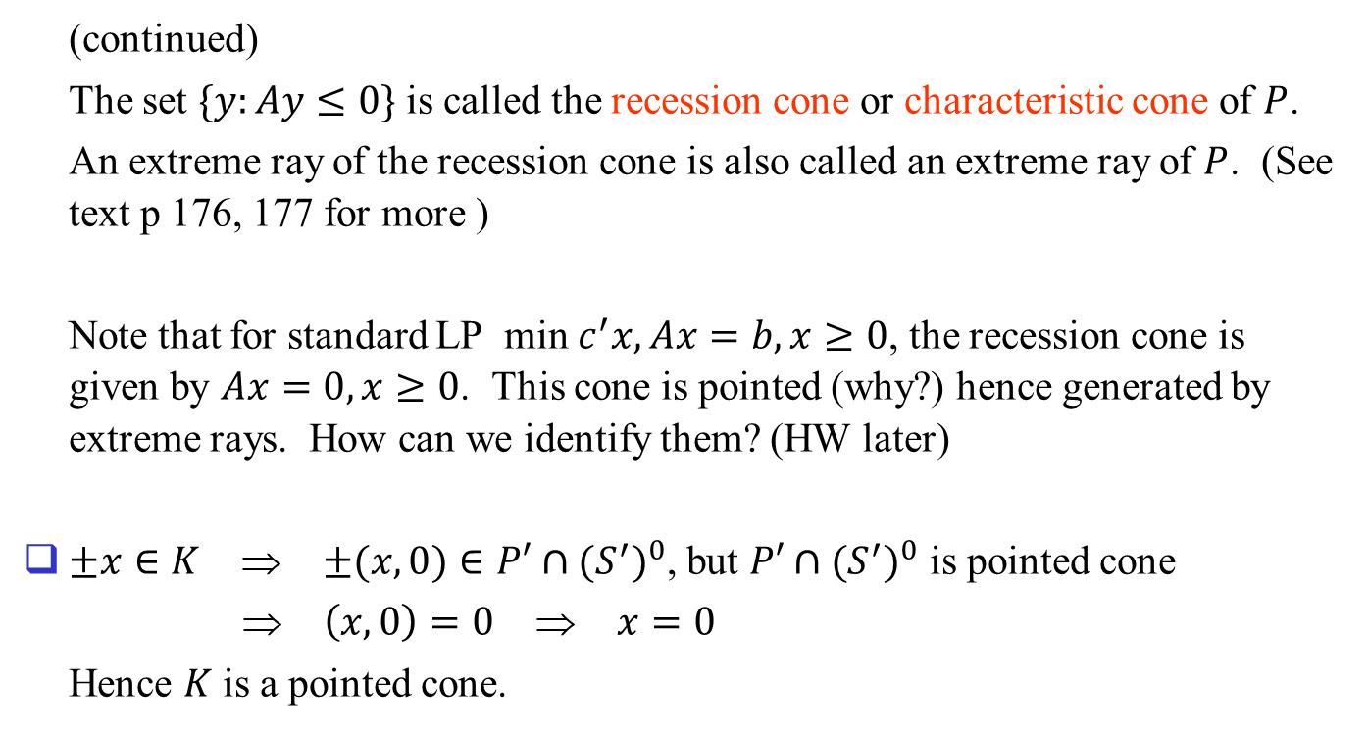
(continued)
The set $\{y:Ay≤0\}$ is called the recession cone or characteristic cone of $P$.
An extreme ray of the recession cone is also called an extreme ray of $P$. (See text p 176, 177 for more )
Note that for standard LP min $c^{′}x,Ax=b,x≥0$, the recession cone is given by $Ax=0,x≥0$. This cone is pointed (why?) hence generated by extreme rays. How can we identify them? (HW later)
$±x∈K$ ⇒ $±(x,0)∈P′∩{(S^{′})}^{0}$, but $P′∩{(S^{′})}^{0}$ is pointed cone
⇒ $\left(x,0\right)=0$ ⇒ $x=0$
Hence $K$ is a pointed cone.

Slide 8
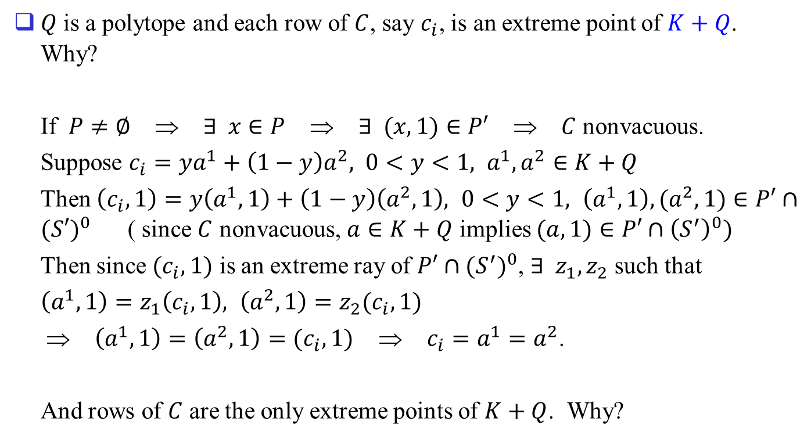
$Q$ is a polytope and each row of $C$, say $c_{i}$, is an extreme point of $K+Q$. Why?
If $P≠∅$ ⇒ $∃ x∈P$ ⇒ $∃ (x,1)∈P′$ ⇒ $C$ nonvacuous.
Suppose $c_{i}=ya^{1}+\left(1−y\right)a^{2}, 0<y<1, a^{1},a^{2}∈K+Q$
Then $\left(c_{i},1\right)=y\left(a^{1},1\right)+\left(1−y\right)\left(a^{2},1\right), 0<y<1, \left(a^{1},1\right),(a^{2},1)∈P′∩{(S′)}^{0}$ ( since $C$ nonvacuous, $a∈K+Q$ implies $(a,1)∈P′∩{\left(S^{′}\right)}^{0})$
Then since $(c_{i},1)$ is an extreme ray of $P′∩{(S^{′})}^{0}$, $∃ z_{1},z_{2}$ such that
$\left(a^{1},1\right)=z_{1}\left(c_{i},1\right), \left(a^{2},1\right)=z_{2}(c_{i},1)$
⇒ $\left(a^{1},1\right)=\left(a^{2},1\right)=(c_{i},1)$ ⇒ $c_{i}=a^{1}=a^{2}$.
And rows of $C$ are the only extreme points of $K+Q$. Why?

Slide 9
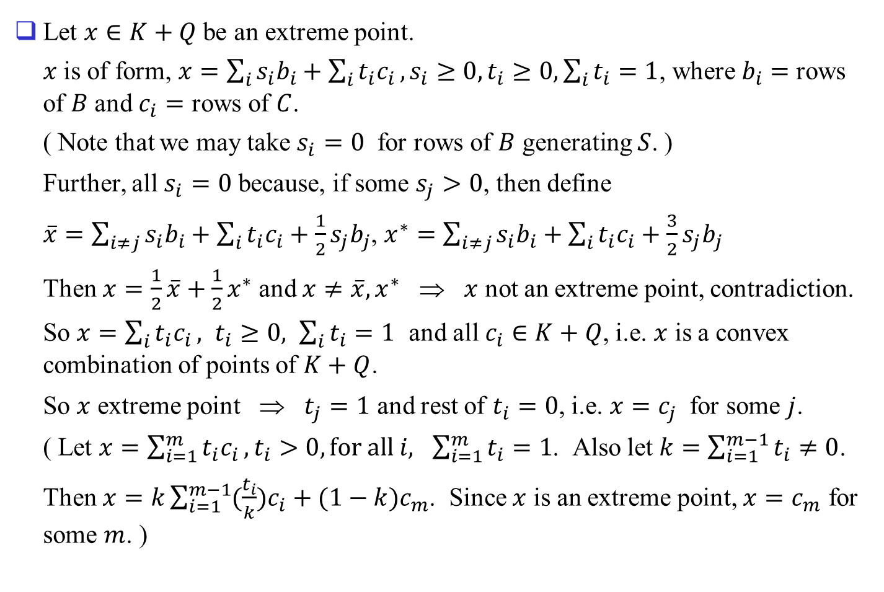
Let $x∈K+Q$ be an extreme point.
$x$ is of form, $x=\sum_{i}{s_{i}b_{i}}+\sum_{i}{t_{i}c_{i}}, s_{i}≥0, t_{i}≥0, \sum_{i}{t_{i}}=1$, where $b_{i}=$ rows of $B$ and $c_{i}=$ rows of $C$.
( Note that we may take $s_{i}=0$ for rows of $B$ generating $S$. )
Further, all $s_{i}=0$ because, if some $s_{j}>0$, then define
$\overline{x}=\sum_{i≠j}{s_{i}b_{i}}+\sum_{i}{t_{i}c_{i}}+\frac{1}{2}s_{j}b_{j}$, $x^{∗}=\sum_{i≠j}{s_{i}b_{i}}+\sum_{i}{t_{i}c_{i}}+\frac{3}{2}s_{j}b_{j}$
Then $x=\frac{1}{2}\overline{x}+\frac{1}{2}x^{∗}$ and $x≠\overline{x},x^{∗}$ ⇒ $x$ not an extreme point, contradiction.
So $x=\sum_{i}{t_{i}c_{i}}, t_{i}≥0, \sum_{i}{t_{i}}=1$ and all $c_{i}∈K+Q$, i.e. $x$ is a convex combination of points of $K+Q$.
So $x$ extreme point ⇒ $t_{j}=1$ and rest of $t_{i}=0$, i.e. $x=c_{j}$ for some $j$.
( Let $x=\sum_{i=1}^{m}{t_{i}c_{i}}, t_{i}>0, for all i, \sum_{i=1}^{m}{t_{i}}=1$. Also let $k=\sum_{i=1}^{m−1}{t_{i}}≠0$.
Then $x=k\sum_{i=1}^{m−1}{(\frac{t_{i}}{k})c_{i}}+(1−k)c_{m}$. Since $x$ is an extreme point, $x=c_{m}$ for some $m$. )

Slide 10
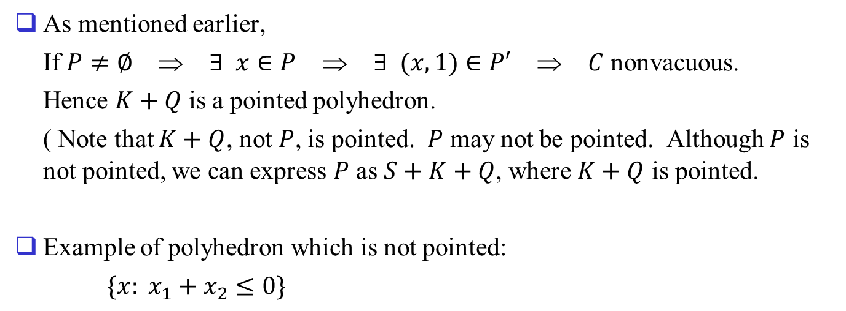
As mentioned earlier,
If $P≠∅$ ⇒ $∃ x∈P$ ⇒ $∃ (x,1)∈P′$ ⇒ $C$ nonvacuous.
Hence $K+Q$ is a pointed polyhedron.
( Note that $K+Q$, not $P$, is pointed. $P$ may not be pointed. Although $P$ is not pointed, we can express $P$ as $S+K+Q$, where $K+Q$ is pointed.
Example of polyhedron which is not pointed:
$\{x: x_{1}+x_{2}≤0\}$

Slide 11
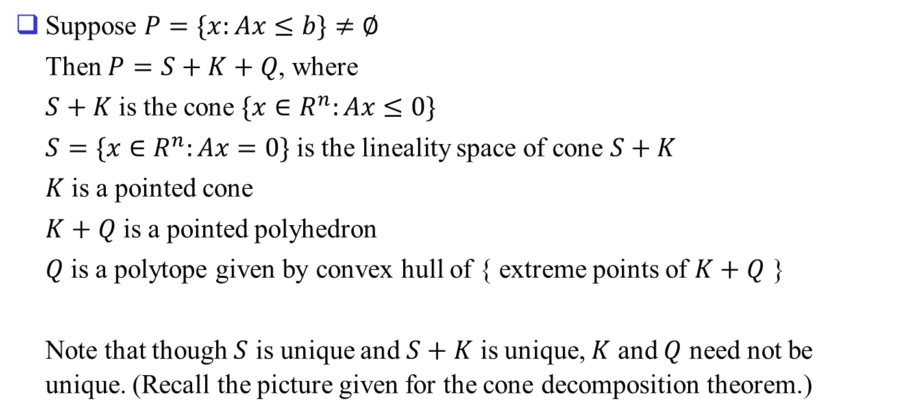
Decomposition Theorem
Suppose $P=\{x:Ax≤b\}≠∅$
Then $P=S+K+Q$, where
$S+K$ is the cone $\{x∈R^{n}:Ax≤0\}$
$S=\{x∈R^{n}:Ax=0\}$ is the lineality space of cone $S+K$
$K$ is a pointed cone
$K+Q$ is a pointed polyhedron
$Q$ is a polytope given by convex hull of { extreme points of $K+Q$ }
Note that though $S$ is unique and $S+K$ is unique, $K$ and $Q$ need not be unique. (Recall the picture given for the cone decomposition theorem.)

Slide 12

Clearly, $P=S+K_{1}+\{q_{1}\}$ and $P=S+K_{2}+\{q_{2}\}$
H₁
H₁
H₂
∈H₂
∈H₂
K₁
∈H₁
K₂
∈H₁
q₂
q₁
0
Subspace $S$ in $S+K+Q$

Slide 13
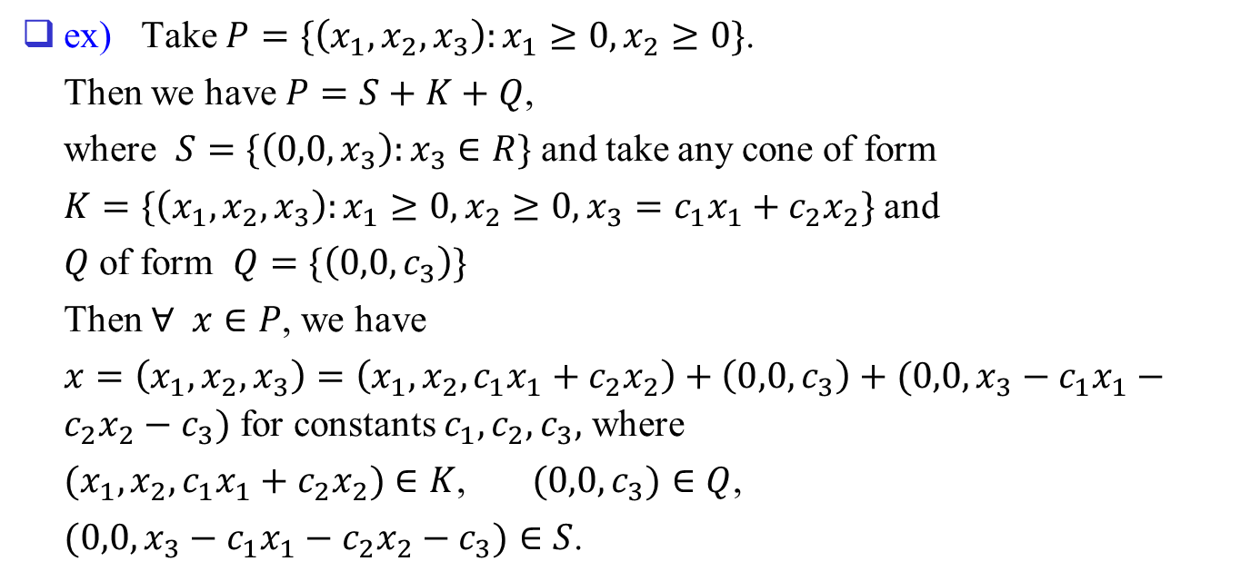
ex) Take $P=\{\left(x_{1},x_{2},x_{3}\right):x_{1}≥0,x_{2}≥0\}$.
Then we have $P=S+K+Q$,
where $S=\{\left(0,0,x_{3}\right):x_{3}∈R\}$ and take any cone of form
$K=\{\left(x_{1},x_{2},x_{3}\right):x_{1}≥0,x_{2}≥0,x_{3}=c_{1}x_{1}+c_{2}x_{2}\}$ and
$Q$ of form $Q=\{\left(0,0,c_{3}\right)\}$
Then $∀ x∈P$, we have
$x=\left(x_{1},x_{2},x_{3}\right)=\left(x_{1},x_{2},c_{1}x_{1}+c_{2}x_{2}\right)+\left(0,0,c_{3}\right)+(0,0,x_{3}−c_{1}x_{1}−c_{2}x_{2}−c_{3})$ for constants $c_{1},c_{2},c_{3},$ where
$(x_{1},x_{2},c_{1}x_{1}+c_{2}x_{2})∈K$, $(0,0,c_{3})∈Q$,
$(0,0,x_{3}−c_{1}x_{1}−c_{2}x_{2}−c_{3})∈S$.

Slide 14
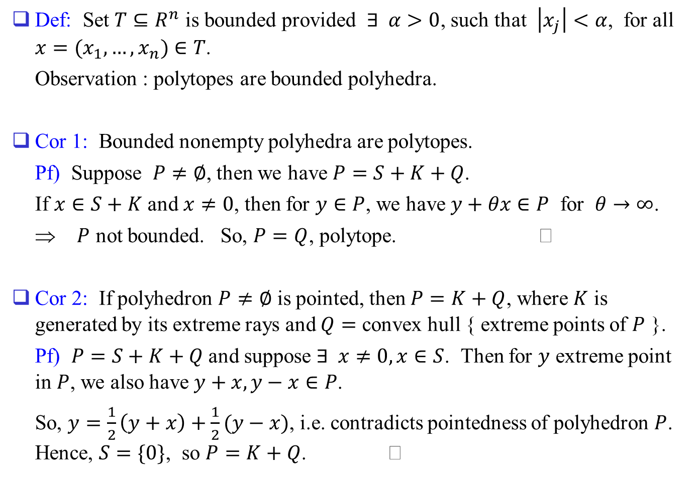
Def: Set $T⊆R^{n}$ is bounded provided $∃ α>0$, such that $\left|x_{j}\right|<α$, for all $x=(x_{1},…,x_{n})∈T$.
Observation : polytopes are bounded polyhedra.
Cor 1: Bounded nonempty polyhedra are polytopes.
Pf) Suppose $P≠∅$, then we have $P=S+K+Q$.
If $x∈S+K$ and $x≠0$, then for $y∈P$, we have $y+θx∈P$ for $θ→∞$.
⇒ $P$ not bounded. So, $P=Q$, polytope.
Cor 2: If polyhedron $P≠∅$ is pointed, then $P=K+Q$, where $K$ is generated by its extreme rays and $Q=$ convex hull { extreme points of $P$ }.
Pf) $P=S+K+Q$ and suppose $∃ x≠0, x∈S$. Then for $y$ extreme point in $P$, we also have $y+x,y−x∈P$.
So, $y=\frac{1}{2}\left(y+x\right)+\frac{1}{2}(y−x)$, i.e. contradicts pointedness of polyhedron $P$. Hence, $S=\{0\}$, so $P=K+Q$.

Slide 15
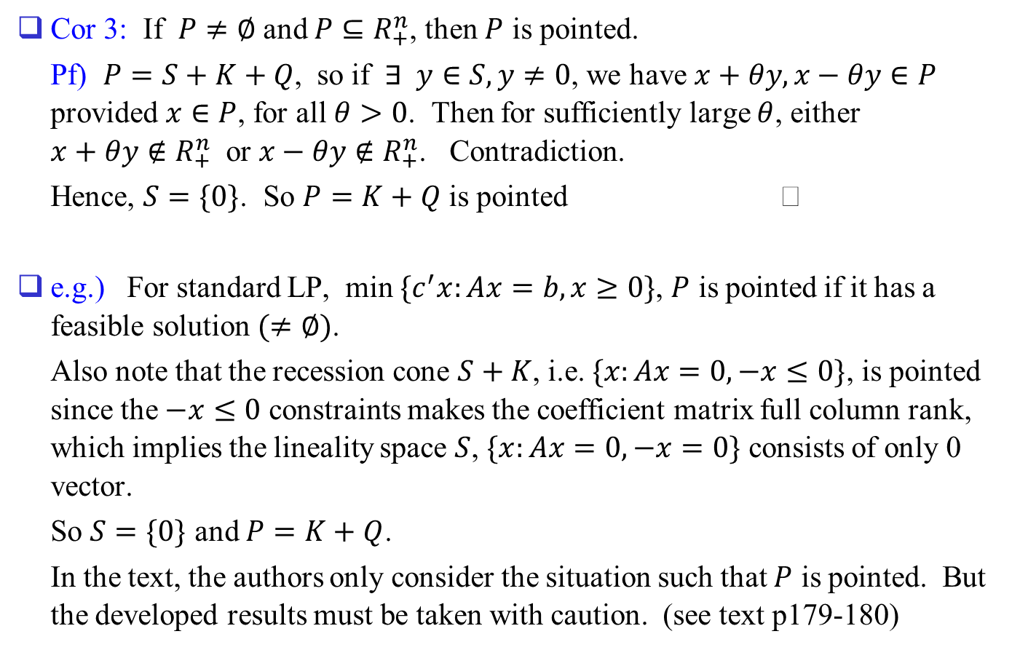
Cor 3: If $P≠∅$ and $P⊆R_{+}^{n}$, then $P$ is pointed.
Pf) $P=S+K+Q$, so if $∃ y∈S,y≠0$, we have $x+θy,x−θy∈P$ provided $x∈P$, for all $θ>0$. Then for sufficiently large $θ$, either $x+θy∉R_{+}^{n}$ or $x−θy∉R_{+}^{n}$. Contradiction.
Hence, $S=\{0\}$. So $P=K+Q$ is pointed
e.g.) For standard LP, min $\{c^{′}x:Ax=b,x≥0\}$, $P$ is pointed if it has a feasible solution $(≠∅)$.
Also note that the recession cone $S+K$, i.e. $\{x:Ax=0,−x≤0\}$, is pointed since the $−x≤0$ constraints makes the coefficient matrix full column rank, which implies the lineality space $S$, $\{x:Ax=0, −x=0\}$ consists of only 0 vector.
So $S=\{0\}$ and $P=K+Q$.
In the text, the authors only consider the situation such that $P$ is pointed. But the developed results must be taken with caution. (see text p179-180)

Slide 16
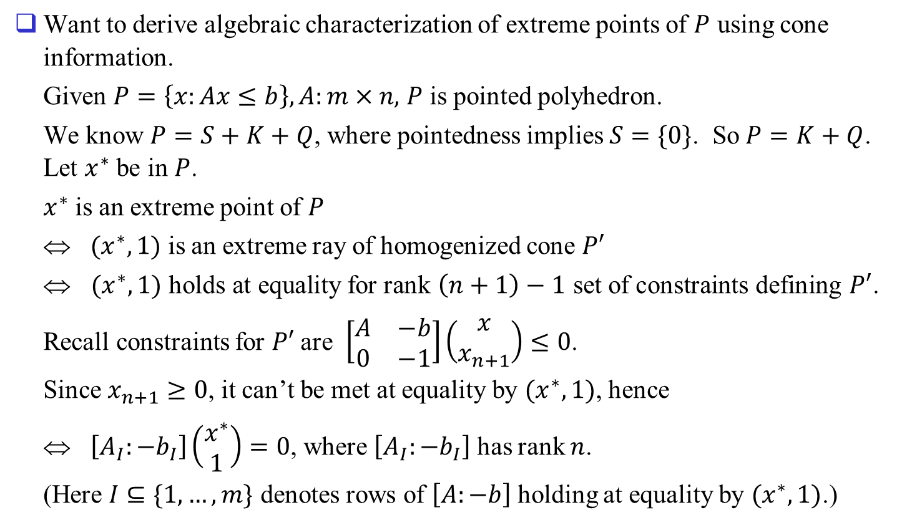
Extreme Points of Pointed Polyhedra
Want to derive algebraic characterization of extreme points of $P$ using cone information.
Given $P=\left\{x:Ax≤b\right\}, A:m×n,$ $P$ is pointed polyhedron.
We know $P=S+K+Q$, where pointedness implies $S=\{0\}$. So $P=K+Q$. Let $x^{∗}$ be in $P$.
$x^{∗}$ is an extreme point of $P$
⇔ $(x^{∗},1)$ is an extreme ray of homogenized cone $P′$
⇔ $(x^{∗},1)$ holds at equality for rank $\left(n+1\right)−1$ set of constraints defining $P′$.
Recall constraints for $P′$ are $\left[\begin{matrix}A & −b \\ 0 & −1\end{matrix}\right]\left(\begin{matrix}x \\ x_{n+1}\end{matrix}\right)≤0$.
Since $x_{n+1}≥0$, it can’t be met at equality by $(x^{∗},1)$, hence
⇔ $\left[A_{I}:{−b}_{I}\right]\left(\begin{matrix}x^{∗} \\ 1\end{matrix}\right)=0$, where $\left[A_{I}:−b_{I}\right]$ has rank $n$.
(Here $I⊆\{1,…,m\}$ denotes rows of $\left[A:−b\right]$ holding at equality by $(x^{∗},1)$.)

Slide 17
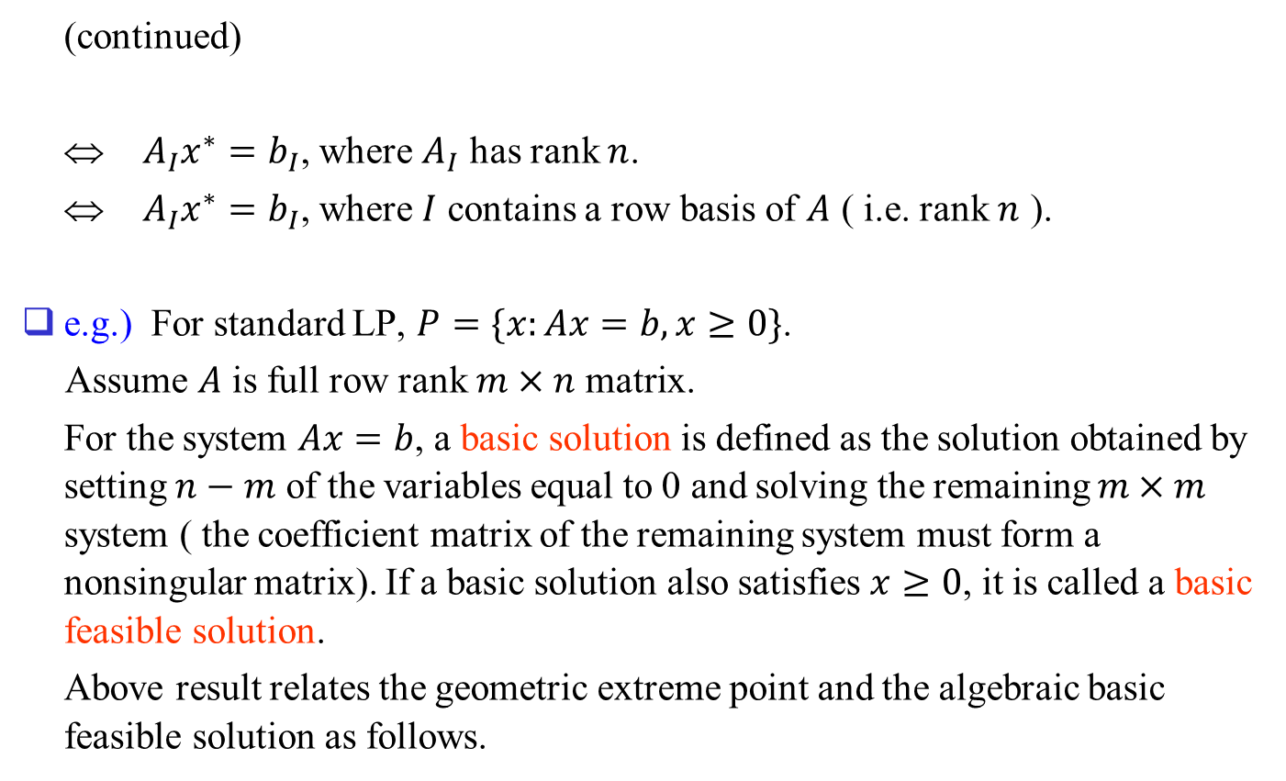
(continued)
⇔ $A_{I}x^{∗}=b_{I}$, where $A_{I}$ has rank $n$.
⇔ $A_{I}x^{∗}=b_{I}$, where $I$ contains a row basis of $A$ ( i.e. rank $n$ ).
e.g.) For standard LP, $P=\{x:Ax=b, x≥0\}$.
Assume $A$ is full row rank $m×n$ matrix.
For the system $Ax=b$, a basic solution is defined as the solution obtained by setting $n−m$ of the variables equal to 0 and solving the remaining $m×m$ system ( the coefficient matrix of the remaining system must form a nonsingular matrix). If a basic solution also satisfies $x≥0$, it is called a basic feasible solution.
Above result relates the geometric extreme point and the algebraic basic feasible solution as follows.

Slide 18
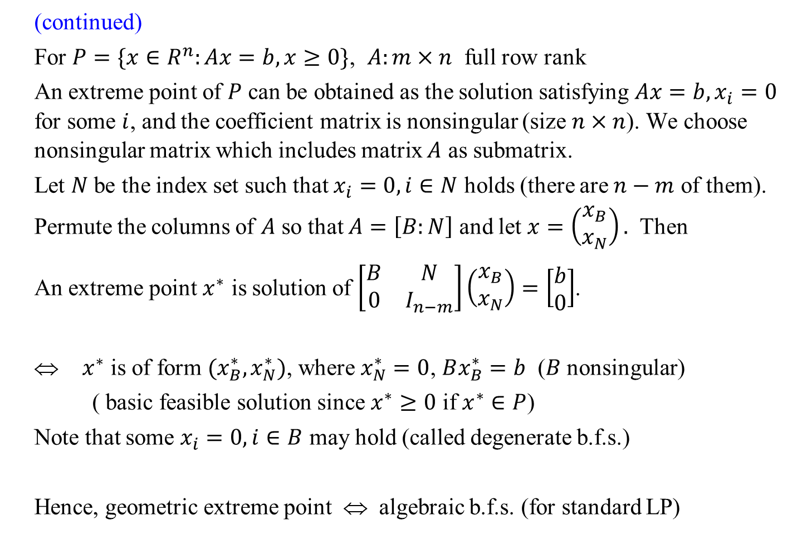
(continued)
For $P=\{x∈R^{n}:Ax=b,x≥0\}$, $A:m×n$ full row rank
An extreme point of $P$ can be obtained as the solution satisfying $Ax=b, x_{i}=0$ for some $i$, and the coefficient matrix is nonsingular (size $n×n$). We choose nonsingular matrix which includes matrix $A$ as submatrix.
Let $N$ be the index set such that $x_{i}=0,i∈N$ holds (there are $n−m$ of them). Permute the columns of $A$ so that $A=\left[B:N\right]$ and let $x=\left(\begin{matrix}x_{B} \\ x_{N}\end{matrix}\right).$ Then
An extreme point $x^{∗}$ is solution of $\left[\begin{matrix}B & N \\ 0 & I_{n−m}\end{matrix}\right]\left(\begin{matrix}x_{B} \\ x_{N}\end{matrix}\right)=\left[\begin{matrix}b \\ 0\end{matrix}\right]$.
⇔ $x^{∗}$ is of form $(x_{B}^{∗},x_{N}^{∗})$, where $x_{N}^{∗}=0$, $Bx_{B}^{∗}=b$ ($B$ nonsingular)
( basic feasible solution since $x^{∗}≥0$ if $x^{∗}∈P$)
Note that some $x_{i}=0,i∈B$ may hold (called degenerate b.f.s.)
Hence, geometric extreme point ⇔ algebraic b.f.s. (for standard LP)

Slide 19
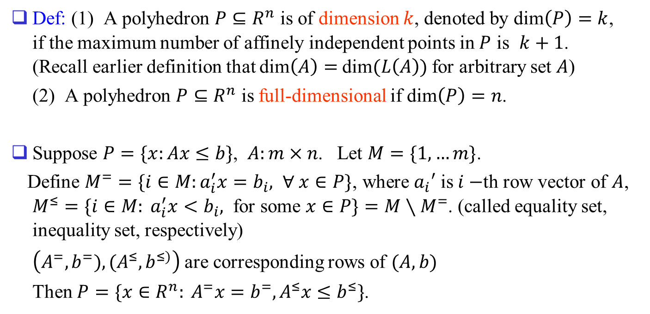
Faces of Polyhedra
Def: (1) A polyhedron $P⊆R^{n}$ is of dimension $k$, denoted by dim$\left(P\right)=k$, if the maximum number of affinely independent points in $P$ is $k+1$. (Recall earlier definition that dim$\left(A\right)=$ dim$(L\left(A\right))$ for arbitrary set $A$)
(2) A polyhedron $P⊆R^{n}$ is full-dimensional if dim$\left(P\right)=n$.
Suppose $P=\{x:Ax≤b\}$, $A:m×n$. Let $M=\{1,…m\}$.
Define $M^{=}=\{i∈M:a_{i}^{′}x=b_{i}, ∀ x∈P\}$, where $a_{i}′$ is $i−$th row vector of $A$, $M^{≤}=\{i∈M: a_{i}^{′}x<b_{i},$ for some $x∈P\}=M∖M^{=}$. (called equality set, inequality set, respectively)
$\left(A^{=},b^{=}), (A^{≤},b^{≤)}\right)$ are corresponding rows of $(A,b)$
Then $P=\{x∈R^{n}: A^{=}x=b^{=}, A^{≤}x≤b^{≤}\}$.

Slide 20
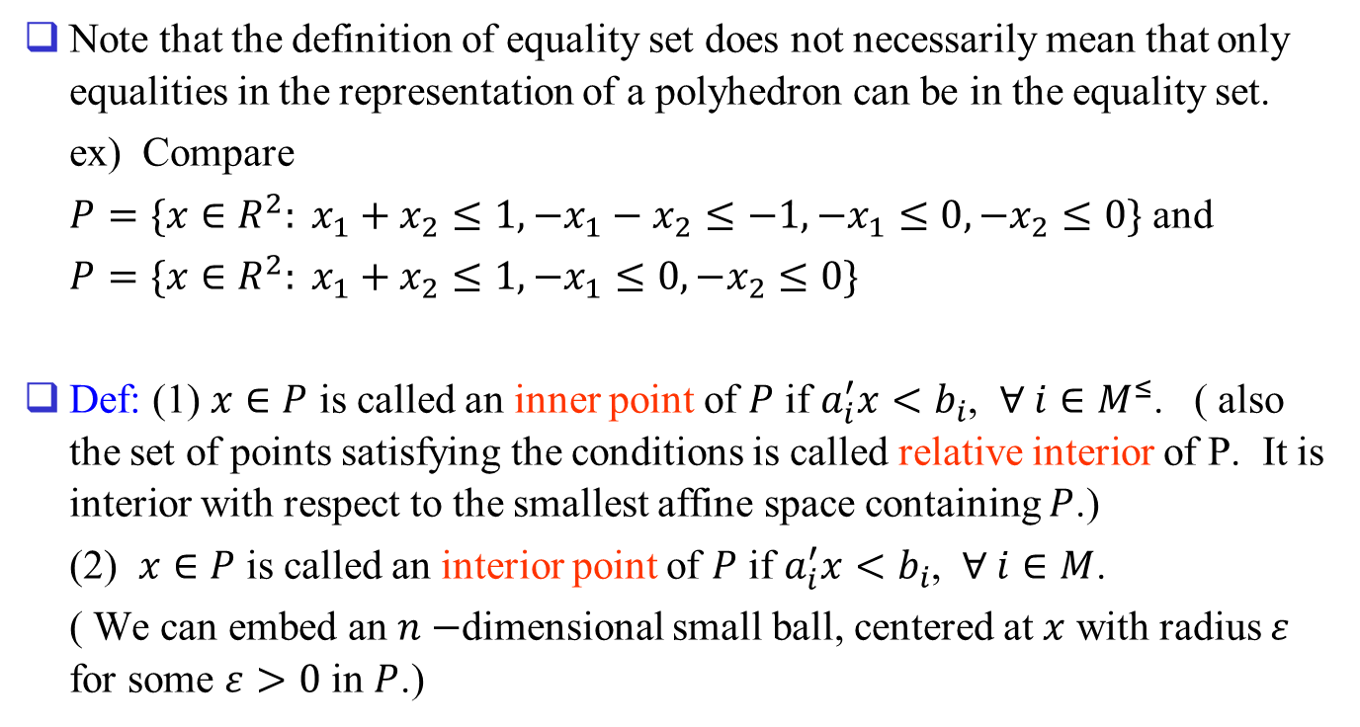
Note that the definition of equality set does not necessarily mean that only equalities in the representation of a polyhedron can be in the equality set.
ex) Compare
$P=\{x∈R^{2}: x_{1}+x_{2}≤1,−x_{1}−x_{2}≤−1,−x_{1}≤0,−x_{2}≤0\}$ and
$P=\{x∈R^{2}: x_{1}+x_{2}≤1,−x_{1}≤0,−x_{2}≤0\}$
Def: (1) $x∈P$ is called an inner point of $P$ if $a_{i}^{′}x<b_{i}$, $∀ i∈M^{≤}$. ( also the set of points satisfying the conditions is called relative interior of P. It is interior with respect to the smallest affine space containing $P$.)
(2) $x∈P$ is called an interior point of $P$ if $a_{i}^{′}x<b_{i}$, $∀ i∈M$.
( We can embed an $n−$dimensional small ball, centered at $x$ with radius $ε$ for some $ε>0$ in $P$.)

Slide 21
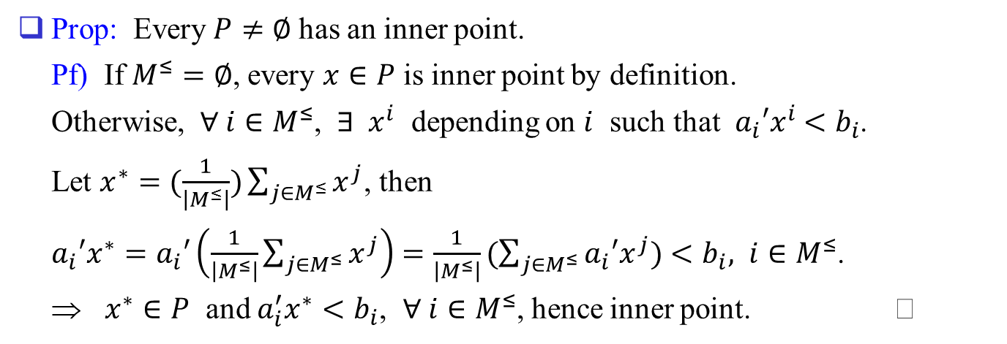
Prop: Every $P≠∅$ has an inner point.
Pf) If $M^{≤}=∅$, every $x∈P$ is inner point by definition.
Otherwise, $∀ i∈M^{≤}$, $∃ x^{i}$ depending on $i$ such that $a_{i}′x^{i}$ $<b_{i}$.
Let $x^{∗}=(\frac{1}{\left|M^{≤}\right|})\sum_{j∈M^{≤}}{x^{j}}$, then
$a_{i}′x^{∗}=a_{i}′\left(\frac{1}{\left|M^{≤}\right|}\sum_{j∈M^{≤}}{x^{j}}\right)$ $=\frac{1}{\left|M^{≤}\right|}(\sum_{j∈M^{≤}}{a_{i}′x^{j})}<b_{i}, i∈M^{≤}$.
⇒ $x^{∗}∈P$ and $a_{i}^{′}x^{∗}<b_{i}$, $∀ i∈M^{≤}$, hence inner point.

Slide 22
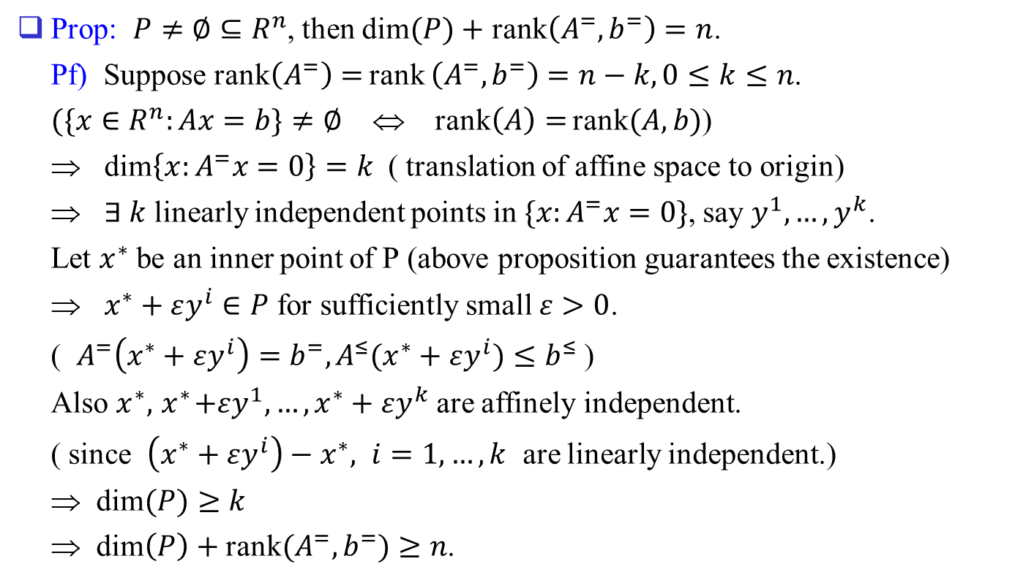
Prop: $P≠∅⊆R^{n}$, then dim$(P)$ $+$ rank$\left(A^{=},b^{=}\right)=n$.
Pf) Suppose rank$\left(A^{=}\right)=$ rank $\left(A^{=},b^{=}\right)=n−k, 0≤k≤n$.
$(\{x∈R^{n}:Ax=b\}≠∅$ ⇔ rank$\left(A\right)=$ rank$(A,b)$)
⇒ dim$\left\{x:A^{=}x=0\right\}=k$ ( translation of affine space to origin)
⇒ $∃ k$ linearly independent points in $\{x:A^{=}x=0\}$, say $y^{1},…,y^{k}$.
Let $x^{∗}$ be an inner point of P (above proposition guarantees the existence)
⇒ $x^{∗}+εy^{i}∈P$ for sufficiently small $ε>0$.
( $A^{=}\left(x^{∗}+εy^{i}\right)=b^{=}, A^{≤}(x^{∗}+εy^{i})≤b^{≤}$ )
Also $x^{∗},{ x}^{∗}+εy^{1},…, x^{∗}+εy^{k}$are affinely independent.
( since $\left(x^{∗}+εy^{i}\right)−x^{∗}, i=1,…,k$ are linearly independent.)
⇒ dim$(P)≥k$
⇒ dim$\left(P\right)+$ rank$(A^{=},b^{=})≥n$.

Slide 23
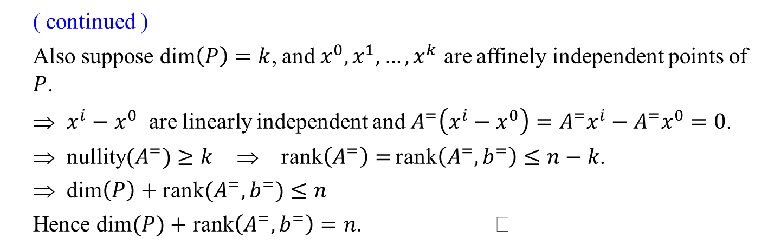
( continued )
Also suppose dim$\left(P\right)=k$, and $x^{0}, x^{1},…, x^{k}$ are affinely independent points of $P$.
⇒ $x^{i}−x^{0}$ are linearly independent and $A^{=}\left(x^{i}−x^{0}\right)=A^{=}x^{i}−A^{=}x^{0}=0$.
⇒ nullity$(A^{=})≥k$ ⇒ rank$\left(A^{=}\right)=$ rank$\left(A^{=},b^{=}\right)≤n−k$.
⇒ dim$\left(P\right)+$ rank$(A^{=},b^{=})≤n$
Hence dim$(P)$ $+$ rank$\left(A^{=},b^{=}\right)=n.$

Slide 24
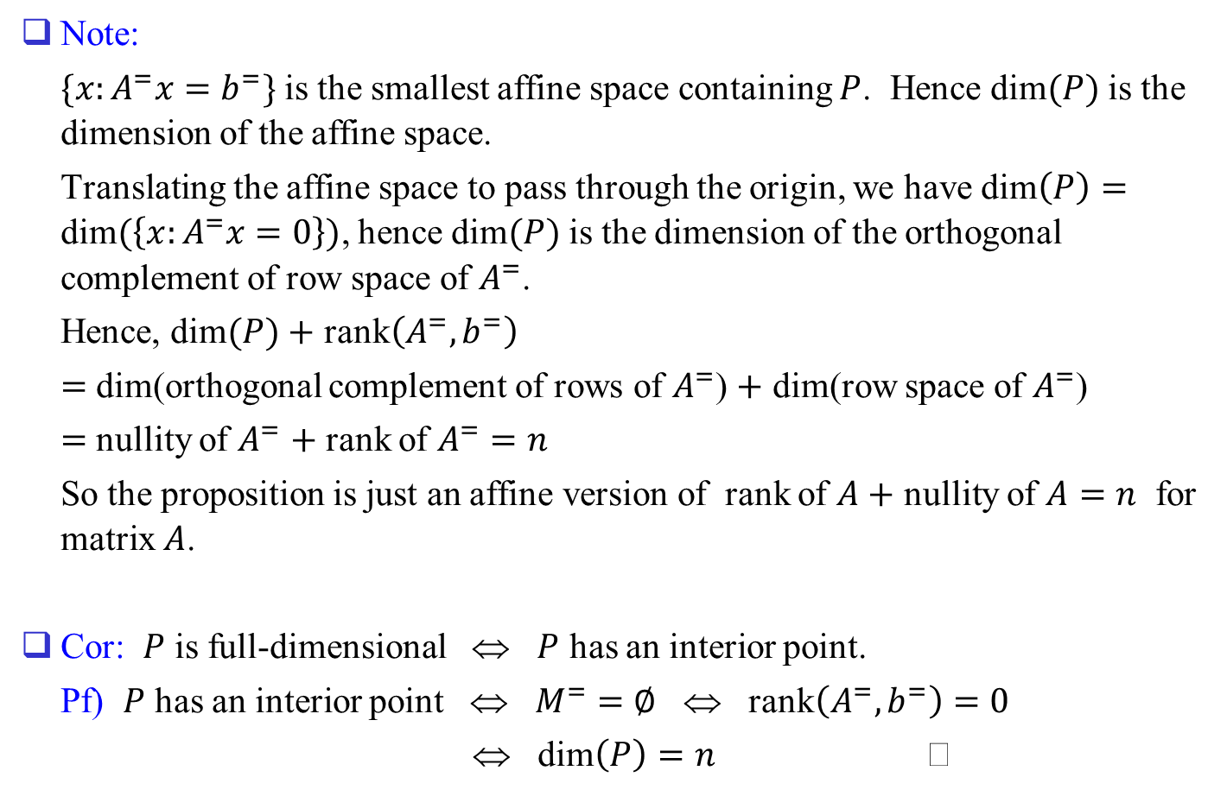
Note:
$\{x:A^{=}x=b^{=}\}$ is the smallest affine space containing $P$. Hence dim$(P)$ is the dimension of the affine space.
Translating the affine space to pass through the origin, we have dim$\left(P\right)=$ dim$(\left\{x:A^{=}x=0\right\})$, hence dim$(P)$ is the dimension of the orthogonal complement of row space of $A^{=}$.
Hence, dim$(P)$ $+$ rank$\left(A^{=},b^{=}\right)$
$=$ dim(orthogonal complement of rows of $A^{=}$) $+$ dim(row space of $A^{=}$)
$=$ nullity of $A^{=}$ $+$ rank of $A^{=}=n$
So the proposition is just an affine version of rank of $A+$ nullity of $A=n$ for matrix $A$.
Cor: $P$ is full-dimensional ⇔ $P$ has an interior point.
Pf) $P$ has an interior point ⇔ $M^{=}=∅$ ⇔ rank$\left(A^{=},b^{=}\right)=0$
⇔ dim$\left(P\right)=n$

Slide 25
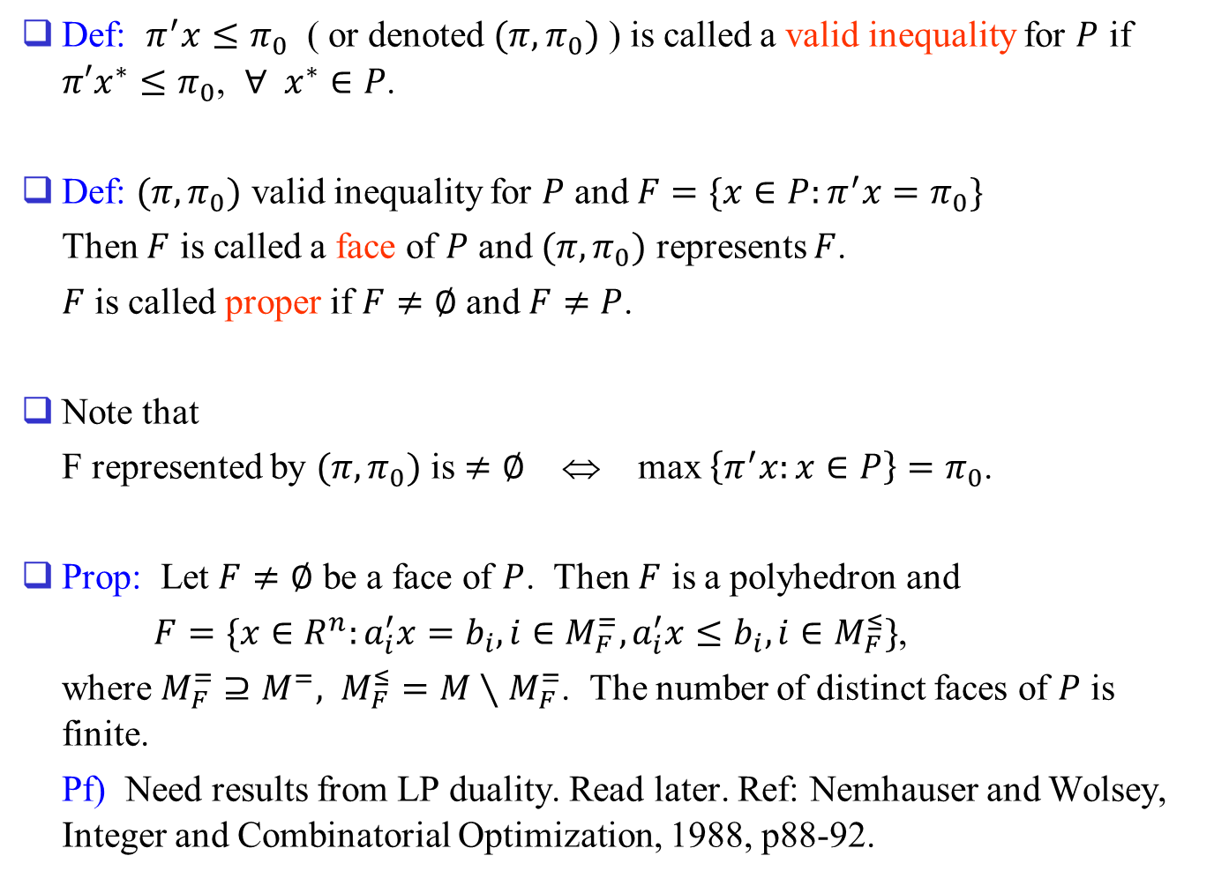
Def: $π^{′}x≤π_{0}$ ( or denoted $(π,π_{0})$ ) is called a valid inequality for $P$ if $π′x^{∗}≤π_{0}$, $∀ x^{∗}∈P$.
Def: $(π,π_{0})$ valid inequality for $P$ and $F=\{x∈P:π^{′}x=π_{0}\}$
Then $F$ is called a face of $P$ and $(π,π_{0})$ represents $F$.
$F$ is called proper if $F≠∅$ and $F≠P$.
Note that
F represented by $(π,π_{0})$ is $≠∅$ ⇔ max $\left\{π^{′}x:x∈P\right\}=π_{0}$.
Prop: Let $F≠∅$ be a face of $P$. Then $F$ is a polyhedron and
$F=\{x∈R^{n}:a_{i}^{′}x=b_{i}, i∈M_{F}^{=}, a_{i}^{′}x≤b_{i}, i∈M_{F}^{≤}\}$,
where $M_{F}^{=}⊇M^{=}, M_{F}^{≤}=M∖M_{F}^{=}$. The number of distinct faces of $P$ is finite.
Pf) Need results from LP duality. Read later. Ref: Nemhauser and Wolsey, Integer and Combinatorial Optimization, 1988, p88-92.

Slide 26
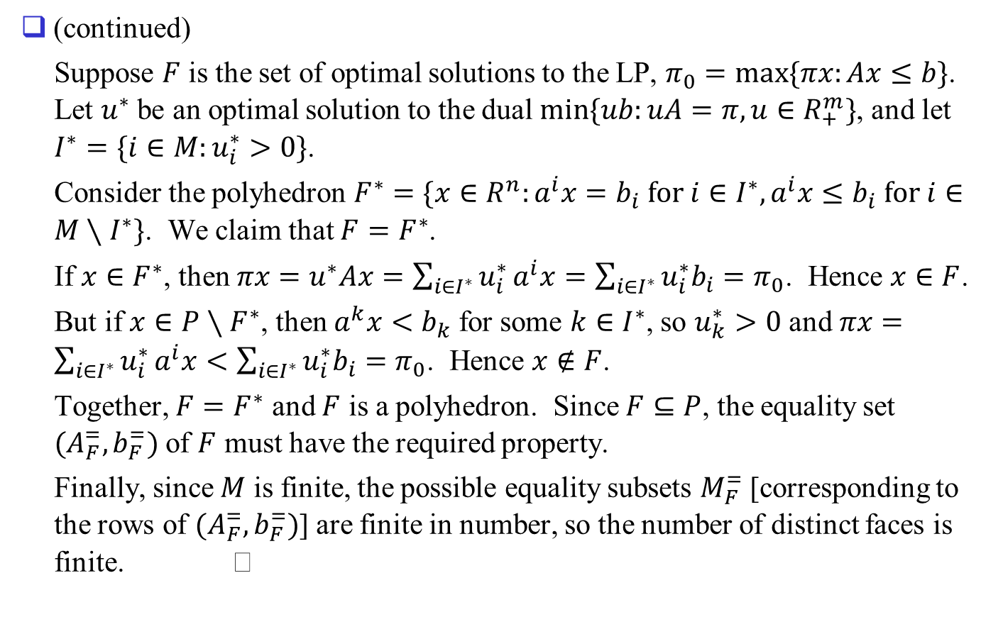
(continued)
Suppose $F$ is the set of optimal solutions to the LP, $π_{0}=max⁡\{πx:Ax≤b\}$. Let $u^{∗}$ be an optimal solution to the dual $min⁡\{ub:uA=π,u∈R_{+}^{m}\}$, and let $I^{∗}=\{i∈M:u_{i}^{∗}>0\}$.
Consider the polyhedron $F^{∗}=\{x∈R^{n}:a^{i}x=b_{i} for i∈I^{∗}, a^{i}x≤b_{i} for i∈M∖I^{∗}\}$. We claim that $F=F^{∗}$.
If $x∈F^{∗}$, then $πx=u^{∗}Ax=\sum_{i∈I^{∗}}{u_{i}^{∗}}a^{i}x=\sum_{i∈I^{∗}}{u_{i}^{∗}b_{i}}=π_{0}$. Hence $x∈F$.
But if $x∈P∖F^{∗}$, then $a^{k}x<b_{k}$ for some $k∈I^{∗}$, so $u_{k}^{∗}>0$ and $πx=\sum_{i∈I^{∗}}{u_{i}^{∗}}a^{i}x<\sum_{i∈I^{∗}}{u_{i}^{∗}b_{i}}=π_{0}$. Hence $x∉F$.
Together, $F=F^{∗}$ and $F$ is a polyhedron. Since $F⊆P$, the equality set $(A_{F}^{=},b_{F}^{=})$ of $F$ must have the required property.
Finally, since $M$ is finite, the possible equality subsets $M_{F}^{=}$ [corresponding to the rows of $(A_{F}^{=},b_{F}^{=})$] are finite in number, so the number of distinct faces is finite.

Slide 27
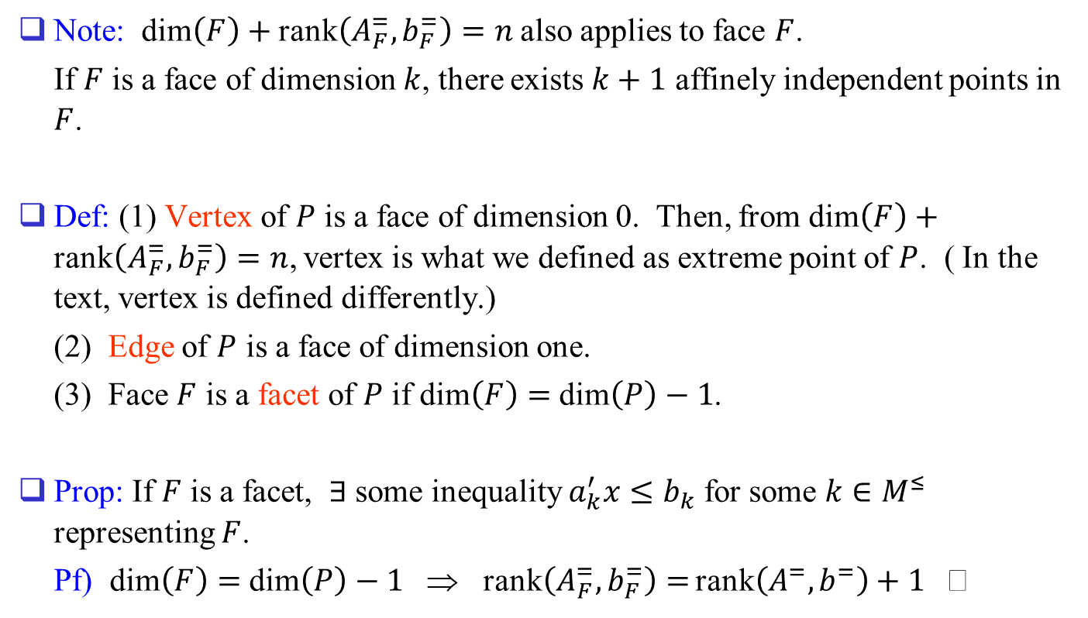
Note: dim$\left(F\right)+$ rank$\left(A_{F}^{=},b_{F}^{=}\right)=n$ also applies to face $F$.
If $F$ is a face of dimension $k$, there exists $k+1$ affinely independent points in $F$.
Def: (1) Vertex of $P$ is a face of dimension 0. Then, from dim$\left(F\right)+$ rank$\left(A_{F}^{=},b_{F}^{=}\right)=n$, vertex is what we defined as extreme point of $P$. ( In the text, vertex is defined differently.)
(2) Edge of $P$ is a face of dimension one.
(3) Face $F$ is a facet of $P$ if dim$\left(F\right)=$ dim$\left(P\right)−1$.
Prop: If $F$ is a facet, $∃$ some inequality $a_{k}^{′}x≤b_{k}$ for some $k∈M^{≤}$ representing $F$.
Pf) dim$\left(F\right)=$ dim$\left(P\right)−1$ ⇒ rank$\left(A_{F}^{=},b_{F}^{=}\right)=$ rank$\left(A^{=},b^{=}\right)+1$

Slide 28
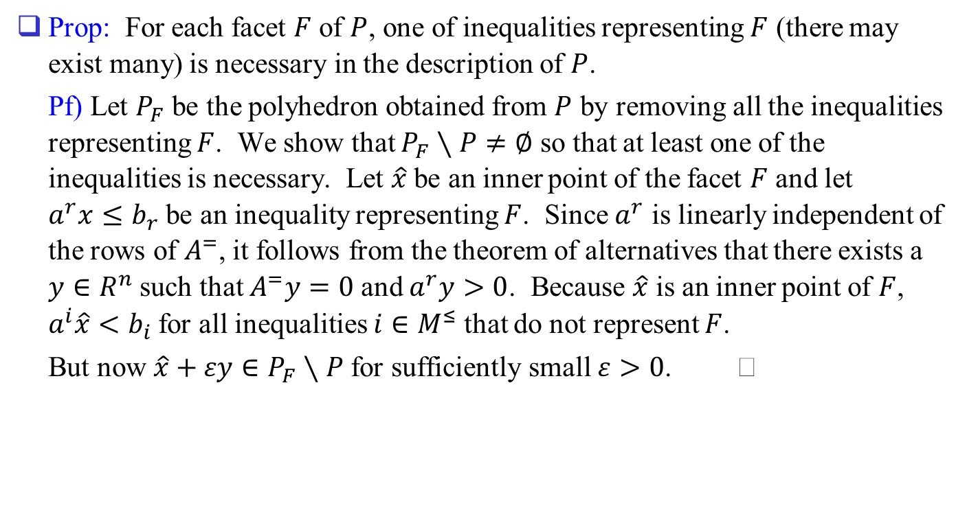
Prop: For each facet $F$ of $P$, one of inequalities representing $F$ (there may exist many) is necessary in the description of $P$.
Pf) Let $P_{F}$ be the polyhedron obtained from $P$ by removing all the inequalities representing $F$. We show that $P_{F}∖P≠∅$ so that at least one of the inequalities is necessary. Let $\hat{x}$ be an inner point of the facet $F$ and let $a^{r}x≤b_{r}$ be an inequality representing $F$. Since $a^{r}$ is linearly independent of the rows of $A^{=}$, it follows from the theorem of alternatives that there exists a $y∈R^{n}$ such that $A^{=}y=0$ and $a^{r}y>0$. Because $\hat{x}$ is an inner point of $F$, $a^{i}\hat{x}<b_{i}$ for all inequalities $i∈M^{≤}$ that do not represent $F$.
But now $\hat{x}+εy∈P_{F}∖P$ for sufficiently small $ε>0$.

Slide 29
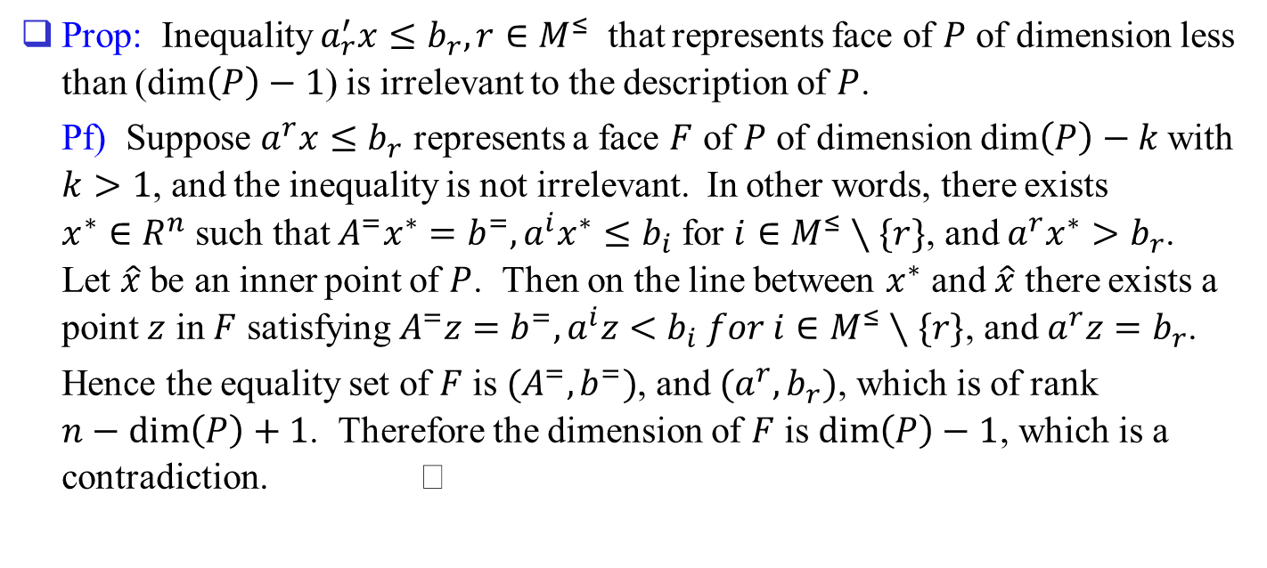
Prop: Inequality $a_{r}^{′}x≤b_{r}, r∈M^{≤}$ that represents face of $P$ of dimension less than (dim$\left(P\right)−1$) is irrelevant to the description of $P$.
Pf) Suppose $a^{r}x≤b_{r}$ represents a face $F$ of $P$ of dimension dim$\left(P\right)−k$ with $k>1$, and the inequality is not irrelevant. In other words, there exists $x^{∗}∈R^{n}$ such that $A^{=}x^{∗}=b^{=}, a^{i}x^{∗}≤b_{i}$ for $i∈M^{≤}∖\{r\}$, and $a^{r}x^{∗}>b_{r}$. Let $\hat{x}$ be an inner point of $P$. Then on the line between $x^{∗}$ and $\hat{x}$ there exists a point $z$ in $F$ satisfying $A^{=}z=b^{=}, a^{i}z<b_{i} for i∈M^{≤}∖\{r\}$, and $a^{r}z=b_{r}$.
Hence the equality set of $F$ is $(A^{=},b^{=})$, and $(a^{r},b_{r})$, which is of rank $n−\dim\left(P\right)+1$. Therefore the dimension of $F$ is $\dim\left(P\right)−1$, which is a contradiction.

Slide 30
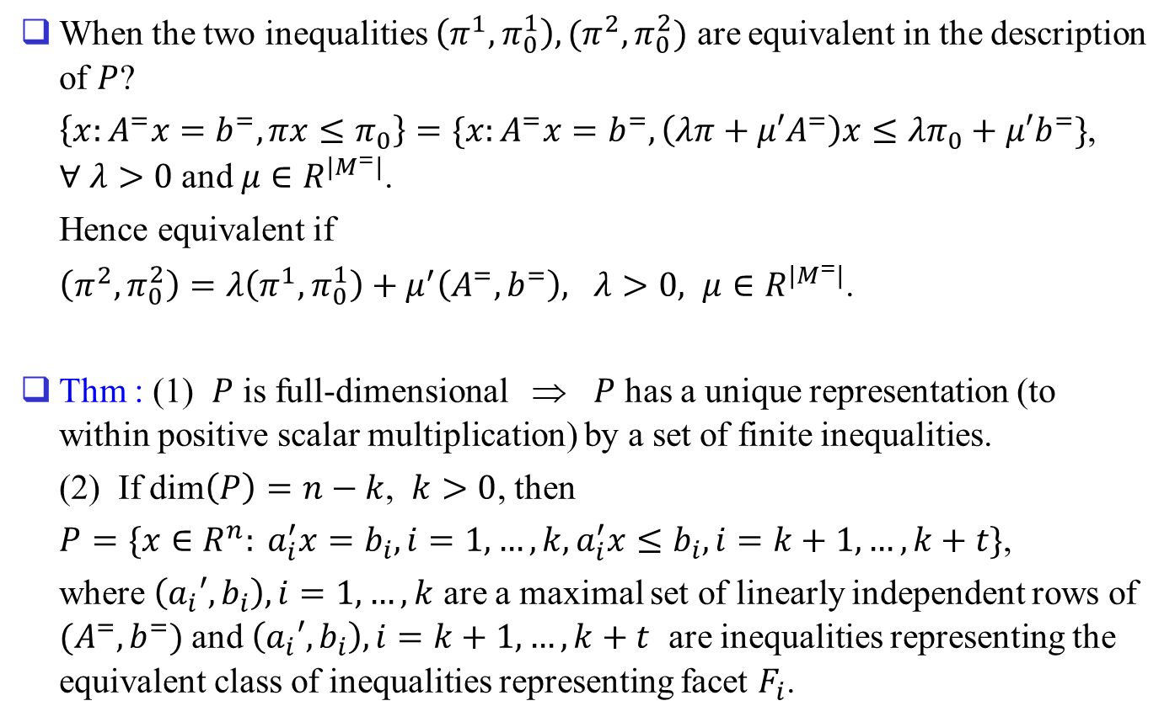
When the two inequalities $\left(π^{1},π_{0}^{1}\right), (π^{2},π_{0}^{2})$ are equivalent in the description of $P$?
$\left\{x:A^{=}x=b^{=}, πx≤π_{0}\right\}=\{x:A^{=}x=b^{=},\left(λπ+μ′A^{=}\right)x≤λπ_{0}+μ′b^{=}\}$, $∀ λ>0$ and $μ∈R^{|M^{=}|}$.
Hence equivalent if
$\left(π^{2}, π_{0}^{2}\right)=λ\left(π^{1},π_{0}^{1}\right)+μ^{′}\left(A^{=},b^{=}\right), λ>0, μ∈R^{|M^{=}|}$.
Thm : (1) $P$ is full-dimensional ⇒ $P$ has a unique representation (to within positive scalar multiplication) by a set of finite inequalities.
(2) If dim$\left(P\right)=n−k$, $k>0$, then
$P=\{x∈R^{n}: a_{i}^{′}x=b_{i}, i=1,…,k, a_{i}^{′}x≤b_{i}, i=k+1,…,k+t\}$,
where $\left(a_{i}′,b_{i}\right), i=1,…,k$ are a maximal set of linearly independent rows of $(A^{=},b^{=})$ and $\left(a_{i}′,b_{i}\right), i=k+1,…,k+t$ are inequalities representing the equivalent class of inequalities representing facet $F_{i}$.

