Slide 1
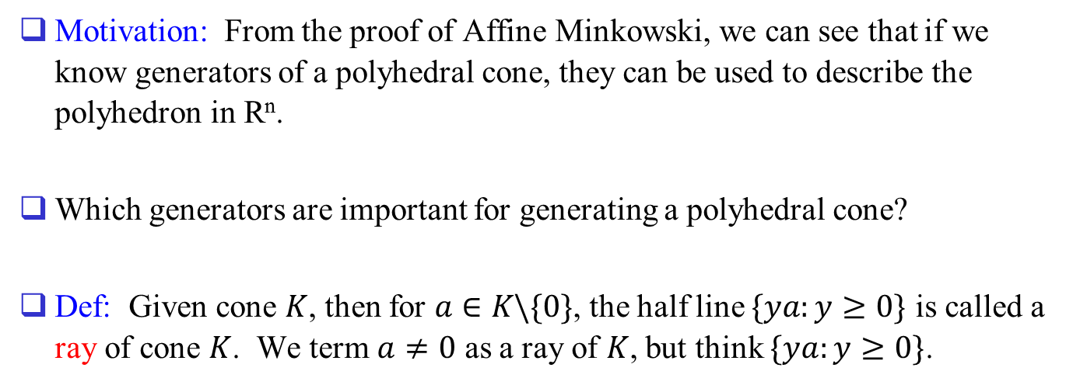
Back to Cone
Motivation: From the proof of Affine Minkowski, we can see that if we know generators of a polyhedral cone, they can be used to describe the polyhedron in R^{n}.
Which generators are important for generating a polyhedral cone?
Def: Given cone $K$, then for $a∈K\backslash \{0\}$, the half line $\{ya:y≥0\}$ is called a ray of cone $K$. We term $a≠0$ as a ray of $K$, but think $\{ya:y≥0\}$.

Slide 2
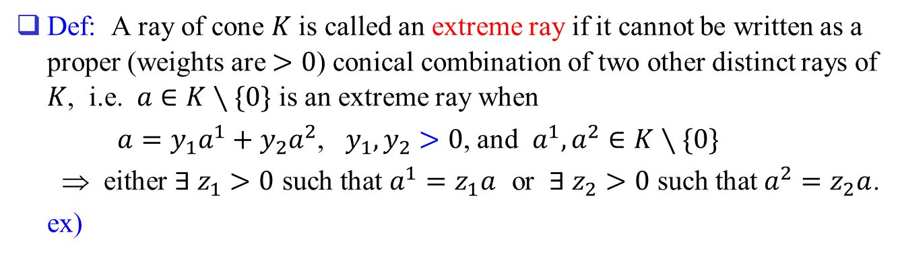
Def: A ray of cone $K$ is called an extreme ray if it cannot be written as a proper (weights are $>0$) conical combination of two other distinct rays of $K$, i.e. $a∈K∖\{0\}$ is an extreme ray when
$a=y_{1}a^{1}+y_{2}a^{2}$, $y_{1},y_{2}>0$, and $a^{1},a^{2}∈K∖\{0\}$
⇒ either $∃ z_{1}>0$ such that $a^{1}=z_{1}a$ or $∃ z_{2}>0$ such that $a^{2}=z_{2}a$.
ex)
Note that the cone is
generated by extreme
rays.
Then can we say that
all cones are generated
by extreme rays?
O
X
O
O
0

Slide 3
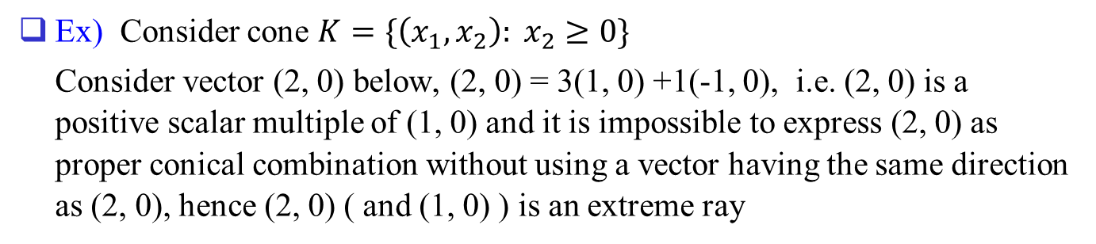
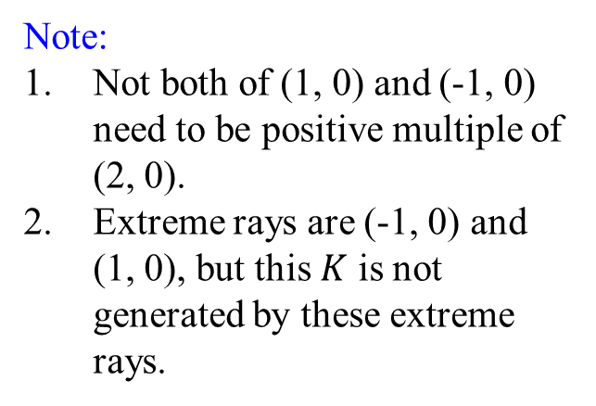



Ex) Consider cone $K=\{\left(x_{1},x_{2}\right): x_{2}≥0\}$
Consider vector (2, 0) below, (2, 0) = 3(1, 0) +1(-1, 0), i.e. (2, 0) is a positive scalar multiple of (1, 0) and it is impossible to express (2, 0) as proper conical combination without using a vector having the same direction as (2, 0), hence (2, 0) ( and (1, 0) ) is an extreme ray
$$x_{2}$$
Note:
Not both of (1, 0) and (-1, 0) need to be positive multiple of (2, 0).
Extreme rays are (-1, 0) and (1, 0), but this $K$ is not generated by these extreme rays.
$$K$$
0
(1, 0)
(2, 0)
$$x_{1}$$
(-1, 0)

Slide 4

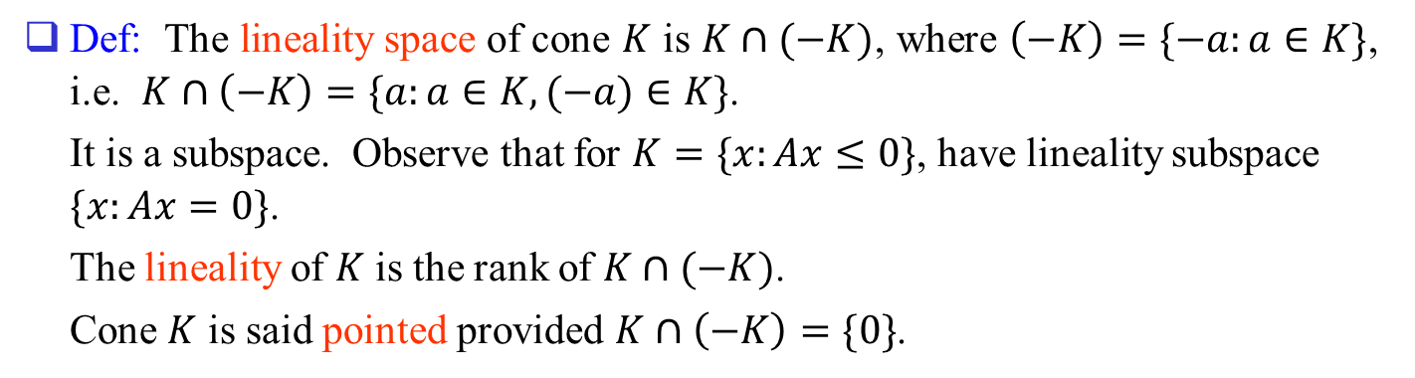







Def: The lineality space of cone $K$ is $K∩(−K)$, where $\left(−K\right)=\{−a:a∈K\}$, i.e. $K∩\left(−K\right)=\{a:a∈K, (−a)∈K\}$.
It is a subspace. Observe that for $K=\{x:Ax≤0\}$, have lineality subspace $\{x:Ax=0\}$.
The lineality of $K$ is the rank of $K∩(−K)$.
Cone $K$ is said pointed provided $K∩\left(−K\right)=\{0\}$.
$$x_{2}$$
$$K$$
$$K$$
$$K∩(−K)$$
$$K∩(−K)$$
0
0
$$x_{1}$$
$$−K$$
$$−K$$
Pointed cone

Slide 5
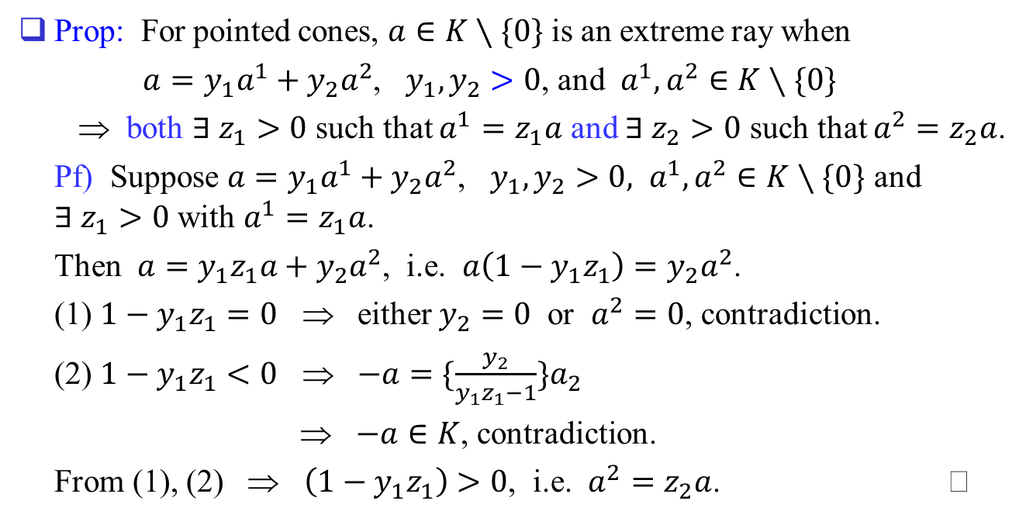
Prop: For pointed cones, $a∈K∖\{0\}$ is an extreme ray when
$a=y_{1}a^{1}+y_{2}a^{2}$, $y_{1},y_{2}>0$, and $a^{1},a^{2}∈K∖\{0\}$
⇒ both $∃ z_{1}>0$ such that $a^{1}=z_{1}a$ and $∃ z_{2}>0$ such that $a^{2}=z_{2}a$.
Pf) Suppose $a=y_{1}a^{1}+y_{2}a^{2}$, $y_{1},y_{2}>0, a^{1},a^{2}∈K∖\{0\}$ and $∃ z_{1}>0$ with $a^{1}=z_{1}a$.
Then $a=y_{1}z_{1}a+y_{2}a^{2}$, i.e. $a\left(1−y_{1}z_{1}\right)=y_{2}a^{2}$.
(1) $1−y_{1}z_{1}=0$ ⇒ either $y_{2}=0$ or $a^{2}=0$, contradiction.
(2) $1−y_{1}z_{1}<0$ ⇒ $−a=\{\frac{y_{2}}{y_{1}z_{1}−1}\}a_{2}$
⇒ $−a∈K$, contradiction.
From (1), (2) ⇒ $\left(1−y_{1}z_{1}\right)>0$, i.e. $a^{2}=z_{2}a$.

Slide 6
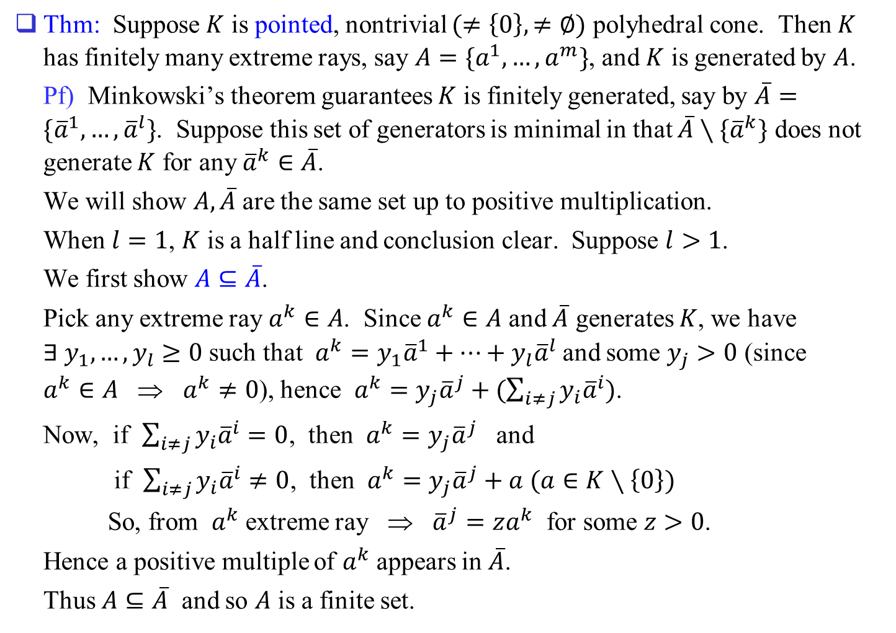
Thm: Suppose $K$ is pointed, nontrivial $(≠\left\{0\right\}, ≠∅)$ polyhedral cone. Then $K$ has finitely many extreme rays, say $A=\{a^{1},…,a^{m}\}$, and $K$ is generated by $A$.
Pf) Minkowski’s theorem guarantees $K$ is finitely generated, say by $\overline{A}=\{{\overline{a}}^{1},…,{\overline{a}}^{l}\}$. Suppose this set of generators is minimal in that $\overline{A}∖\{{\overline{a}}^{k}\}$ does not generate $K$ for any ${\overline{a}}^{k}∈\overline{A}$.
We will show $A,\overline{A}$ are the same set up to positive multiplication.
When $l=1$, $K$ is a half line and conclusion clear. Suppose $l>1$.
We first show $A⊆\overline{A}$.
Pick any extreme ray $a^{k}∈A$. Since $a^{k}∈A$ and $\overline{A}$ generates $K$, we have $∃ y_{1},…,y_{l}≥0$ such that $a^{k}=y_{1}{\overline{a}}^{1}+…+y_{l}{\overline{a}}^{l}$ and some $y_{j}>0$ (since $a^{k}∈A$ ⇒ $a^{k}≠0$), hence $a^{k}=y_{j}{\overline{a}}^{j}+(\sum_{i≠j}{y_{i}{\overline{a}}^{i}})$.
Now, if $\sum_{i≠j}{y_{i}{\overline{a}}^{i}}=0$, then $a^{k}=y_{j}{\overline{a}}^{j}$ and
if $\sum_{i≠j}{y_{i}{\overline{a}}^{i}}≠0$, then $a^{k}=y_{j}{\overline{a}}^{j}+a (a∈K∖\left\{0\right\})$
So, from $a^{k}$ extreme ray ⇒ ${\overline{a}}^{j}=za^{k}$ for some $z>0$.
Hence a positive multiple of $a^{k}$ appears in $\overline{A}$.
Thus $A⊆\overline{A}$ and so $A$ is a finite set.

Slide 7
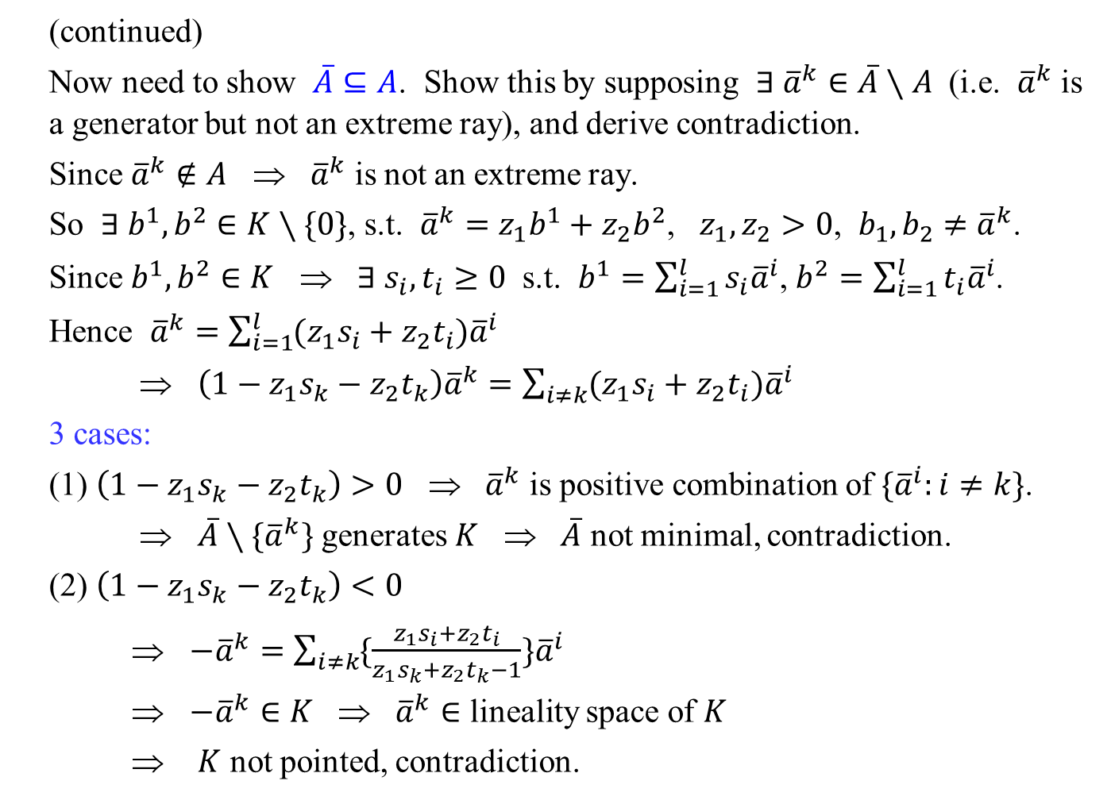
(continued)
Now need to show $\overline{A}⊆A$. Show this by supposing $∃ {\overline{a}}^{k}∈\overline{A}∖A$ (i.e. ${\overline{a}}^{k}$ is a generator but not an extreme ray), and derive contradiction.
Since ${\overline{a}}^{k}∉A$ ⇒ ${\overline{a}}^{k}$ is not an extreme ray.
So $∃ b^{1},b^{2}∈K∖\{0\}$, s.t. ${\overline{a}}^{k}=z_{1}b^{1}+z_{2}b^{2}$, $z_{1},z_{2}>0$, $b_{1},b_{2}≠{\overline{a}}^{k}$.
Since $b^{1},b^{2}∈K$ ⇒ $∃ s_{i},t_{i}≥0$ s.t. $b^{1}=\sum_{i=1}^{l}{s_{i}{\overline{a}}^{i}}$, $b^{2}=\sum_{i=1}^{l}{t_{i}{\overline{a}}^{i}}$.
Hence ${\overline{a}}^{k}=\sum_{i=1}^{l}{(z_{1}s_{i}+z_{2}t_{i}){\overline{a}}^{i}}$
⇒ $\left(1−z_{1}s_{k}−z_{2}t_{k}\right){\overline{a}}^{k}=\sum_{i≠k}{(z_{1}s_{i}+z_{2}t_{i}){\overline{a}}^{i}}$
3 cases:
(1) $\left(1−z_{1}s_{k}−z_{2}t_{k}\right)>0$ ⇒ ${\overline{a}}^{k}$ is positive combination of $\{{\overline{a}}^{i}:i≠k\}$.
⇒ $\overline{A}∖\{{\overline{a}}^{k}\}$ generates $K$ ⇒ $\overline{A}$ not minimal, contradiction.
(2) $\left(1−z_{1}s_{k}−z_{2}t_{k}\right)<0$
⇒ $−{\overline{a}}^{k}=\sum_{i≠k}{\{\frac{z_{1}s_{i}+z_{2}t_{i}}{z_{1}s_{k}+z_{2}t_{k}−1}\}{\overline{a}}^{i}}$
⇒ $−{\overline{a}}^{k}∈K$ ⇒ ${\overline{a}}^{k}∈$ lineality space of $K$
⇒ $K$ not pointed, contradiction.

Slide 8
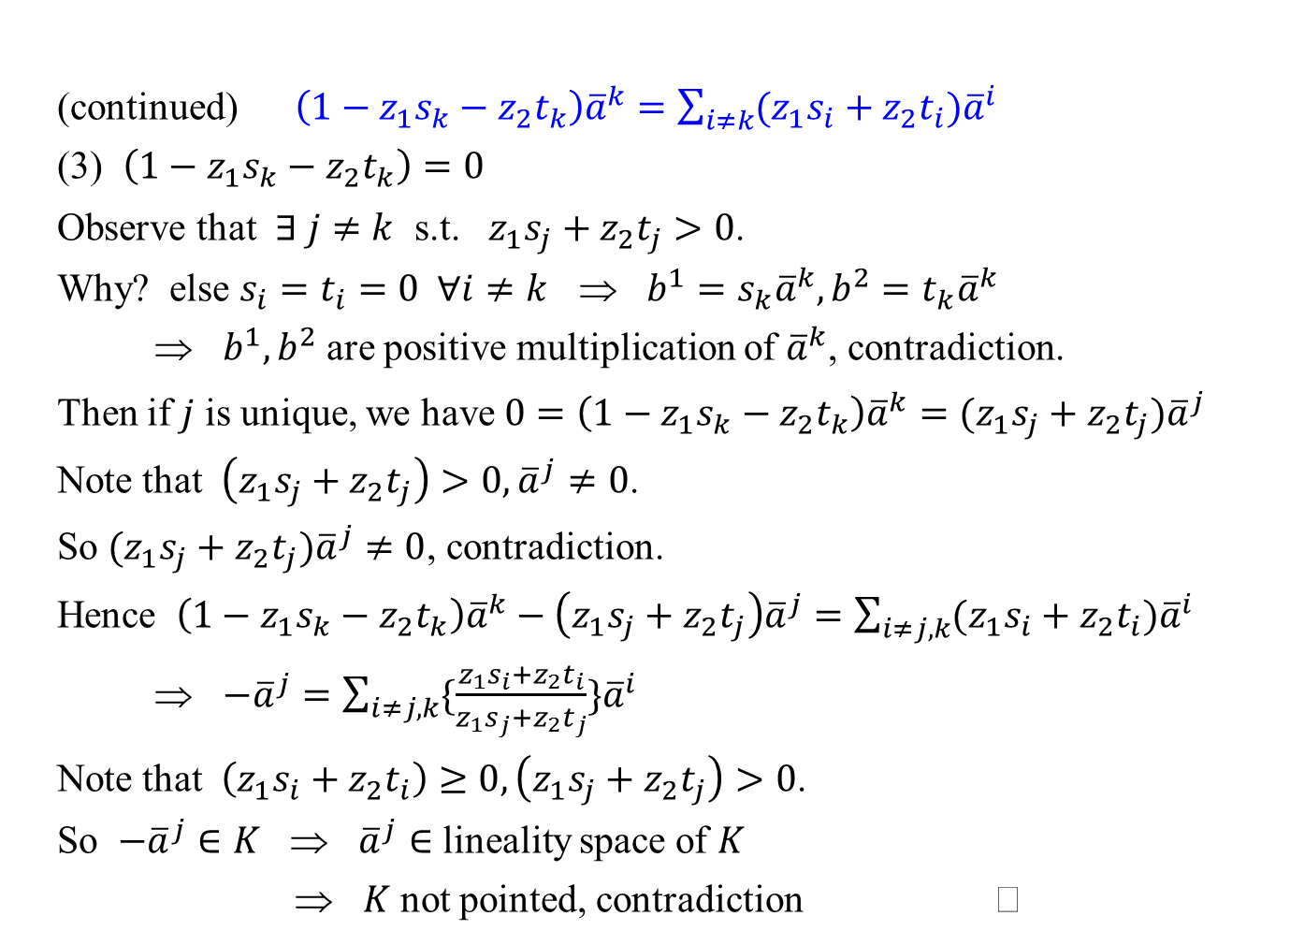
(continued) $\left(1−z_{1}s_{k}−z_{2}t_{k}\right){\overline{a}}^{k}=\sum_{i≠k}{(z_{1}s_{i}+z_{2}t_{i}){\overline{a}}^{i}}$
(3) $\left(1−z_{1}s_{k}−z_{2}t_{k}\right)=0$
Observe that $∃ j≠k$ s.t. $z_{1}s_{j}+z_{2}t_{j}>0$.
Why? else $s_{i}=t_{i}=0 ∀i≠k$ ⇒ $b^{1}=s_{k}{\overline{a}}^{k}, b^{2}=t_{k}{\overline{a}}^{k}$
⇒ $b^{1},b^{2}$ are positive multiplication of ${\overline{a}}^{k}$, contradiction.
Then if $j$ is unique, we have $0=\left(1−z_{1}s_{k}−z_{2}t_{k}\right){\overline{a}}^{k}=(z_{1}s_{j}+z_{2}t_{j}){\overline{a}}^{j}$
Note that $\left(z_{1}s_{j}+z_{2}t_{j}\right)>0, {\overline{a}}^{j}≠0$.
So $(z_{1}s_{j}+z_{2}t_{j}){\overline{a}}^{j}≠0$, contradiction.
Hence $\left(1−z_{1}s_{k}−z_{2}t_{k}\right){\overline{a}}^{k}−\left(z_{1}s_{j}+z_{2}t_{j}\right){\overline{a}}^{j}=\sum_{i≠j,k}{(z_{1}s_{i}+z_{2}t_{i}){\overline{a}}^{i}}$
⇒ $−{\overline{a}}^{j}=\sum_{i≠j,k}{\{\frac{z_{1}s_{i}+z_{2}t_{i}}{z_{1}s_{j}+z_{2}t_{j}}\}{\overline{a}}^{i}}$
Note that $\left(z_{1}s_{i}+z_{2}t_{i}\right)≥0,\left(z_{1}s_{j}+z_{2}t_{j}\right)>0$.
So $−{\overline{a}}^{j}∈K$ ⇒ ${\overline{a}}^{j}∈$ lineality space of $K$
⇒ $K$ not pointed, contradiction

Slide 9
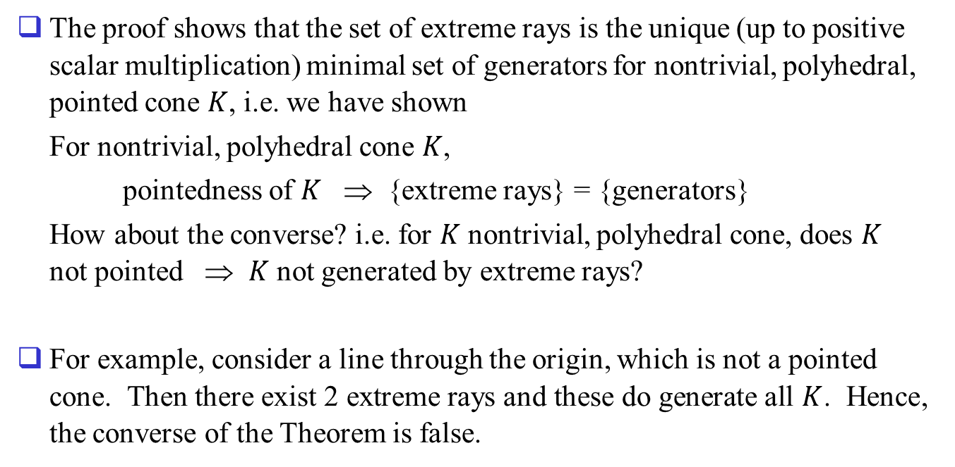
The proof shows that the set of extreme rays is the unique (up to positive scalar multiplication) minimal set of generators for nontrivial, polyhedral, pointed cone $K$, i.e. we have shown
For nontrivial, polyhedral cone $K$,
pointedness of $K$ ⇒ {extreme rays} = {generators}
How about the converse? i.e. for $K$ nontrivial, polyhedral cone, does $K$ not pointed ⇒ $K$ not generated by extreme rays?
For example, consider a line through the origin, which is not a pointed cone. Then there exist 2 extreme rays and these do generate all $K$. Hence, the converse of the Theorem is false.

Slide 10
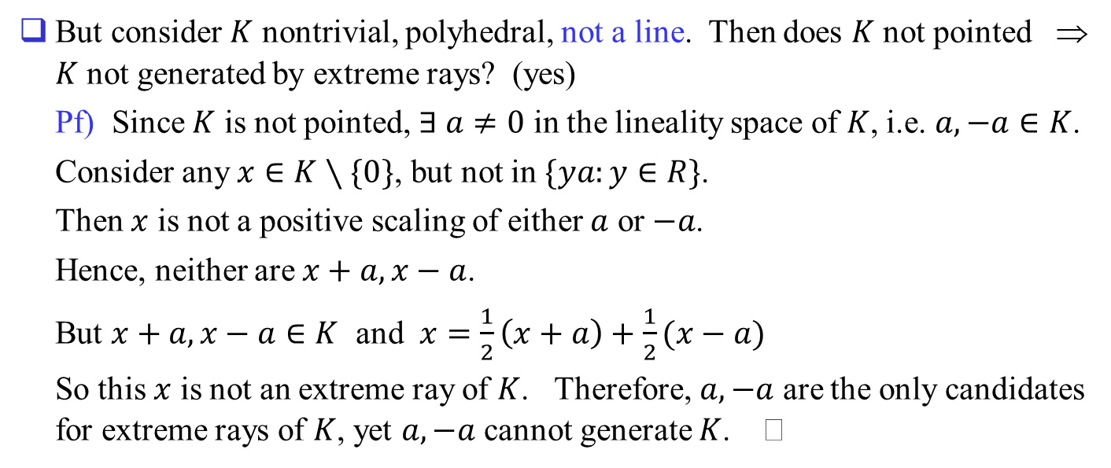
But consider $K$ nontrivial, polyhedral, not a line. Then does $K$ not pointed ⇒ $K$ not generated by extreme rays? (yes)
Pf) Since $K$ is not pointed, $∃ a≠0$ in the lineality space of $K$, i.e. $a, −a∈K$.
Consider any $x∈K∖\{0\}$, but not in $\{ya:y∈R\}$.
Then $x$ is not a positive scaling of either $a$ or $−a$.
Hence, neither are $x+a, x−a$.
But $x+a, x−a∈K$ and $x=\frac{1}{2}\left(x+a\right)+\frac{1}{2}(x−a)$
So this $x$ is not an extreme ray of $K$. Therefore, $a, −a$ are the only candidates for extreme rays of $K$, yet $a, −a$ cannot generate $K$.

Slide 11
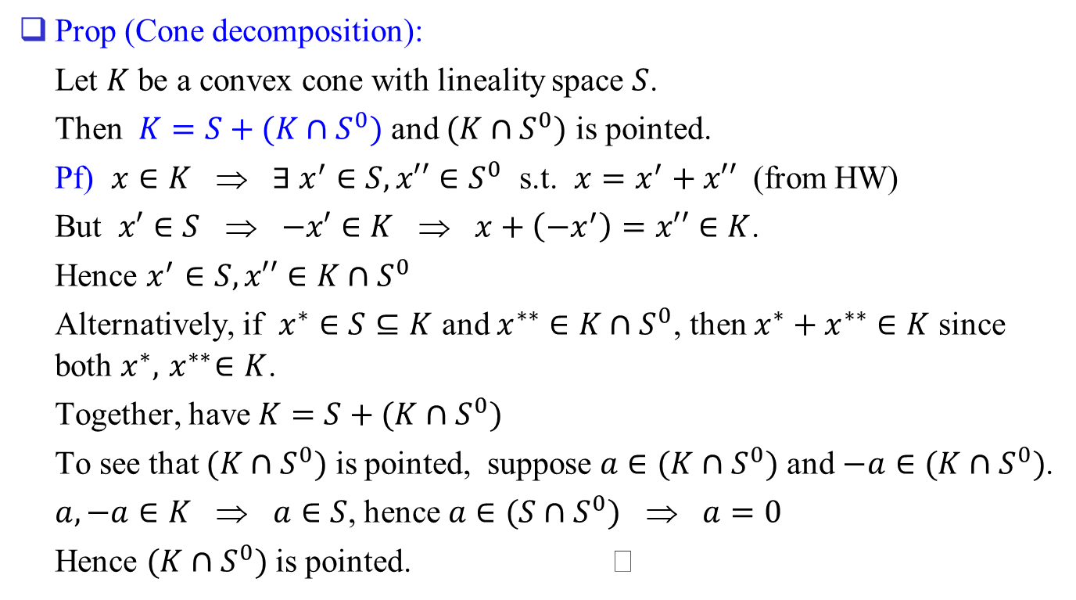
Prop (Cone decomposition):
Let $K$ be a convex cone with lineality space $S$.
Then $K=S+(K∩S^{0})$ and $(K∩S^{0})$ is pointed.
Pf) $x∈K$ ⇒ $∃ x^{′}∈S, x′′∈S^{0}$ s.t. $x=x^{′}+x′′$ (from HW)
But $x′∈S$ ⇒ $−x′∈K$ ⇒ $x+\left(−x^{′}\right)=x′′∈K$.
Hence $x^{′}∈S, x′′∈K∩S^{0}$
Alternatively, if $x^{∗}∈S⊆K$ and $x^{∗∗}∈K∩S^{0}$, then $x^{∗}+x^{∗∗}∈K$ since both $x^{∗},{ x}^{∗∗}∈K$.
Together, have $K=S+(K∩S^{0})$
To see that $(K∩S^{0})$ is pointed, suppose $a∈(K∩S^{0})$ and $−a∈(K∩S^{0})$.
$a, −a∈K$ ⇒ $a∈S$, hence $a∈(S∩S^{0})$ ⇒ $a=0$
Hence $(K∩S^{0})$ is pointed.

Slide 12

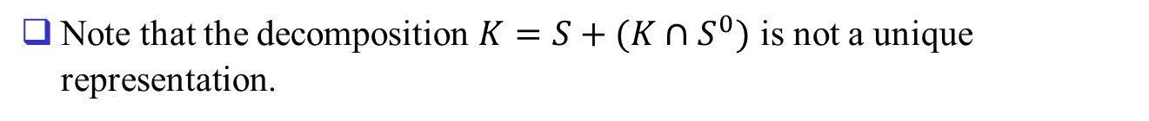







Note that the decomposition $K=S+(K∩S^{0})$ is not a unique representation.
$$x_{2}$$
$$a$$
$$K$$
$$K∩S^{0}$$
$$S$$
0
$$x_{1}$$
$K=S+\{ya:y≥0\}$ also.
$$S^{0}$$

Slide 13
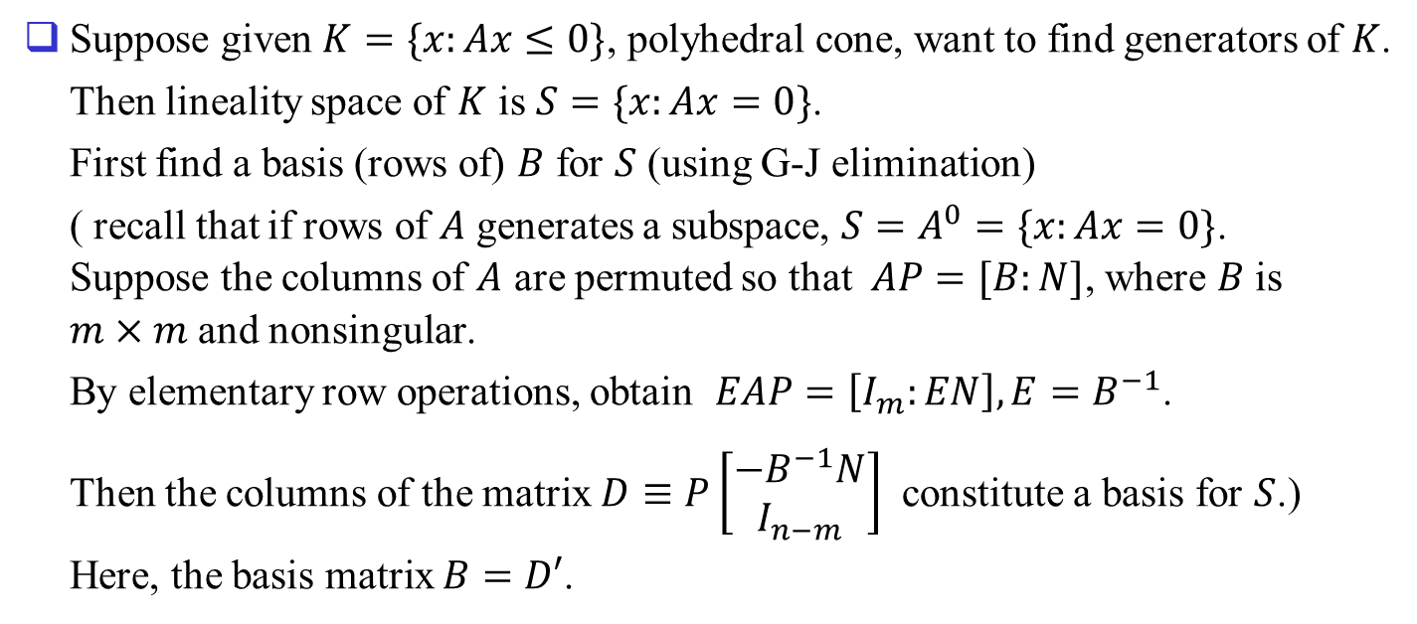
Finding Generators of Cone $K$
Suppose given $K=\{x:Ax≤0\}$, polyhedral cone, want to find generators of $K$.
Then lineality space of $K$ is $S=\{x:Ax=0\}$.
First find a basis (rows of) $B$ for $S$ (using G-J elimination)
( recall that if rows of $A$ generates a subspace, $S=A^{0}=\{x:Ax=0\}$. Suppose the columns of $A$ are permuted so that $AP=[B:N]$, where $B$ is $m×m$ and nonsingular.
By elementary row operations, obtain $EAP=\left[I_{m}:EN\right], E=B^{−1}$.
Then the columns of the matrix $D≡P\left[\begin{matrix}−B^{−1}N \\ I_{n−m}\end{matrix}\right]$ constitute a basis for $S$.)
Here, the basis matrix $B=D′$.

Slide 14
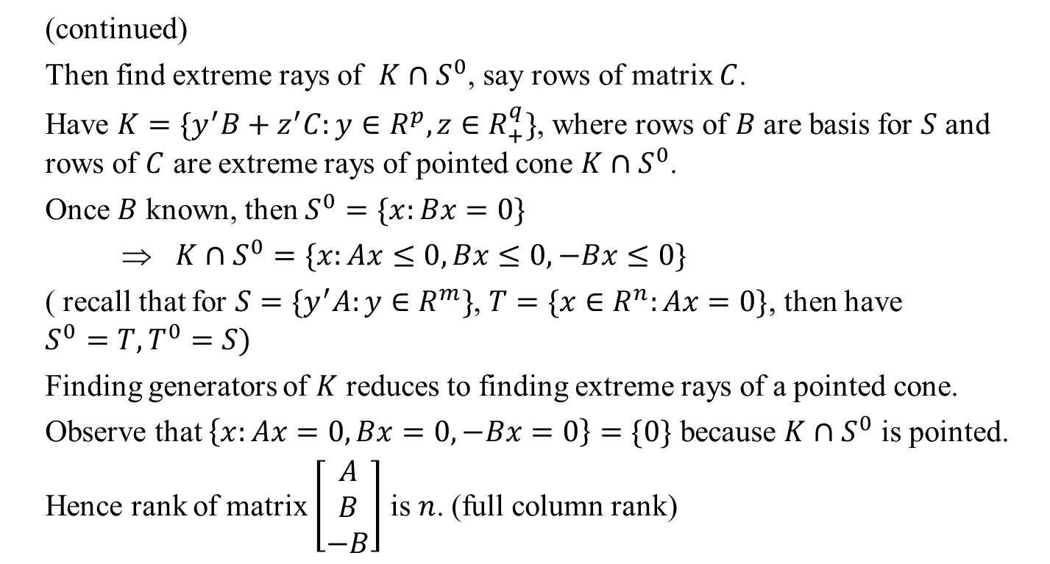
(continued)
Then find extreme rays of $K∩S^{0}$, say rows of matrix $C$.
Have $K=\{y^{′}B+z^{′}C:y∈R^{p}, z∈R_{+}^{q}\}$, where rows of $B$ are basis for $S$ and rows of $C$ are extreme rays of pointed cone $K∩S^{0}$.
Once $B$ known, then $S^{0}=\{x:Bx=0\}$
⇒ $K∩S^{0}=\{x:Ax≤0, Bx≤0, −Bx≤0\}$
( recall that for $S=\{y^{′}A:y∈R^{m}\}$, $T=\{x∈R^{n}:Ax=0\}$, then have $S^{0}=T, T^{0}=S)$
Finding generators of $K$ reduces to finding extreme rays of a pointed cone.
Observe that $\left\{x:Ax=0, Bx=0, −Bx=0\right\}=\{0\}$ because $K∩S^{0}$ is pointed. Hence rank of matrix $\left[\begin{matrix}A \\ B \\ −B\end{matrix}\right]$ is $n$. (full column rank)

Slide 15
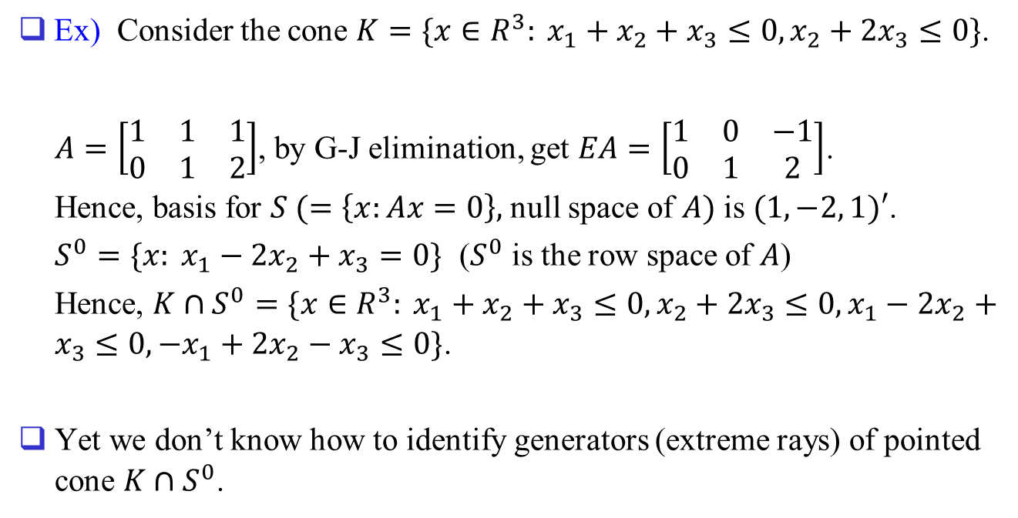
Ex) Consider the cone $K=\{x∈R^{3}: x_{1}+x_{2}+x_{3}≤0, x_{2}+2x_{3}≤0\}$.
$A=\left[\begin{matrix}1 & 1 & 1 \\ 0 & 1 & 2\end{matrix}\right]$, by G-J elimination, get $EA=\left[\begin{matrix}1 & 0 & −1 \\ 0 & 1 & 2\end{matrix}\right]$.
Hence, basis for $S (=\left\{x:Ax=0\right\},$ null space of $A)$ is $(1, −2, 1)′$.
$S^{0}=\{x: x_{1}−2x_{2}+x_{3}=0\}$ ($S^{0}$ is the row space of $A$)
Hence, $K∩S^{0}=\{x∈R^{3}: x_{1}+x_{2}+x_{3}≤0, x_{2}+2x_{3}≤0, x_{1}−2x_{2}+x_{3}≤0, −x_{1}+2x_{2}−x_{3}≤0\}$.
Yet we don’t know how to identify generators (extreme rays) of pointed cone $K∩S^{0}$.

Slide 16








Geometric view
$$a^{1}$$
$$a^{4}$$
$$H_{4}$$
$$a^{2}$$
$$H_{3}$$
$$H_{1}$$
$$a^{3}$$
$$H_{2}$$
0

Slide 17
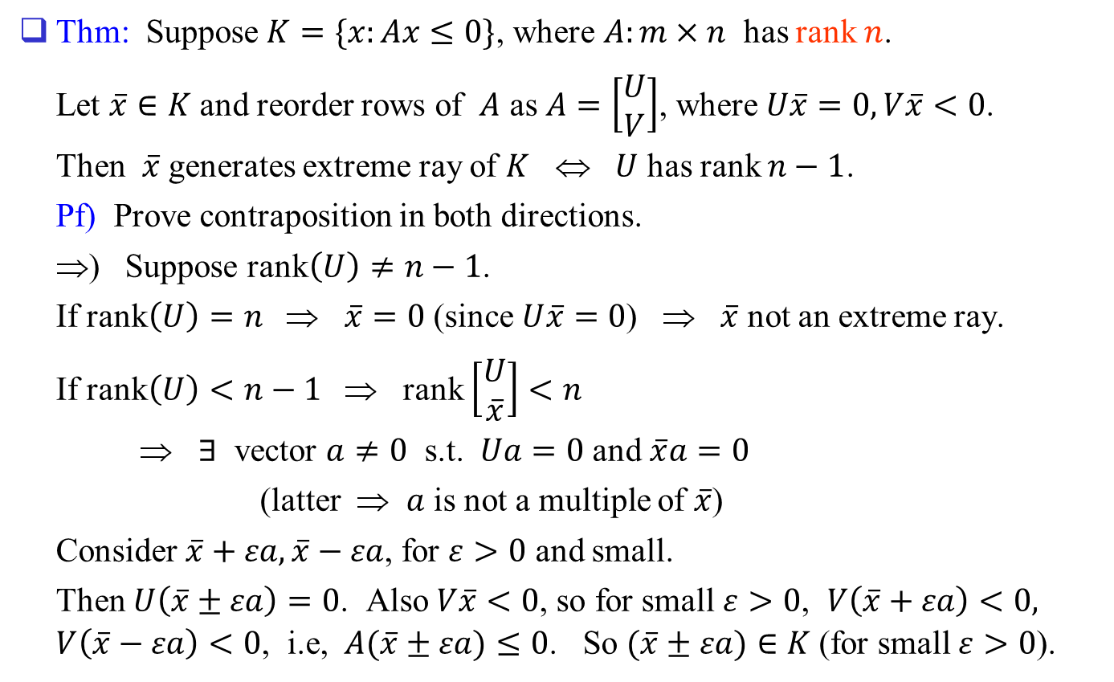
Characterizing Extreme Rays
Thm: Suppose $K=\{x:Ax≤0\}$, where $A:m×n$ has rank $n$.
Let $\overline{x}∈K$ and reorder rows of $A$ as $A=\left[\begin{matrix}U \\ V\end{matrix}\right]$, where $U\overline{x}=0, V\overline{x}<0$.
Then $\overline{x}$ generates extreme ray of $K$ ⇔ $U$ has rank $n−1$.
Pf) Prove contraposition in both directions.
⇒) Suppose rank$\left(U\right)≠n−1$.
If rank$\left(U\right)=n$ ⇒ $\overline{x}=0$ (since $U\overline{x}=0$) ⇒ $\overline{x}$ not an extreme ray.
If rank$\left(U\right)<n−1$ ⇒ rank $\left[\begin{matrix}U \\ \overline{x}\end{matrix}\right]<n$
⇒ $∃$ vector $a≠0$ s.t. $Ua=0$ and $\overline{x}a=0$
(latter ⇒ $a$ is not a multiple of $\overline{x}$)
Consider $\overline{x}+εa, \overline{x}−εa$, for $ε>0$ and small.
Then $U\left(\overline{x}±εa\right)=0$. Also $V\overline{x}<0$, so for small $ε>0$, $V\left(\overline{x}+εa\right)<0, V\left(\overline{x}−εa\right)<0$, i.e, $A(\overline{x}±εa)≤0$. So $(\overline{x}±εa)∈K$ (for small $ε>0$).

Slide 18
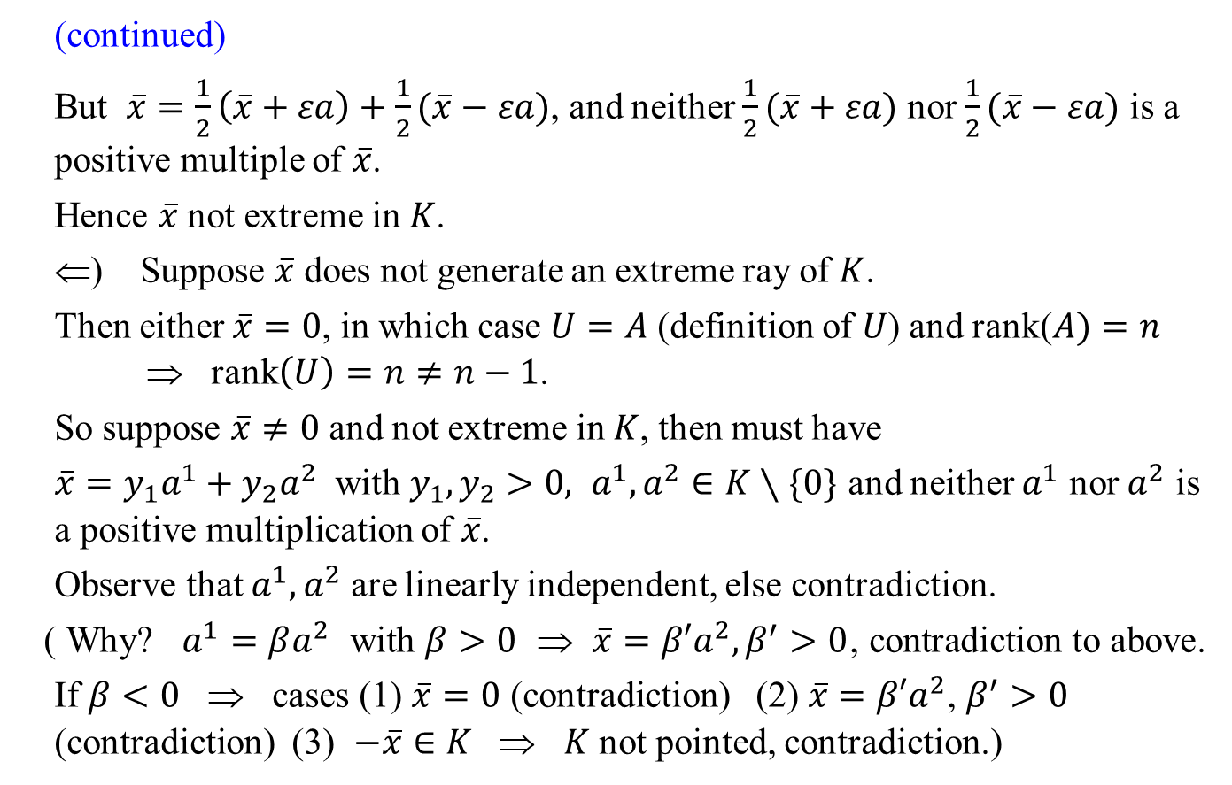
(continued)
But $\overline{x}=\frac{1}{2}\left(\overline{x}+εa\right)+\frac{1}{2}(\overline{x}−εa)$, and neither $\frac{1}{2}(\overline{x}+εa)$ nor $\frac{1}{2}(\overline{x}−εa)$ is a positive multiple of $\overline{x}$.
Hence $\overline{x}$ not extreme in $K$.
⇐) Suppose $\overline{x}$ does not generate an extreme ray of $K$.
Then either $\overline{x}=0$, in which case $U=A$ (definition of $U$) and rank($A)=n$ ⇒ rank$\left(U\right)=n≠n−1$.
So suppose $\overline{x}≠0$ and not extreme in $K$, then must have
$\overline{x}=y_{1}a^{1}+y_{2}a^{2}$ with $y_{1}, y_{2}>0, a^{1}, a^{2}∈K∖\{0\}$ and neither $a^{1}$ nor $a^{2}$ is a positive multiplication of $\overline{x}$.
Observe that $a^{1}, a^{2}$ are linearly independent, else contradiction.
( Why? $a^{1}=βa^{2}$ with $β>0$ ⇒ $\overline{x}=β′a^{2}, β^{′}>0$, contradiction to above.
If $β<0$ ⇒ cases (1) $\overline{x}=0$ (contradiction) (2) $\overline{x}=β′a^{2}$, $β^{′}>0$ (contradiction) (3) $−\overline{x}∈K$ ⇒ $K$ not pointed, contradiction.)

Slide 19
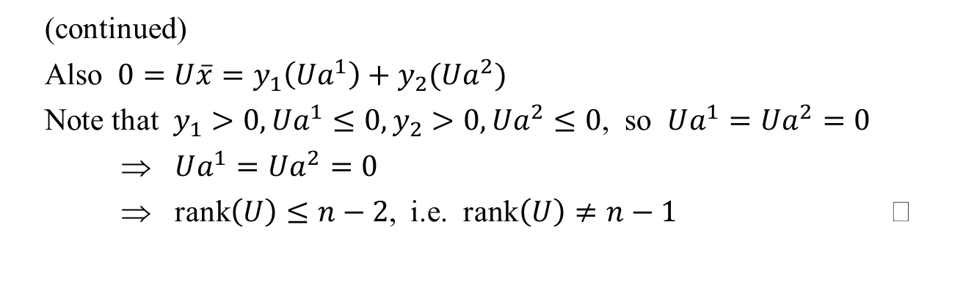
(continued)
Also $0=U\overline{x}=y_{1}\left(Ua^{1}\right)+y_{2}(Ua^{2})$
Note that $y_{1}>0, Ua^{1}≤0, y_{2}>0, Ua^{2}≤0$, so $Ua^{1}=Ua^{2}=0$
⇒ $Ua^{1}=Ua^{2}=0$
⇒ rank$\left(U\right)≤n−2$, i.e. rank$\left(U\right)≠n−1$

Slide 20
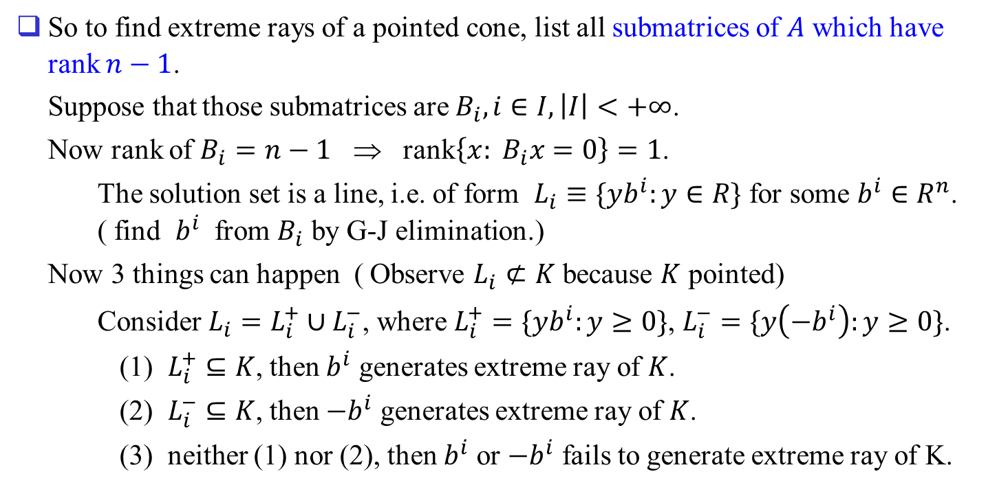
So to find extreme rays of a pointed cone, list all submatrices of $A$ which have rank $n−1$.
Suppose that those submatrices are $B_{i}, i∈I, \left|I\right|<+∞$.
Now rank of $B_{i}=n−1$ ⇒ rank$\left\{x: B_{i}x=0\right\}=1$.
The solution set is a line, i.e. of form $L_{i}≡\{yb^{i}:y∈R\}$ for some $b^{i}∈R^{n}$. ( find $b^{i}$ from $B_{i}$ by G-J elimination.)
Now 3 things can happen ( Observe $L_{i}⊄K$ because $K$ pointed)
Consider $L_{i}=L_{i}^{+}∪L_{i}^{−}$, where $L_{i}^{+}=\{yb^{i}:y≥0\}$, $L_{i}^{−}=\{y\left(−b^{i}\right):y≥0\}$.
(1) $L_{i}^{+}⊆K$, then $b^{i}$ generates extreme ray of $K$.
(2) $L_{i}^{−}⊆K$, then $−b^{i}$ generates extreme ray of $K$.
(3) neither (1) nor (2), then $b^{i}$ or $−b^{i}$ fails to generate extreme ray of K.

Slide 21




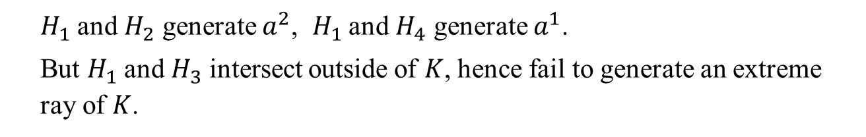




Ex)
$$a^{1}$$
$$a^{4}$$
$$H_{4}$$
$$a^{2}$$
$$H_{3}$$
$$H_{1}$$
$$a^{3}$$
$$H_{2}$$
0
$H_{1}$ and $H_{2}$ generate $a^{2}$, $H_{1}$ and $H_{4}$ generate $a^{1}$.
But $H_{1}$ and $H_{3}$ intersect outside of $K$, hence fail to generate an extreme ray of $K$.

Slide 22
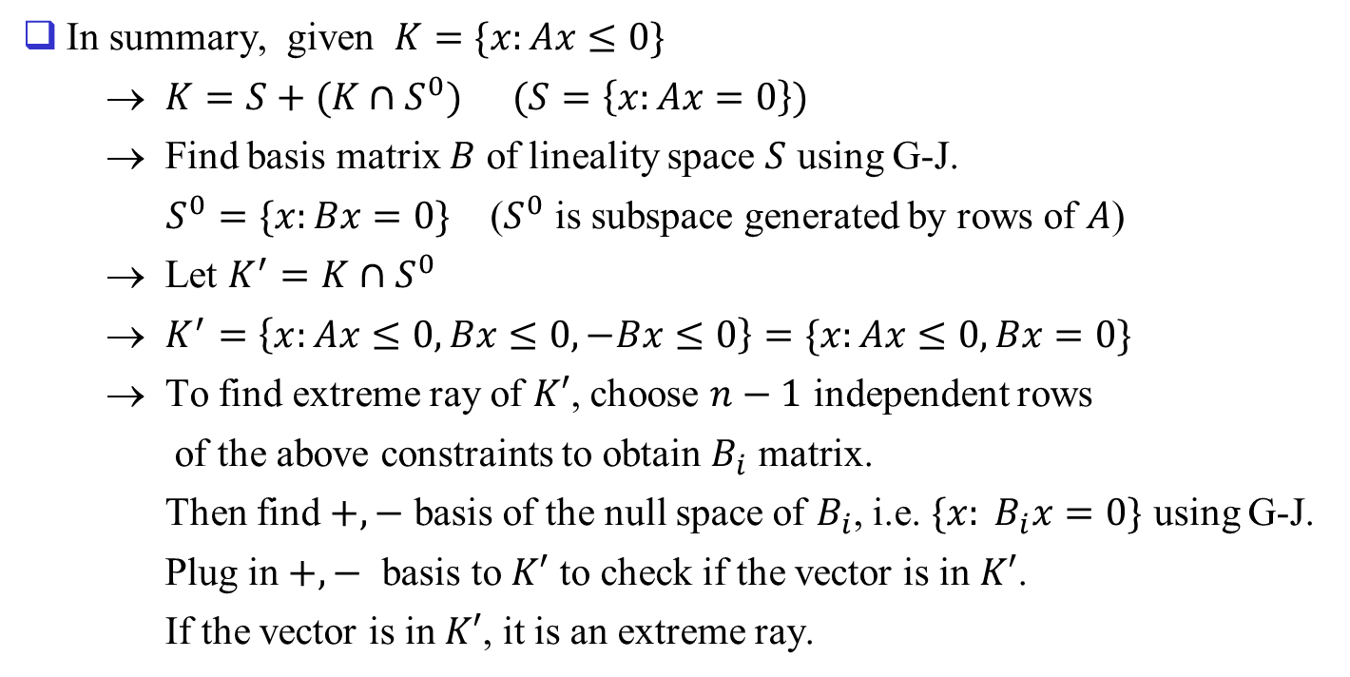
In summary, given $K=\{x:Ax≤0\}$
→ $K=S+(K∩S^{0})$ $(S=\left\{x:Ax=0\right\})$
→ Find basis matrix $B$ of lineality space $S$ using G-J.
$S^{0}=\{x:Bx=0\}$ ($S^{0}$ is subspace generated by rows of $A$)
→ Let $K^{′}=K∩S^{0}$
→ $K^{′}=\left\{x:Ax≤0, Bx≤0, −Bx≤0\right\}=\{x:Ax≤0, Bx=0\}$
→ To find extreme ray of $K′$, choose $n−1$ independent rows
of the above constraints to obtain $B_{i}$ matrix.
Then find $+, −$ basis of the null space of $B_{i}$, i.e. $\{x: B_{i}x=0\}$ using G-J.
Plug in $+, −$ basis to $K′$ to check if the vector is in $K′$.
If the vector is in $K′$, it is an extreme ray.

Slide 23
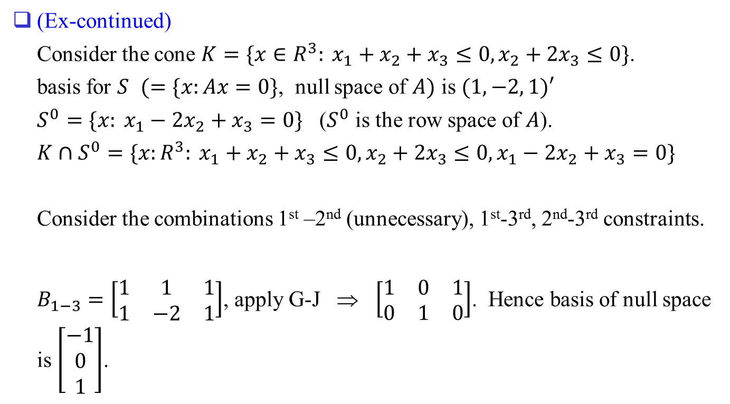
(Ex-continued)
Consider the cone $K=\{x∈R^{3}: x_{1}+x_{2}+x_{3}≤0, x_{2}+2x_{3}≤0\}$.
basis for $S$ $(=\{x:Ax=0\}$, null space of $A)$ is $(1, −2, 1)′$
$S^{0}=\{x: x_{1}−2x_{2}+x_{3}=0\}$ ($S^{0}$ is the row space of $A$).
$K∩S^{0}=\{x:R^{3}: x_{1}+x_{2}+x_{3}≤0, x_{2}+2x_{3}≤0, x_{1}−2x_{2}+x_{3}=0\}$
Consider the combinations 1st –2nd (unnecessary), 1st-3rd, 2nd-3rd constraints.
$B_{1−3}=\left[\begin{matrix}1 & 1 & 1 \\ 1 & −2 & 1\end{matrix}\right]$, apply G-J ⇒ $\left[\begin{matrix}1 & 0 & 1 \\ 0 & 1 & 0\end{matrix}\right]$. Hence basis of null space is $\left[\begin{matrix}−1 \\ 0 \\ 1\end{matrix}\right]$.

Slide 24
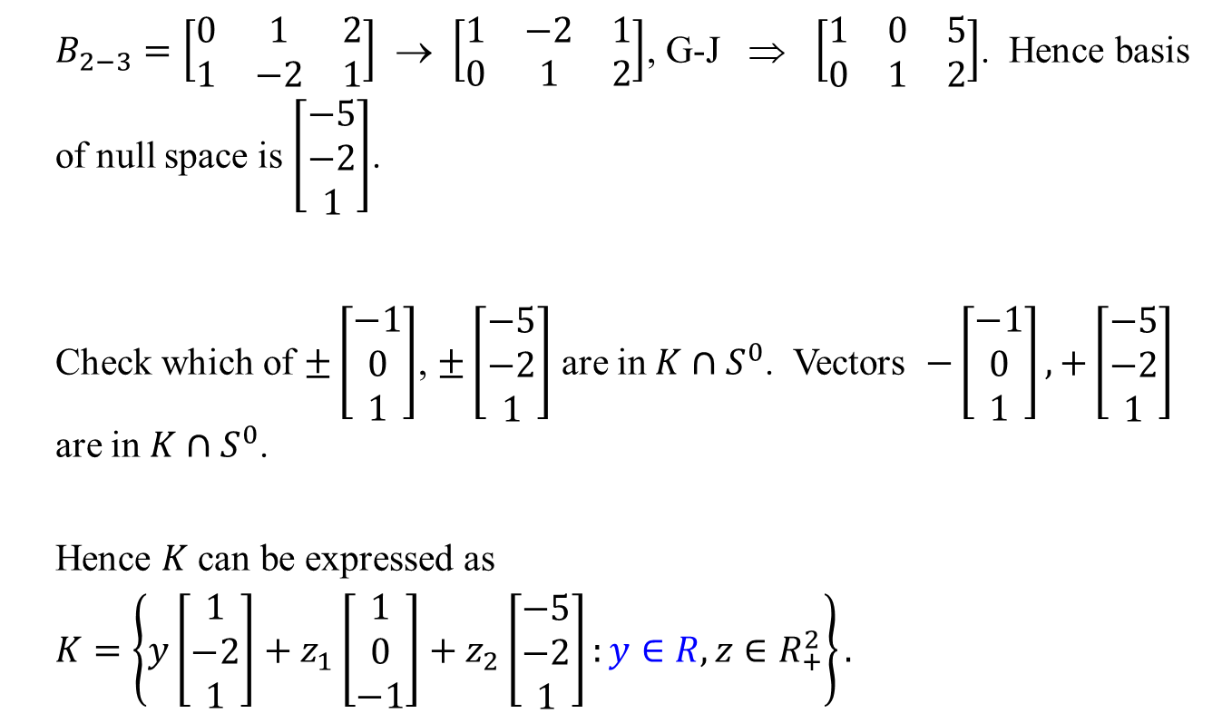
$B_{2−3}=\left[\begin{matrix}0 & 1 & 2 \\ 1 & −2 & 1\end{matrix}\right]$ → $\left[\begin{matrix}1 & −2 & 1 \\ 0 & 1 & 2\end{matrix}\right]$, G-J ⇒ $\left[\begin{matrix}1 & 0 & 5 \\ 0 & 1 & 2\end{matrix}\right]$. Hence basis of null space is $\left[\begin{matrix}−5 \\ −2 \\ 1\end{matrix}\right]$.
Check which of $±\left[\begin{matrix}−1 \\ 0 \\ 1\end{matrix}\right]$, $±\left[\begin{matrix}−5 \\ −2 \\ 1\end{matrix}\right]$ are in $K∩S^{0}$. Vectors $−\left[\begin{matrix}−1 \\ 0 \\ 1\end{matrix}\right], +\left[\begin{matrix}−5 \\ −2 \\ 1\end{matrix}\right]$ are in $K∩S^{0}$.
Hence $K$ can be expressed as $K=\left\{y\left[\begin{matrix}1 \\ −2 \\ 1\end{matrix}\right]+z_{1}\left[\begin{matrix}1 \\ 0 \\ −1\end{matrix}\right]+z_{2}\left[\begin{matrix}−5 \\ −2 \\ 1\end{matrix}\right]:y∈R, z∈R_{+}^{2}\right\}.$

Slide 25
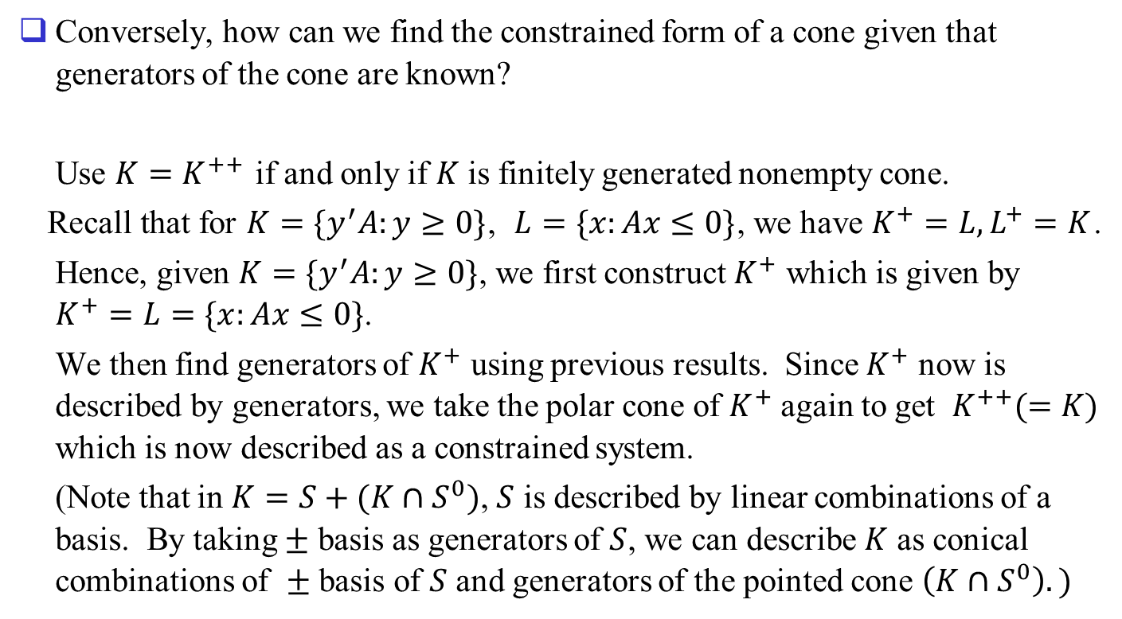
Conversely, how can we find the constrained form of a cone given that generators of the cone are known?
Use $K=K^{++}$ if and only if $K$ is finitely generated nonempty cone.
Recall that for $K=\{y^{′}A:y≥0\}$, $L=\{x:Ax≤0\}$, we have $K^{+}=L, L^{+}=K$.
Hence, given $K=\{y^{′}A:y≥0\}$, we first construct $K^{+}$ which is given by $K^{+}=L=\{x:Ax≤0\}$.
We then find generators of $K^{+}$ using previous results. Since $K^{+}$ now is described by generators, we take the polar cone of $K^{+}$ again to get $K^{++}(=K)$ which is now described as a constrained system.
(Note that in $K=S+(K∩S^{0})$, $S$ is described by linear combinations of a basis. By taking $±$ basis as generators of $S$, we can describe $K$ as conical combinations of $±$ basis of $S$ and generators of the pointed cone $\left(K∩S^{0}\right).)$

Slide 26




Example)
$$x_{2}$$
(1, 2)
$$K=K^{++}$$
(-2, 1)
(2, 1)
$$x_{1}$$
$$K^{+}$$
(1, -2)

Slide 27
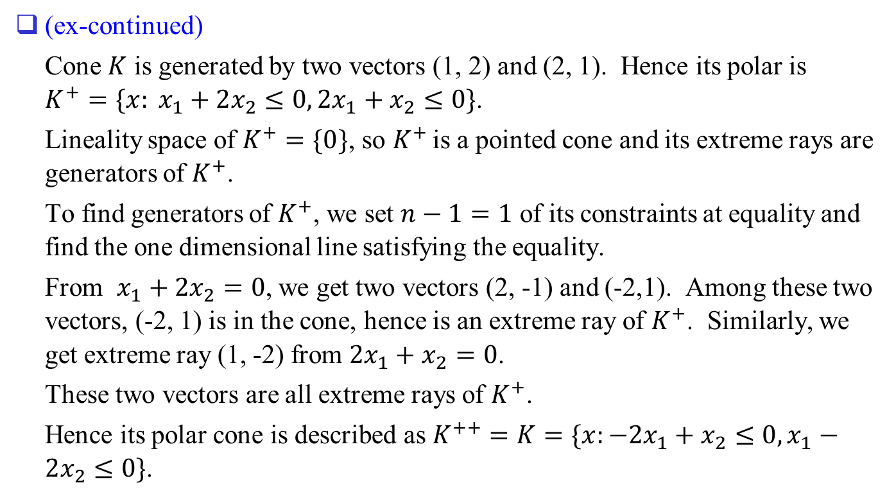
(ex-continued)
Cone $K$ is generated by two vectors (1, 2) and (2, 1). Hence its polar is $K^{+}=\{x: x_{1}+2x_{2}≤0, 2x_{1}+x_{2}≤0\}$.
Lineality space of $K^{+}=\{0\}$, so $K^{+}$ is a pointed cone and its extreme rays are generators of $K^{+}$.
To find generators of $K^{+}$, we set $n−1=1$ of its constraints at equality and find the one dimensional line satisfying the equality.
From $x_{1}+2x_{2}=0$, we get two vectors (2, -1) and (-2,1). Among these two vectors, (-2, 1) is in the cone, hence is an extreme ray of $K^{+}$. Similarly, we get extreme ray (1, -2) from $2x_{1}+x_{2}=0$.
These two vectors are all extreme rays of $K^{+}$.
Hence its polar cone is described as $K^{++}=K=\{x:−2x_{1}+x_{2}≤0, x_{1}−2x_{2}≤0\}$.

Slide 28
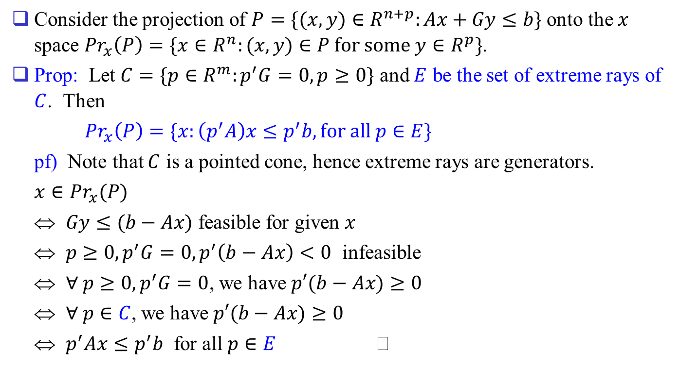
Back to Projection
Consider the projection of $P=\{(x, y)∈R^{n+p}:Ax+Gy≤b\}$ onto the $x$ space ${Pr}_{x}\left(P\right)=\{x∈R^{n}:(x, y)∈P for some y∈R^{p}\}$.
Prop: Let $C=\{p∈R^{m}:p^{′}G=0, p≥0\}$ and $E$ be the set of extreme rays of $C$. Then
${Pr}_{x}\left(P\right)=\{x:\left(p^{′}A\right)x≤p^{′}b, for all p∈E\}$
pf) Note that $C$ is a pointed cone, hence extreme rays are generators.
$x∈{Pr}_{x}(P)$
⇔ $Gy≤(b−Ax)$ feasible for given $x$
⇔ $p≥0, p^{′}G=0, p^{′}\left(b−Ax\right)<0$ infeasible
⇔ $∀ p≥0, p^{′}G=0$, we have $p′(b−Ax)≥0$
⇔ $∀ p∈C$, we have $p′(b−Ax)≥0$
⇔ $p^{′}Ax≤p^{′}b$ for all $p∈E$

Slide 29
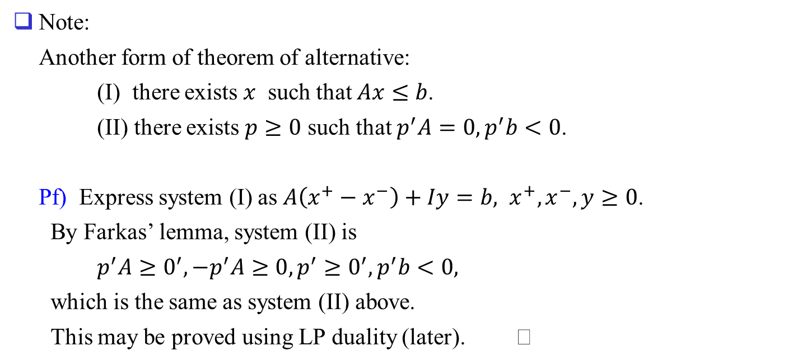
Note:
Another form of theorem of alternative:
(I) there exists $x$ such that $Ax≤b$.
(II) there exists $p≥0$ such that $p^{′}A=0, p^{′}b<0$.
Pf) Express system (I) as $A\left(x^{+}−x^{−}\right)+Iy=b, x^{+}, x^{−}, y≥0$.
By Farkas’ lemma, system (II) is
$p^{′}A≥0^{′}, −p^{′}A≥0, p^{′}≥0^{′}, p^{′}b<0,$
which is the same as system (II) above.
This may be proved using LP duality (later).

