Slide 1
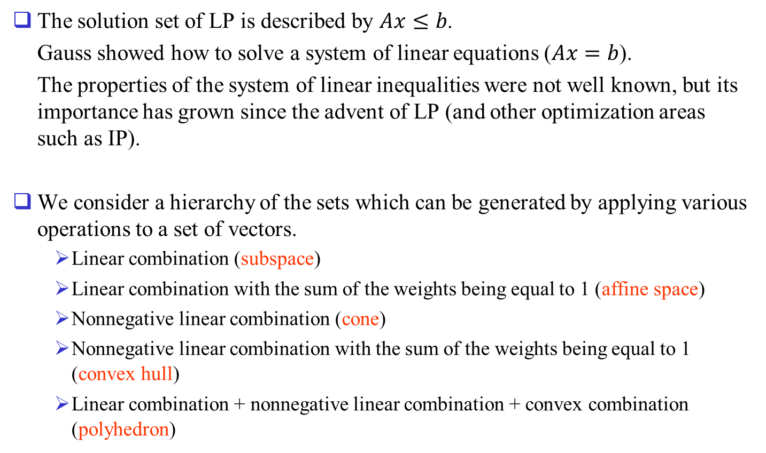
System of Linear Inequalities
The solution set of LP is described by $Ax≤b$.
Gauss showed how to solve a system of linear equations ($Ax=b$).
The properties of the system of linear inequalities were not well known, but its importance has grown since the advent of LP (and other optimization areas such as IP).
We consider a hierarchy of the sets which can be generated by applying various operations to a set of vectors.
  Linear combination (subspace)
  Linear combination with the sum of the weights being equal to 1 (affine space)
  Nonnegative linear combination (cone)
  Nonnegative linear combination with the sum of the weights being equal to 1 (convex hull)
  Linear combination + nonnegative linear combination + convex combination (polyhedron)

Slide 2
Questions:
  Are there any other representations describing the same set?
  How can we identify the different representation given a representation of a set?
  Which are the most important elements in a representation to describe the set and which elements are redundant or unnecessary?
  Given an instance of a representation, does it have a feasible solution or not?
  How can we verify that it has a feasible solution or not?

Slide 3
References:
Convexity and Optimization in Finite Dimensions 1, Josef Stoer and Christoph Witzgall, 1970, Springer-Verlag.
Convex Analysis, R. Tyrrell Rockafellar, 1970, Princeton University Press.
Integer and Combinatorial Optimization, George L. Nemhauser, Laurence A. Wolsey, 1988, Wiley.
Theory of Linear and Integer Programming, Alexander Schrijver, 1986, Wiley.

Slide 4
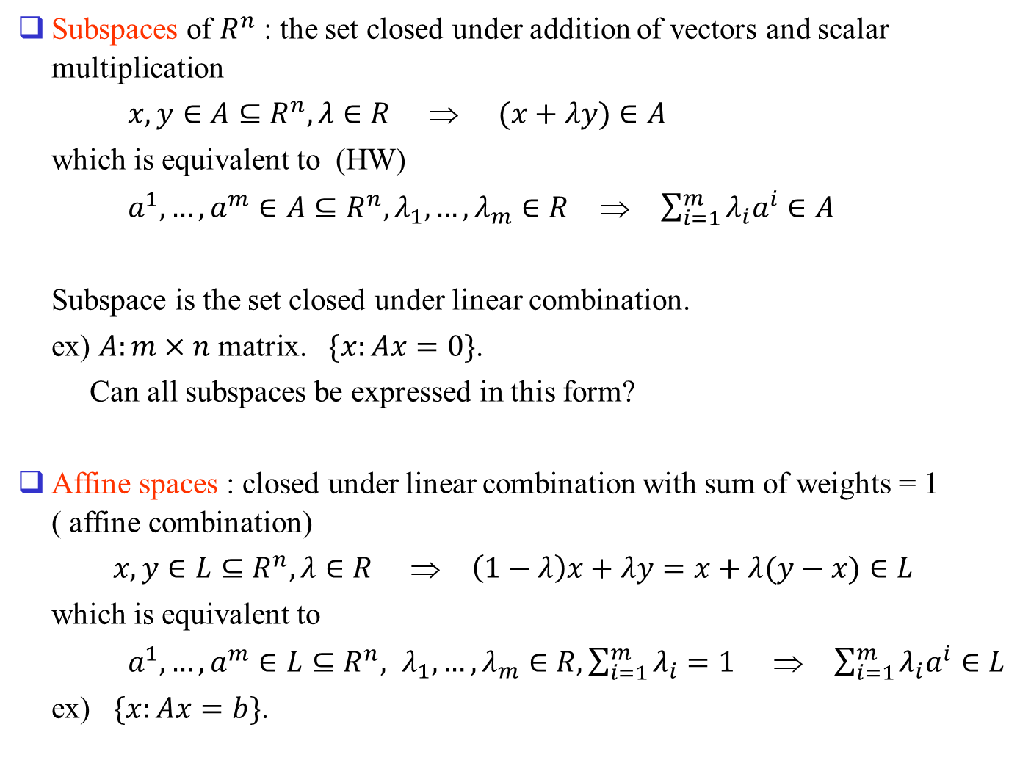
Subspaces of $R^{n}$ : the set closed under addition of vectors and scalar multiplication
$x,y∈A⊆R^{n}, λ∈R$ ⇒ $(x+λy)∈A$
which is equivalent to (HW)
$a^{1},…,a^{m}∈A⊆R^{n}, λ_{1},…,λ_{m}∈R$ ⇒ $\sum_{i=1}^{m}{λ_{i}a^{i}∈A}$
Subspace is the set closed under linear combination.
ex) $A:m×n$ matrix. $\{x:Ax=0\}$.
Can all subspaces be expressed in this form?
Affine spaces : closed under linear combination with sum of weights = 1 ( affine combination)
$x,y∈L⊆R^{n},λ∈R$ ⇒ $\left(1−λ\right)x+λy=x+λ(y−x)∈L$
which is equivalent to
$a^{1},…,a^{m}∈L⊆R^{n}, λ_{1},…,λ_{m}∈R, \sum_{i=1}^{m}{λ_{i}}=1$ ⇒ $\sum_{i=1}^{m}{λ_{i}a^{i}}∈L$
ex) $\{x:Ax=b\}$.

Slide 5
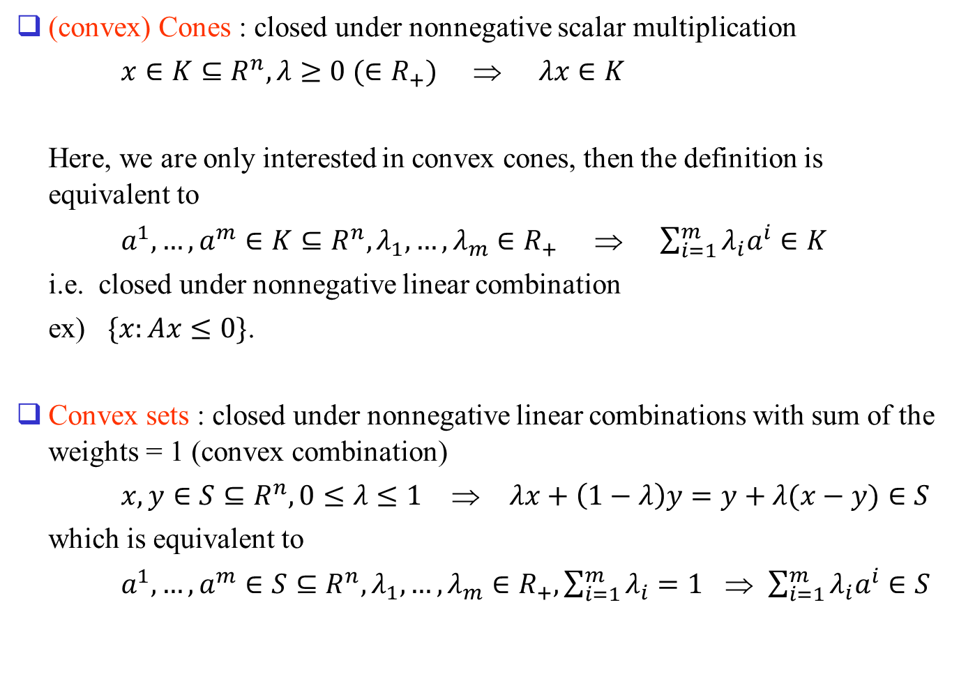
(convex) Cones : closed under nonnegative scalar multiplication
$x∈K⊆R^{n},λ≥0 (∈R_{+})$ ⇒ $λx∈K$
Here, we are only interested in convex cones, then the definition is equivalent to
$a^{1},…,a^{m}∈K⊆R^{n}, λ_{1},…,λ_{m}∈R_{+}$ ⇒ $\sum_{i=1}^{m}{λ_{i}a^{i}}∈K$
i.e. closed under nonnegative linear combination
ex) $\{x:Ax≤0\}$.
Convex sets : closed under nonnegative linear combinations with sum of the weights = 1 (convex combination)
$x,y∈S⊆R^{n}, 0≤λ≤1$ ⇒ $λx+\left(1−λ\right)y=y+λ(x−y)∈S$
which is equivalent to
$a^{1},…,a^{m}∈S⊆R^{n}, λ_{1},…,λ_{m}∈R_{+}, \sum_{i=1}^{m}{λ_{i}}=1$ ⇒ $\sum_{i=1}^{m}{λ_{i}a^{i}}∈S$

Slide 6
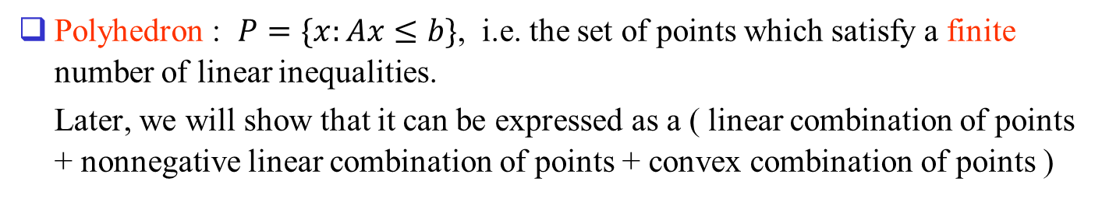
Polyhedron : $P=\{x:Ax≤b\}$, i.e. the set of points which satisfy a finite number of linear inequalities.
Later, we will show that it can be expressed as a ( linear combination of points + nonnegative linear combination of points + convex combination of points )

Slide 7



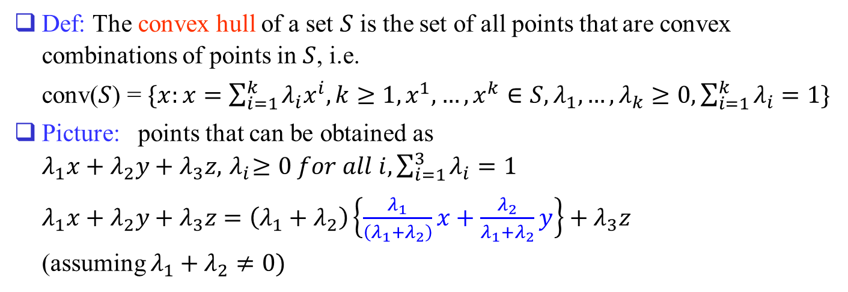
Convex Sets
Def: The convex hull of a set $S$ is the set of all points that are convex combinations of points in $S$, i.e.
conv($S$) = $\{x:x=\sum_{i=1}^{k}{λ_{i}x^{i},}k≥1,x^{1},…,x^{k}∈S, λ_{1},…,λ_{k}≥0, \sum_{i=1}^{k}{λ_{i}}=1\}$
Picture: points that can be obtained as $λ_{1}x+λ_{2}y+λ_{3}z, { λ}_{i}≥0 for all i, \sum_{i=1}^{3}{λ_{i}}=1$
$λ_{1}x+λ_{2}y+λ_{3}z=\left(λ_{1}+λ_{2}\right)\left\{\frac{λ_{1}}{\left(λ_{1}+λ_{2}\right)}x+\frac{λ_{2}}{λ_{1}+λ_{2}}y\right\}+λ_{3}z$
(assuming $λ_{1}+λ_{2}≠0)$
$$z$$
$$x$$
$$y$$

Slide 8
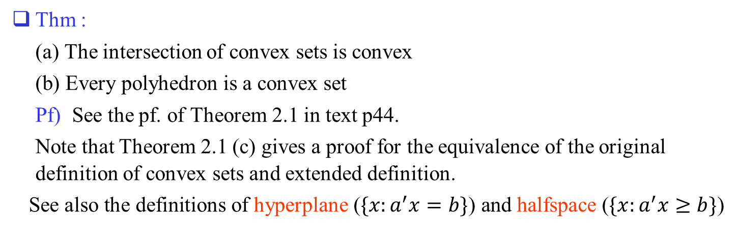
Thm :
(a) The intersection of convex sets is convex
(b) Every polyhedron is a convex set
Pf) See the pf. of Theorem 2.1 in text p44.
Note that Theorem 2.1 (c) gives a proof for the equivalence of the original definition of convex sets and extended definition.
See also the definitions of hyperplane ($\{x:a^{′}x=b\}$) and halfspace ($\{x:a^{′}x≥b\}$)

Slide 9
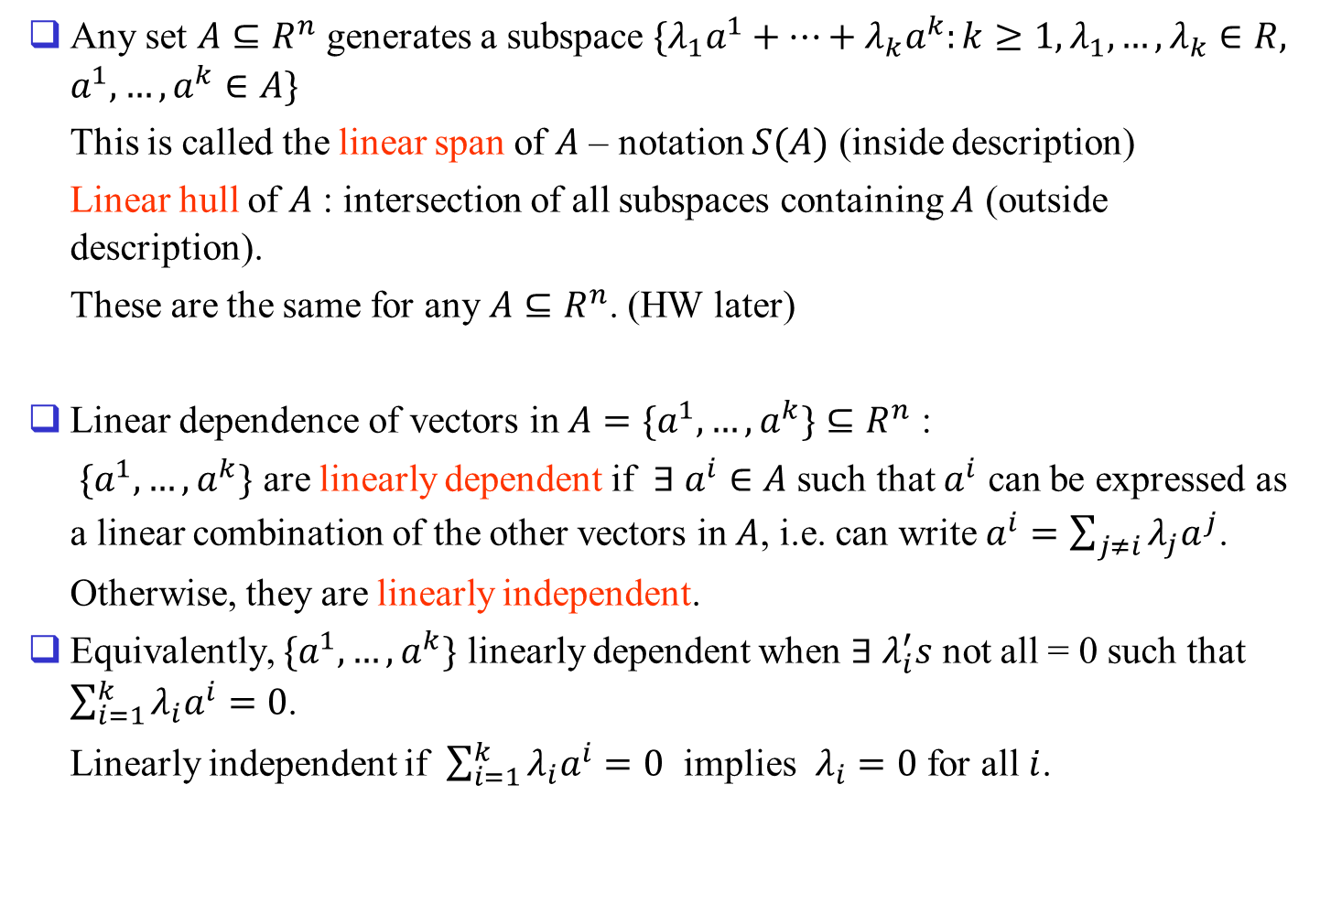
Subspaces
Any set $A⊆R^{n}$ generates a subspace $\{λ_{1}a^{1}+…+λ_{k}a^{k}:k≥1, λ_{1},…,λ_{k}∈R, a^{1},…,a^{k}∈A\}$
This is called the linear span of $A$ – notation $S(A)$ (inside description)
Linear hull of $A$ : intersection of all subspaces containing $A$ (outside description).
These are the same for any $A⊆R^{n}$. (HW later)
Linear dependence of vectors in $A=\{a^{1},…,a^{k}\}⊆R^{n}$ :
$\{a^{1},…,a^{k}\}$ are linearly dependent if $∃ a^{i}∈A$ such that $a^{i}$ can be expressed as a linear combination of the other vectors in $A$, i.e. can write $a^{i}=\sum_{j≠i}{λ_{j}a^{j}}$.
Otherwise, they are linearly independent.
Equivalently, $\{a^{1},…,a^{k}\}$ linearly dependent when $∃ λ_{i}^{′}s$ not all = 0 such that $\sum_{i=1}^{k}{λ_{i}a^{i}}=0$.
Linearly independent if $\sum_{i=1}^{k}{λ_{i}a^{i}}=0$ implies $λ_{i}=0$ for all $i$.

Slide 10
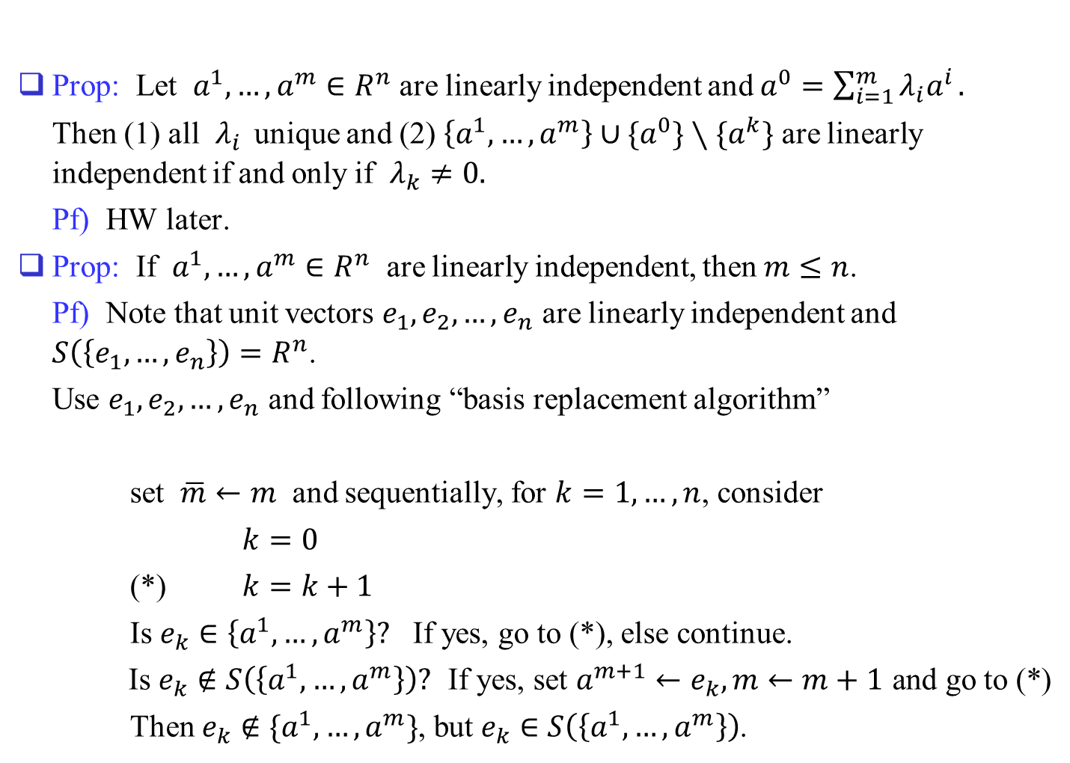
Prop: Let $a^{1},…,a^{m}∈R^{n}$ are linearly independent and $a^{0}=\sum_{i=1}^{m}{λ_{i}a^{i}}.$
Then (1) all $λ_{i}$ unique and (2) $\left\{a^{1},…,a^{m}\right\}∪\{a^{0}\}∖\{a^{k}\}$ are linearly independent if and only if $λ_{k}≠0.$
Pf) HW later.
Prop: If $a^{1},…,a^{m}∈R^{n}$ are linearly independent, then $m≤n$.
Pf) Note that unit vectors $e_{1},e_{2},…,e_{n}$ are linearly independent and $S\left(\left\{e_{1},…,e_{n}\right\}\right)=R^{n}$.
Use $e_{1},e_{2},…,e_{n}$ and following “basis replacement algorithm”
set $\overline{m}←m$ and sequentially, for $k=1,…,n$, consider
$k=0$
(*) $k=k+1$
Is $e_{k}∈\left\{a^{1},…,a^{m}\right\}?$ If yes, go to (*), else continue.
Is $e_{k}∉S\left(\left\{a^{1},…,a^{m}\right\}\right)?$ If yes, set $a^{m+1}←e_{k}, m←m+1$ and go to (*)
Then $e_{k}∉\{a^{1},…,a^{m}\}$, but $e_{k}∈S\left(\left\{a^{1},…,a^{m}\right\}\right)$.

Slide 11
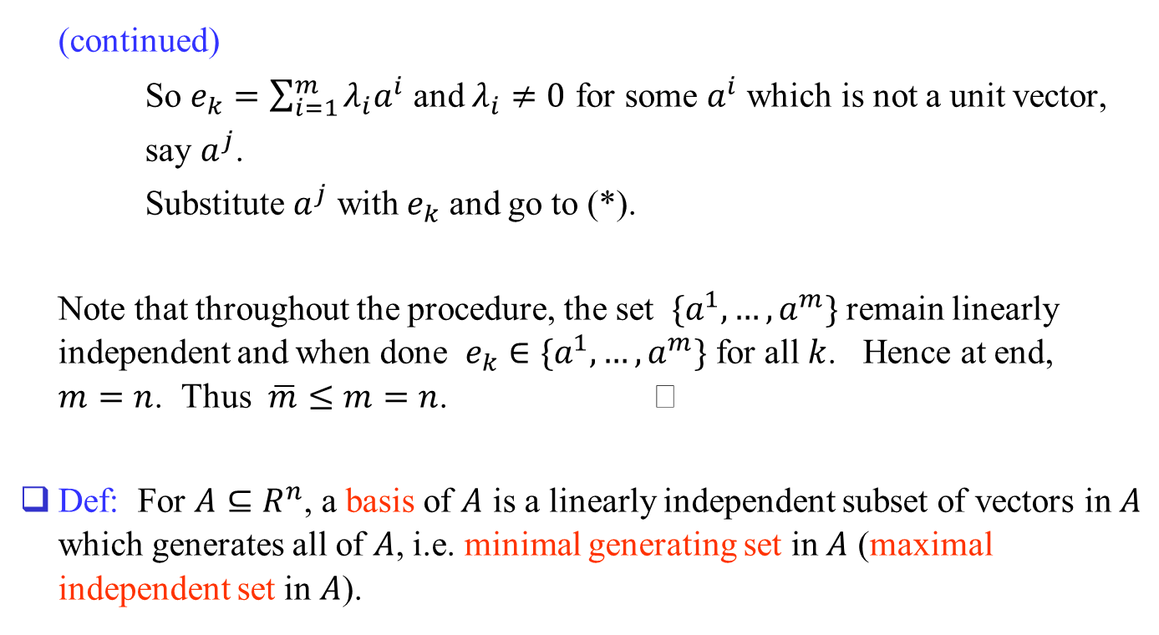
(continued)
So $e_{k}=\sum_{i=1}^{m}{λ_{i}a^{i}}$ and $λ_{i}≠0$ for some $a^{i}$ which is not a unit vector,
say $a^{j}$.
Substitute $a^{j}$ with $e_{k}$ and go to (*).
Note that throughout the procedure, the set $\{a^{1},…,a^{m}\}$ remain linearly independent and when done $e_{k}∈\{a^{1},…,a^{m}\}$ for all $k$. Hence at end, $m=n$. Thus $\overline{m}≤m=n$.
Def: For $A⊆R^{n}$, a basis of $A$ is a linearly independent subset of vectors in $A$ which generates all of $A$, i.e. minimal generating set in $A$ (maximal independent set in $A$).

Slide 12
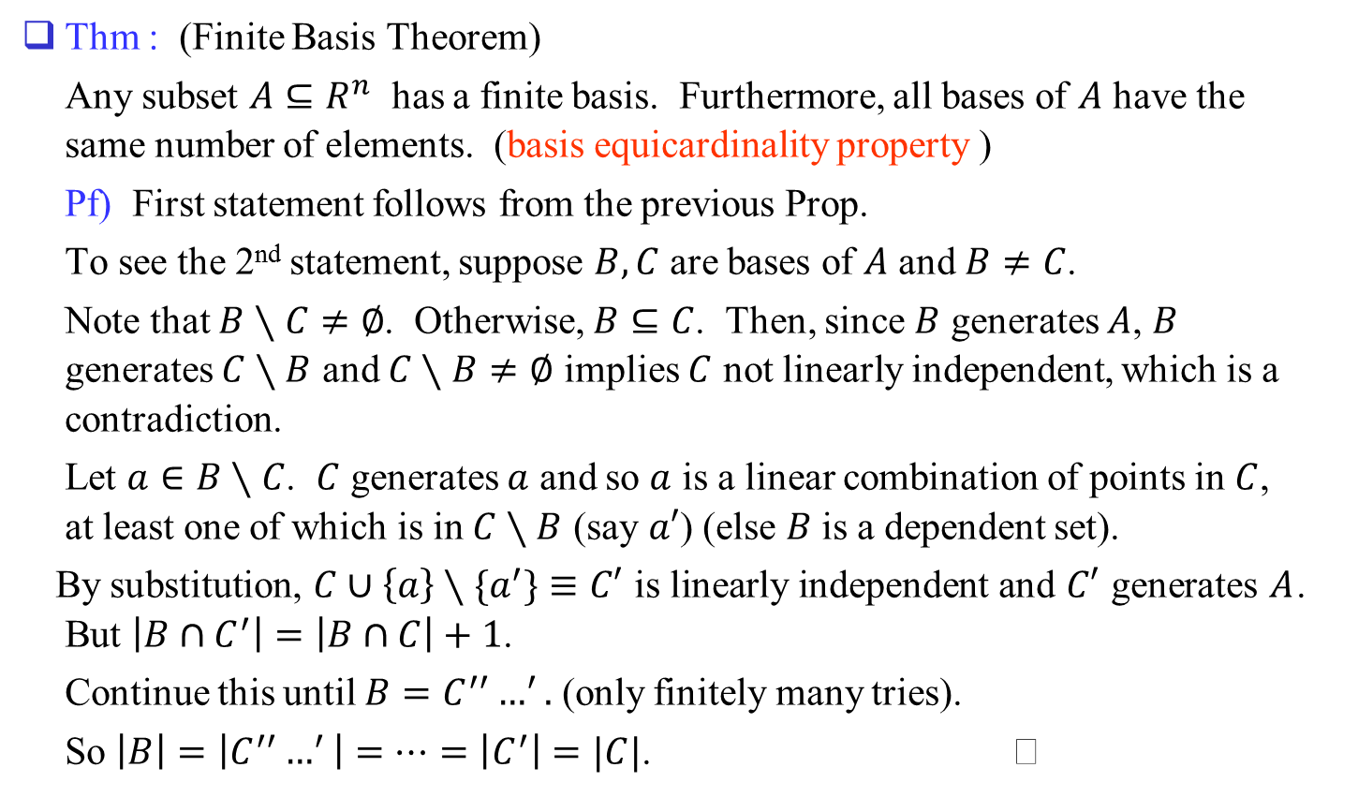
Thm : (Finite Basis Theorem)
Any subset $A⊆R^{n}$ has a finite basis. Furthermore, all bases of $A$ have the same number of elements. (basis equicardinality property )
Pf) First statement follows from the previous Prop.
To see the 2nd statement, suppose $B,C$ are bases of $A$ and $B≠C$.
Note that $B∖C≠∅$. Otherwise, $B⊆C$. Then, since $B$ generates $A$, $B$ generates $C∖B$ and $C∖B≠∅$ implies $C$ not linearly independent, which is a contradiction.
Let $a∈B∖C$. $C$ generates $a$ and so $a$ is a linear combination of points in $C$, at least one of which is in $C∖B$ (say $a′$) (else $B$ is a dependent set).
By substitution, $C∪\left\{a\right\}∖\{a^{′}\}≡C′$ is linearly independent and $C′$ generates $A$. But $\left|B∩C^{′}\right|=\left|B∩C\right|+1$.
Continue this until $B=C^{′′}…^{′}.$ (only finitely many tries).
So $\left|B\right|=\left|C^{′′}…^{′}\right|=…=\left|C^{′}\right|=|C|$.

Slide 13
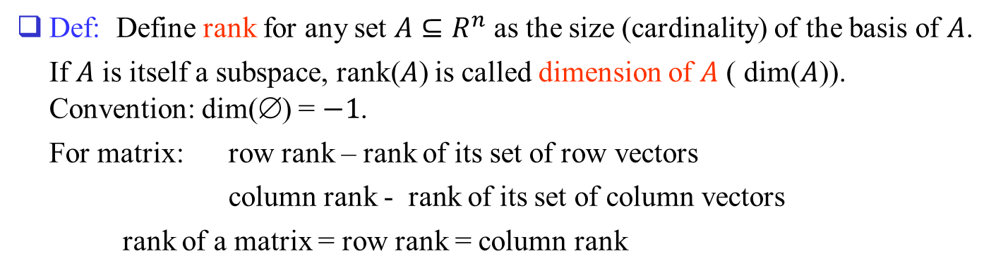
Def: Define rank for any set $A⊆R^{n}$ as the size (cardinality) of the basis of $A$.
If $A$ is itself a subspace, rank($A$) is called dimension of $A$ ( dim($A$)). Convention: dim(∅) = $−1$.
For matrix: row rank – rank of its set of row vectors
column rank - rank of its set of column vectors
rank of a matrix = row rank = column rank

Slide 14
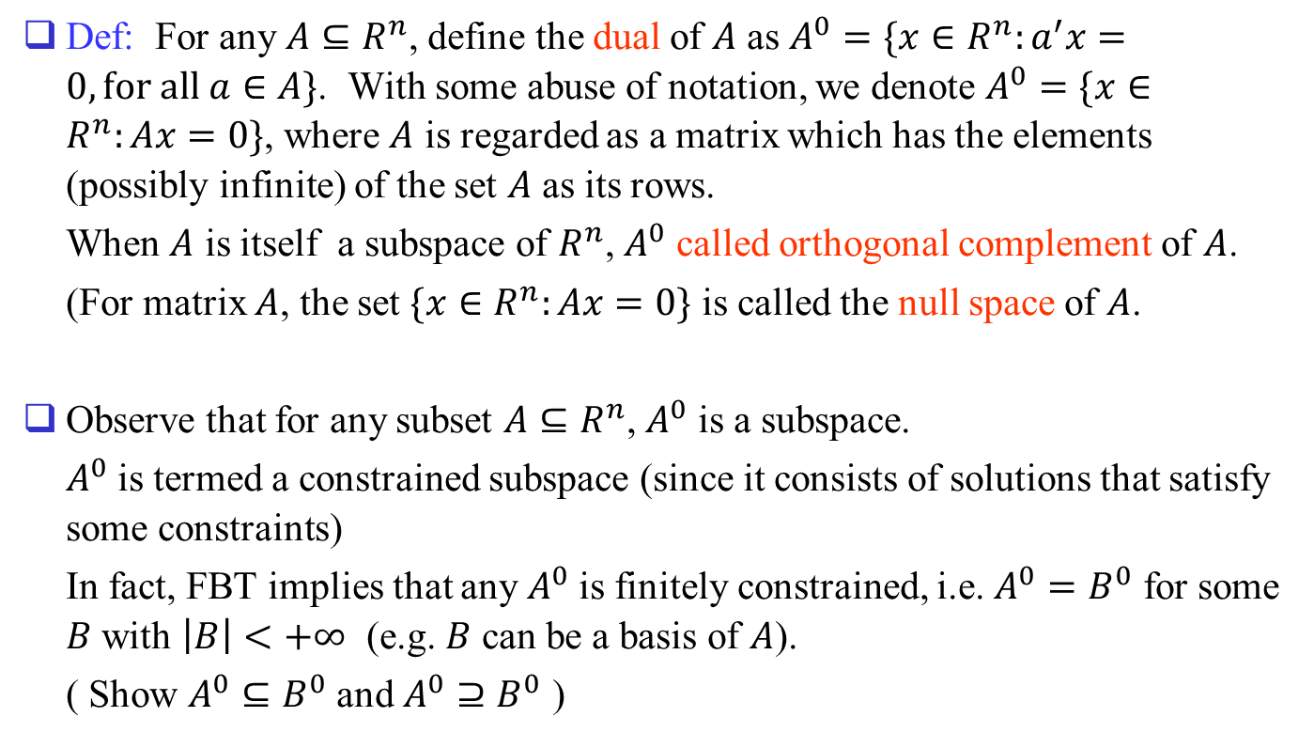
Def: For any $A⊆R^{n}$, define the dual of $A$ as $A^{0}=\{x∈R^{n}:a^{′}x=0, for all a∈A\}$. With some abuse of notation, we denote $A^{0}=\{x∈R^{n}:Ax=0\}$, where $A$ is regarded as a matrix which has the elements (possibly infinite) of the set $A$ as its rows.
When $A$ is itself a subspace of $R^{n}$, $A^{0}$ called orthogonal complement of $A$.
(For matrix $A$, the set $\{x∈R^{n}:Ax=0\}$ is called the null space of $A$.
Observe that for any subset $A⊆R^{n}$, $A^{0}$ is a subspace.
$A^{0}$ is termed a constrained subspace (since it consists of solutions that satisfy some constraints)
In fact, FBT implies that any $A^{0}$ is finitely constrained, i.e. $A^{0}=B^{0}$ for some $B$ with $\left|B\right|<+∞$ (e.g. $B$ can be a basis of $A$).
( Show $A^{0}⊆B^{0}$ and $A^{0}⊇B^{0}$ )

Slide 15
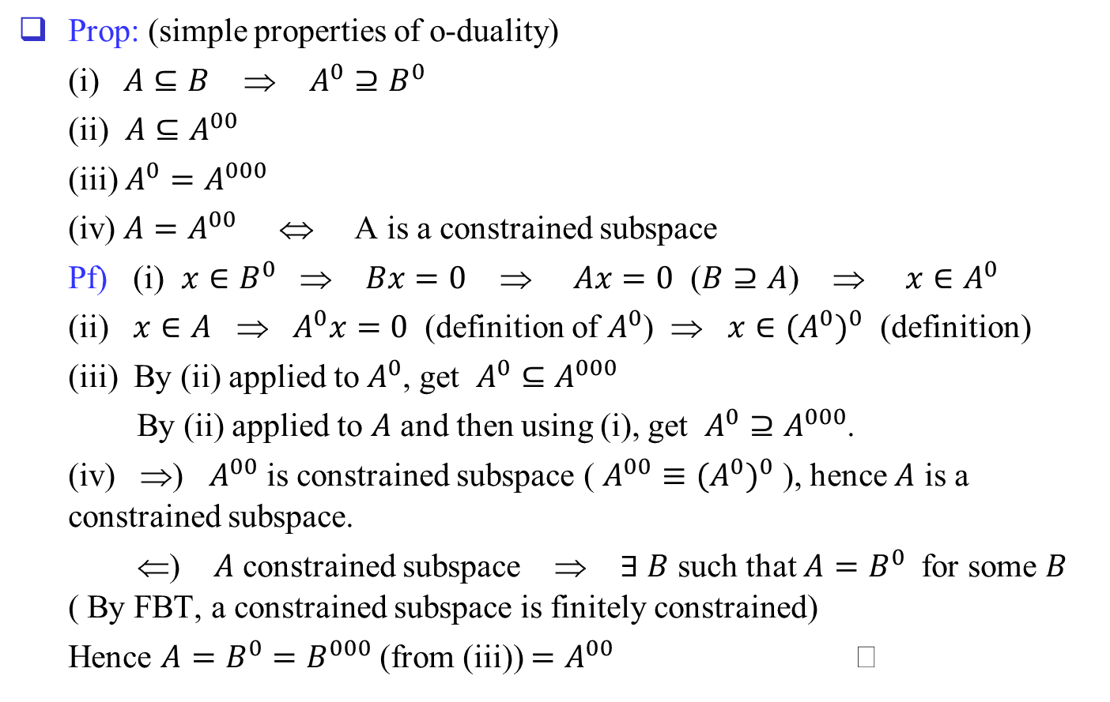
Prop: (simple properties of o-duality)
(i) $A⊆B$ ⇒ $A^{0}⊇B^{0}$
(ii) $A⊆A^{00}$
(iii) $A^{0}=A^{000}$
(iv) $A=A^{00}$ ⇔ A is a constrained subspace
Pf) (i) $x∈B^{0}$ ⇒ $Bx=0$ ⇒ $Ax=0$ ($B⊇A$) ⇒ $x∈A^{0}$
(ii) $x∈A$ ⇒ $A^{0}x=0$ (definition of $A^{0}$) ⇒ $x∈{(A^{0})}^{0}$ (definition)
(iii) By (ii) applied to $A^{0}$, get $A^{0}⊆A^{000}$
By (ii) applied to $A$ and then using (i), get $A^{0}⊇A^{000}$.
(iv) ⇒) $A^{00}$ is constrained subspace ( $A^{00}≡{(A^{0})}^{0}$ ), hence $A$ is a constrained subspace.
⇐) $A$ constrained subspace ⇒ $∃ B$ such that $A=B^{0}$ for some $B$ ( By FBT, a constrained subspace is finitely constrained)
Hence $A=B^{0}=B^{000}$ (from (iii)) $=A^{00}$

Slide 16




Picture:
$$A00$$
$$A000$$
$$A=\{a\}$$
$$A0$$

Slide 17
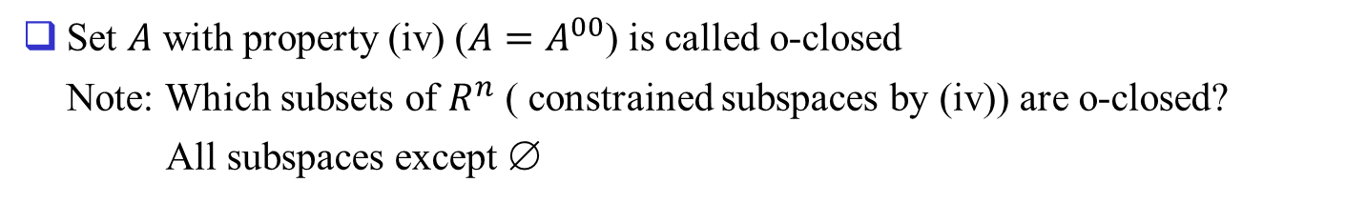
Set $A$ with property (iv) ($A=A^{00}$) is called o-closed
Note: Which subsets of $R^{n}$ ( constrained subspaces by (iv)) are o-closed?
All subspaces except ∅

Slide 18
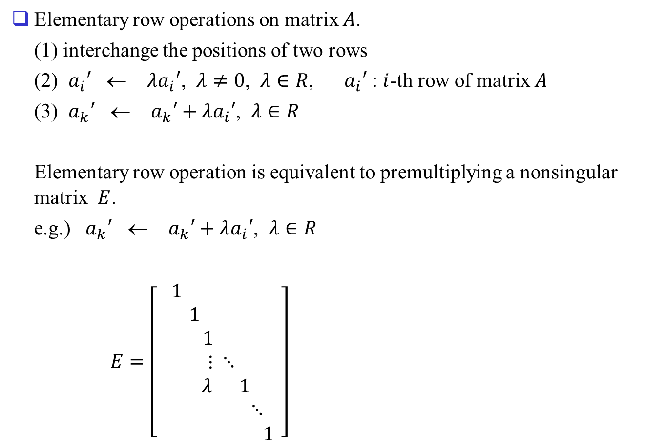
Review
Elementary row operations on matrix $A$.
(1) interchange the positions of two rows
(2) $a_{i}′$ ← $λa_{i}′$, $λ≠0$, $λ∈R$, $a_{i}′$ : $i$-th row of matrix $A$
(3) $a_{k}′$ ← $a_{k}′+λa_{i}′$, $λ∈R$
Elementary row operation is equivalent to premultiplying a nonsingular matrix $E$.
e.g.) $a_{k}′$ ← $a_{k}′+λa_{i}′$, $λ∈R$
$E=\left[\begin{aligned}1 \\ 1 \\ 1 \\ ⋮ ⋱ \\ λ 1 \\ ⋱ \\ 1\end{aligned}\right]$

Slide 19




$EA=A′$ ($a_{k}′$ ← $a_{k}′+λa_{i}′$, $λ∈R$)
$\left[\begin{aligned}1 \\ 1 \\ 1 \\ ⋮ ⋱ \\ λ 1 \\ ⋱ \\ 1\end{aligned}\right]\left[\begin{aligned} ⋯ \\ ⋯ \\ ⋯ \\ ⋯ \\ ⋯ \\ ⋯ \\ ⋯\end{aligned}\right]=\left[\begin{aligned} ⋯ \\ ⋯ \\ ⋯ \\ ⋯ \\ ⋯ \\ ⋯ \\ ⋯\end{aligned}\right]$
$k$ →
$$i$$
$$k$$

Slide 20
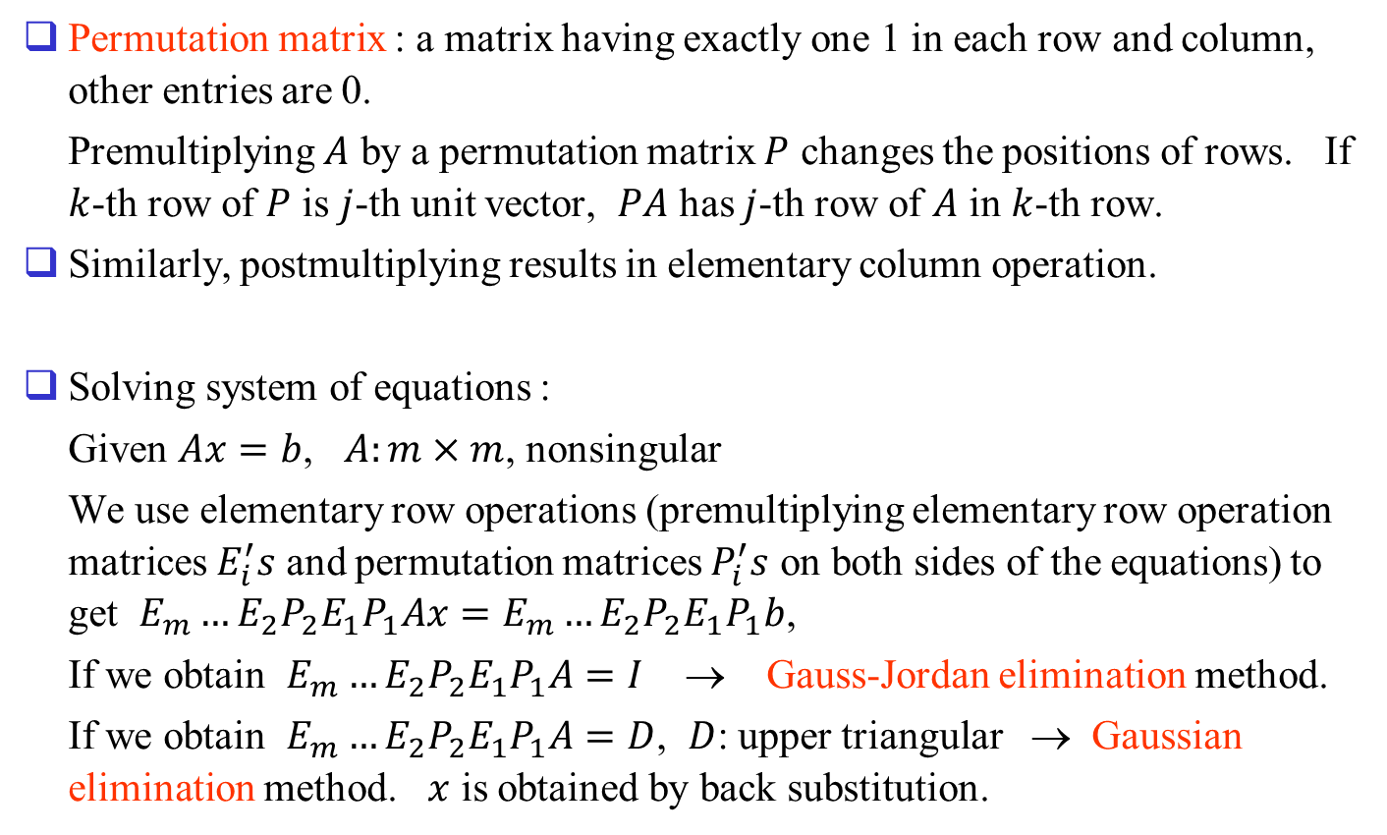
Permutation matrix : a matrix having exactly one 1 in each row and column, other entries are 0.
Premultiplying $A$ by a permutation matrix $P$ changes the positions of rows. If $k$-th row of $P$ is $j$-th unit vector, $PA$ has $j$-th row of $A$ in $k$-th row.
Similarly, postmultiplying results in elementary column operation.
Solving system of equations :
Given $Ax=b$, $A:m×m$, nonsingular
We use elementary row operations (premultiplying elementary row operation matrices $E_{i}^{′}s$ and permutation matrices $P_{i}^{′}s$ on both sides of the equations) to get $E_{m}…E_{2}P_{2}E_{1}P_{1}Ax=E_{m}…E_{2}P_{2}E_{1}P_{1}b$,
If we obtain $E_{m}…E_{2}P_{2}E_{1}P_{1}A=I$ → Gauss-Jordan elimination method.
If we obtain $E_{m}…E_{2}P_{2}E_{1}P_{1}A=D$, $D$: upper triangular → Gaussian elimination method. $x$ is obtained by back substitution.

Slide 21
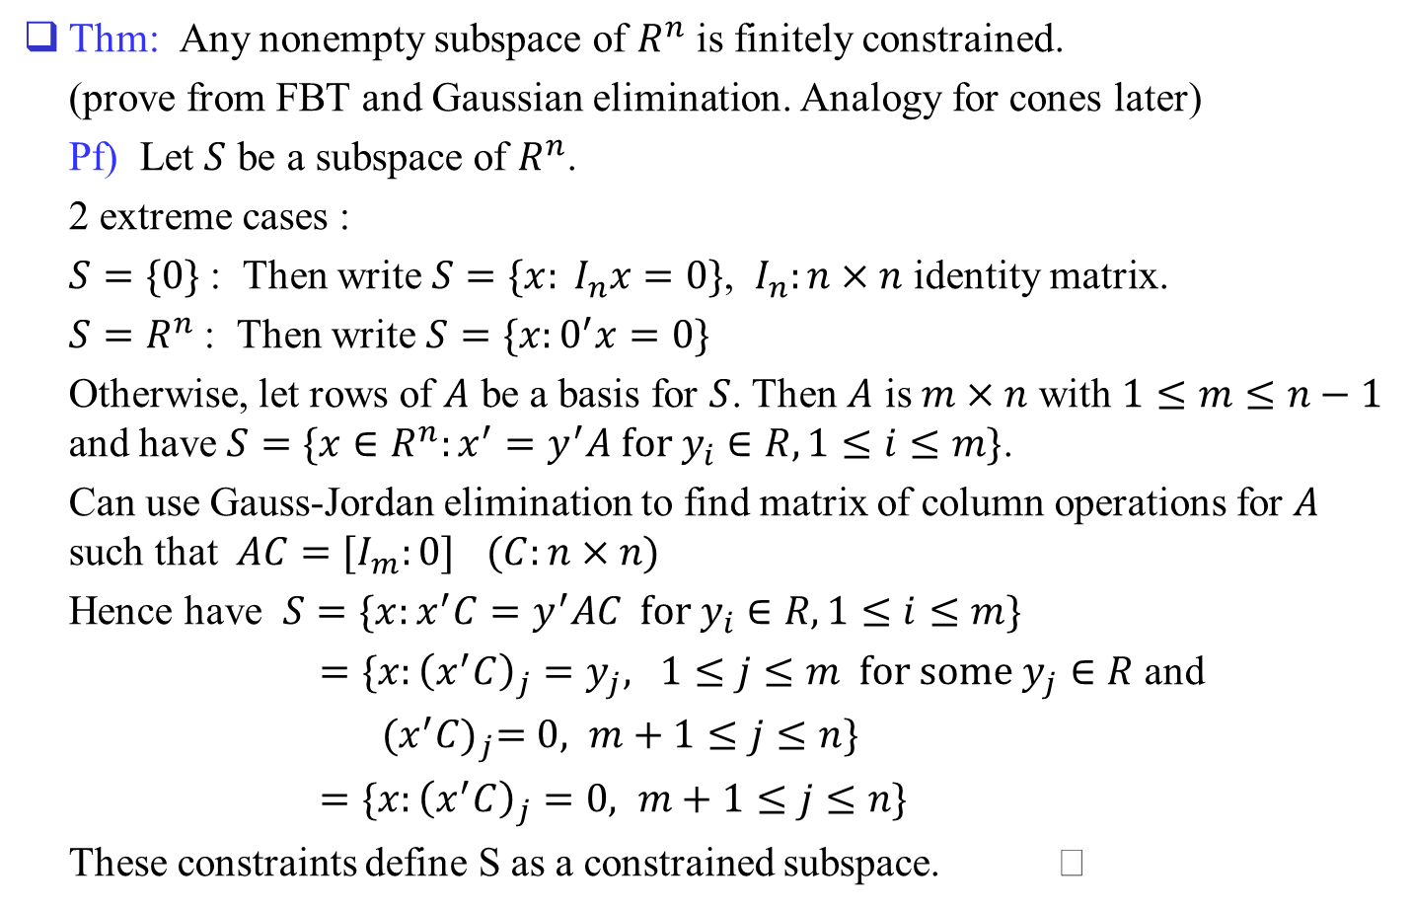
Back to subspace
Thm: Any nonempty subspace of $R^{n}$ is finitely constrained.
(prove from FBT and Gaussian elimination. Analogy for cones later)
Pf) Let $S$ be a subspace of $R^{n}$.
2 extreme cases :
$S=\{0\}$ : Then write $S=\{x: I_{n}x=0\}$, $I_{n}:n×n$ identity matrix.
$S=R^{n}$ : Then write $S=\{x:0^{′}x=0\}$
Otherwise, let rows of $A$ be a basis for $S$. Then $A$ is $m×n$ with $1≤m≤n−1$ and have $S=\{x∈R^{n}:x^{′}=y^{′}A for y_{i}∈R, 1≤i≤m\}$.
Can use Gauss-Jordan elimination to find matrix of column operations for $A$ such that $AC=[I_{m}:0]$ $(C:n×n)$
Hence have $S=\{x:x^{′}C=y^{′}AC for y_{i}∈R, 1≤i≤m\}$
$=\{x:{\left(x_{}^{′}C\right)}_{j}=y_{j}, 1≤j≤m for some y_{j}∈R$ and
${(x_{}^{′}C)}_{j}=0, m+1≤j≤n\}$
$=\{x:{\left(x_{}^{′}C\right)}_{j}=0, m+1≤j≤n\}$
These constraints define S as a constrained subspace.

Slide 22
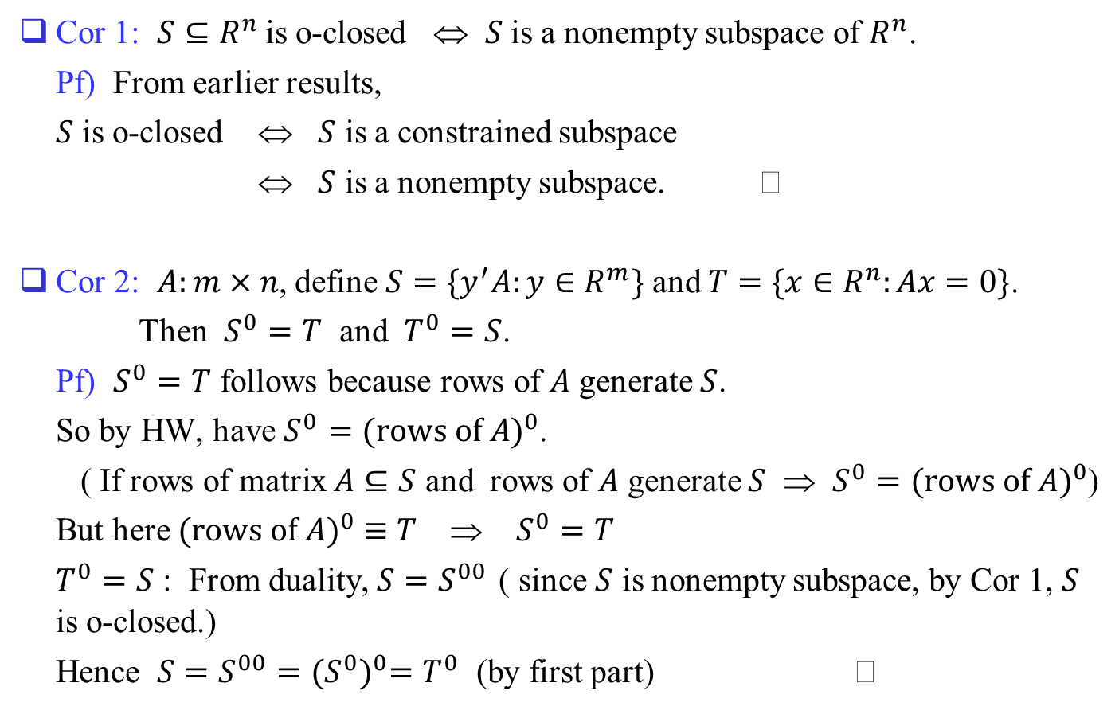
Cor 1: $S⊆R^{n}$ is o-closed ⇔ $S$ is a nonempty subspace of $R^{n}$.
Pf) From earlier results,
$S$ is o-closed ⇔ $S$ is a constrained subspace
⇔ $S$ is a nonempty subspace.
Cor 2: $A:m×n$, define $S=\{y^{′}A:y∈R^{m}\}$ and $T=\{x∈R^{n}:Ax=0\}$.
Then $S^{0}=T$ and $T^{0}=S$.
Pf) $S^{0}=T$ follows because rows of $A$ generate $S$.
So by HW, have $S^{0}={(rows of A)}^{0}$.
( If rows of matrix $A⊆S$ and rows of $A$ generate $S$ ⇒ $S^{0}={(rows of A)}^{0}$)
But here ${(rows of A)}^{0} ≡T$ ⇒ $S^{0}=T$
$T^{0}=S$ : From duality, $S=S^{00}$ ( since $S$ is nonempty subspace, by Cor 1, $S$ is o-closed.)
Hence $S=S^{00}={(S^{0})}^{0}=T^{0}$ (by first part)

Slide 23




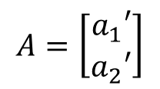
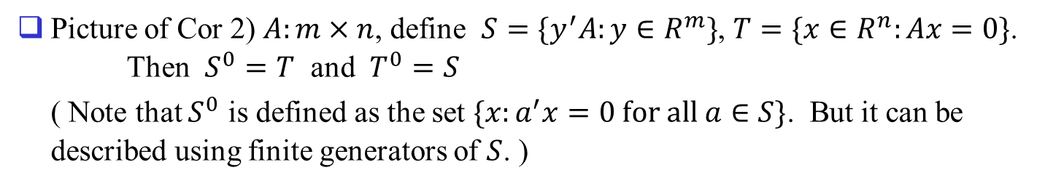
Picture of Cor 2) $A:m×n$, define $S=\{y^{′}A:y∈R^{m}\}$, $T=\{x∈R^{n}:Ax=0\}$. Then $S^{0}=T$ and $T^{0}=S$
( Note that $S^{0}$ is defined as the set $\{x:a^{′}x=0 for all a∈S\}$. But it can be described using finite generators of $S$. )
$$T=S^{0}$$
$$A=\left[\begin{matrix}a_{1}′ \\ a_{2}′\end{matrix}\right]$$
$$a_{2}$$
$$S=T^{0}$$
$$a_{1}$$

Slide 24
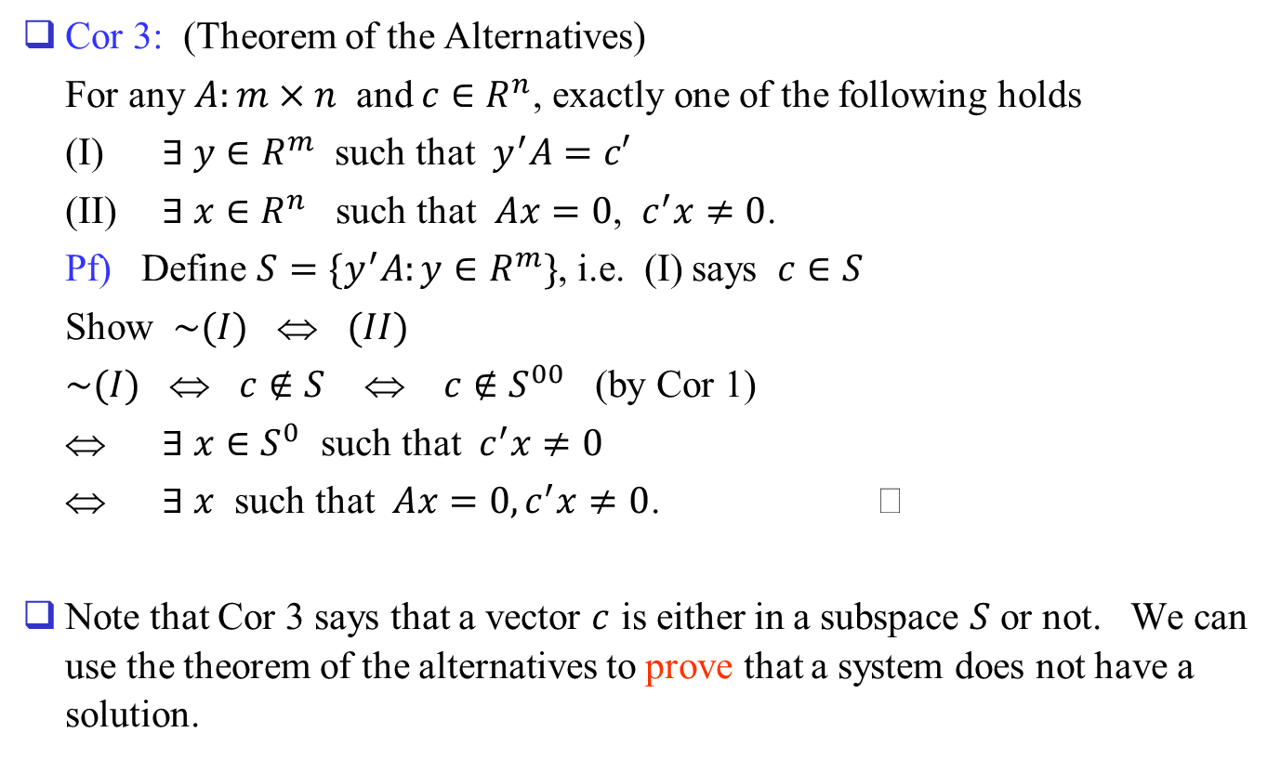
Cor 3: (Theorem of the Alternatives)
For any $A:m×n$ and $c∈R^{n}$, exactly one of the following holds
(I) $∃ y∈R^{m}$ such that $y^{′}A=c′$
(II) $∃ x∈R^{n}$ such that $Ax=0$, $c^{′}x≠0$.
Pf) Define $S=\{y^{′}A:y∈R^{m}\}$, i.e. (I) says $c∈S$
Show $\sim (I)$ ⇔ $(II)$
$\sim (I)$ ⇔ $c∉S$ ⇔ $c∉S^{00}$ (by Cor 1)
⇔ $∃ x∈S^{0}$ such that $c^{′}x≠0$
⇔ $∃ x$ such that $Ax=0, c^{′}x≠0$.
Note that Cor 3 says that a vector $c$ is either in a subspace $S$ or not. We can use the theorem of the alternatives to prove that a system does not have a solution.

Slide 25
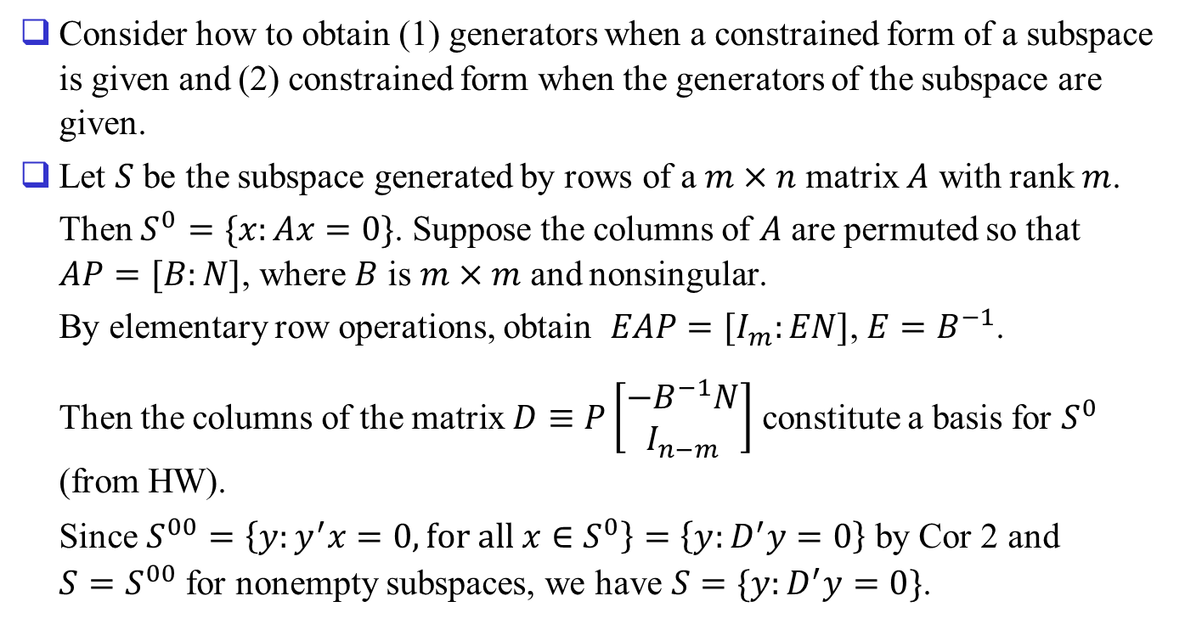
Remarks
Consider how to obtain (1) generators when a constrained form of a subspace is given and (2) constrained form when the generators of the subspace are given.
Let $S$ be the subspace generated by rows of a $m×n$ matrix $A$ with rank $m$.
Then $S^{0}=\{x:Ax=0\}$. Suppose the columns of $A$ are permuted so that $AP=[B:N]$, where $B$ is $m×m$ and nonsingular.
By elementary row operations, obtain $EAP=[I_{m}:EN]$, $E=B^{−1}$.
Then the columns of the matrix $D≡P\left[\begin{matrix}−B^{−1}N \\ I_{n−m}\end{matrix}\right]$ constitute a basis for $S^{0}$ (from HW).
Since $S^{00}=\left\{y:y^{′}x=0, for all x∈S^{0}\right\}=\left\{y:D^{′}y=0\right\}$ by Cor 2 and $S=S^{00}$ for nonempty subspaces, we have $S=\{y:D^{′}y=0\}$.

Slide 26
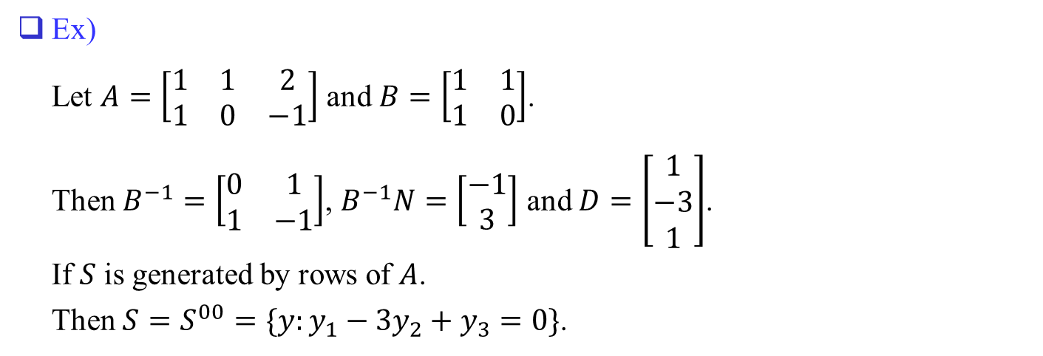
Ex)
Let $A=\left[\begin{matrix}1 & 1 & 2 \\ 1 & 0 & −1\end{matrix}\right]$ and $B=\left[\begin{matrix}1 & 1 \\ 1 & 0\end{matrix}\right]$.
Then $B^{−1}=\left[\begin{matrix}0 & 1 \\ 1 & −1\end{matrix}\right]$, $B^{−1}N=\left[\begin{matrix}−1 \\ 3\end{matrix}\right]$ and $D=\left[\begin{matrix}1 \\ −3 \\ 1\end{matrix}\right]$.
If $S$ is generated by rows of $A$.
Then $S=S^{00}=\{y:y_{1}−3y_{2}+y_{3}=0\}$.

Slide 27
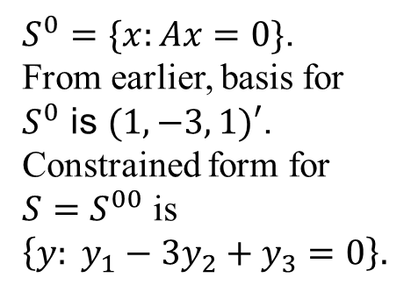




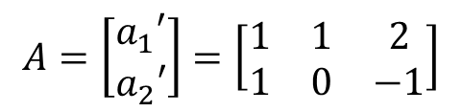
Obtaining constrained form from generators
$$T=S^{0}$$
$$A=\left[\begin{matrix}a_{1}′ \\ a_{2}′\end{matrix}\right]=\left[\begin{matrix}1 & 1 & 2 \\ 1 & 0 & −1\end{matrix}\right]$$
(1, -3, 1)
$$a_{2}$$
$S^{0}=\{x:Ax=0\}$.
From earlier, basis for $S^{0}$ is $(1, −3, 1)′$.
Constrained form for $S=S^{00}$ is $\left\{y: y_{1}−3y_{2}+y_{3}=0\right\}.$
$$S=S^{00}$$
0
$$a_{1}$$

Slide 28
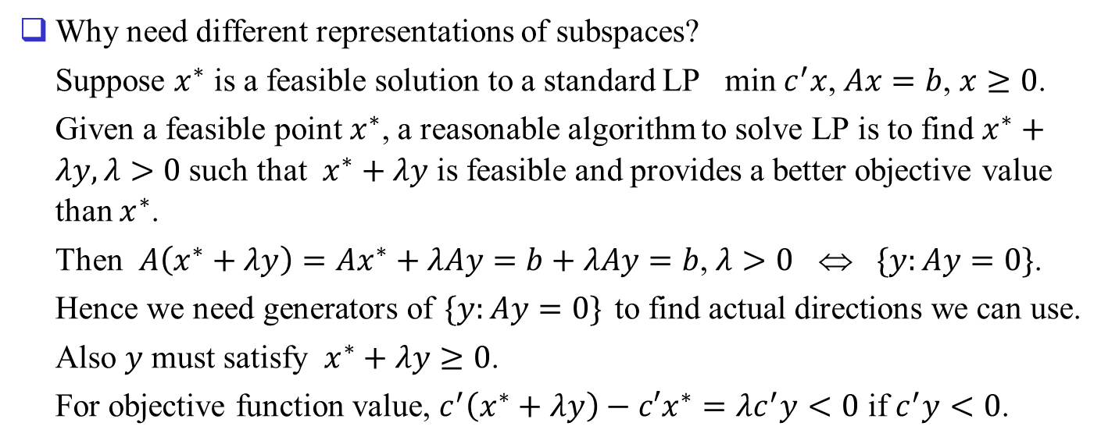
Remarks
Why need different representations of subspaces?
Suppose $x^{∗}$ is a feasible solution to a standard LP min $c^{′}x$, $Ax=b$, $x≥0$.
Given a feasible point $x^{∗}$, a reasonable algorithm to solve LP is to find $x^{∗}+λy,λ>0$ such that $x^{∗}+λy$ is feasible and provides a better objective value than $x^{∗}$.
Then $A\left(x^{∗}+λy\right)=Ax^{∗}+λAy=b+λAy=b$, $λ>0$ ⇔ $\{y:Ay=0\}$.
Hence we need generators of $\{y:Ay=0\}$ to find actual directions we can use.
Also $y$ must satisfy $x^{∗}+λy≥0$.
For objective function value, $c^{′}\left(x^{∗}+λy\right)−c′x^{∗}=λc^{′}y<0$ if $c^{′}y<0$.

