Slide 1
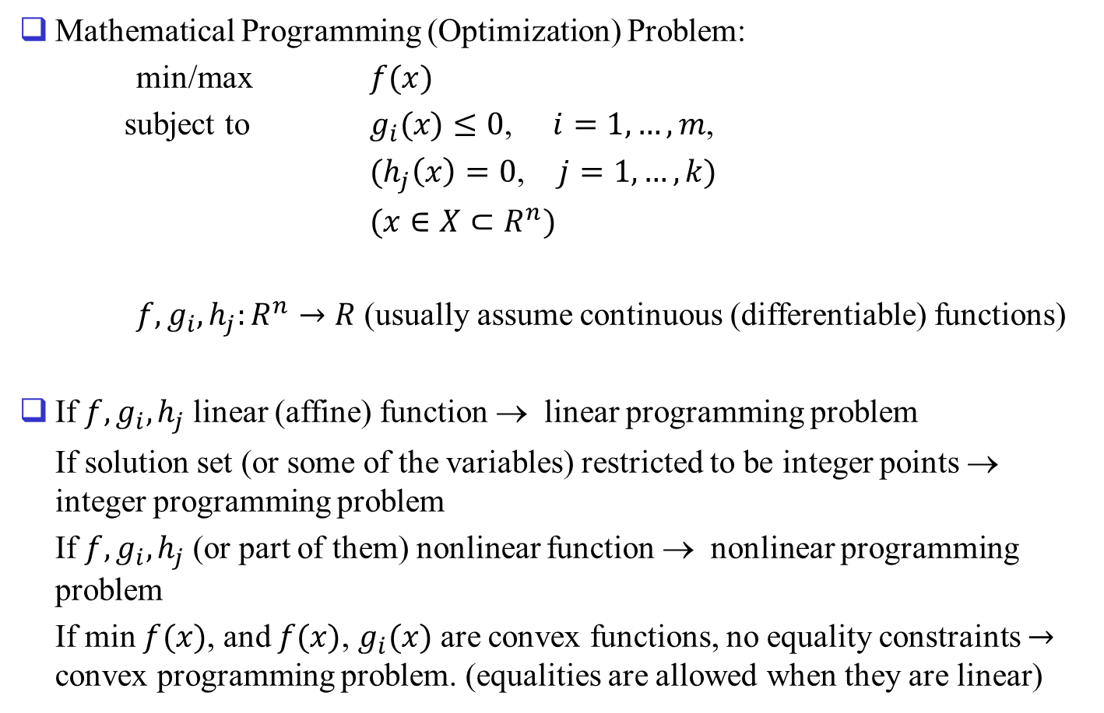
Chapter 1. Introduction
Mathematical Programming (Optimization) Problem:
min/max $f(x)$
subject to $g_{i}(x)≤0$, $i=1,…,m$,
$(h_{j}\left(x\right)=0$, $j=1,…,k)$
$(x∈X⊂R^{n})$
$f,g_{i},h_{j}:R^{n}→R$ (usually assume continuous (differentiable) functions)
If $f,g_{i},h_{j}$ linear (affine) function → linear programming problem
If solution set (or some of the variables) restricted to be integer points → integer programming problem
If $f,g_{i},h_{j}$ (or part of them) nonlinear function → nonlinear programming problem
If min $f(x)$, and $f(x)$, $g_{i}(x)$ are convex functions, no equality constraints $→$ convex programming problem. (equalities are allowed when they are linear)

Slide 2
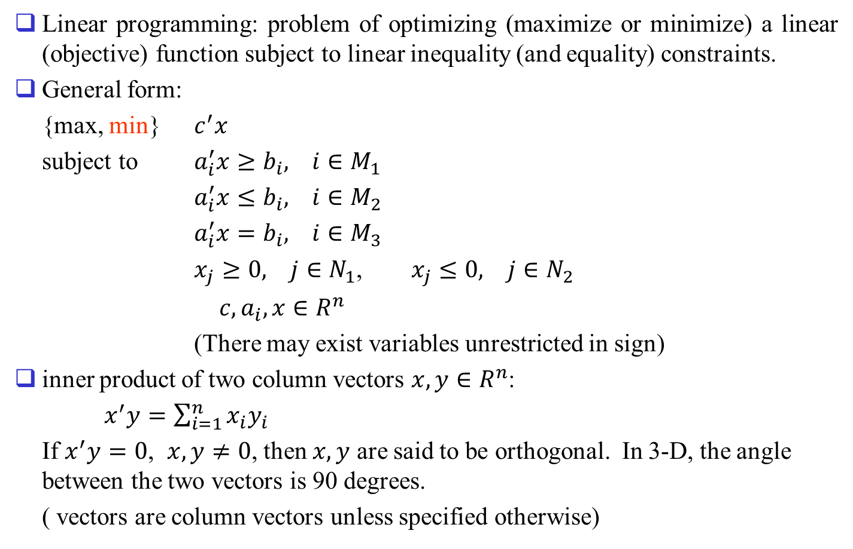
Linear programming: problem of optimizing (maximize or minimize) a linear (objective) function subject to linear inequality (and equality) constraints.
General form:
{max, min} $c^{′}x$
subject to $a_{i}^{′}x≥b_{i}, i∈M_{1}$
$a_{i}^{′}x≤b_{i}, i∈M_{2}$
$a_{i}^{′}x=b_{i}, i∈M_{3}$
$x_{j}≥0, j∈N_{1}$, $x_{j}≤0, j∈N_{2}$
$c,a_{i},x∈R^{n}$
(There may exist variables unrestricted in sign)
inner product of two column vectors $x,y∈R^{n}$:
$x^{′}y=\sum_{i=1}^{n}{x_{i}y_{i}}$
If $x^{′}y=0$, $x,y≠0$, then $x,y$ are said to be orthogonal. In 3-D, the angle between the two vectors is 90 degrees.
( vectors are column vectors unless specified otherwise)

Slide 3
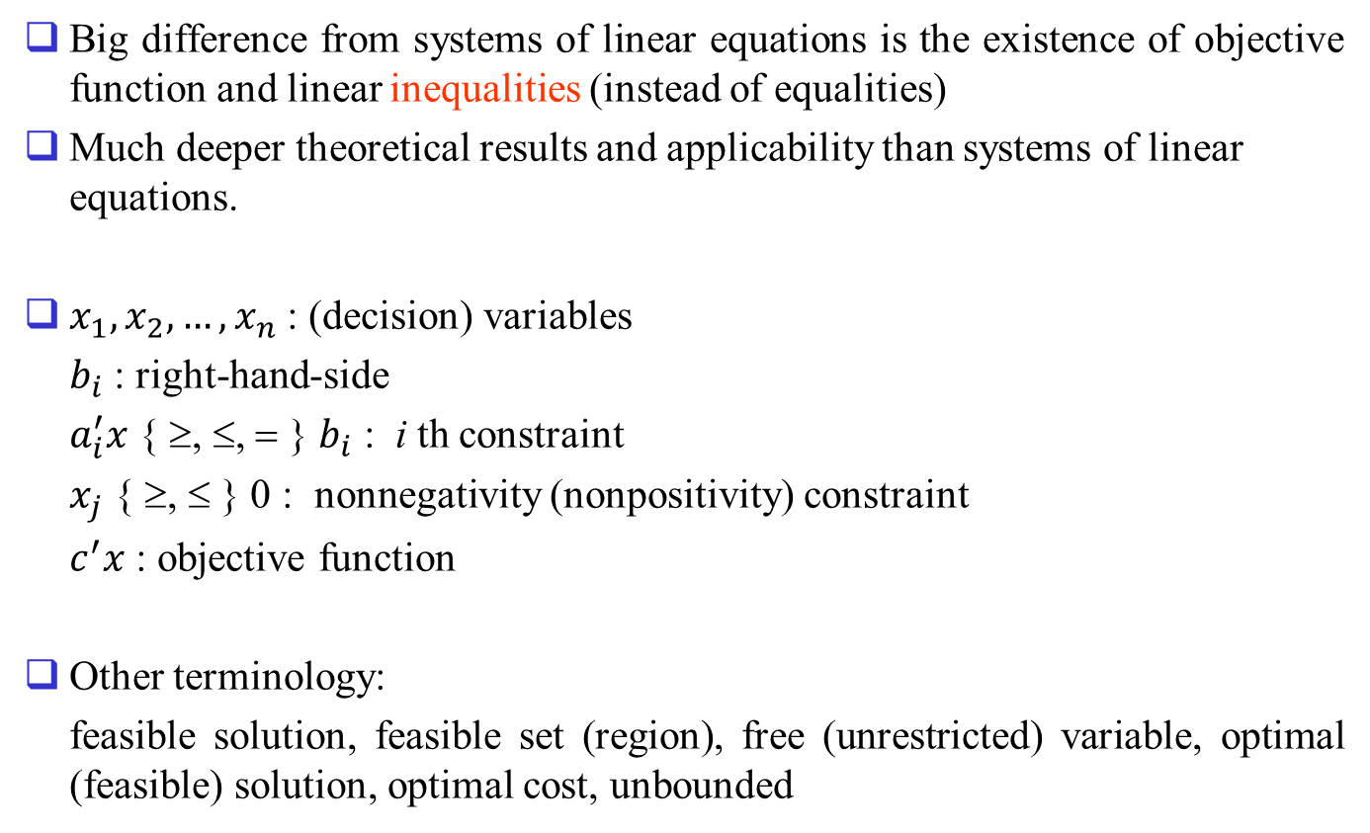
Big difference from systems of linear equations is the existence of objective function and linear inequalities (instead of equalities)
Much deeper theoretical results and applicability than systems of linear equations.
$x_{1},x_{2},…,x_{n}$ : (decision) variables
$b_{i}$ : right-hand-side
$a_{i}^{′}x$ { ≥, ≤, = } $b_{i}$ : i th constraint
$x_{j}$ { ≥, ≤ } 0 : nonnegativity (nonpositivity) constraint
$c^{′}x$ : objective function
Other terminology:
feasible solution, feasible set (region), free (unrestricted) variable, optimal (feasible) solution, optimal cost, unbounded

Slide 4

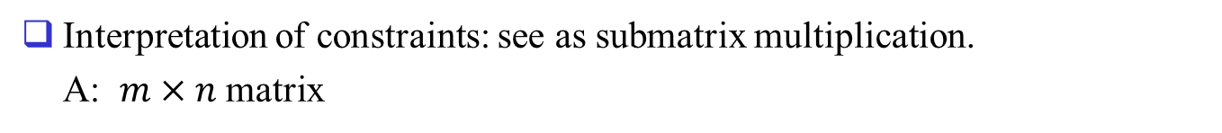
Important submatrix multiplications
Interpretation of constraints: see as submatrix multiplication.
A: $m×n$ matrix
, where $e_{i}$ is i-th unit vector
denote constraints as $Ax$ { ≥, ≤, = } $b$

Slide 5
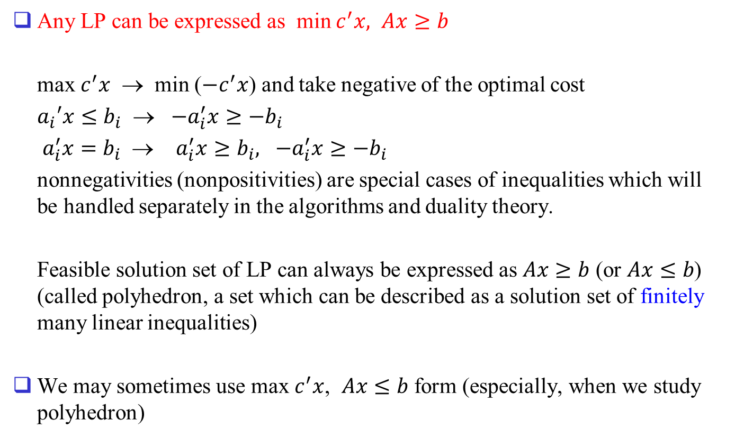
Any LP can be expressed as min $c^{′}x, Ax≥b$
max $c^{′}x$ → min ($−c^{′}x$) and take negative of the optimal cost
$a_{i}′x≤b_{i}$ → ${−a}_{i}^{′}x≥−b_{i}$
$a_{i}^{′}x=b_{i}$ → $a_{i}^{′}x≥b_{i}, {−a}_{i}^{′}x≥−b_{i}$
nonnegativities (nonpositivities) are special cases of inequalities which will be handled separately in the algorithms and duality theory.
Feasible solution set of LP can always be expressed as $Ax≥b$ (or $Ax≤b$) (called polyhedron, a set which can be described as a solution set of finitely many linear inequalities)
We may sometimes use max $c^{′}x$, $Ax≤b$ form (especially, when we study polyhedron)

Slide 6
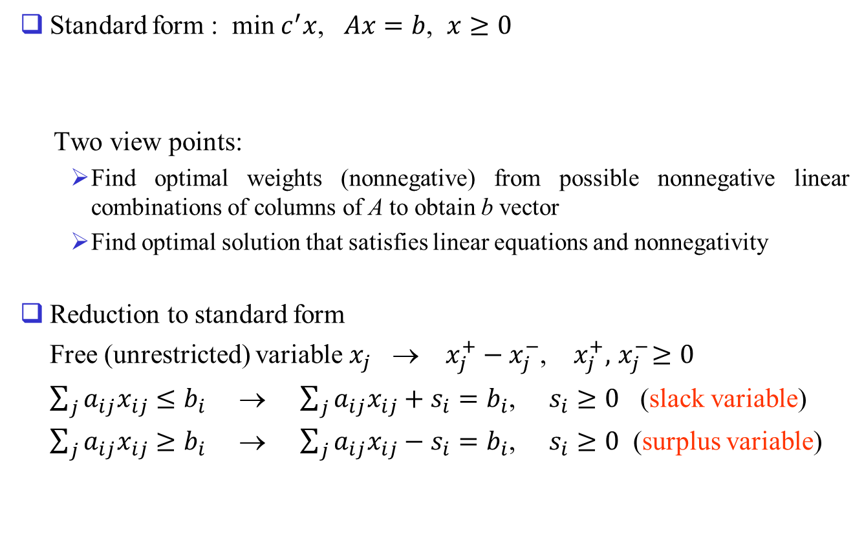
Standard form problems
Standard form : min $c^{′}x$, $Ax=b$, $x≥0$
Two view points:
  Find optimal weights (nonnegative) from possible nonnegative linear combinations of columns of A to obtain b vector
  Find optimal solution that satisfies linear equations and nonnegativity
Reduction to standard form
Free (unrestricted) variable $x_{j}$ → $x_{j}^{+}−x_{j}^{−}$, $x_{j}^{+},{ x}_{j}^{−}≥0$
$\sum_{j}{a_{ij}x_{ij}}≤b_{i}$ → $\sum_{j}{a_{ij}x_{ij}}+s_{i}=b_{i}$, $s_{i}≥0$ (slack variable)
$\sum_{j}{a_{ij}x_{ij}}≥b_{i}$ → $\sum_{j}{a_{ij}x_{ij}}−s_{i}=b_{i}$, $s_{i}≥0$ (surplus variable)

Slide 7
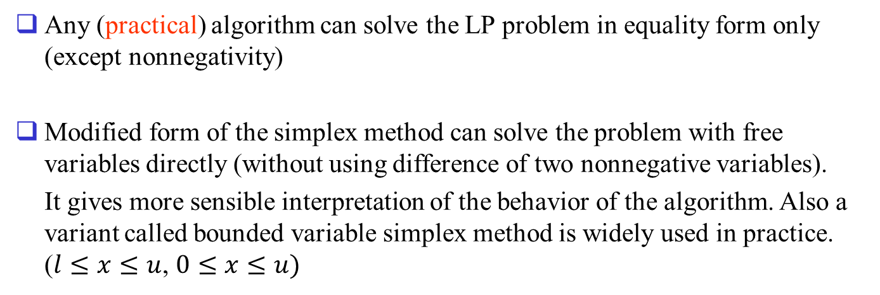
Any (practical) algorithm can solve the LP problem in equality form only (except nonnegativity)
Modified form of the simplex method can solve the problem with free variables directly (without using difference of two nonnegative variables).
It gives more sensible interpretation of the behavior of the algorithm. Also a variant called bounded variable simplex method is widely used in practice. ($l≤x≤u$, $0≤x≤u)$

Slide 8
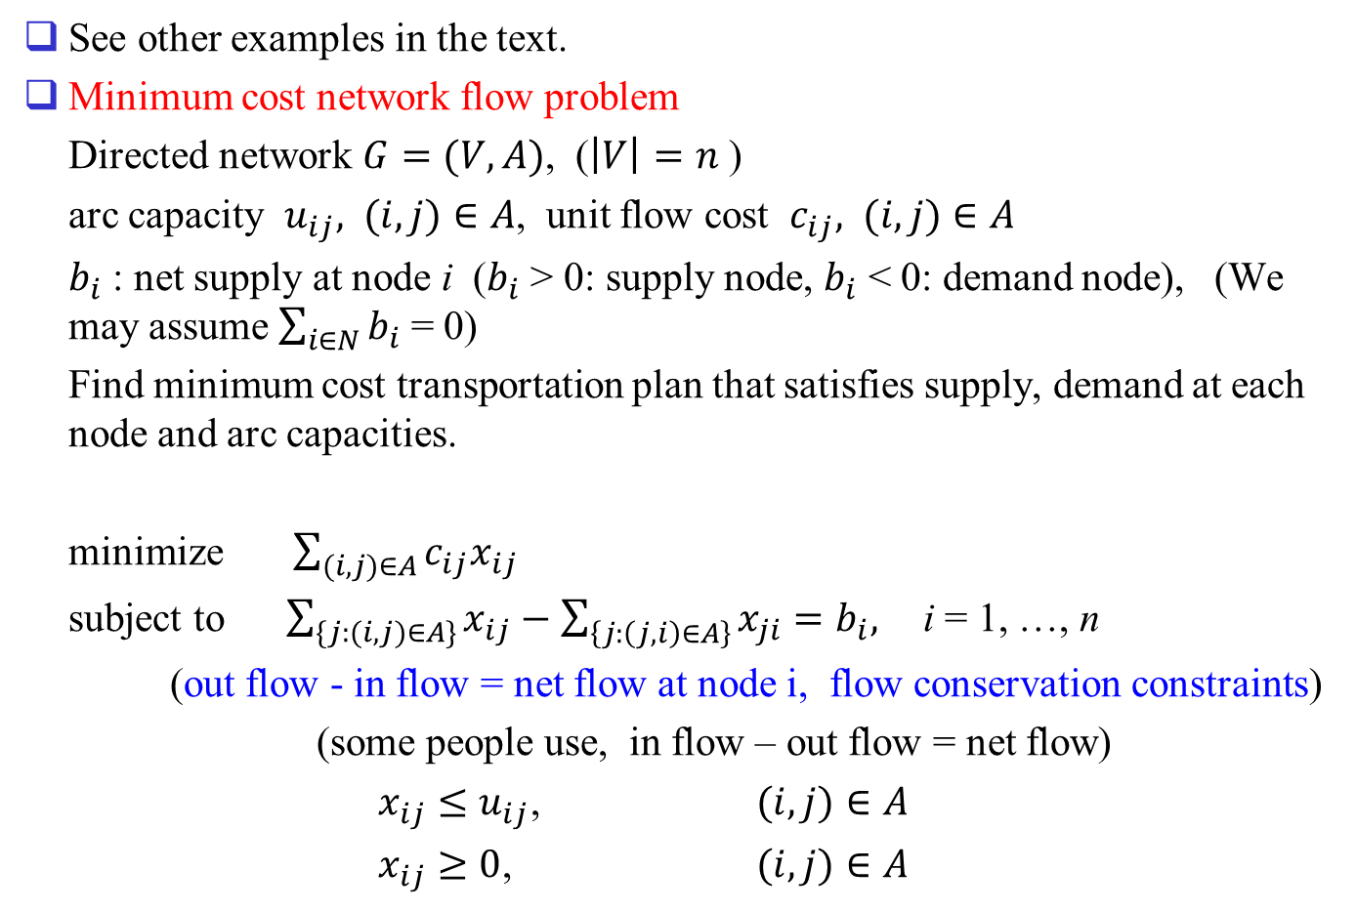
1.2 Formulation examples
See other examples in the text.
Minimum cost network flow problem
Directed network $G=(V,A)$, ($\left|V\right|=n$ )
arc capacity $u_{ij}, (i,j)∈A$, unit flow cost $c_{ij}, (i,j)∈A$
$b_{i}$ : net supply at node i ($b_{i}$ > 0: supply node, $b_{i}$ < 0: demand node), (We may assume $\sum_{i∈N}{b_{i}}$ = 0)
Find minimum cost transportation plan that satisfies supply, demand at each node and arc capacities.
minimize $\sum_{(i,j)∈A}{c_{ij}x_{ij}}$
subject to $\sum_{\{j:(i,j)∈A\}}{x_{ij}}−\sum_{\left\{j:\left(j,i\right)∈A\right\}}{x_{ji}}=b_{i},$ i = 1, …, n
(out flow - in flow = net flow at node i, flow conservation constraints)
(some people use, in flow – out flow = net flow)
$x_{ij}≤u_{ij}$, $(i,j)∈A$
$x_{ij}≥0$, $(i,j)∈A$

Slide 9
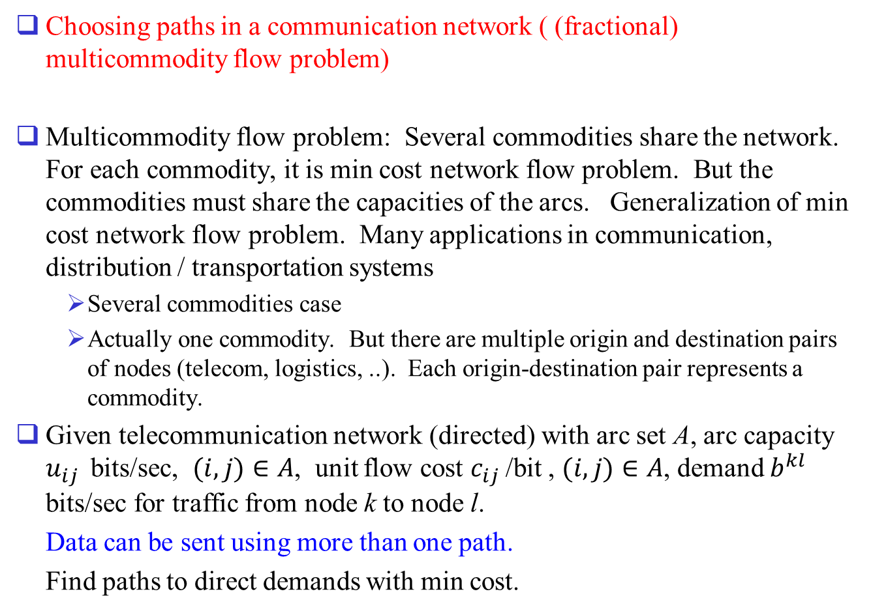
Choosing paths in a communication network ( (fractional) multicommodity flow problem)
Multicommodity flow problem: Several commodities share the network. For each commodity, it is min cost network flow problem. But the commodities must share the capacities of the arcs. Generalization of min cost network flow problem. Many applications in communication, distribution / transportation systems
  Several commodities case
  Actually one commodity. But there are multiple origin and destination pairs of nodes (telecom, logistics, ..). Each origin-destination pair represents a commodity.
Given telecommunication network (directed) with arc set A, arc capacity $u_{ij}$ bits/sec, $(i,j)∈A$, unit flow cost $c_{ij}$ /bit , $(i,j)∈A$, demand $b^{kl}$ bits/sec for traffic from node k to node l.
Data can be sent using more than one path.
Find paths to direct demands with min cost.

Slide 10
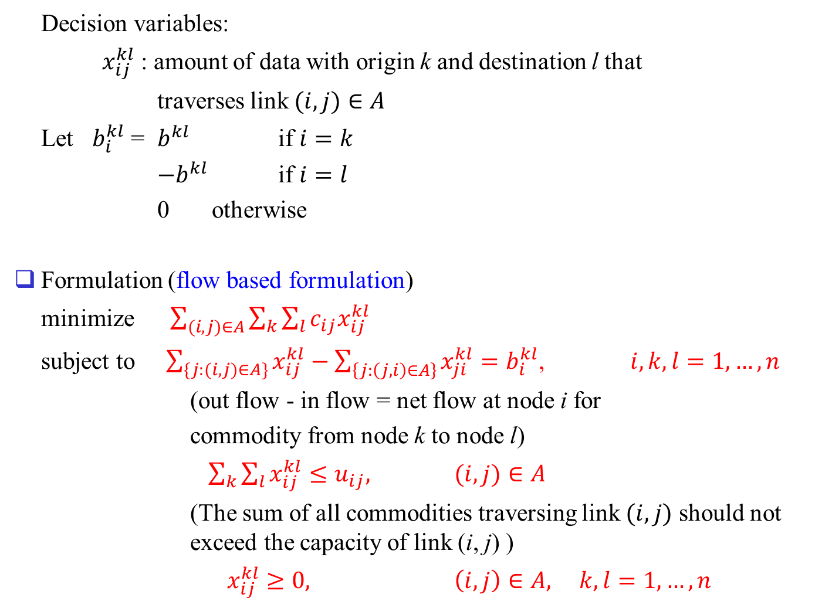
Decision variables:
$x_{ij}^{kl}$ : amount of data with origin k and destination l that
traverses link $(i,j)∈A$
Let $b_{i}^{kl}$ = $b^{kl}$ if $i=k$
$−b^{kl}$ if $i=l$
0 otherwise
Formulation (flow based formulation)
minimize $\sum_{(i,j)∈A}{\sum_{k}{\sum_{l}{c_{ij}x_{ij}^{kl}}}}$
subject to $\sum_{\{j:(i,j)∈A\}}{x_{ij}^{kl}}−\sum_{\left\{j:\left(j,i\right)∈A\right\}}{x_{ji}^{kl}}=b_{i}^{kl}$, $i,k,l=1,…,n$
(out flow - in flow = net flow at node i for
commodity from node k to node l)
$\sum_{k}{\sum_{l}{x_{ij}^{kl}}}≤u_{ij},$ $(i,j)∈A$
(The sum of all commodities traversing link $(i,j)$ should not exceed the capacity of link (i, j) )
$x_{ij}^{kl}≥0,$ $\left(i,j\right)∈A, k,l=1,…,n$

Slide 11
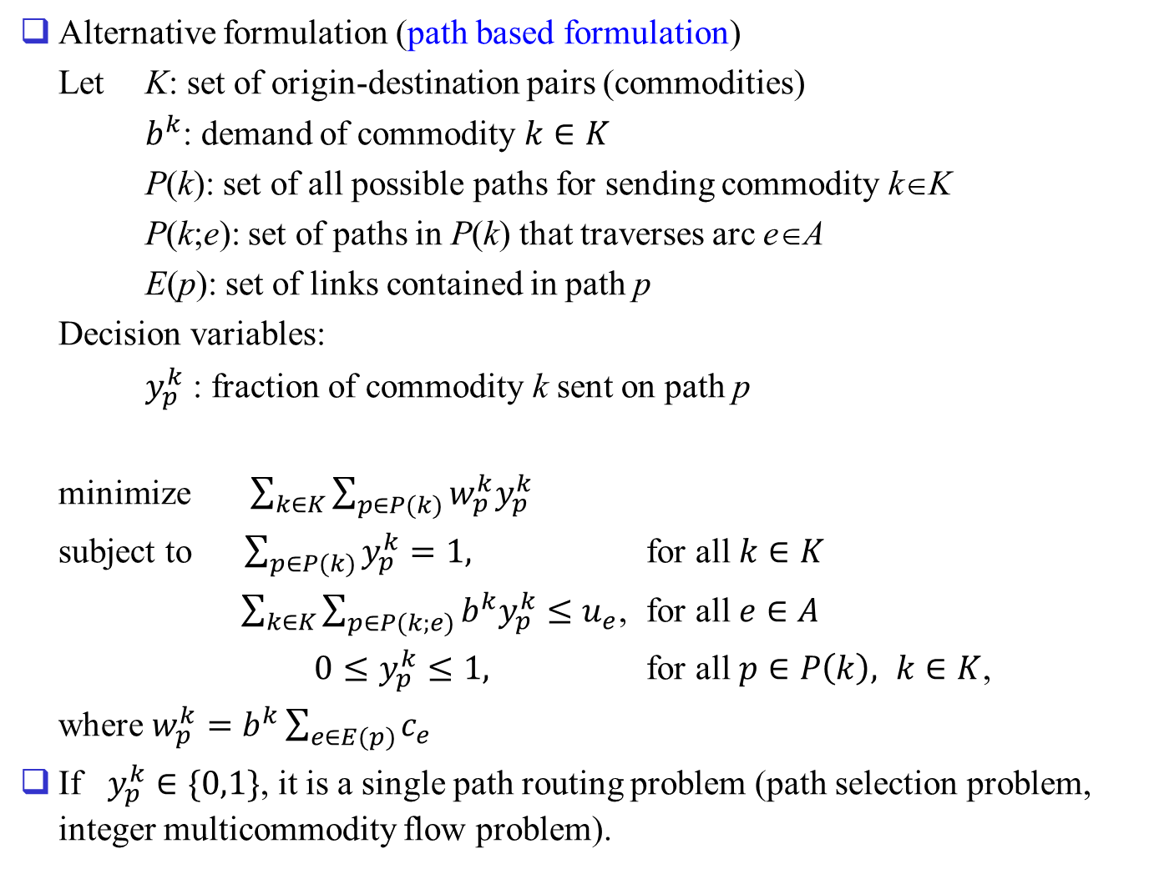
Alternative formulation (path based formulation)
Let K: set of origin-destination pairs (commodities)
$b^{k}$: demand of commodity $k∈K$
P(k): set of all possible paths for sending commodity k∈K
P(k;e): set of paths in P(k) that traverses arc e∈A
E(p): set of links contained in path p
Decision variables:
$y_{p}^{k}$ : fraction of commodity k sent on path p
minimize $\sum_{k∈K}{\sum_{p∈P(k)}{w_{p}^{k}y_{p}^{k}}}$
subject to $\sum_{p∈P(k)}{y_{p}^{k}=1,}$ for all $k∈K$
$\sum_{k∈K}{\sum_{p∈P(k;e)}{b^{k}y_{p}^{k}}}≤u_{e}$, for all $e∈A$
$0≤y_{p}^{k}≤1,$ for all $p∈P\left(k\right), k∈K$,
where $w_{p}^{k}=b^{k}\sum_{e∈E(p)}{c_{e}}$
If $y_{p}^{k}∈\{0,1\}$, it is a single path routing problem (path selection problem, integer multicommodity flow problem).

Slide 12
path based formulation has smaller number of constraints, but enormous number of variables.
can be solved easily by column generation technique (later).
Integer version is more difficult to solve.
Extensions: Network design - also determine the number and type of facilities to be installed on the links (and/or nodes) together with routing of traffic.
Variations: Integer flow. Bifurcation of traffic may not be allowed. Determine capacities and routing considering rerouting of traffic in case of network failure, Robust network design (data uncertainty), ...

Slide 13
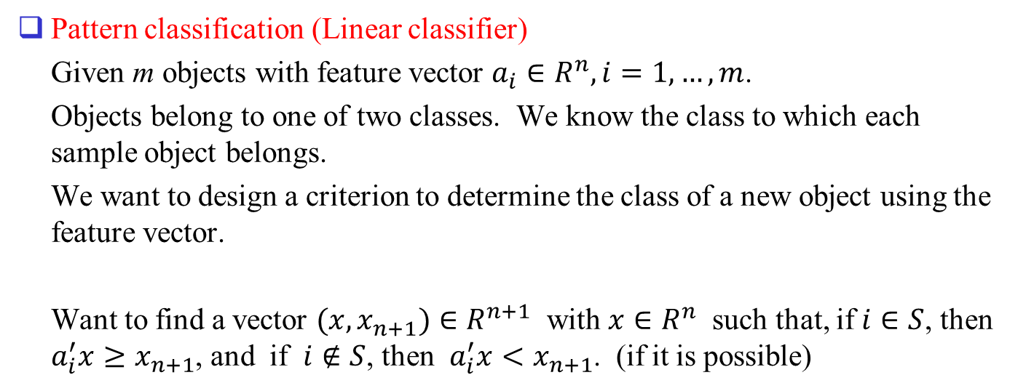
Pattern classification (Linear classifier)
Given m objects with feature vector $a_{i}∈R^{n}, i=1,…,m$.
Objects belong to one of two classes. We know the class to which each sample object belongs.
We want to design a criterion to determine the class of a new object using the feature vector.
Want to find a vector $(x,x_{n+1})∈R^{n+1}$ with $x∈R^{n}$ such that, if $i∈S$, then $a_{i}^{′}x≥x_{n+1}$, and if $i∉S$, then $a_{i}^{′}x<x_{n+1}$. (if it is possible)

Slide 14
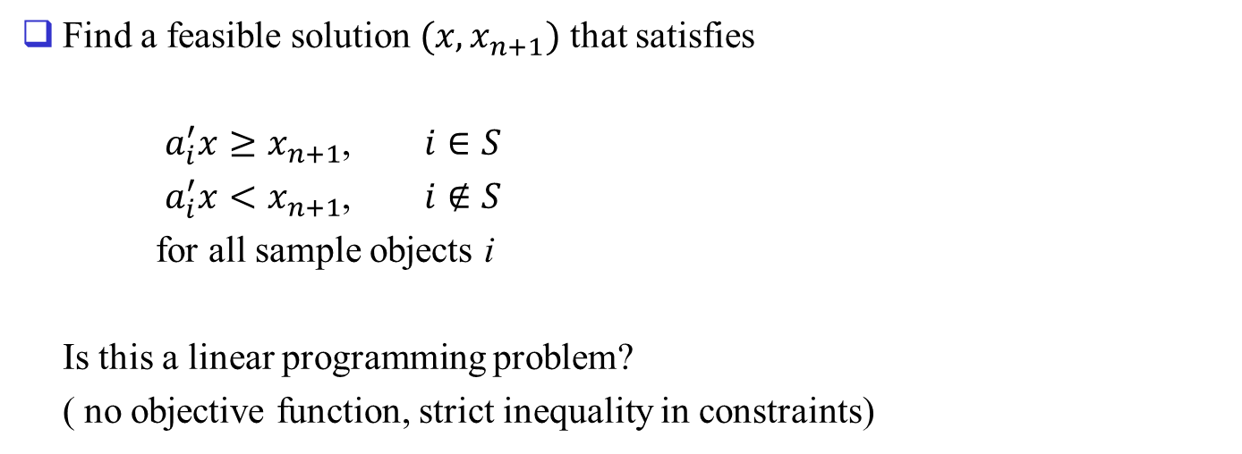
Find a feasible solution $(x,x_{n+1})$ that satisfies
$a_{i}^{′}x≥x_{n+1}$, $i∈S$
$a_{i}^{′}x<x_{n+1}$, $i∉S$
for all sample objects i
Is this a linear programming problem?
( no objective function, strict inequality in constraints)

Slide 15
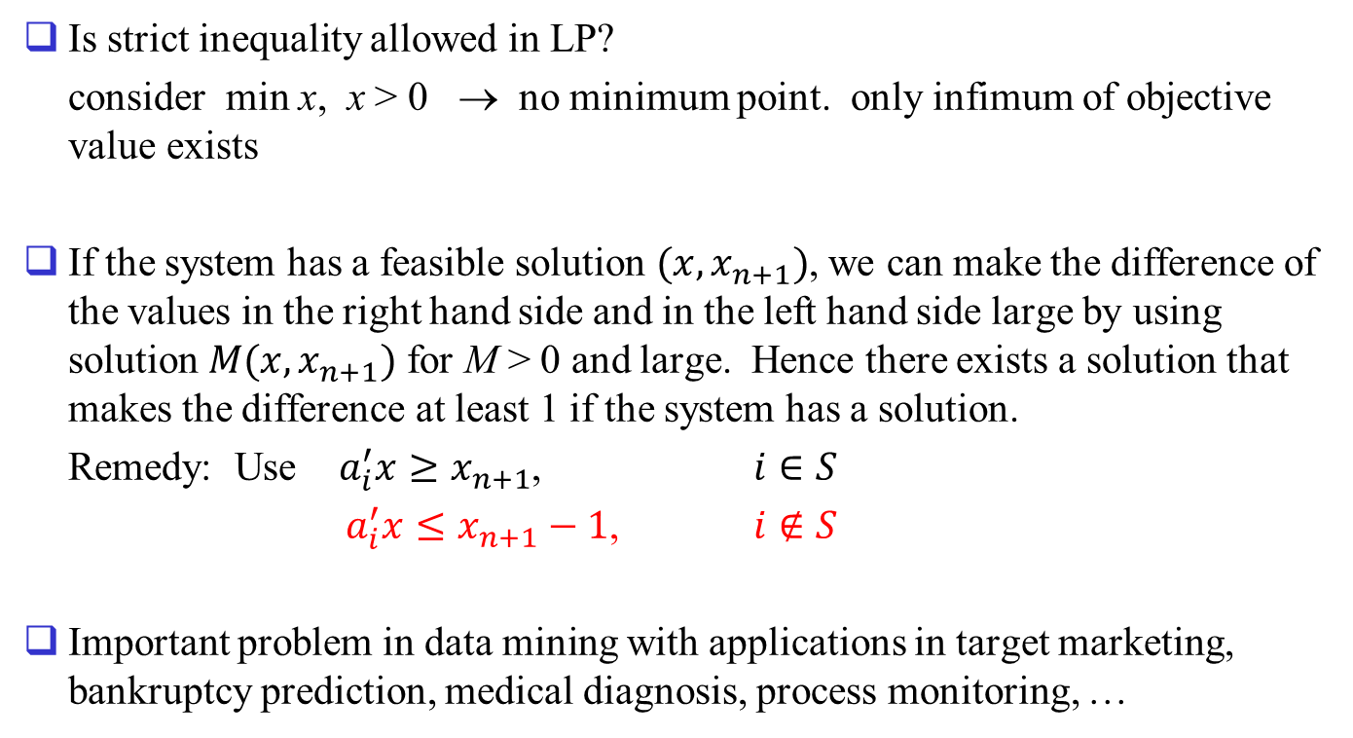
Is strict inequality allowed in LP?
consider min x, x > 0 → no minimum point. only infimum of objective value exists
If the system has a feasible solution $(x,x_{n+1})$, we can make the difference of the values in the right hand side and in the left hand side large by using solution $M(x,x_{n+1})$ for M > 0 and large. Hence there exists a solution that makes the difference at least 1 if the system has a solution.
Remedy: Use $a_{i}^{′}x≥x_{n+1}$, $i∈S$
$a_{i}^{′}x≤x_{n+1}−1$, $i∉S$
Important problem in data mining with applications in target marketing, bankruptcy prediction, medical diagnosis, process monitoring, …

Slide 16
Variations
  What if there are many choices of hyperplanes? any reasonable criteria?
  What if there is no hyperplane separating the two classes?
  Do we have to use only one hyperplane?
  Use of nonlinear function possible? How to solve them?
    SVM (support vector machine), convex optimization
  More than two classes?

Slide 17
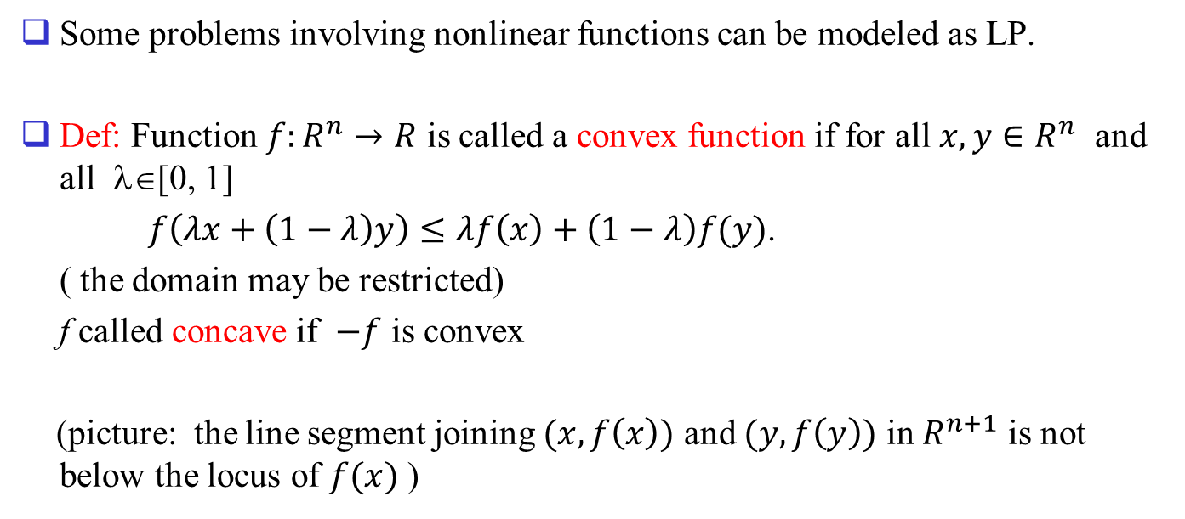
1.3 Piecewise linear convex objective functions
Some problems involving nonlinear functions can be modeled as LP.
Def: Function $f:R^{n}→R$ is called a convex function if for all $x,y∈R^{n}$ and all λ∈[0, 1]
$f\left(λx+\left(1−λ\right)y\right)≤λf\left(x\right)+\left(1−λ\right)f(y)$.
( the domain may be restricted)
f called concave if $−f$ is convex
(picture: the line segment joining $(x,f\left(x\right))$ and $(y,f\left(y\right))$ in $R^{n+1}$ is not below the locus of $f(x)$ )

Slide 18
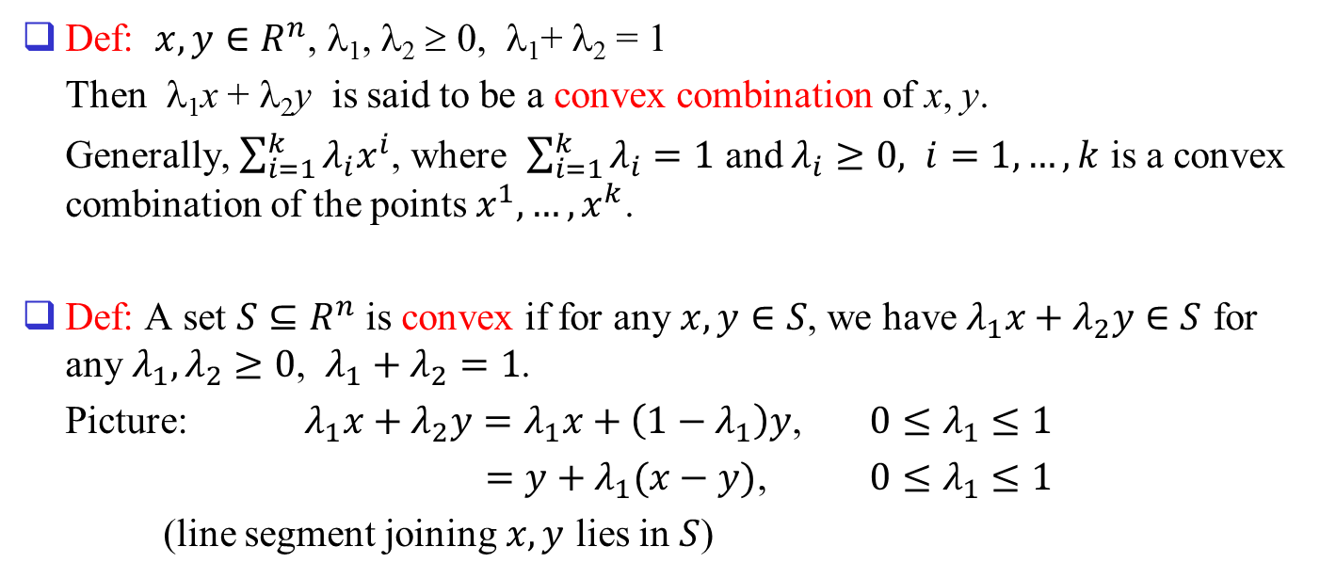


Def: $x,y∈R^{n}$, λ₁, λ₂ ≥ 0, λ₁+ λ₂ = 1
Then λ₁x + λ₂y is said to be a convex combination of x, y.
Generally, $\sum_{i=1}^{k}{λ_{i}x^{i}}$, where $\sum_{i=1}^{k}{λ_{i}}=1$ and $λ_{i}≥0, i=1,…,k$ is a convex combination of the points $x^{1},…,x^{k}$.
Def: A set $S⊆R^{n}$ is convex if for any $x,y∈S$, we have $λ_{1}x+λ_{2}y∈S$ for any $λ_{1},λ_{2}≥0$, $λ_{1}+λ_{2}=1$.
Picture: $λ_{1}x+λ_{2}y=λ_{1}x+\left(1−λ_{1}\right)y$, $0≤λ_{1}≤1$
$=y+λ_{1}(x−y)$, $0≤λ_{1}≤1$
(line segment joining $x,y$ lies in $S$)
x (λ₁ = 1)
$$(x−y)$$
y (λ₁ = 0)
$$(x−y)$$

Slide 19
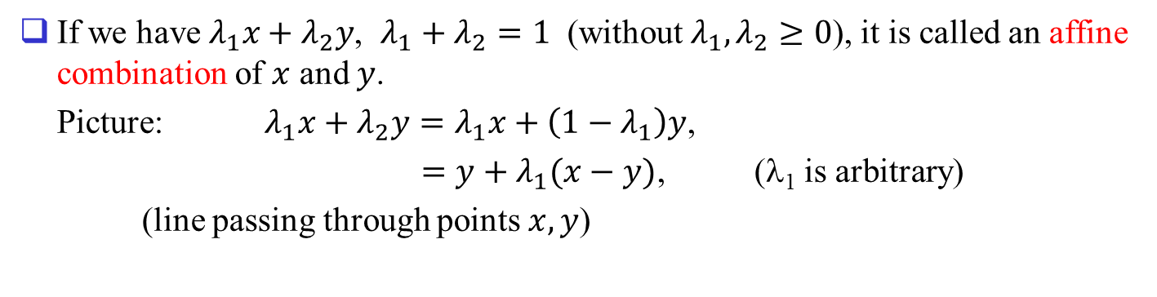
If we have $λ_{1}x+λ_{2}y$, $λ_{1}+λ_{2}=1$ (without $λ_{1}, λ_{2}≥0$), it is called an affine combination of $x$ and $y$.
Picture: $λ_{1}x+λ_{2}y=λ_{1}x+\left(1−λ_{1}\right)y$,
$=y+λ_{1}(x−y)$, (λ₁ is arbitrary)
(line passing through points $x,y$)

Slide 20
Picture of convex function

Slide 21
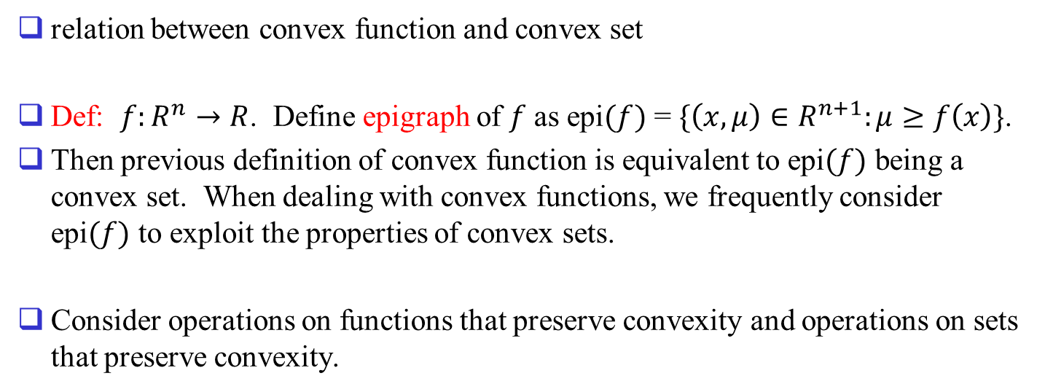
relation between convex function and convex set
Def: $f:R^{n}→R$. Define epigraph of $f$ as epi$(f)$ = $\{\left(x,μ\right)∈R^{n+1}:μ≥f\left(x\right)\}$.
Then previous definition of convex function is equivalent to epi$(f)$ being a convex set. When dealing with convex functions, we frequently consider epi$(f)$ to exploit the properties of convex sets.
Consider operations on functions that preserve convexity and operations on sets that preserve convexity.

Slide 22



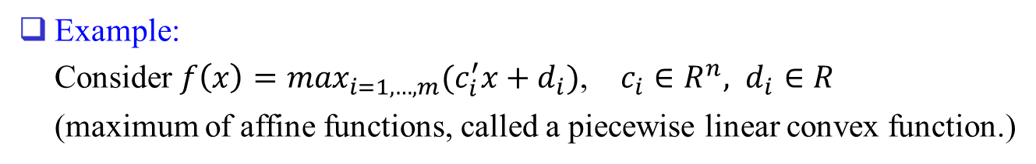

Example:
Consider $f\left(x\right)=\max_{i=1,…,m}(c_{i}^{′}x+d_{i})$, $c_{i}∈R^{n}, d_{i}∈R$
(maximum of affine functions, called a piecewise linear convex function.)
$$c_{1}^{′}x+d_{1}$$
$$c_{2}^{′}x+d_{2}$$
$$c_{3}^{′}x+d_{3}$$
$$x$$

Slide 23
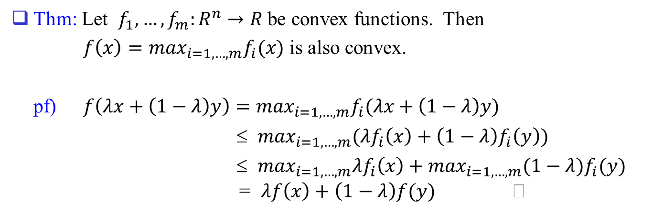
Thm: Let $f_{1},…,f_{m}:R^{n}→R$ be convex functions. Then
$f\left(x\right)=\max_{i=1,…,m}f_{i}(x)$ is also convex.
pf) $f\left(λx+\left(1−λ\right)y\right)=\max_{i=1,…,m}f_{i}(λx+\left(1−λ\right)y)$
≤ $\max_{i=1,…,m}(λf_{i}\left(x\right)+\left(1−λ\right)f_{i}\left(y\right))$
≤ $\max_{i=1,…,m}λf_{i}\left(x\right)+\max_{i=1,…,m}(1−λ)f_{i}(y)$ = $λf\left(x\right)+\left(1−λ\right)f(y)$

Slide 24
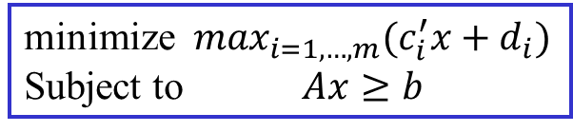
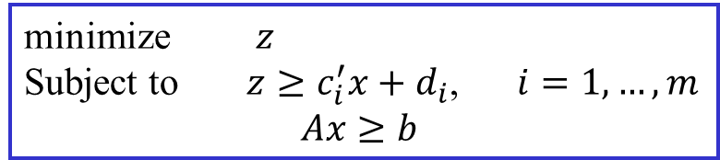
Min of piecewise linear convex functions
minimize $\max_{i=1,…,m}(c_{i}^{′}x+d_{i})$
Subject to $Ax≥b$
minimize $z$
Subject to $z≥c_{i}^{′}x+d_{i}$, $i=1,…,m$
$Ax≥b$

Slide 25
Q: What can we do about finding maximum of a piecewise linear convex function?
maximum of a piecewise linear concave function (can be obtained as minimum of affine functions)?
Minimum of a piecewise linear concave function?

Slide 26
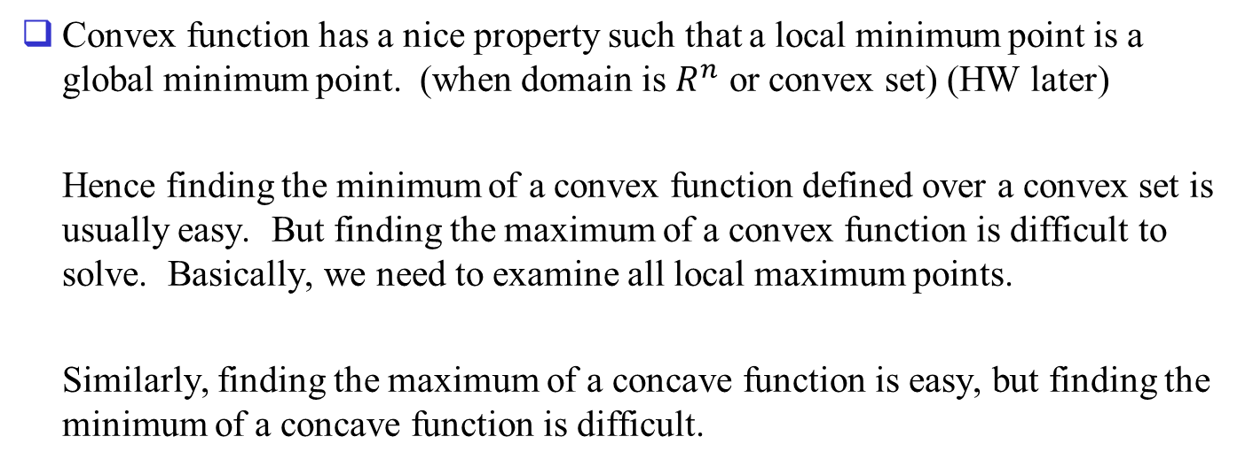
Convex function has a nice property such that a local minimum point is a global minimum point. (when domain is $R^{n}$ or convex set) (HW later)
Hence finding the minimum of a convex function defined over a convex set is usually easy. But finding the maximum of a convex function is difficult to solve. Basically, we need to examine all local maximum points.
Similarly, finding the maximum of a concave function is easy, but finding the minimum of a concave function is difficult.

Slide 27
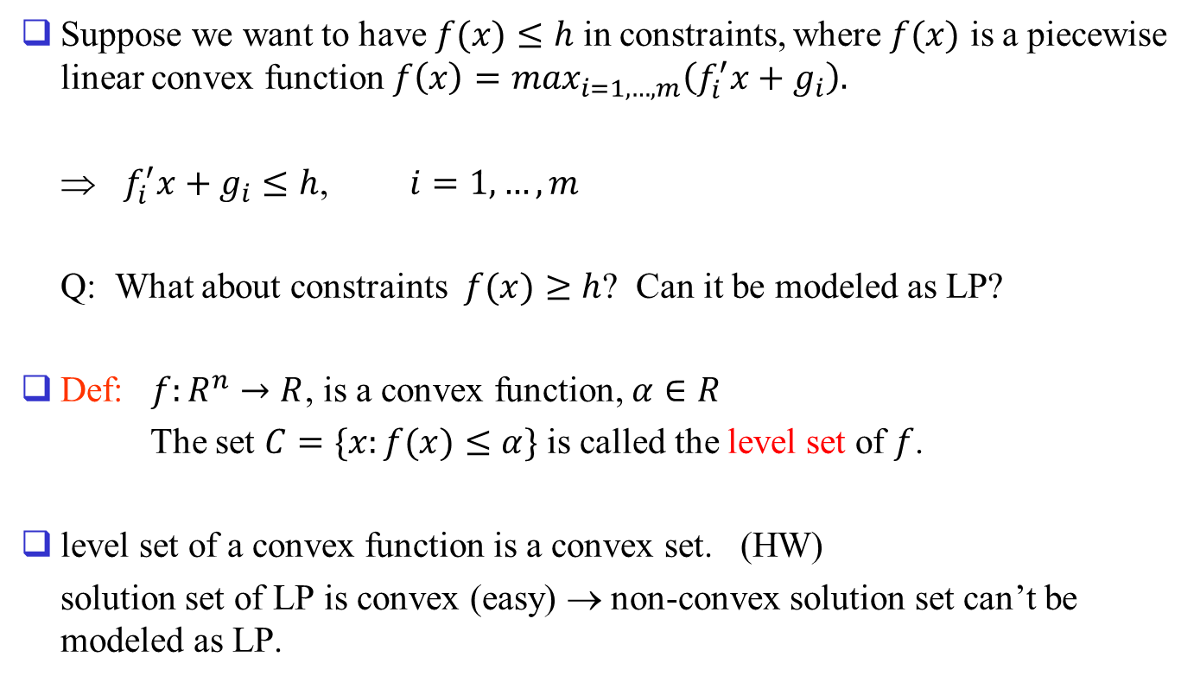
Suppose we want to have $f(x)≤h$ in constraints, where $f(x)$ is a piecewise linear convex function $f\left(x\right)=\max_{i=1,…,m}\left(f_{i}^{′}x+g_{i}\right).$
⇒ $f_{i}^{′}x+g_{i}≤h$, $i=1,…,m$
Q: What about constraints $f(x)≥h$? Can it be modeled as LP?
Def: $f:R^{n}→R$, is a convex function, $α∈R$
The set $C=\{x:f(x)≤α\}$ is called the level set of $f$.
level set of a convex function is a convex set. (HW)
solution set of LP is convex (easy) → non-convex solution set can’t be modeled as LP.

Slide 28
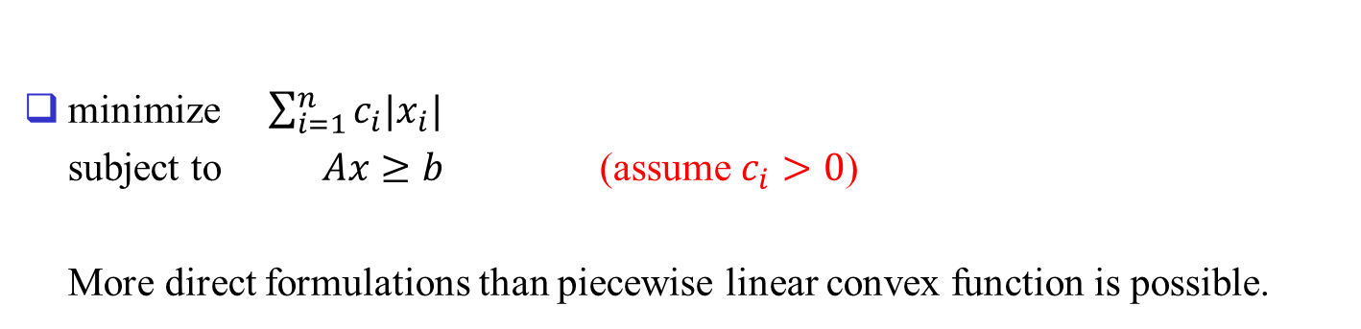
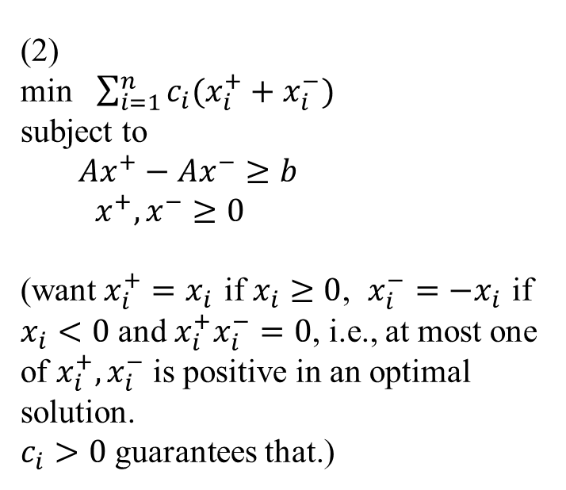
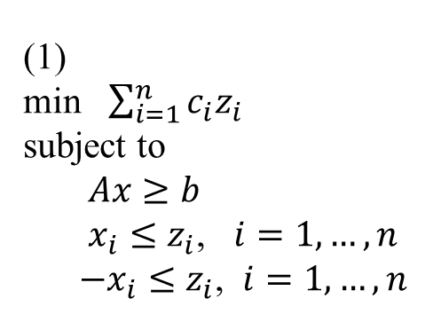
Problems involving absolute values
minimize $\sum_{i=1}^{n}{c_{i}|x_{i}|}$
subject to $Ax≥b$ (assume $c_{i}>0$)
More direct formulations than piecewise linear convex function is possible.
(1)
min $\sum_{i=1}^{n}{c_{i}z_{i}}$
subject to
$Ax≥b$
$x_{i}≤z_{i}$, $i=1,…,n$
$−x_{i}≤z_{i}$, $i=1,…,n$
(2)
min $\sum_{i=1}^{n}{c_{i}(x_{i}^{+}+x_{i}^{−})}$
subject to
$Ax^{+}−Ax^{−}≥b$
$x^{+},x^{−}≥0$
(want $x_{i}^{+}=x_{i}$ if $x_{i}≥0$, $x_{i}^{−}=−x_{i}$ if $x_{i}<0$ and $x_{i}^{+}x_{i}^{−}=0$, i.e., at most one of $x_{i}^{+},x_{i}^{−}$ is positive in an optimal solution.
$c_{i}>0$ guarantees that.)

Slide 29
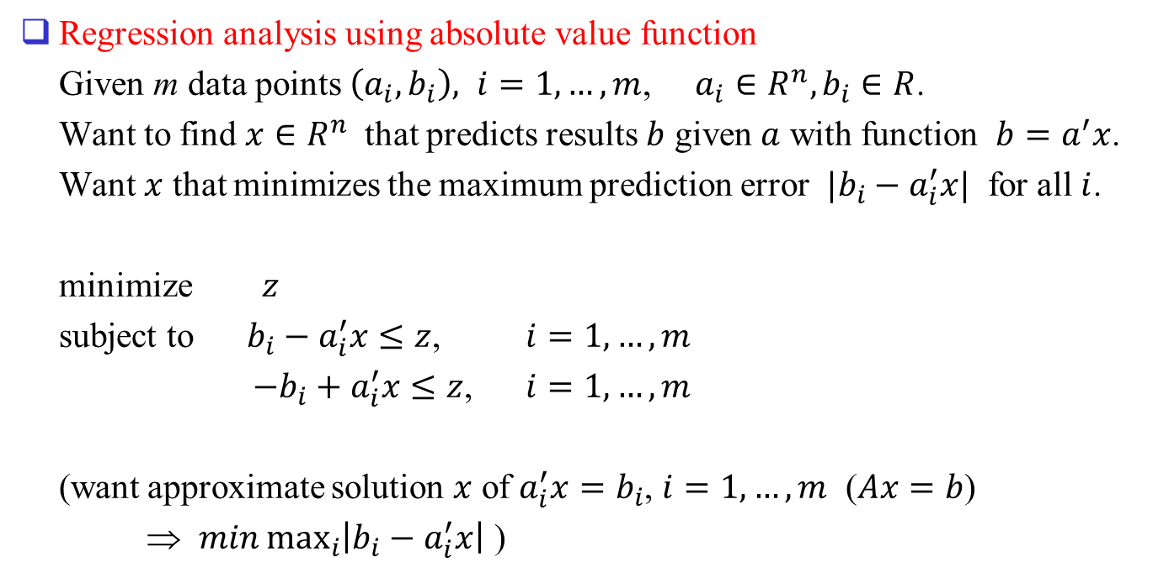
Data Fitting
Regression analysis using absolute value function
Given m data points $\left(a_{i},b_{i}\right), i=1,…,m$, $a_{i}∈R^{n}, b_{i}∈R$.
Want to find $x∈R^{n}$ that predicts results $b$ given $a$ with function $b=a^{′}x$.
Want $x$ that minimizes the maximum prediction error $|b_{i}−a_{i}^{′}x|$ for all $i$.
minimize $z$
subject to $b_{i}−a_{i}^{′}x≤z$, $i=1,…,m$
$−b_{i}+a_{i}^{′}x≤z$, $i=1,…,m$
(want approximate solution $x$ of $a_{i}^{′}x=b_{i}$, $i=1,…,m$ ($Ax=b$)
⇒ $min\max_{i}\left|b_{i}−a_{i}^{′}x\right|$ )

Slide 30
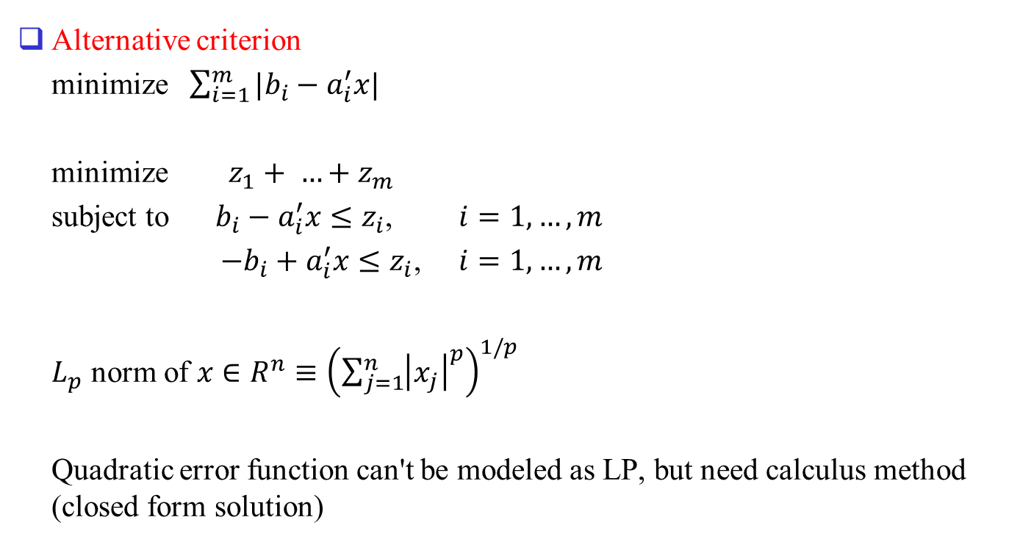
Alternative criterion
minimize $\sum_{i=1}^{m}{|b_{i}−a_{i}^{′}x|}$
minimize $z_{1}+ …+z_{m}$
subject to $b_{i}−a_{i}^{′}x≤z_{i}$, $i=1,…,m$
$−b_{i}+a_{i}^{′}x≤z_{i}$, $i=1,…,m$
$L_{p}$ norm of $x∈R^{n}≡{\left(\sum_{j=1}^{n}{{\left|x_{j}\right|}^{p}}\right)}^{1/p}$
Quadratic error function can't be modeled as LP, but need calculus method (closed form solution)

Slide 31



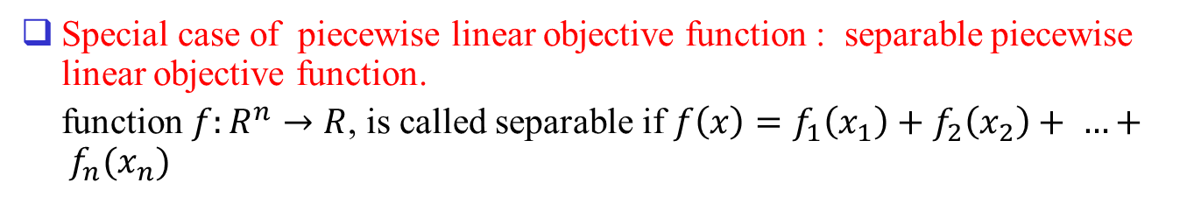












Special case of piecewise linear objective function : separable piecewise linear objective function.
function $f:R^{n}→R$, is called separable if $f\left(x\right)=f_{1}\left(x_{1}\right)+f_{2}\left(x_{2}\right)+ …+ f_{n}(x_{n})$
$$f_{i}(x_{i})$$
$$c_{1}<c_{2}<c_{3}<c_{4}$$
$$c_{4}$$
Approximation of
nonlinear function.
slope: $c_{i}$
$$c_{3}$$
$$c_{2}$$
$$c_{1}$$
$$a_{1}$$
$$a_{2}$$
$$a_{3}$$
$$x_{i}$$
0
$$x_{1i}$$
$$x_{2i}$$
$$x_{3i}$$
$$x_{4i}$$

Slide 32
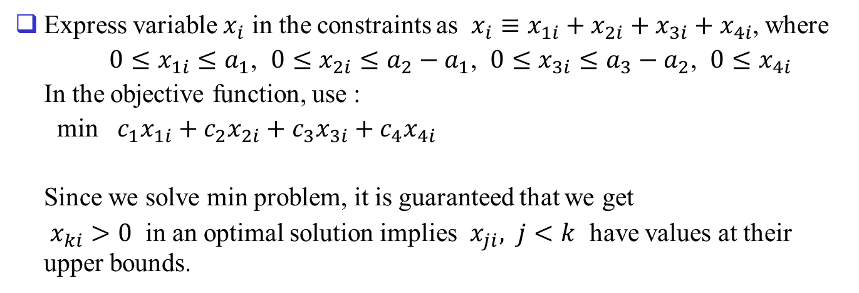
Express variable $x_{i}$ in the constraints as $x_{i}≡x_{1i}+x_{2i}+x_{3i}+x_{4i}$, where
$0≤x_{1i}≤a_{1}$, $0≤x_{2i}≤{a_{2}−a}_{1}$, $0≤x_{3i}≤{a_{3}−a}_{2}$, $0≤x_{4i}$
In the objective function, use :
min $c_{1}x_{1i}+c_{2}x_{2i}+c_{3}x_{3i}+c_{4}x_{4i}$
Since we solve min problem, it is guaranteed that we get
$x_{ki}>0$ in an optimal solution implies $x_{ji}, j<k$ have values at their upper bounds.

Slide 33

1.4 Graphical representation and solution
Let $a∈R^{n}, b∈R$.
Geometric intuition for the solution sets of
$\{x:a^{′}x=0\}$
$\{x:a^{′}x≤0\}$
$\{x:a^{′}x≥0\}$
$\{x:a^{′}x=b\}$
$\{x:a^{′}x≤b\}$
$\{x:a^{′}x≥b\}$

Slide 34




Geometry in 2-D
$$\{x:a^{′}x≥0\}$$
$$a$$
0
$$\{ x :a’x  0 \}$$
$$\{ x :a’x=0 \}$$

Slide 35

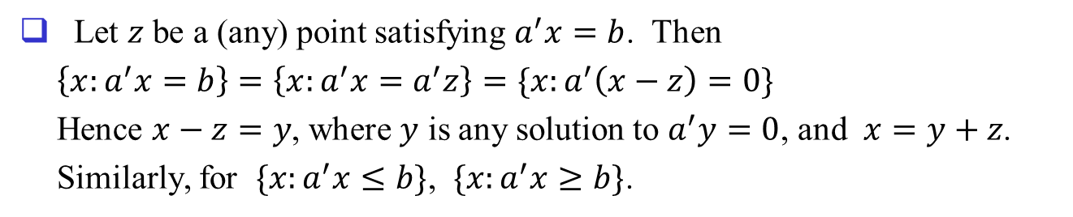





Let $z$ be a (any) point satisfying $a^{′}x=b$. Then
$\left\{x:a^{′}x=b\right\}=\left\{x:a^{′}x=a^{′}z\right\}=\{x:a^{′}\left(x−z\right)=0\}$
Hence $x−z=y$, where $y$ is any solution to $a^{′}y=0$, and $x=y+z$.
Similarly, for $\{x:a^{′}x≤b\}$, $\{x:a^{′}x≥b\}$.
$$\{x:a^{′}x≥b\}$$
$$a$$
$$z$$
$$\{x:a^{′}x≤b\}$$
0
$$\{x:a^{′}x=b\}$$
$$\{x:a^{′}x=0\}$$

Slide 36

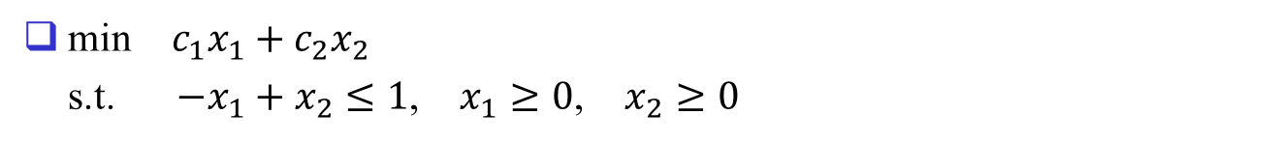








min $c_{1}x_{1}+c_{2}x_{2}$
s.t. $−x_{1}+x_{2}≤1$, $x_{1}≥0$, $x_{2}≥0$
$$x2$$
gradient of obj. fn. is $(c_{1},c_{2})$
$$c=(1, 0)$$
$$c=(−1, −1)$$
$$c=(1, 1)$$
$$c=(0, 1)$$
$$x1$$
$$\{x: x1 + x2 = 0\}$$
$$\{x: x1 + x2 = z\}$$

Slide 37

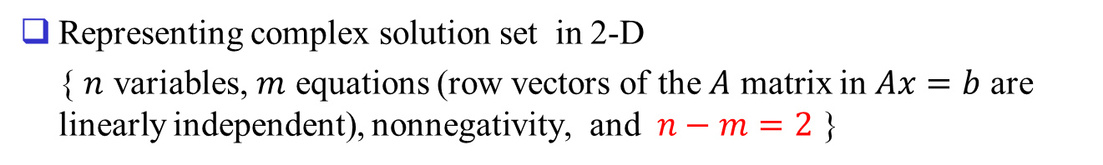






Representing complex solution set in 2-D
{ $n$ variables, $m$ equations (row vectors of the $A$ matrix in $Ax=b$ are linearly independent), nonnegativity, and $n−m=2$ }
(e.g. $x_{1}+x_{2}+x_{3}=1, x_{i}≥0 ∀i)$
$$x3$$
$$x2$$
$$x1=0$$
$$x2=0$$
$$x3=0$$
$$x1$$
See text sec. 1.5, 1.6 for more backgrounds

