Slide 1
Chapter 4 Duality in integer optimization (BW)

Slide 2
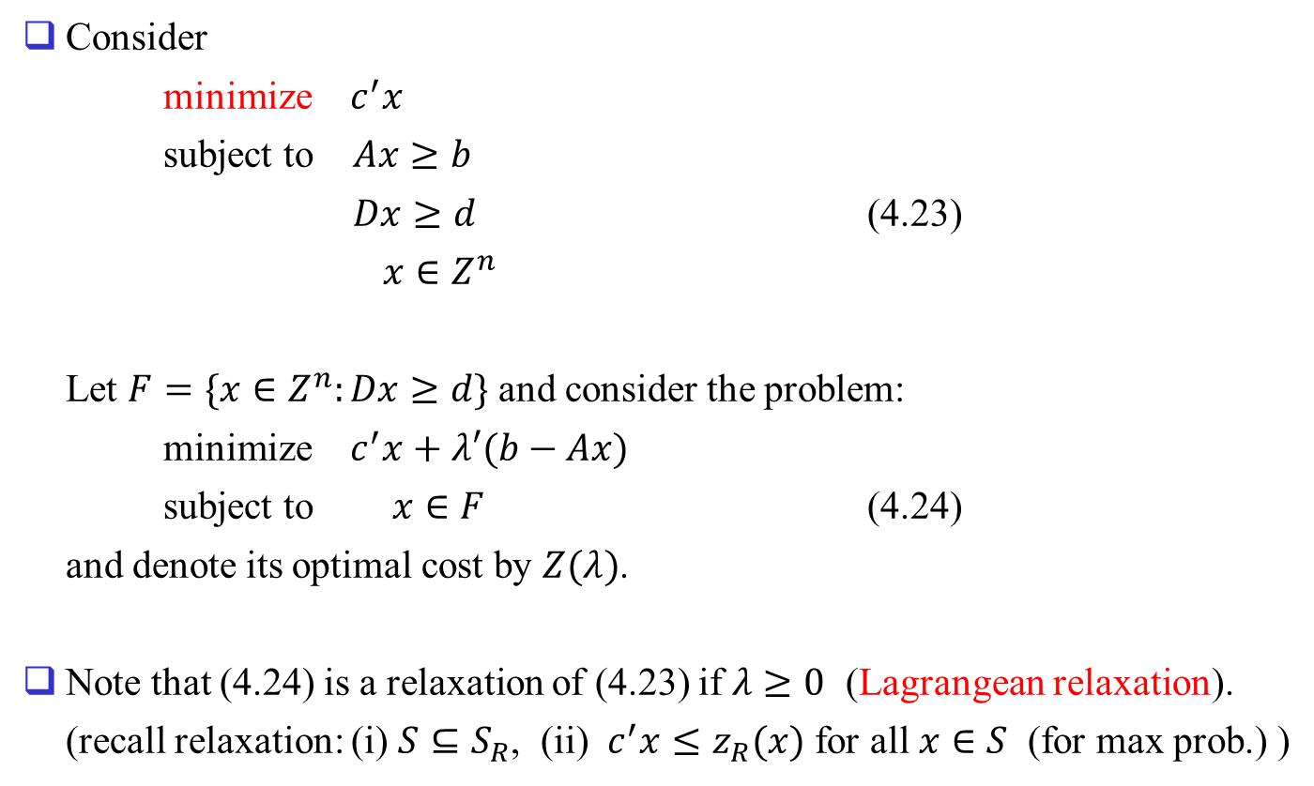
4.3 Lagrangean duality
Consider
minimize $c^{′}x$
subject to $Ax≥b$
$Dx≥d$ (4.23)
$x∈Z^{n}$
Let $F=\{x∈Z^{n}:Dx≥d\}$ and consider the problem:
minimize $c^{′}x+λ′(b−Ax)$
subject to $x∈F$ (4.24)
and denote its optimal cost by $Z(λ)$.
Note that (4.24) is a relaxation of (4.23) if $λ≥0$ (Lagrangean relaxation).
(recall relaxation: (i) $S⊆S_{R}$, (ii) $c^{′}x≤z_{R}(x)$ for all $x∈S$ (for max prob.) )

Slide 3
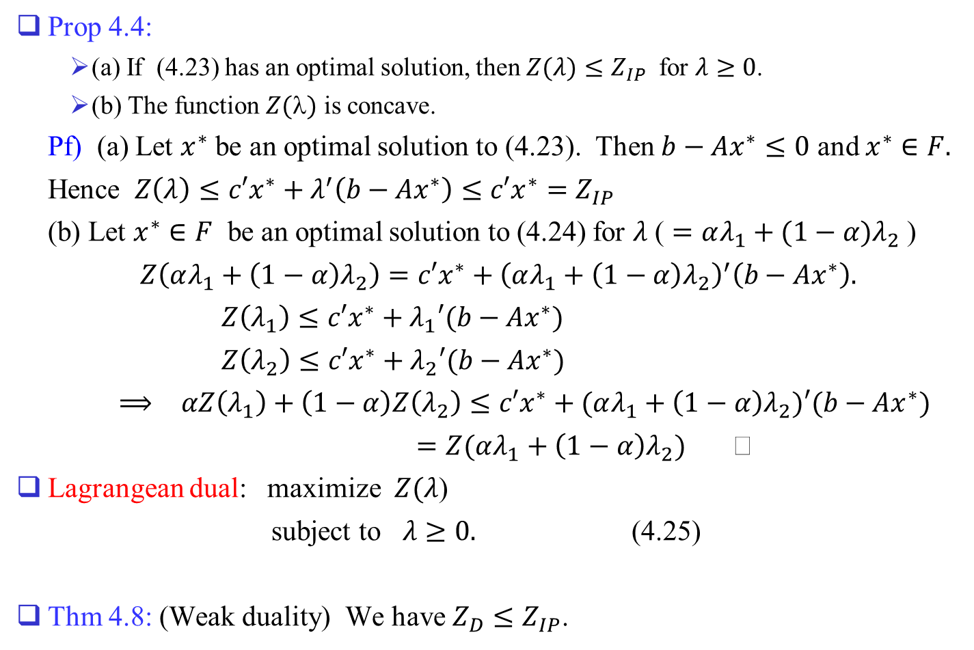
Prop 4.4:
(a) If (4.23) has an optimal solution, then $Z(λ)≤Z_{IP}$ for $λ≥0$.
(b) The function $Z()$ is concave.
Pf) (a) Let $x^{∗}$ be an optimal solution to (4.23). Then $b−Ax^{∗}≤0$ and $x^{∗}∈F.$
Hence $Z\left(λ\right)≤c′x^{∗}+λ^{′}\left(b−Ax^{∗}\right)≤c′x^{∗}=Z_{IP}$
(b) Let $x^{∗}∈F$ be an optimal solution to (4.24) for $λ$ ( $=αλ_{1}+(1−α)λ_{2}$ )
$Z\left(αλ_{1}+\left(1−α\right)λ_{2}\right)=c′x^{∗}+{\left(αλ_{1}+\left(1−α\right)λ_{2}\right)}^{′}\left(b−Ax^{∗}\right).$
$Z\left(λ_{1}\right)≤c′x^{∗}+λ_{1}′(b−Ax^{∗})$
$Z\left(λ_{2}\right)≤c′x^{∗}+λ_{2}′(b−Ax^{∗})$
$⟹$ $αZ\left(λ_{1}\right)+\left(1−α\right)Z\left(λ_{2}\right)≤c′x^{∗}+(αλ_{1}+\left(1−α\right)λ_{2})′(b−Ax^{∗})$
$=Z(αλ_{1}+\left(1−α\right)λ_{2})$
Lagrangean dual: maximize $Z(λ$)
subject to $λ≥0.$ (4.25)
Thm 4.8: (Weak duality) We have $Z_{D}≤Z_{IP}$.

Slide 4
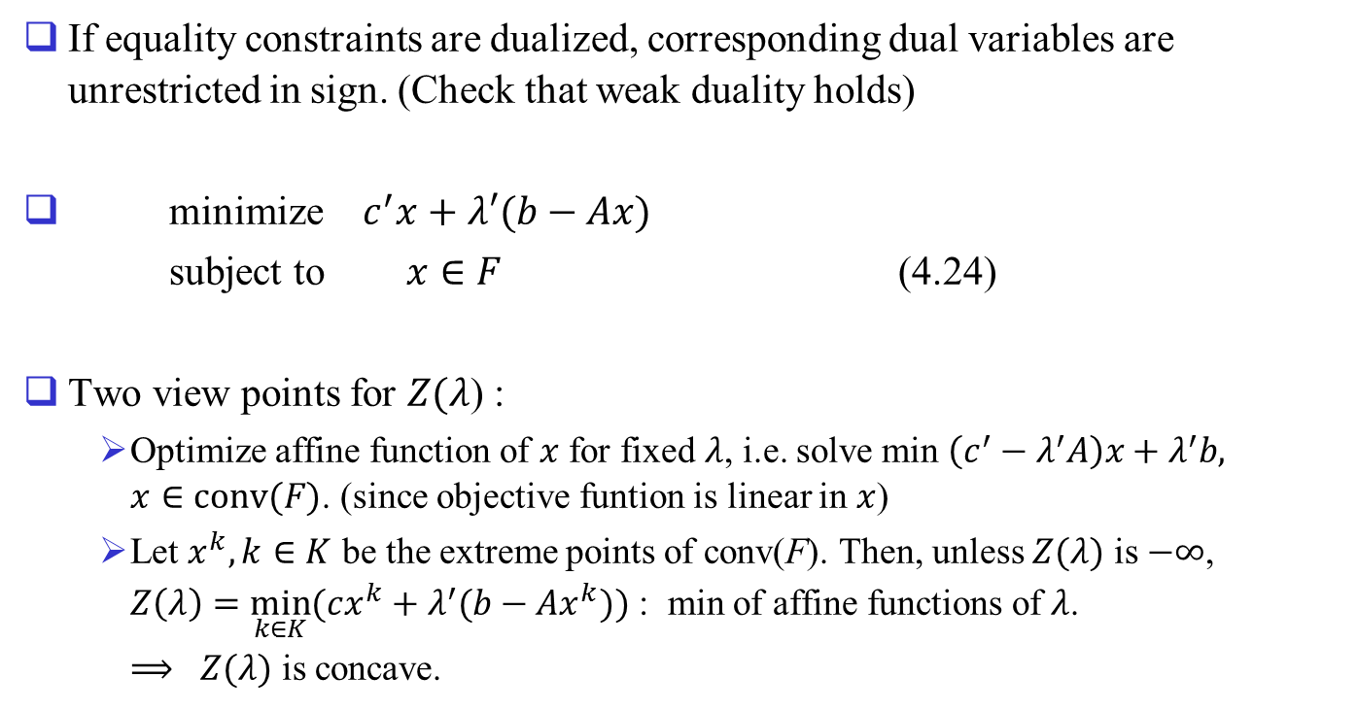
If equality constraints are dualized, corresponding dual variables are unrestricted in sign. (Check that weak duality holds)
minimize $c^{′}x+λ′(b−Ax)$
subject to $x∈F$ (4.24)
Two view points for $Z(λ$) :
Optimize affine function of $x$ for fixed $λ$, i.e. solve min $\left(c^{′}−λ^{′}A\right)x+λ^{′}b,$ $x∈conv(F)$. (since objective funtion is linear in $x$)
Let $x^{k},k∈K$ be the extreme points of conv(F). Then, unless $Z(λ)$ is $−∞$, $Z\left(λ\right)=\min_{k∈K}{(cx^{k}+λ^{′}(b−Ax^{k})})$ : min of affine functions of $λ$.
$⟹$ $Z(λ)$ is concave.

Slide 5
Thm 4.9: The optimal value $Z_{D}$ of the Lagrangean dual (4.25) is equal to the optimal cost of the following linear optimization problem:
minimize $c^{′}x$
subject to $Ax≥b$
$x∈conv(F)$ (4.27)
Pf) By definition, $Z\left(λ\right)=\min_{x∈F}{(c^{′}x+λ′(b−Ax)})$
$=\min_{x∈conv(F)}{(c^{′}x+λ′(b−Ax)})$ (since obj fn. is linear in $x$)
$⟹$ $Z_{D}=\max_{λ≥0}{\min_{x∈conv(F)}{(c^{′}x+λ′(b−Ax)}})$
Let $x^{k}, k∈K,$ $w^{j}, j∈J,$ be the extreme pts and extreme rays of conv($F$). Then
$Z\left(λ\right)=−∞$ if $\left(c^{′}−λ^{′}A\right)w^{j}<0,$ for some $j∈J$
$=\min_{k∈K}{(c′x^{k}+λ′(b−Ax^{k})})$ otherwise
Hence Lagrangean dual is equivalent to
maximize $\min_{k∈K}{(c′x^{k}+λ′(b−Ax^{k})})$
subject to $(c^{′}−λ^{′}A)w^{j}≥0,$ for all $j∈J$
$λ≥0$

Slide 6
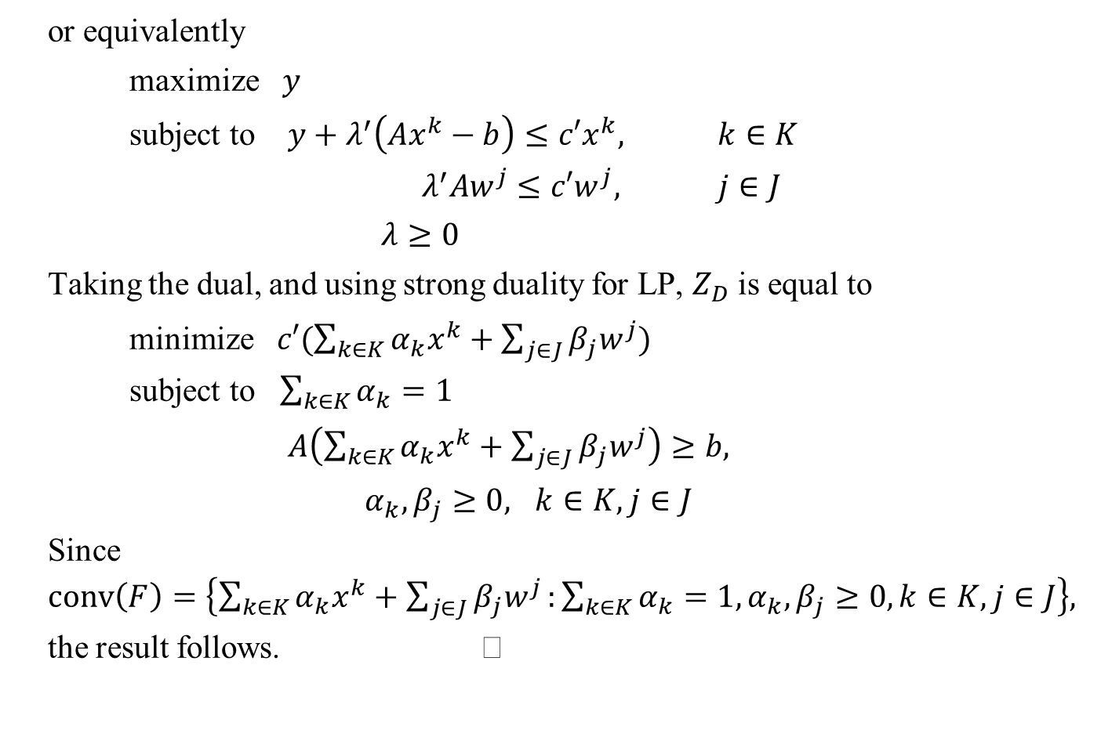
or equivalently
maximize $y$
subject to $y+λ^{′}\left(Ax^{k}−b\right)≤c′x^{k},$ $k∈K$
$λ^{′}Aw^{j}≤c′w^{j},$ $j∈J$
$λ≥0$
Taking the dual, and using strong duality for LP, $Z_{D}$ is equal to
minimize $c′(\sum_{k∈K}{α_{k}x^{k}}+\sum_{j∈J}{β_{j}w^{j}})$
subject to $\sum_{k∈K}{α_{k}}=1$
$A\left(\sum_{k∈K}{α_{k}x^{k}}+\sum_{j∈J}{β_{j}w^{j}}\right)≥b,$
$α_{k},β_{j}≥0,$ $k∈K, j∈J$
Since $conv\left(F\right)=\left\{\sum_{k∈K}{α_{k}x^{k}}+\sum_{j∈J}{β_{j}w^{j}}:\sum_{k∈K}{α_{k}}=1, α_{k},β_{j}≥0,k∈K,j∈J\right\},$
the result follows.

Slide 7

Ex 4.3:
Consider the problem:
minimize $3x_{1}−x_{2}$
subject to $x_{1}−x_{2}≥−1$
$−x_{1}+2x_{2}≤5$
$3x_{1}+2x_{2}≥3$
$6x_{1}+x_{2}≤15$
$x_{1},x_{2}≥0$, $x_{1},x_{2}∈Z.$

Slide 8
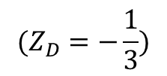
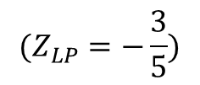
conv($F$)
$$x_{2}$$
Ex:
3
$$x_{1}−x_{2}≥−1$$
$$x_{IP}$$
$$(Z_{D}=−\frac{1}{3})$$
2
$$x_{D}$$
$$(Z_{IP}=1)$$
c
$$x_{LP}$$
$$(Z_{LP}=−\frac{3}{5})$$
1
0
1
2
$$x_{1}$$

Slide 9
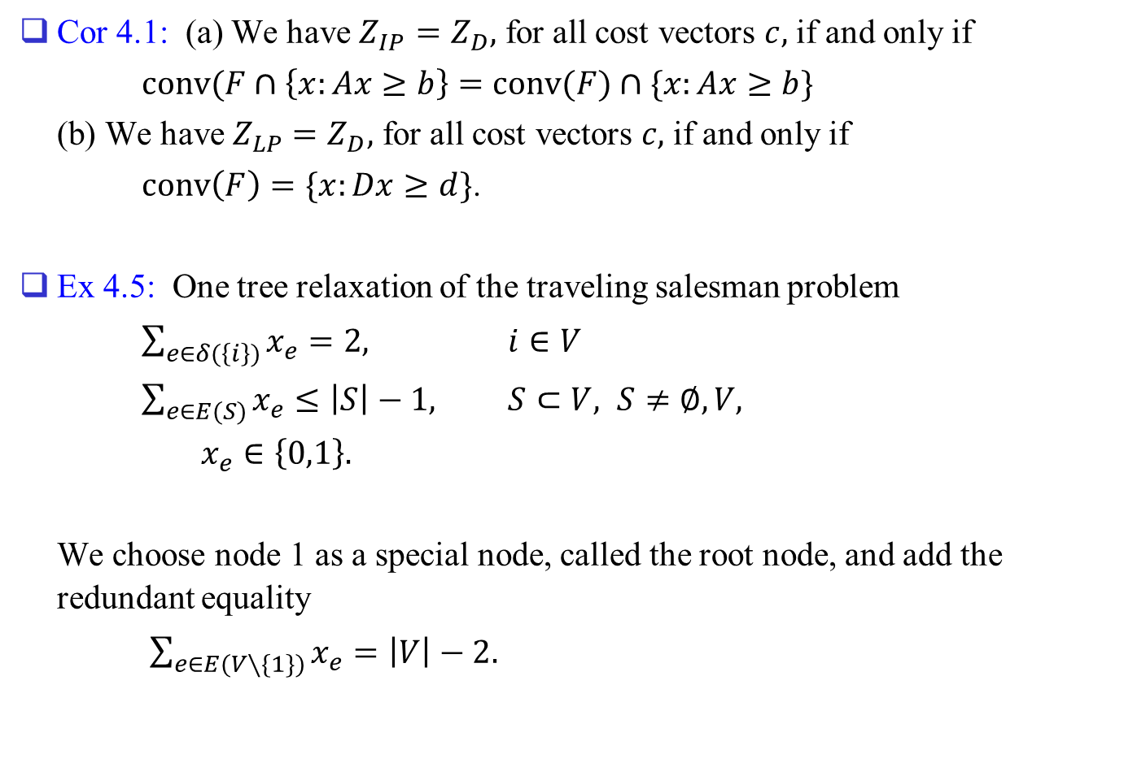
Cor 4.1: (a) We have $Z_{IP}=Z_{D},$ for all cost vectors $c,$ if and only if
$conv(F∩\left\{x:Ax≥b\right\}=conv(F)∩\{x:Ax≥b\}$
(b) We have $Z_{LP}=Z_{D},$ for all cost vectors $c,$ if and only if
$conv\left(F\right)=\{x:Dx≥d\}$.
Ex 4.5: One tree relaxation of the traveling salesman problem
$\sum_{e∈δ(\left\{i\right\})}{x_{e}}=2,$ $i∈V$
$\sum_{e∈E(S)}{x_{e}}≤\left|S\right|−1,$ $S⊂V, S≠∅,V,$
$x_{e}∈\left\{0,1\right\}.$
We choose node 1 as a special node, called the root node, and add the redundant equality
$\sum_{e∈E(V∖\{1\})}{x_{e}}=\left|V\right|−2.$

Slide 10
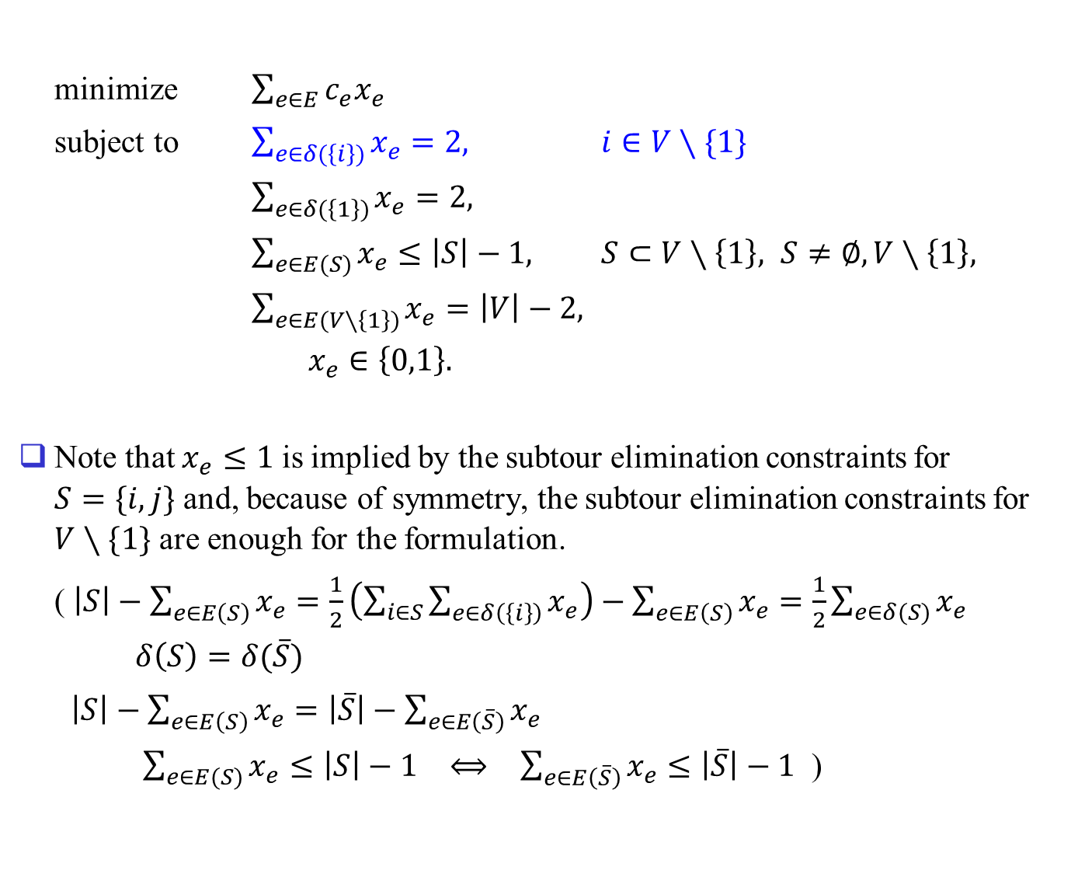
minimize $\sum_{e∈E}{c_{e}x_{e}}$
subject to $\sum_{e∈δ(\left\{i\right\})}{x_{e}}=2,$ $i∈V∖\{1\}$
$\sum_{e∈δ(\left\{1\right\})}{x_{e}}=2,$
$\sum_{e∈E(S)}{x_{e}}≤\left|S\right|−1,$ $S⊂V∖\left\{1\right\}, S≠∅,V∖\left\{1\right\},$
$\sum_{e∈E(V∖\left\{1\right\})}{x_{e}}=\left|V\right|−2,$
$x_{e}∈\left\{0,1\right\}.$
Note that $x_{e}≤1$ is implied by the subtour elimination constraints for $S=\{i,j\}$ and, because of symmetry, the subtour elimination constraints for $V∖\{1\}$ are enough for the formulation.
( $\left|S\right|−\sum_{e∈E\left(S\right)}{x_{e}}=\frac{1}{2}\left(\sum_{i∈S}{\sum_{e∈δ\left(\left\{i\right\}\right)}{x_{e}}}\right)−\sum_{e∈E\left(S\right)}{x_{e}}=\frac{1}{2}\sum_{e∈δ(S)}{x_{e}}$
$δ\left(S\right)=δ(\overline{S})$
$\left|S\right|−\sum_{e∈E\left(S\right)}{x_{e}}=\left|\overline{S}\right|−\sum_{e∈E\left(\overline{S}\right)}{x_{e}}$
$\sum_{e∈E(S)}{x_{e}}≤\left|S\right|−1$ $⟺$ $\sum_{e∈E\left(\overline{S}\right)}{x_{e}}≤\left|\overline{S}\right|−1$ )

Slide 11
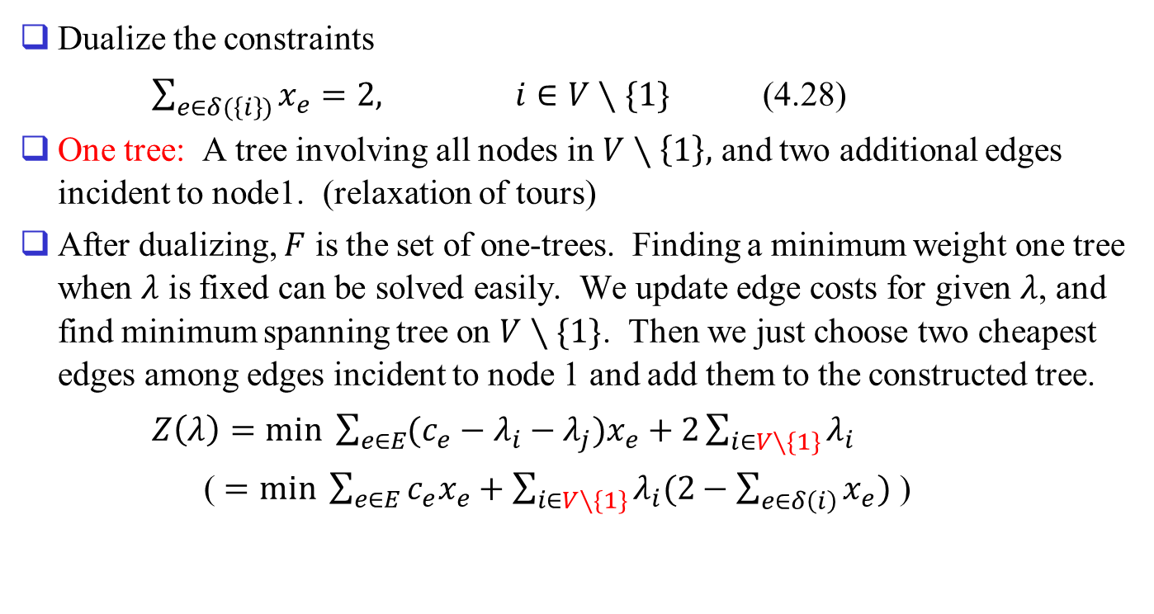
Dualize the constraints
$\sum_{e∈δ(\left\{i\right\})}{x_{e}}=2,$ $i∈V∖\{1\}$ (4.28)
One tree: A tree involving all nodes in $V∖\left\{1\right\},$ and two additional edges incident to node1. (relaxation of tours)
After dualizing, $F$ is the set of one-trees. Finding a minimum weight one tree when $λ$ is fixed can be solved easily. We update edge costs for given $λ$, and find minimum spanning tree on $V∖\{1\}$. Then we just choose two cheapest edges among edges incident to node 1 and add them to the constructed tree.
$Z\left(λ\right)=min \sum_{e∈E}{(c_{e}−λ_{i}−λ_{j})x_{e}}+2\sum_{i∈V∖\{1\}}{λ_{i}}$
( $=min \sum_{e∈E}{c_{e}x_{e}}+\sum_{i∈V∖\{1\}}{λ_{i}(2−\sum_{e∈δ\left(i\right)}{x_{e}})}$ )

Slide 12
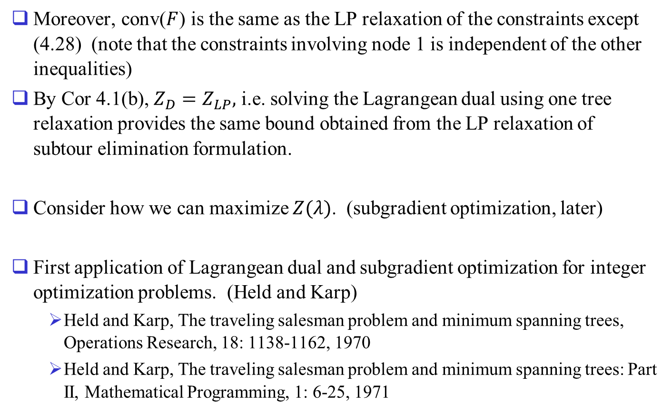
Moreover, conv($F$) is the same as the LP relaxation of the constraints except (4.28) (note that the constraints involving node 1 is independent of the other inequalities)
By Cor 4.1(b), $Z_{D}=Z_{LP},$ i.e. solving the Lagrangean dual using one tree relaxation provides the same bound obtained from the LP relaxation of subtour elimination formulation.
Consider how we can maximize $Z(λ)$. (subgradient optimization, later)
First application of Lagrangean dual and subgradient optimization for integer optimization problems. (Held and Karp)
Held and Karp, The traveling salesman problem and minimum spanning trees, Operations Research, 18: 1138-1162, 1970
Held and Karp, The traveling salesman problem and minimum spanning trees: Part II, Mathematical Programming, 1: 6-25, 1971

