Slide 1
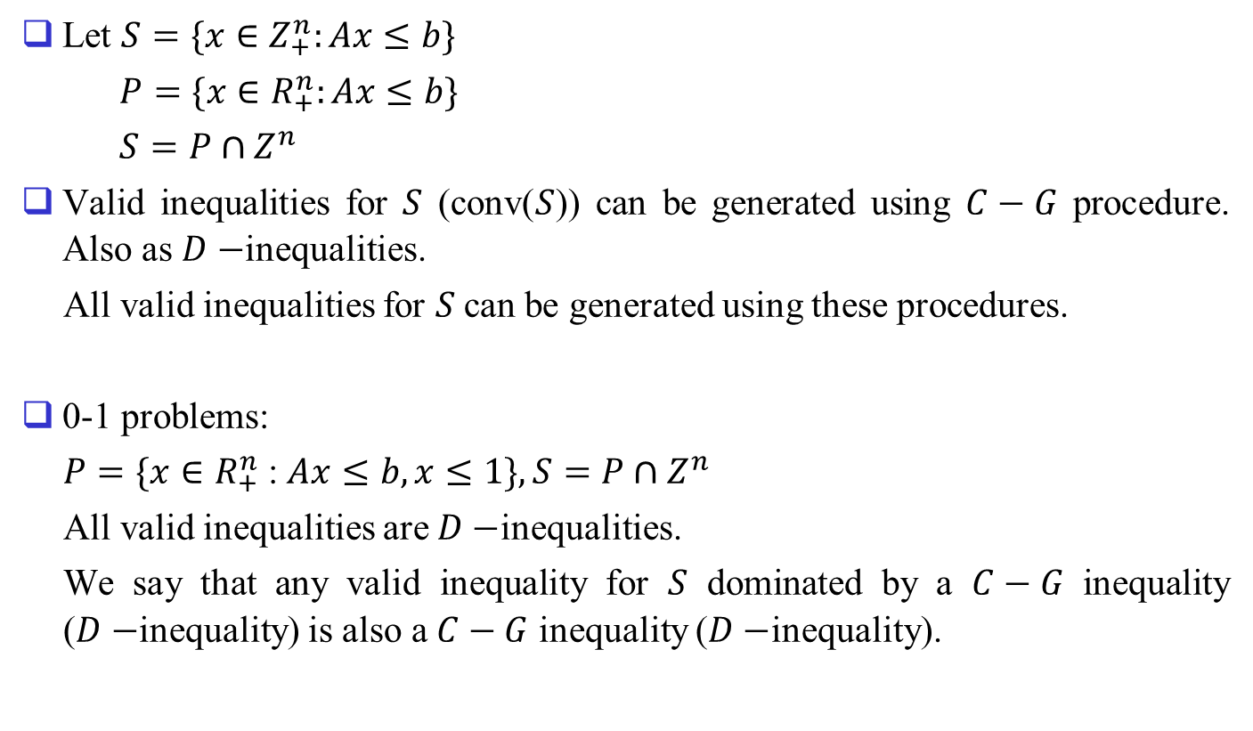
2. Generating All Valid Inequalities
Let $S=\{x∈Z_{+}^{n}:Ax≤b\}$
$P=\{x∈R_{+}^{n}:Ax≤b\}$
$S=P∩Z^{n}$
Valid inequalities for $S$ (conv($S$)) can be generated using $C−G$ procedure. Also as $D−$inequalities.
All valid inequalities for $S$can be generated using these procedures.
0-1 problems:
$P=\{x∈R_{+}^{n}$ :$Ax≤b, x≤1\}, S=P∩Z^{n}$
All valid inequalities are $D−$inequalities.
We say that any valid inequality for $S$ dominated by a $C−G$ inequality ($D−$inequality) is also a $C−G$ inequality ($D−$inequality).

Slide 2
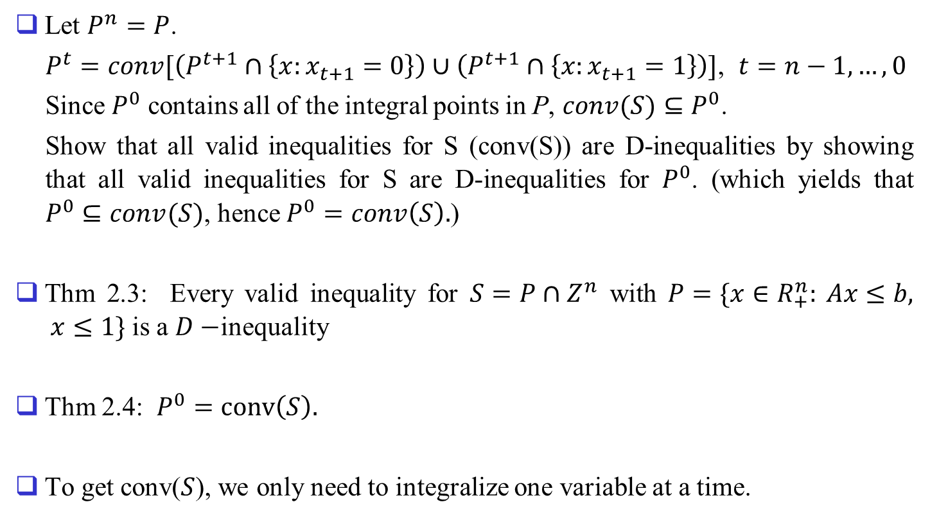
Let $P^{n}=P$.
$P^{t}=conv[\left(P^{t+1}∩\left\{x:x_{t+1}=0\right\}\right)∪\left(P^{t+1}∩\left\{x:x_{t+1}=1\right\}\right)]$, $t=n−1, …, 0$
Since $P^{0}$ contains all of the integral points in P, $conv(S)⊆P^{0}$.
Show that all valid inequalities for S (conv(S)) are D-inequalities by showing that all valid inequalities for S are D-inequalities for $P^{0}$. (which yields that $P^{0}⊆conv(S)$, hence $P^{0}=conv\left(S\right).$)
Thm 2.3: Every valid inequality for $S=P∩Z^{n}$ with $P=\{x∈R_{+}^{n}: Ax≤b, x≤1\}$ is a $D−$inequality
Thm 2.4: $P^{0}=conv\left(S\right).$
To get conv($S$), we only need to integralize one variable at a time.

Slide 3
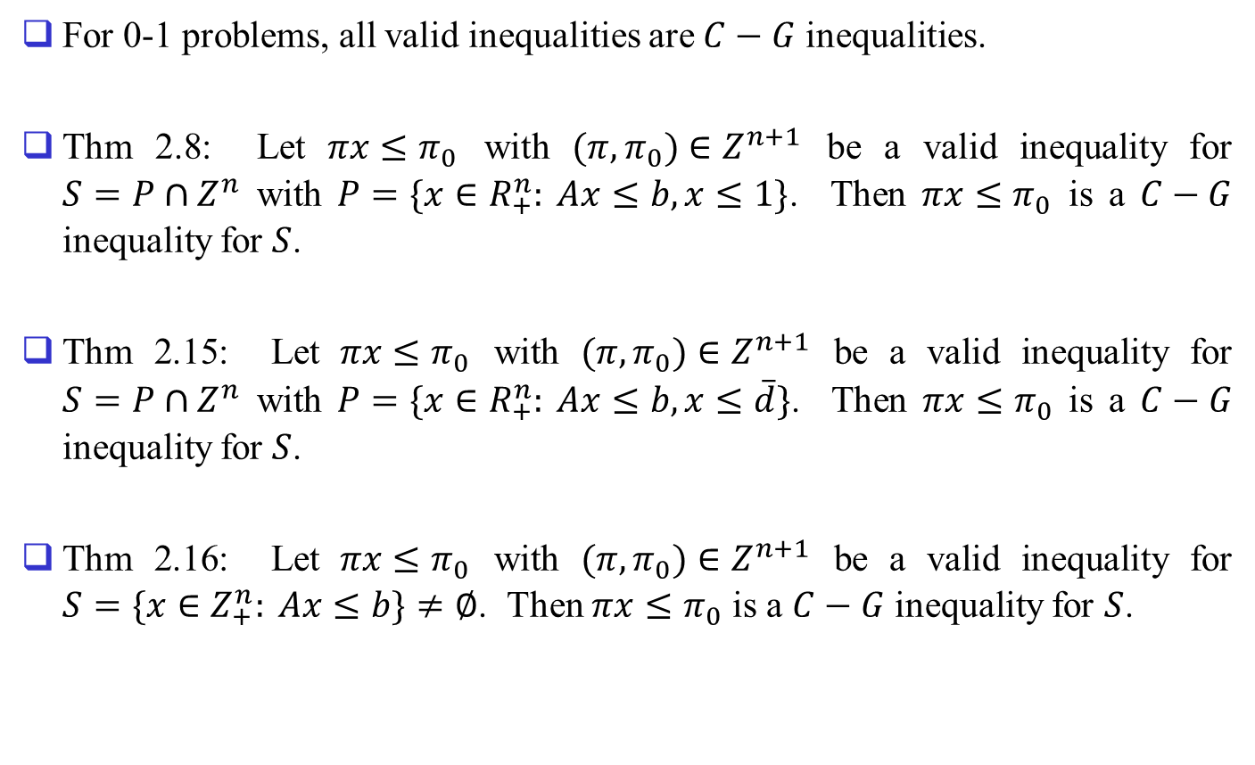
For 0-1 problems, all valid inequalities are $C−G$ inequalities.
Thm 2.8: Let $πx≤π_{0}$ with $(π,π_{0})∈Z^{n+1}$ be a valid inequality for $S=P∩Z^{n}$ with $P=\{x∈R_{+}^{n}: Ax≤b, x≤1\}$. Then $πx≤π_{0}$ is a $C−G$ inequality for $S$.
Thm 2.15: Let $πx≤π_{0}$ with $(π,π_{0})∈Z^{n+1}$ be a valid inequality for $S=P∩Z^{n}$ with $P=\{x∈R_{+}^{n}: Ax≤b, x≤\overline{d}\}$. Then $πx≤π_{0}$ is a $C−G$ inequality for $S$.
Thm 2.16: Let $πx≤π_{0}$ with $(π,π_{0})∈Z^{n+1}$ be a valid inequality for $S=\{x∈Z_{+}^{n}: Ax≤b\}≠∅$. Then $πx≤π_{0}$ is a $C−G$ inequality for $S$.

Slide 4
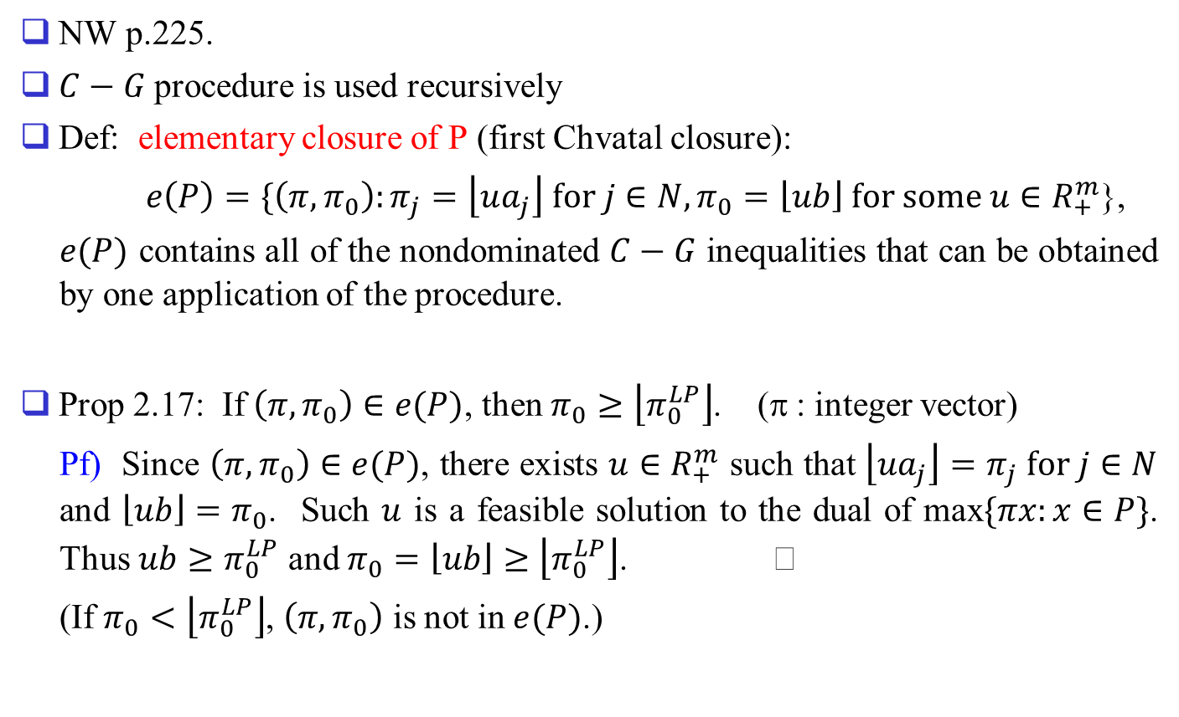
Rank of C-G Inequality
NW p.225.
$C−G$ procedure is used recursively
Def: elementary closure of P (first Chvatal closure):
$e\left(P\right)=\{\left(π,π_{0}\right):π_{j}=\left\lfloor ua_{j}\right\rfloor for j∈N,π_{0}=\left\lfloor ub\right\rfloor for some u∈R_{+}^{m}$},
$e(P)$ contains all of the nondominated $C−G$ inequalities that can be obtained by one application of the procedure.
Prop 2.17: If $\left(π,π_{0}\right)∈e(P)$, then $π_{0}≥\left\lfloor π_{0}^{LP}\right\rfloor$. (π : integer vector)
Pf) Since $\left(π,π_{0}\right)∈e(P)$, there exists $u∈R_{+}^{m}$ such that $\left\lfloor ua_{j}\right\rfloor =π_{j} for j∈N$ and $\left\lfloor ub\right\rfloor =π_{0}$. Such $u$ is a feasible solution to the dual of max$\{πx:x∈P\}$. Thus $ub≥π_{0}^{LP}$ and $π_{0}=\left\lfloor ub\right\rfloor ≥\left\lfloor π_{0}^{LP}\right\rfloor$.
(If $π_{0}<\left\lfloor π_{0}^{LP}\right\rfloor$, $\left(π,π_{0}\right)$ is not in $e(P)$.)

Slide 5
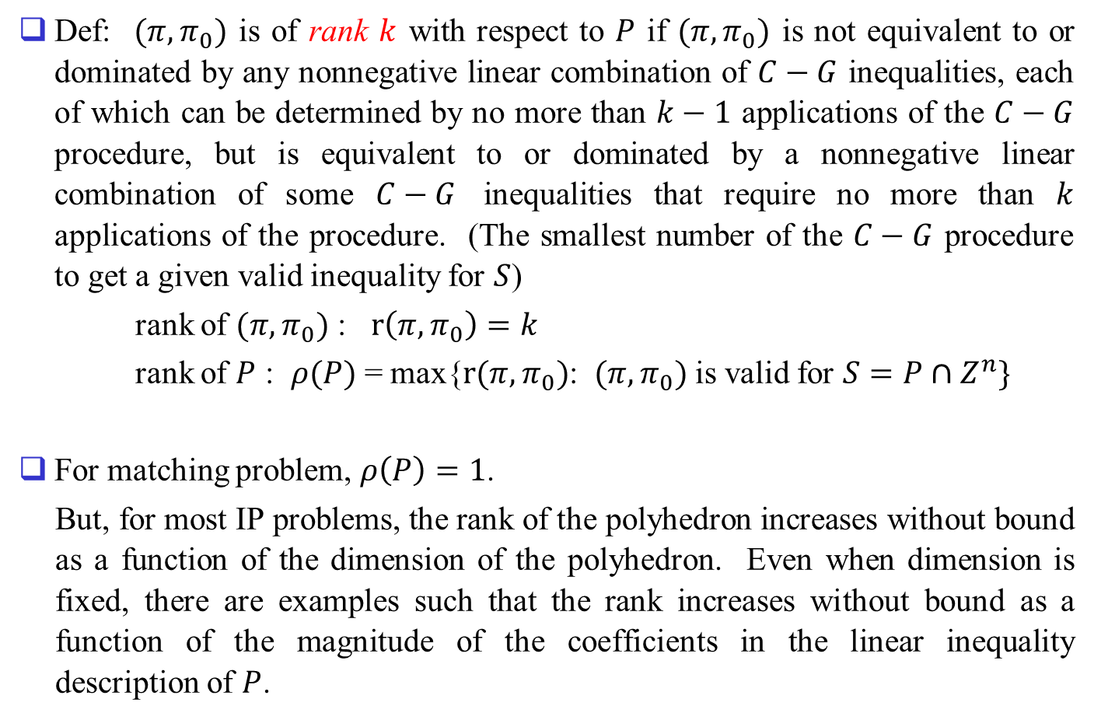
Def: $(π,π_{0})$ is of rank $k$ with respect to $P$ if $(π,π_{0})$ is not equivalent to or dominated by any nonnegative linear combination of $C−G$ inequalities, each of which can be determined by no more than $k−1$ applications of the $C−G$ procedure, but is equivalent to or dominated by a nonnegative linear combination of some $C−G$ inequalities that require no more than $k$ applications of the procedure. (The smallest number of the $C−G$ procedure to get a given valid inequality for $S$)
rank of $(π,π_{0})$ : $r\left(π,π_{0}\right)=k$
rank of $P$ : $ρ(P)$ = max{$r(π,π_{0})$: $(π,π_{0})$ is valid for $S=P∩Z^{n}\}$
For matching problem, $ρ\left(P\right)=1$.
But, for most IP problems, the rank of the polyhedron increases without bound as a function of the dimension of the polyhedron. Even when dimension is fixed, there are examples such that the rank increases without bound as a function of the magnitude of the coefficients in the linear inequality description of $P$.

Slide 6
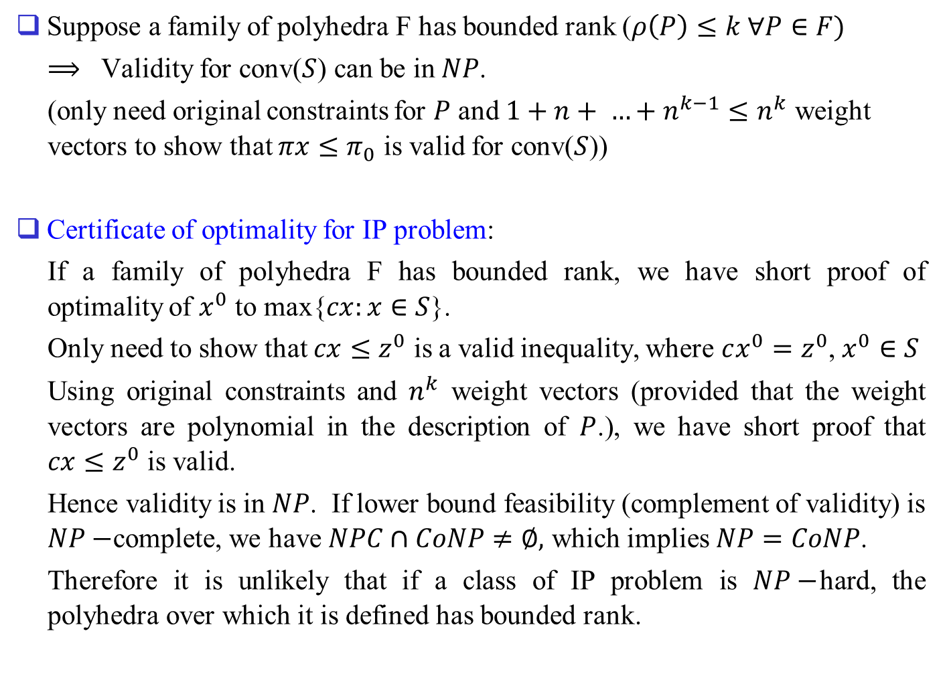
Suppose a family of polyhedra F has bounded rank ($ρ\left(P\right)≤k ∀P∈F)$
$⟹$ Validity for conv($S$) can be in $NP$.
(only need original constraints for $P$ and $1+n+ …+n^{k−1}≤n^{k}$ weight vectors to show that $πx≤π_{0}$ is valid for conv($S$))
Certificate of optimality for IP problem:
If a family of polyhedra F has bounded rank, we have short proof of optimality of $x^{0}$ to max{$cx:x∈S$}.
Only need to show that $cx≤z^{0}$ is a valid inequality, where $cx^{0}=z^{0}$, $x^{0}∈S$
Using original constraints and $n^{k}$ weight vectors (provided that the weight vectors are polynomial in the description of $P$.), we have short proof that $cx≤z^{0}$ is valid.
Hence validity is in $NP$. If lower bound feasibility (complement of validity) is $NP−$complete, we have $NPC∩CoNP≠∅,$ which implies $NP=CoNP$.
Therefore it is unlikely that if a class of IP problem is $NP−$hard, the polyhedra over which it is defined has bounded rank.

Slide 7
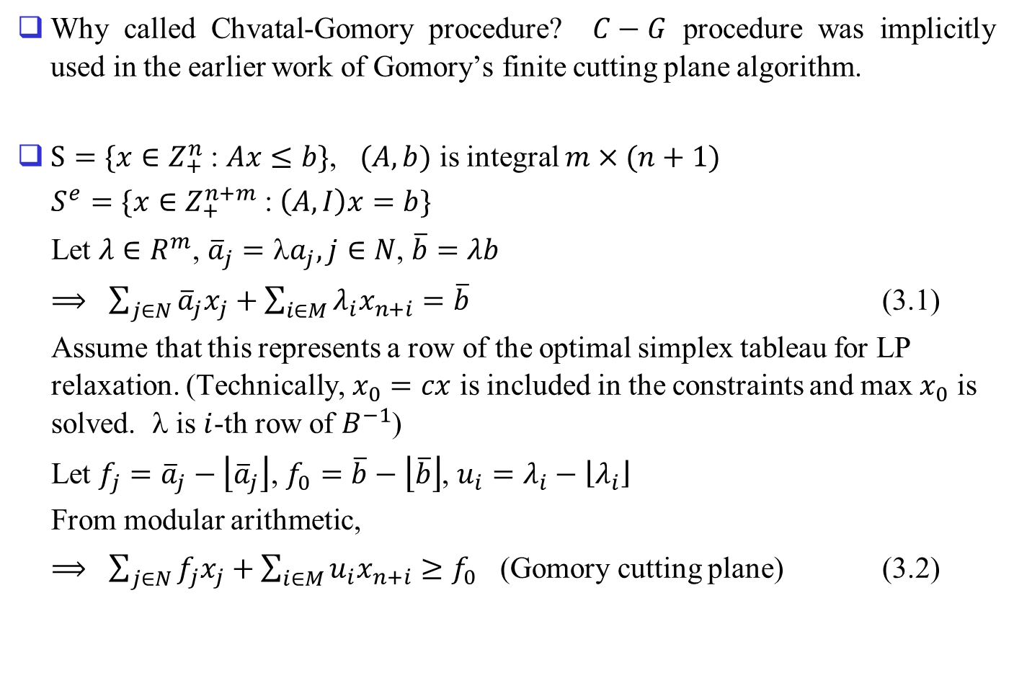
3. Gomory’s Fractional Cuts and Rounding
Why called Chvatal-Gomory procedure? $C−G$ procedure was implicitly used in the earlier work of Gomory’s finite cutting plane algorithm.
$S=\{x∈Z_{+}^{n}$ :$Ax≤b\}$, $(A,b)$ is integral $m×(n+1)$
$S^{e}=\{x∈Z_{+}^{n+m}$ :$\left(A, I\right)x=b\}$
Let $λ∈R^{m}$, ${\overline{a}}_{j}=λa_{j}, j∈N$, $\overline{b}=λb$
$⟹$ $\sum_{j∈N}{{\overline{a}}_{j}x_{j}}+\sum_{i∈M}{λ_{i}x_{n+i}}=\overline{b}$ (3.1)
Assume that this represents a row of the optimal simplex tableau for LP relaxation. (Technically, $x_{0}=cx$ is included in the constraints and max $x_{0}$ is solved. λ is $i$-th row of $B^{−1}$)
Let $f_{j}={\overline{a}}_{j}−\left\lfloor {\overline{a}}_{j}\right\rfloor$, $f_{0}=\overline{b}−\left\lfloor \overline{b}\right\rfloor$, $u_{i}=λ_{i}−\left\lfloor λ_{i}\right\rfloor$
From modular arithmetic,
$⟹$ $\sum_{j∈N}{f_{j}x_{j}}+\sum_{i∈M}{u_{i}x_{n+i}}≥f_{0}$ (Gomory cutting plane) (3.2)

Slide 8
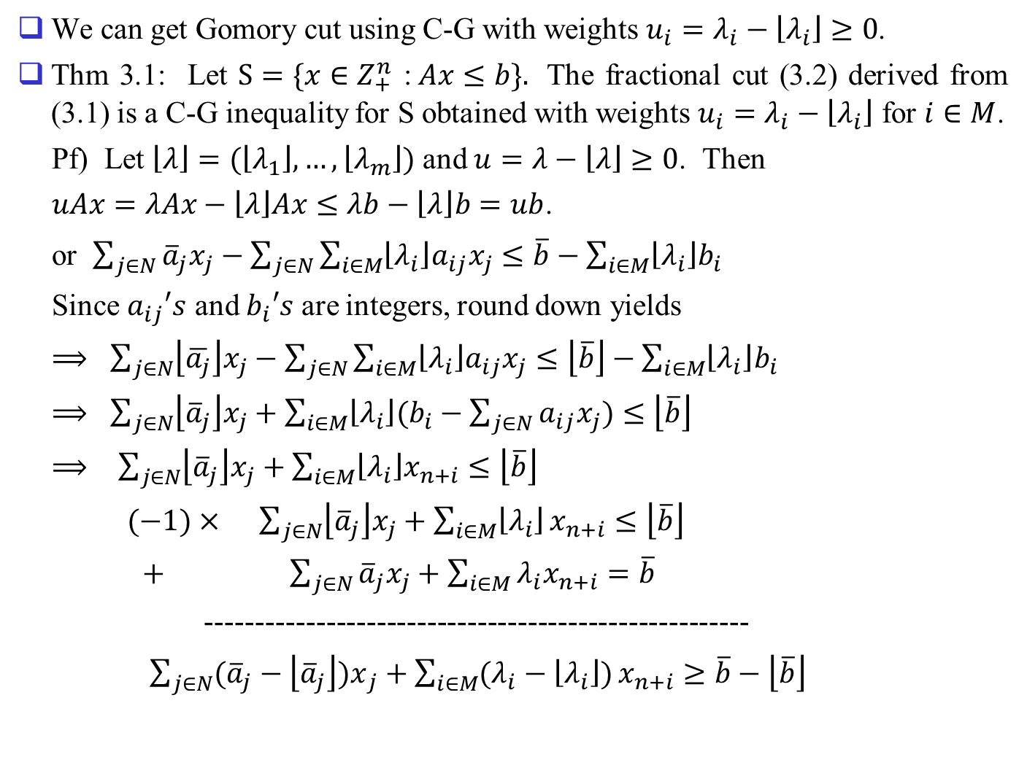
We can get Gomory cut using C-G with weights $u_{i}=λ_{i}−\left\lfloor λ_{i}\right\rfloor ≥0$.
Thm 3.1: Let $S=\{x∈Z_{+}^{n}$ :$Ax≤b\}.$ The fractional cut (3.2) derived from (3.1) is a C-G inequality for S obtained with weights $u_{i}=λ_{i}−\left\lfloor λ_{i}\right\rfloor$ for $i∈M$.
Pf) Let $\left\lfloor λ\right\rfloor =(\left\lfloor λ_{1}\right\rfloor , …, \left\lfloor λ_{m}\right\rfloor )$ and $u=λ−\left\lfloor λ\right\rfloor ≥0$. Then
$uAx=λAx−\left\lfloor λ\right\rfloor Ax≤λb−\left\lfloor λ\right\rfloor b=ub$.
or $\sum_{j∈N}{{\overline{a}}_{j}x_{j}−\sum_{j∈N}{\sum_{i∈M}{\left\lfloor λ_{i}\right\rfloor a_{ij}x_{j}≤\overline{b}−\sum_{i∈M}{\left\lfloor λ_{i}\right\rfloor b_{i}}}}}$
Since $a_{ij}′s$ and $b_{i}′s$ are integers, round down yields
⟹ $\sum_{j∈N}{\left\lfloor \overline{a_{j}}\right\rfloor x_{j}−\sum_{j∈N}{\sum_{i∈M}{\left\lfloor λ_{i}\right\rfloor a_{ij}x_{j}≤\left\lfloor \overline{b}\right\rfloor −\sum_{i∈M}{\left\lfloor λ_{i}\right\rfloor b_{i}}}}}$
$⟹$ $\sum_{j∈N}{\left\lfloor {\overline{a}}_{j}\right\rfloor x_{j}+\sum_{i∈M}{\left\lfloor λ_{i}\right\rfloor (b_{i}−\sum_{j∈N}{a_{ij}x_{j})≤\left\lfloor \overline{b}\right\rfloor }}}$
⟹ $\sum_{j∈N}{\left\lfloor {\overline{a}}_{j}\right\rfloor x_{j}+\sum_{i∈M}{\left\lfloor λ_{i}\right\rfloor x_{n+i}}≤\left\lfloor \overline{b}\right\rfloor }$
$(−1)×$ $\sum_{j∈N}{\left\lfloor {\overline{a}}_{j}\right\rfloor x_{j}+\sum_{i∈M}{\left\lfloor λ_{i}\right\rfloor }}x_{n+i}≤\left\lfloor \overline{b}\right\rfloor$
$+$ $\sum_{j∈N}{{\overline{a}}_{j}x_{j}}+\sum_{i∈M}{λ_{i}x_{n+i}}=\overline{b}$
------------------------------------------------------
$\sum_{j∈N}{({\overline{a}}_{j}−\left\lfloor {\overline{a}}_{j}\right\rfloor {)x}_{j}+\sum_{i∈M}{(λ_{i}−\left\lfloor λ_{i}\right\rfloor )}}x_{n+i}≥\overline{b}−\left\lfloor \overline{b}\right\rfloor$

Slide 9
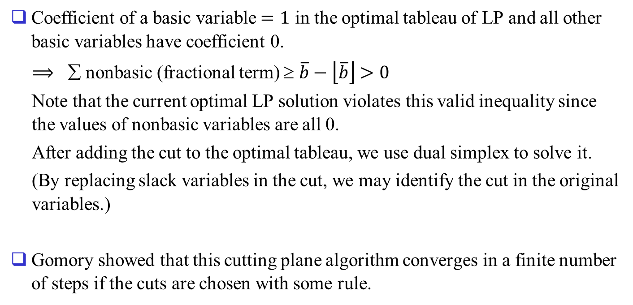
Coefficient of a basic variable $=1$ in the optimal tableau of LP and all other basic variables have coefficient 0.
$⟹$ ∑ nonbasic (fractional term) $$ $\overline{b}−\left\lfloor \overline{b}\right\rfloor$ $>0$
Note that the current optimal LP solution violates this valid inequality since the values of nonbasic variables are all 0.
After adding the cut to the optimal tableau, we use dual simplex to solve it.
(By replacing slack variables in the cut, we may identify the cut in the original variables.)
Gomory showed that this cutting plane algorithm converges in a finite number of steps if the cuts are chosen with some rule.

Slide 10
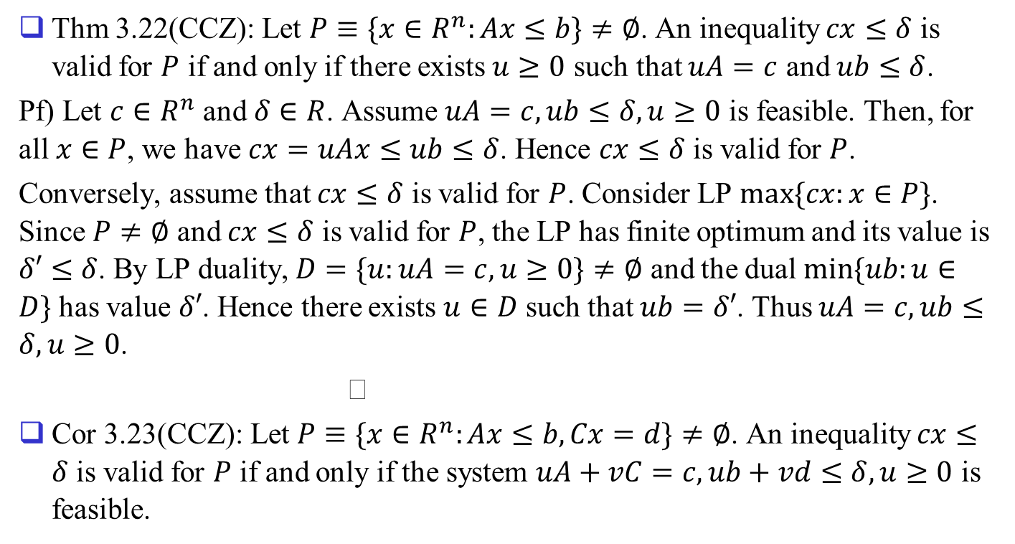
Cutting Planes for MIP
Thm 3.22(CCZ): Let $P≡\{x∈R^{n}:Ax≤b\}≠∅$. An inequality $cx≤δ$ is valid for $P$ if and only if there exists $u≥0$ such that $uA=c$ and $ub≤δ$.
Pf) Let $c∈R^{n}$ and $δ∈R$. Assume $uA=c, ub≤δ, u≥0$ is feasible. Then, for all $x∈P$, we have $cx=uAx≤ub≤δ$. Hence $cx≤δ$ is valid for $P$.
Conversely, assume that $cx≤δ$ is valid for $P$. Consider LP $max⁡\{cx:x∈P\}$. Since $P≠∅$ and $cx≤δ$ is valid for $P$, the LP has finite optimum and its value is $δ′≤δ$. By LP duality, $D=\{u:uA=c,u≥0\}≠∅$ and the dual $min⁡\{ub:u∈D\}$ has value $δ′$. Hence there exists $u∈D$ such that $ub=δ′$. Thus $uA=c, ub≤δ,u≥0$.
Cor 3.23(CCZ): Let $P≡\{x∈R^{n}:Ax≤b, Cx=d\}≠∅$. An inequality $cx≤δ$ is valid for $P$ if and only if the system $uA+vC=c, ub+vd≤δ, u≥0$ is feasible.

Slide 11
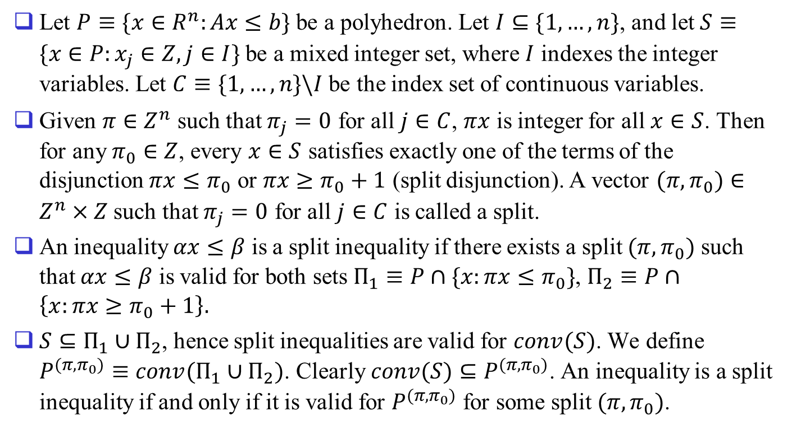
Split Inequalities
Let $P≡\{x∈R^{n}:Ax≤b\}$ be a polyhedron. Let $I⊆\{1,…,n\}$, and let $S≡\{x∈P:x_{j}∈Z,j∈I\}$ be a mixed integer set, where $I$ indexes the integer variables. Let $C≡\{1,…,n\}\backslash I$ be the index set of continuous variables.
Given $π∈Z^{n}$ such that $π_{j}=0$ for all $j∈C$, $πx$ is integer for all $x∈S$. Then for any $π_{0}∈Z$, every $x∈S$ satisfies exactly one of the terms of the disjunction $πx≤π_{0}$ or $πx≥π_{0}+1$ (split disjunction). A vector $(π,π_{0})∈Z^{n}×Z$ such that $π_{j}=0$ for all $j∈C$ is called a split.
An inequality $αx≤β$ is a split inequality if there exists a split $(π,π_{0})$ such that $αx≤β$ is valid for both sets $Π_{1}≡P∩\{x:πx≤π_{0}\}$, $Π_{2}≡P∩\left\{x:πx≥π_{0}+1\right\}.$
$S⊆Π_{1}∪Π_{2}$, hence split inequalities are valid for $conv(S)$. We define $P^{(π,π_{0})}≡conv(Π_{1}∪Π_{2})$. Clearly $conv(S)⊆P^{(π,π_{0})}$. An inequality is a split inequality if and only if it is valid for $P^{(π,π_{0})}$ for some split $(π,π_{0})$.

Slide 12
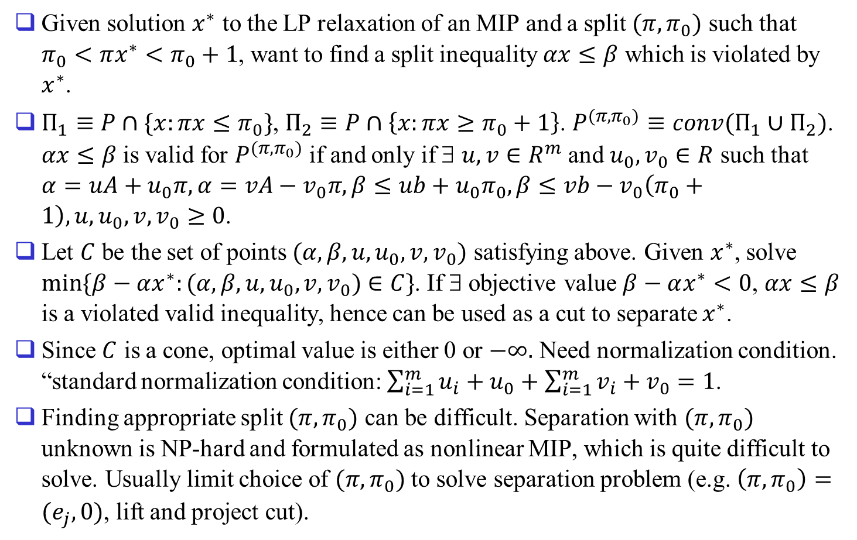
Split cut
Given solution $x^{∗}$ to the LP relaxation of an MIP and a split $(π,π_{0})$ such that $π_{0}<πx^{∗}<π_{0}+1$, want to find a split inequality $αx≤β$ which is violated by $x^{∗}$.
$Π_{1}≡P∩\{x:πx≤π_{0}\}$, $Π_{2}≡P∩\left\{x:πx≥π_{0}+1\right\}$. $P^{(π,π_{0})}≡conv(Π_{1}∪Π_{2})$. $αx≤β$ is valid for $P^{(π,π_{0})}$ if and only if ∃ $u,v∈R^{m}$ and $u_{0},v_{0}∈R$ such that $α=uA+u_{0}π,α=vA−v_{0}π,β≤ub+u_{0}π_{0},β≤vb−v_{0}\left(π_{0}+1\right),u,u_{0},v,v_{0}≥0$.
Let $C$ be the set of points $(α,β,u,u_{0},v,v_{0})$ satisfying above. Given $x^{∗}$, solve $min⁡\{β−αx^{∗}:(α,β,u,u_{0},v,v_{0})∈C\}$. If ∃ objective value $β−αx^{∗}<0$, $αx≤β$ is a violated valid inequality, hence can be used as a cut to separate $x^{∗}$.
Since $C$ is a cone, optimal value is either 0 or $−∞.$ Need normalization condition. “standard normalization condition: $\sum_{i=1}^{m}{u_{i}}+u_{0}+\sum_{i=1}^{m}{v_{i}}+v_{0}=1$.
Finding appropriate split $(π,π_{0})$ can be difficult. Separation with $(π,π_{0})$ unknown is NP-hard and formulated as nonlinear MIP, which is quite difficult to solve. Usually limit choice of $(π,π_{0})$ to solve separation problem (e.g. $\left(π,π_{0}\right)=(e_{j},0)$, lift and project cut).

Slide 13
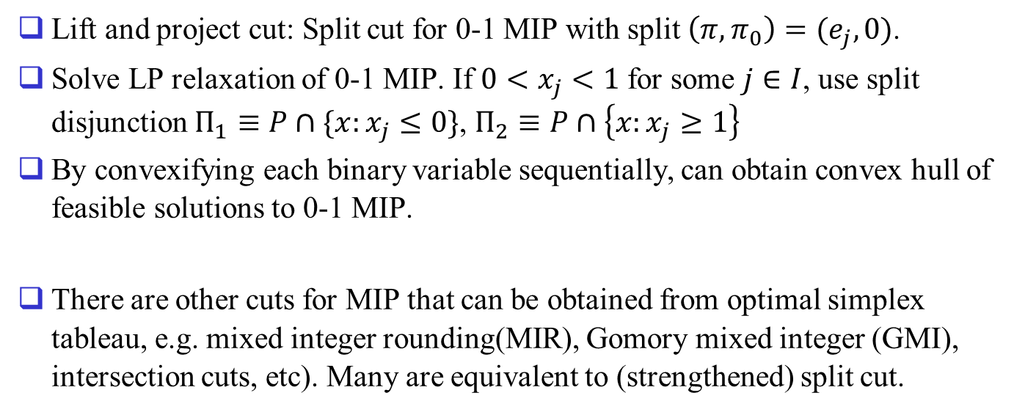
Lift and Project Cuts for 0-1 MIP
Lift and project cut: Split cut for 0-1 MIP with split $\left(π,π_{0}\right)=(e_{j},0)$.
Solve LP relaxation of 0-1 MIP. If $0<x_{j}<1$ for some $j∈I$, use split disjunction $Π_{1}≡P∩\{x:x_{j}≤0\}$, $Π_{2}≡P∩\left\{x:x_{j}≥1\right\}$
By convexifying each binary variable sequentially, can obtain convex hull of feasible solutions to 0-1 MIP.
There are other cuts for MIP that can be obtained from optimal simplex tableau, e.g. mixed integer rounding(MIR), Gomory mixed integer (GMI), intersection cuts, etc). Many are equivalent to (strengthened) split cut.

