Slide 1
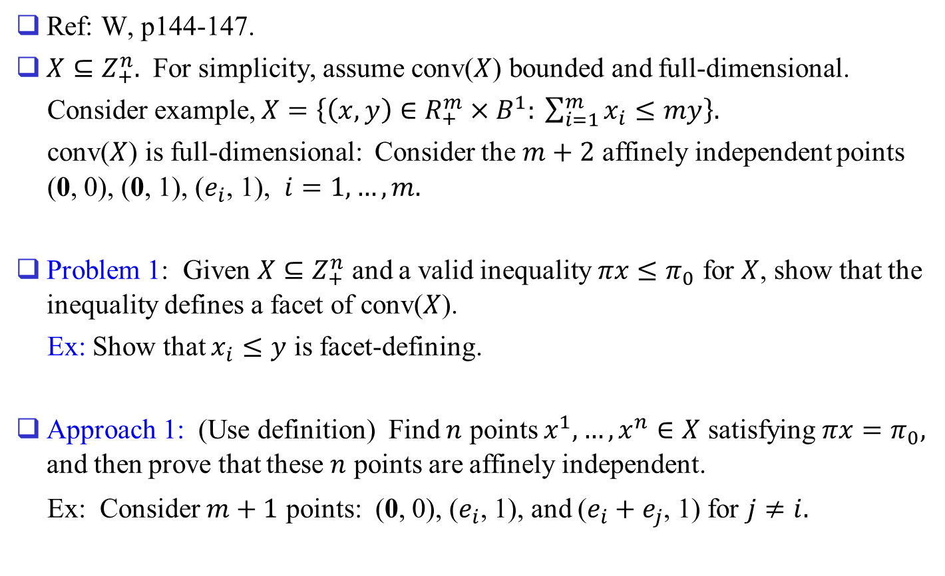
Proving that a Valid Inequality is Facet-defining
Ref: W, p144-147.
$X⊆Z_{+}^{n}.$ For simplicity, assume conv($X$) bounded and full-dimensional.
Consider example, $X=\left\{\left(x,y\right)∈R_{+}^{m}×B^{1}: \sum_{i=1}^{m}{x_{i}}≤my\right\}.$
conv($X$) is full-dimensional: Consider the $m+2$ affinely independent points (0, 0), (0, 1), ($e_{i}$, 1), $i=1,…,m.$
Problem 1: Given $X⊆Z_{+}^{n}$ and a valid inequality $πx≤π_{0}$ for $X$, show that the inequality defines a facet of conv($X$).
Ex: Show that $x_{i}≤y$ is facet-defining.
Approach 1: (Use definition) Find $n$ points $x^{1},…,x^{n}∈X$ satisfying $πx=π_{0},$ and then prove that these $n$ points are affinely independent.
Ex: Consider $m+1$ points: (0, 0), ($e_{i}$, 1), and ($e_{i}+e_{j}$, 1) for $j≠i.$

Slide 2
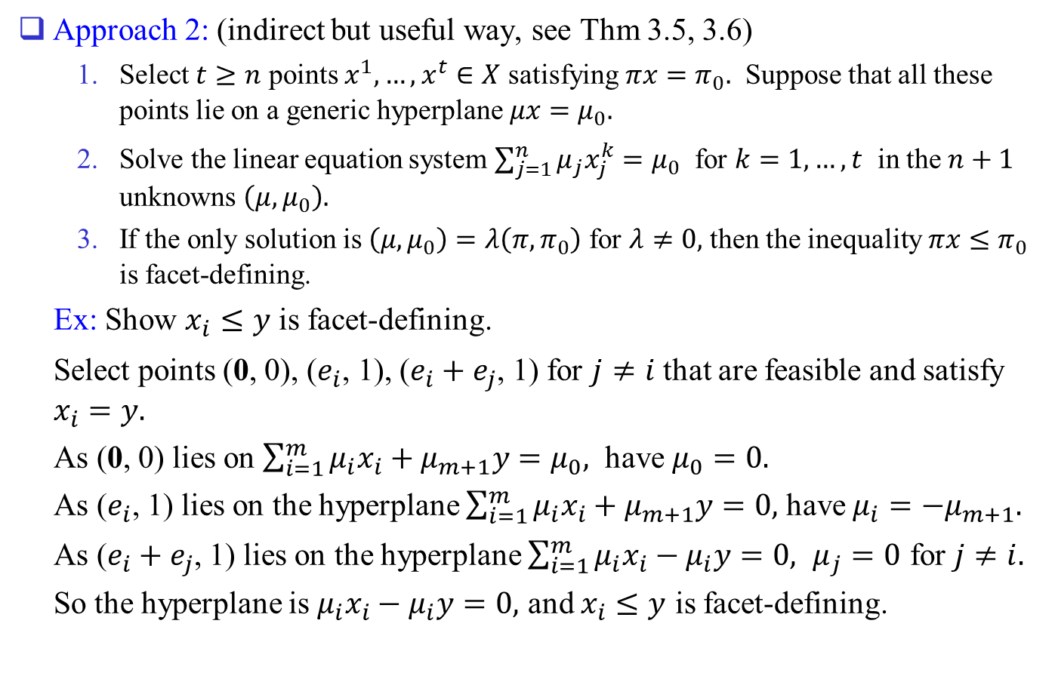
Approach 2: (indirect but useful way, see Thm 3.5, 3.6)
  Select $t≥n$ points $x^{1},…,x^{t}∈X$ satisfying $πx=π_{0}.$ Suppose that all these points lie on a generic hyperplane $μx=μ_{0}.$
  Solve the linear equation system $\sum_{j=1}^{n}{μ_{j}x_{j}^{k}}=μ_{0}$ for $k=1,…,t$ in the $n+1$ unknowns $\left(μ,μ_{0}\right).$
  If the only solution is $\left(μ,μ_{0}\right)=λ\left(π,π_{0}\right)$ for $λ≠0,$ then the inequality $πx≤π_{0}$ is facet-defining.
Ex: Show $x_{i}≤y$ is facet-defining.
Select points (0, 0), ($e_{i}$, 1), ($e_{i}+e_{j}$, 1) for $j≠i$ that are feasible and satisfy $x_{i}=y.$
As (0, 0) lies on $\sum_{i=1}^{m}{μ_{i}x_{i}}+μ_{m+1}y=μ_{0},$ have $μ_{0}=0.$
As ($e_{i}$, 1) lies on the hyperplane $\sum_{i=1}^{m}{μ_{i}x_{i}}+μ_{m+1}y=0,$ have $μ_{i}=−μ_{m+1}.$
As ($e_{i}+e_{j}$, 1) lies on the hyperplane $\sum_{i=1}^{m}{μ_{i}x_{i}}−μ_{i}y=0,$ $μ_{j}=0$ for $j≠i.$
So the hyperplane is $μ_{i}x_{i}−μ_{i}y=0,$ and $x_{i}≤y$ is facet-defining.

Slide 3
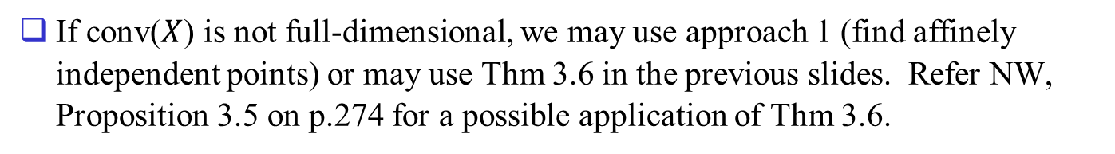
If conv($X$) is not full-dimensional, we may use approach 1 (find affinely independent points) or may use Thm 3.6 in the previous slides. Refer NW, Proposition 3.5 on p.274 for a possible application of Thm 3.6.

Slide 4
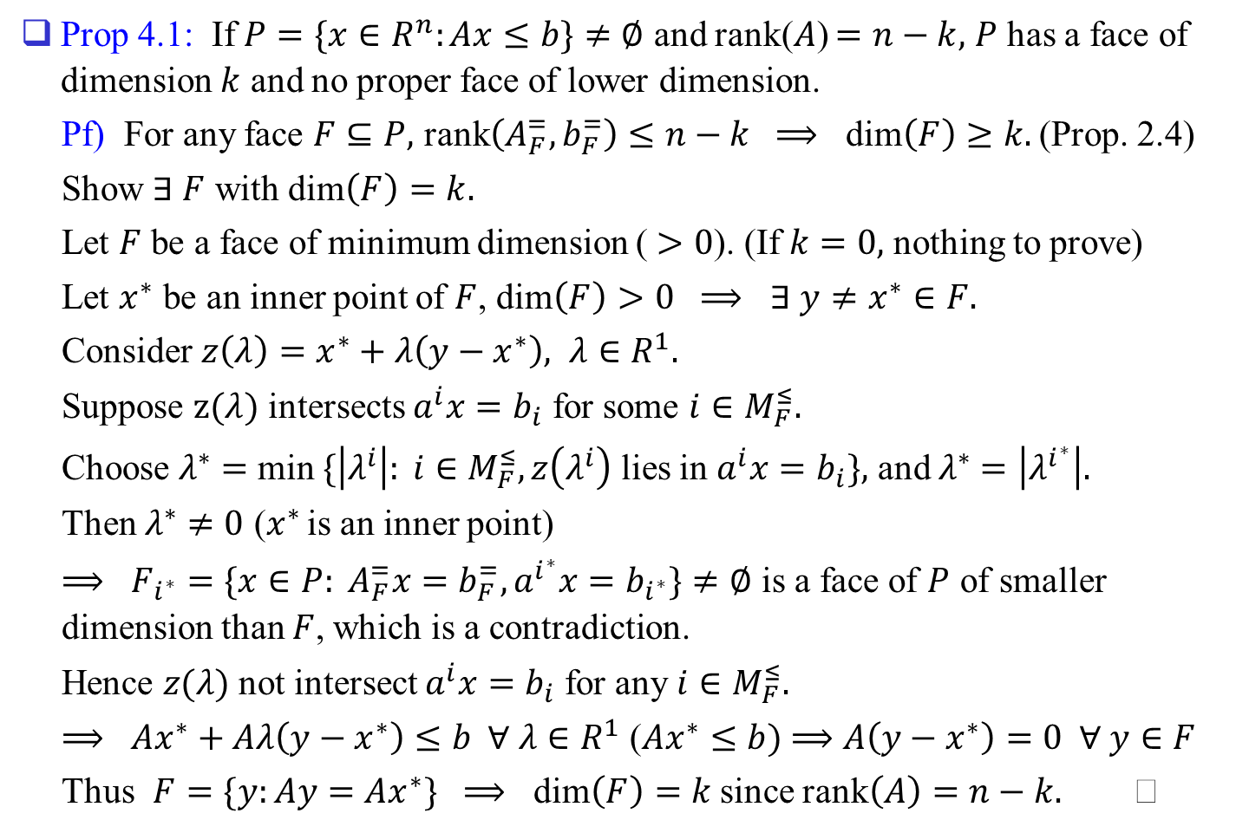
4. Describing Polyhedra by Extreme Points and Extreme Rays
Prop 4.1: If $P=\{x∈R^{n}:Ax≤b\}≠∅$ and rank($A$) $=n−k,$ $P$ has a face of dimension $k$ and no proper face of lower dimension.
Pf) For any face $F⊆P,$ rank$\left(A_{F}^{=},b_{F}^{=}\right)≤n−k$ $⟹$ dim$\left(F\right)≥k.$ (Prop. 2.4)
Show $∃ F$ with dim$\left(F\right)=k.$
Let $F$ be a face of minimum dimension ( $>0$). (If $k=0,$ nothing to prove)
Let $x^{∗}$ be an inner point of $F$, dim$\left(F\right)>0$ $⟹$ $∃ y≠x^{∗}∈F.$
Consider $z\left(λ\right)=x^{∗}+λ\left(y−x^{∗}\right),$ $λ∈R^{1}.$
Suppose $z(λ)$ intersects $a^{i}x=b_{i}$ for some $i∈M_{F}^{≤}.$
Choose $λ^{∗}=$ min $\{\left|λ^{i}\right|: i∈M_{F}^{≤}, z\left(λ^{i}\right)$ lies in $a^{i}x=b_{i}\},$ and $λ^{∗}=\left|λ^{i^{∗}}\right|.$
Then $λ^{∗}≠0$ ($x^{∗}$ is an inner point)
$⟹$ $F_{i^{∗}}=\{x∈P: A_{F}^{=}x=b_{F}^{=}, a^{i^{∗}}x=b_{i^{∗}}\}≠∅$ is a face of $P$ of smaller dimension than $F$, which is a contradiction.
Hence $z(λ)$ not intersect $a^{i}x=b_{i}$ for any $i∈M_{F}^{≤}.$
$⟹$ $Ax^{∗}+Aλ\left(y−x^{∗}\right)≤b ∀ λ∈R^{1}$ ($Ax^{∗}≤b)$ $⟹$ $A\left(y−x^{∗}\right)=0 ∀ y∈F$
Thus $F=\{y:Ay=Ax^{∗}\}$ $⟹$ dim$\left(F\right)=k$ since rank$\left(A\right)=n−k.$

Slide 5
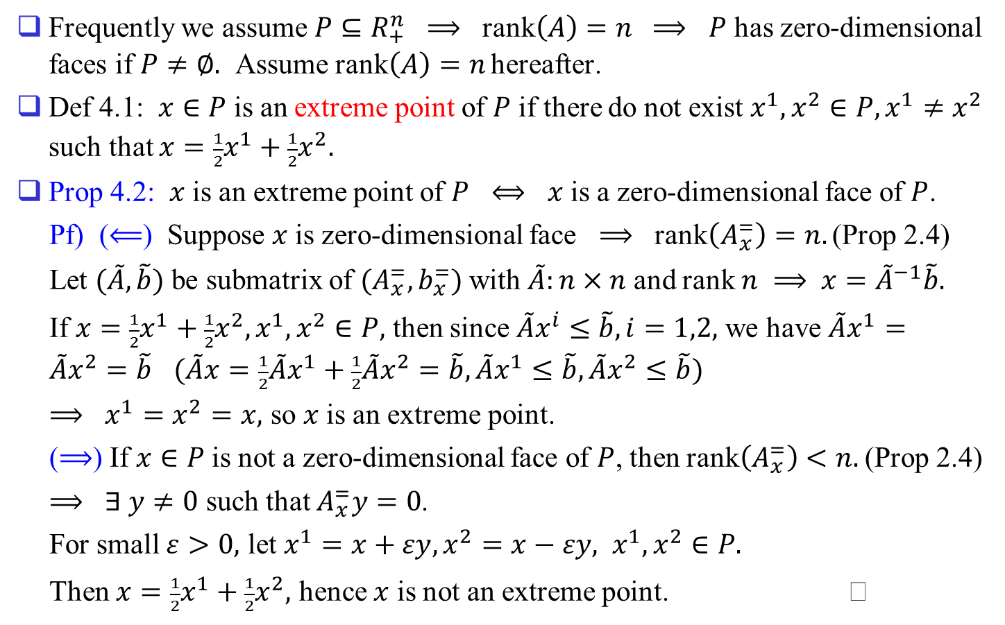
Frequently we assume $P⊆R_{+}^{n}$ $⟹$ rank$\left(A\right)=n$ $⟹$ $P$ has zero-dimensional faces if $P≠∅.$ Assume rank$\left(A\right)=n$ hereafter.
Def 4.1: $x∈P$ is an extreme point of $P$ if there do not exist $x^{1},x^{2}∈P, x^{1}≠x^{2}$ such that $x={\frac{1}{2}x}^{1}+\frac{1}{2}x^{2}.$
Prop 4.2: $x$ is an extreme point of $P$ $⟺$ $x$ is a zero-dimensional face of $P$.
Pf) ($⟸$) Suppose $x$ is zero-dimensional face $⟹$ rank$\left(A_{x}^{=}\right)=n.$ (Prop 2.4)
Let $(\tilde{A},\tilde{b})$ be submatrix of $(A_{x}^{=},b_{x}^{=})$ with $\tilde{A}:n×n$ and rank $n$ $⟹$ $x={\tilde{A}}^{−1}\tilde{b}.$
If $x={\frac{1}{2}x}^{1}+\frac{1}{2}x^{2}, x^{1},x^{2}∈P,$ then since ${\tilde{A}x}^{i}≤\tilde{b}, i=1,2,$ we have $\tilde{A}x^{1}=\tilde{A}x^{2}=\tilde{b}$ $(\tilde{A}x=\frac{1}{2}\tilde{A}x^{1}+\frac{1}{2}\tilde{A}x^{2}=\tilde{b}, \tilde{A}x^{1}≤\tilde{b}, \tilde{A}x^{2}≤\tilde{b})$
$⟹$ $x^{1}=x^{2}=x,$ so $x$ is an extreme point.
($⟹$) If $x∈P$ is not a zero-dimensional face of $P$, then rank$\left(A_{x}^{=}\right)<n.$ (Prop 2.4)
$⟹$ $∃ y≠0$ such that $A_{x}^{=}y=0$.
For small $ε>0,$ let $x^{1}=x+εy, x^{2}=x−εy, x^{1},x^{2}∈P.$
Then $x=\frac{1}{2}x^{1}+\frac{1}{2}x^{2},$ hence $x$ is not an extreme point.

Slide 6
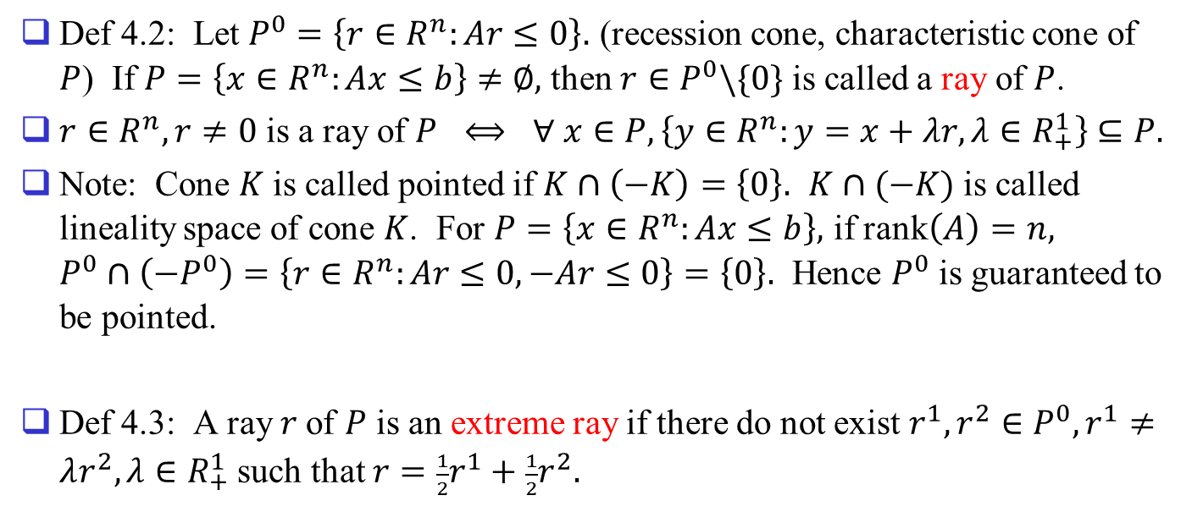
Def 4.2: Let $P^{0}=\left\{r∈R^{n}:Ar≤0\right\}.$ (recession cone, characteristic cone of $P$) If $P=\left\{x∈R^{n}:Ax≤b\right\}≠∅,$ then $r∈P^{0}\backslash \{0\}$ is called a ray of $P$.
$r∈R^{n}, r≠0$ is a ray of $P$ $⟺$ $∀ x∈P, \left\{y∈R^{n}:y=x+λr, λ∈R_{+}^{1}\right\}⊆P.$
Note: Cone $K$ is called pointed if $K∩\left(−K\right)=\left\{0\right\}.$ $K∩(−K)$ is called lineality space of cone $K$. For $P=\left\{x∈R^{n}:Ax≤b\right\},$ if rank$\left(A\right)=n,$ $P^{0}∩\left(−P^{0}\right)=\left\{r∈R^{n}:Ar≤0, −Ar≤0\right\}=\left\{0\right\}.$ Hence $P^{0}$ is guaranteed to be pointed.
Def 4.3: A ray $r$of $P$ is an extreme ray if there do not exist $r^{1},r^{2}∈P^{0}, r^{1}≠λr^{2}, λ∈R_{+}^{1}$ such that $r=\frac{1}{2}r^{1}+\frac{1}{2}r^{2}.$

Slide 7
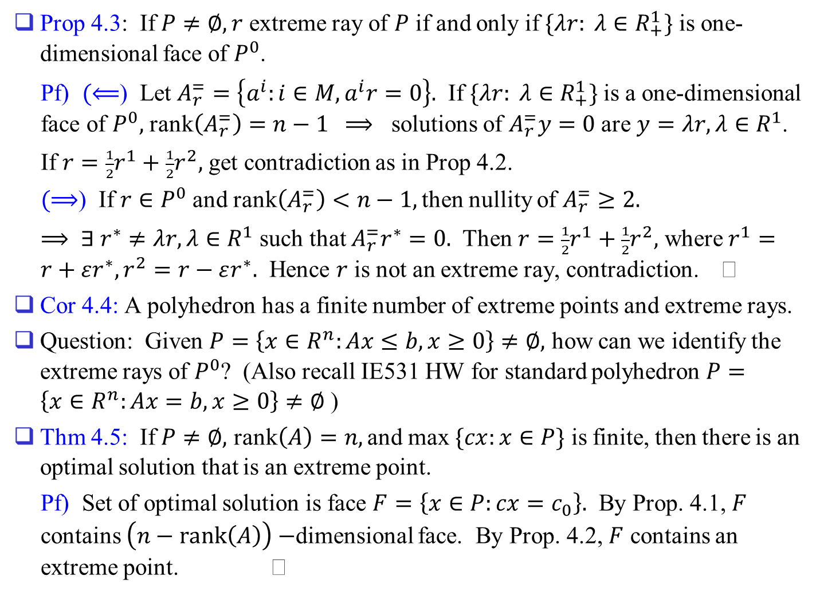
Prop 4.3: If $P≠∅, r$ extreme ray of $P$ if and only if $\{λr: λ∈R_{+}^{1}\}$ is one-dimensional face of $P^{0}$.
Pf) $(⟸$) Let $A_{r}^{=}=\left\{a^{i}:i∈M, a^{i}r=0\right\}.$ If $\{λr: λ∈R_{+}^{1}\}$ is a one-dimensional face of $P^{0},$ rank$\left(A_{r}^{=}\right)=n−1$ $⟹$ solutions of $A_{r}^{=}y=0$ are $y=λr, λ∈R^{1}$.
If $r=\frac{1}{2}r^{1}+\frac{1}{2}r^{2},$ get contradiction as in Prop 4.2.
$(⟹$) If $r∈P^{0}$ and rank$\left(A_{r}^{=}\right)<n−1,$ then nullity of $A_{r}^{=}≥2.$
$⟹$ $∃ r^{∗}≠λr, λ∈R^{1}$ such that $A_{r}^{=}r^{∗}=0.$ Then $r=\frac{1}{2}r^{1}+\frac{1}{2}r^{2},$ where $r^{1}=r+εr^{∗}, r^{2}=r−εr^{∗}.$ Hence $r$ is not an extreme ray, contradiction.
Cor 4.4: A polyhedron has a finite number of extreme points and extreme rays.
Question: Given $P=\left\{x∈R^{n}:Ax≤b, x≥0\right\}≠∅,$ how can we identify the extreme rays of $P^{0}$? (Also recall IE531 HW for standard polyhedron $P=\left\{x∈R^{n}:Ax=b, x≥0\right\}≠∅$ )
Thm 4.5: If $P≠∅,$ rank$\left(A\right)=n,$ and max $\{cx:x∈P\}$ is finite, then there is an optimal solution that is an extreme point.
Pf) Set of optimal solution is face $F=\left\{x∈P:cx=c_{0}\right\}.$ By Prop. 4.1, $F$ contains $\left(n−rank\left(A\right)\right)−$dimensional face. By Prop. 4.2, $F$ contains an extreme point.

Slide 8
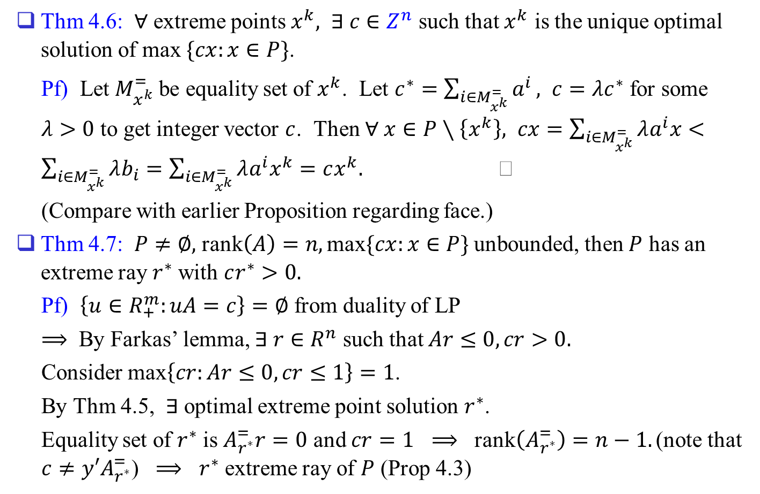
Thm 4.6: $∀$ extreme points $x^{k},$ $∃ c∈Z^{n}$ such that $x^{k}$ is the unique optimal solution of max $\{cx:x∈P\}$.
Pf) Let $M_{x^{k}}^{=}$ be equality set of $x^{k}$. Let $c^{∗}=\sum_{i∈M_{x^{k}}^{=}}{a^{i}},$ $c=λc^{∗}$ for some $λ>0$ to get integer vector $c$. Then $∀ x∈P∖\left\{x^{k}\right\},$ $cx=\sum_{i∈M_{x^{k}}^{=}}{λa^{i}x}<\sum_{i∈M_{x^{k}}^{=}}{λb_{i}}=\sum_{i∈M_{x^{k}}^{=}}{λa^{i}x^{k}}=cx^{k}.$
(Compare with earlier Proposition regarding face.)
Thm 4.7: $P≠∅,$ rank$\left(A\right)=n,$ max$\{cx:x∈P\}$ unbounded, then $P$ has an extreme ray $r^{∗}$ with $cr^{∗}>0.$
Pf) $\left\{u∈R_{+}^{m}:uA=c\right\}=∅$ from duality of LP
$⟹$ By Farkas’ lemma, $∃ r∈R^{n}$ such that $Ar≤0, cr>0.$
Consider max$\left\{cr:Ar≤0, cr≤1\right\}=1$.
By Thm 4.5, $∃$ optimal extreme point solution $r^{∗}$.
Equality set of $r^{∗}$ is $A_{r^{∗}}^{=}r=0$ and $cr=1$ $⟹$ rank$\left(A_{r^{∗}}^{=}\right)=n−1.$ (note that $c≠y′A_{r^{∗}}^{=}$) $⟹$ $r^{∗}$ extreme ray of $P$ (Prop 4.3)

Slide 9
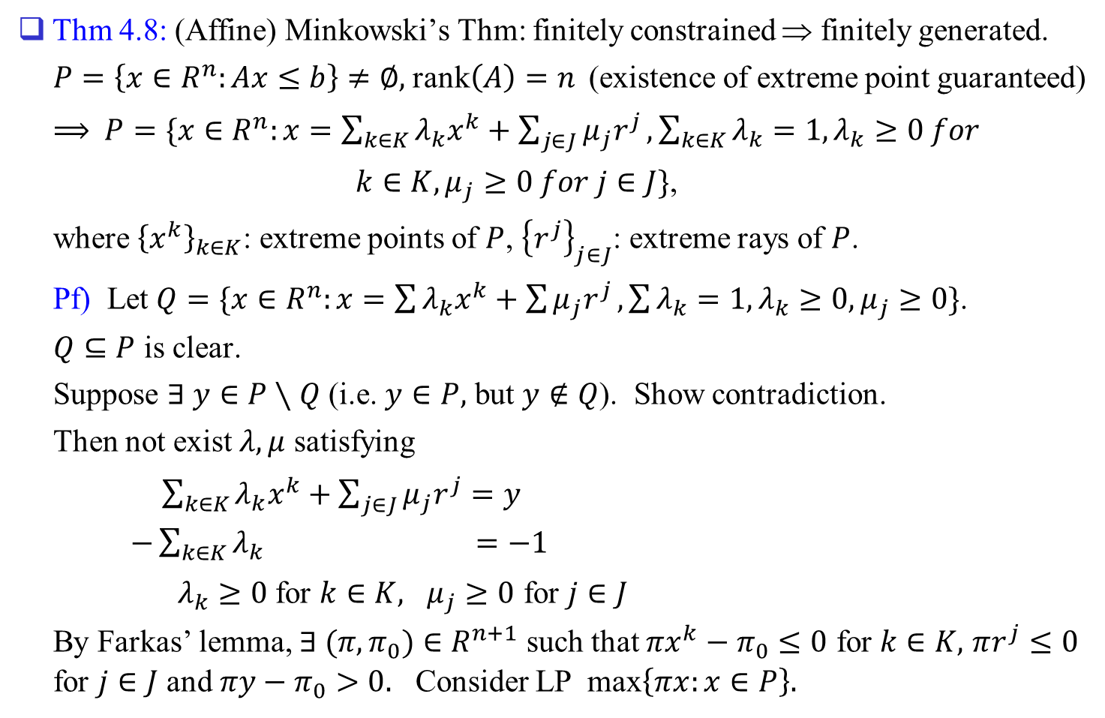
Thm 4.8: (Affine) Minkowski’s Thm: finitely constrained ⇒ finitely generated.
$P=\left\{x∈R^{n}:Ax≤b\right\}≠∅,$rank$\left(A\right)=n$ (existence of extreme point guaranteed)
$⟹$ $P=\{x∈R^{n}:x=\sum_{k∈K}{λ_{k}x^{k}+\sum_{j∈J}{μ_{j}r^{j}}, \sum_{k∈K}{λ_{k}=1, λ_{k}≥0 for}}$
$k∈K, μ_{j}≥0 for j∈J\}$,
where ${\left\{x^{k}\right\}}_{k∈K}$: extreme points of $P$, ${\left\{r^{j}\right\}}_{j∈J}$: extreme rays of $P$.
Pf) Let $Q=\{x∈R^{n}:x=\sum{λ_{k}x^{k}+\sum{μ_{j}r^{j}}, \sum{λ_{k}=1, λ_{k}≥0, μ_{j}≥0\}}}$.
$Q⊆P$ is clear.
Suppose $∃ y∈P∖Q$ (i.e. $y∈P,$ but $y∉Q$). Show contradiction.
Then not exist $λ,μ$ satisfying
$\sum_{k∈K}{λ_{k}x^{k}}+\sum_{j∈J}{μ_{j}r^{j}}=y$
$−\sum_{k∈K}{λ_{k}}$ $=−1$
$λ_{k}≥0$ for $k∈K,$ $μ_{j}≥0$ for $j∈J$
By Farkas’ lemma, $∃ (π,π_{0})∈R^{n+1}$ such that $πx^{k}−π_{0}≤0$ for $k∈K,$ $πr^{j}≤0$ for $j∈J$ and $πy−π_{0}>0.$ Consider LP max$\left\{πx:x∈P\right\}.$

Slide 10
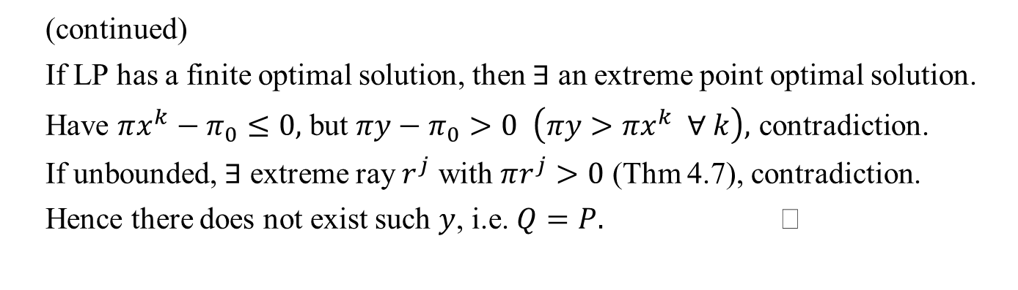
(continued)
If LP has a finite optimal solution, then $∃$ an extreme point optimal solution.
Have $πx^{k}−π_{0}≤0,$ but $πy−π_{0}>0$ $\left(πy>πx^{k} ∀ k\right),$ contradiction.
If unbounded, $∃$ extreme ray $r^{j}$ with $πr^{j}>0$ (Thm 4.7), contradiction.
Hence there does not exist such $y$, i.e. $Q=P.$

Slide 11
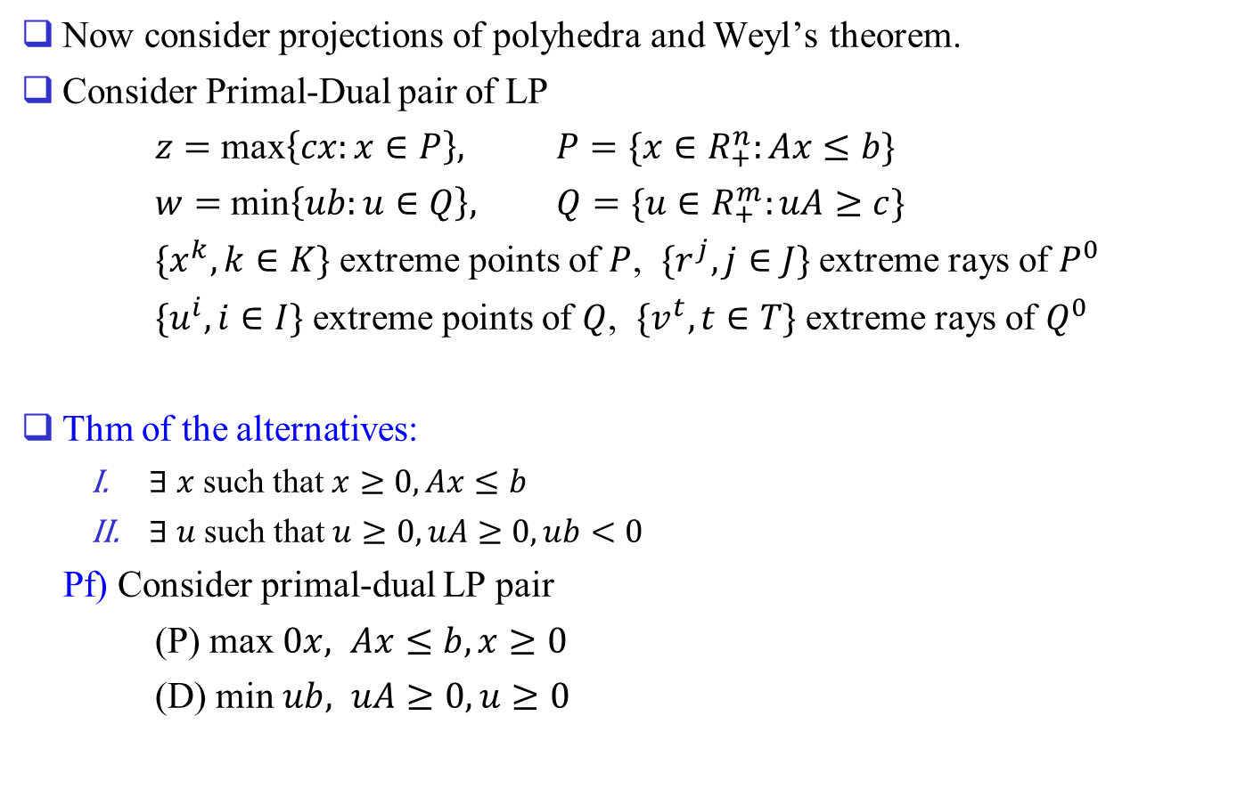
Now consider projections of polyhedra and Weyl’s theorem.
Consider Primal-Dual pair of LP
$z=$ max$\left\{cx:x∈P\right\},$ $P=\{x∈R_{+}^{n}:Ax≤b\}$
$w=$ min$\left\{ub:u∈Q\right\},$ $Q=\{u∈R_{+}^{m}:uA≥c\}$
$\{x^{k}, k∈K\}$ extreme points of $P$, $\{r^{j}, j∈J\}$ extreme rays of $P^{0}$
$\{u^{i}, i∈I\}$ extreme points of $Q$, $\{v^{t}, t∈T\}$ extreme rays of $Q^{0}$
Thm of the alternatives:
  $∃ x$ such that $x≥0, Ax≤b$
  $∃ u$ such that $u≥0, uA≥0, ub<0$
Pf) Consider primal-dual LP pair
(P) max $0x,$ $Ax≤b, x≥0$
(D) min $ub,$ $uA≥0, u≥0$

Slide 12
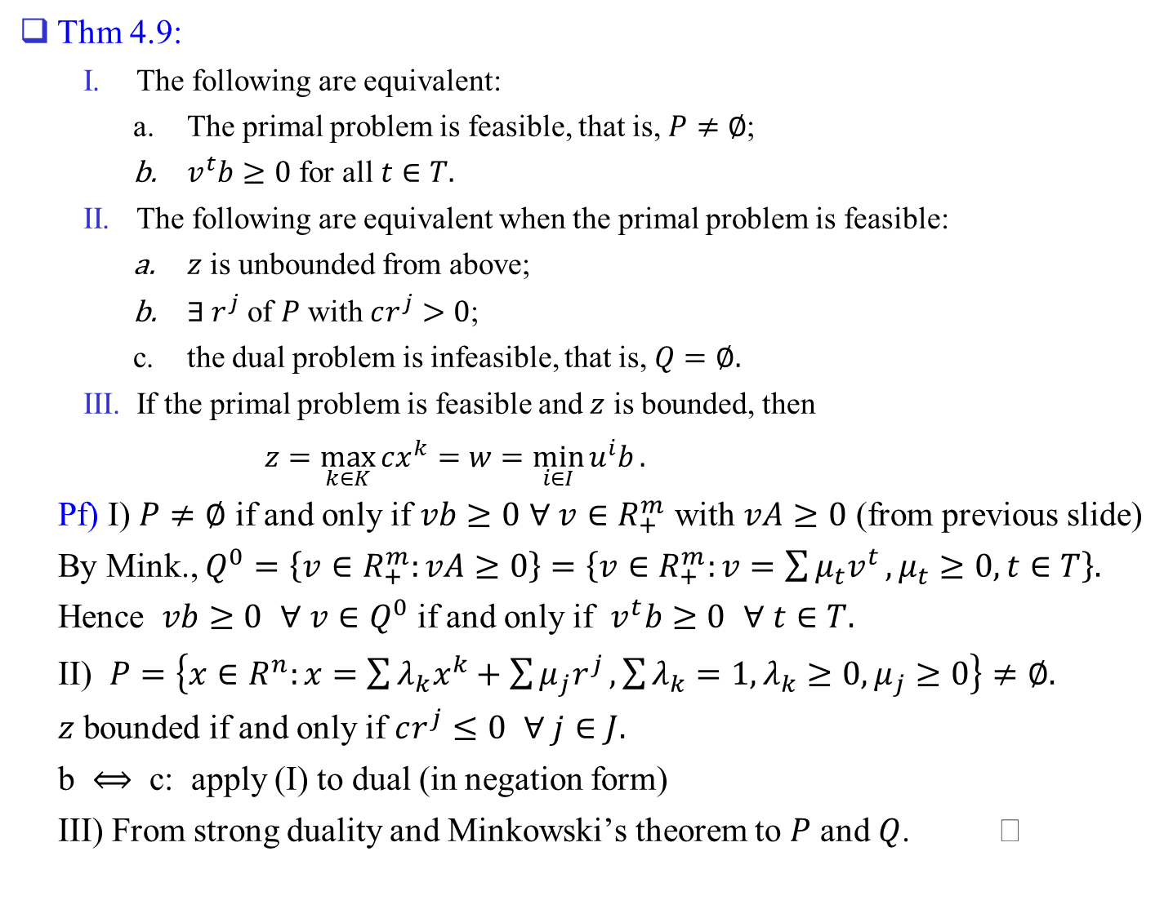
Thm 4.9:
  The following are equivalent:
    The primal problem is feasible, that is, $P≠∅$;
    $v^{t}b≥0$ for all $t∈T.$
  The following are equivalent when the primal problem is feasible:
    $z$ is unbounded from above;
    $∃ r^{j}$ of $P$ with $cr^{j}>0$;
    the dual problem is infeasible, that is, $Q=∅.$
  If the primal problem is feasible and $z$ is bounded, then
  $z=\max_{k∈K}{cx^{k}}=w=\min_{i∈I}{u^{i}b}.$
Pf) I) $P≠∅$ if and only if $vb≥0$ $∀ v∈R_{+}^{m}$ with $vA≥0$ (from previous slide)
By Mink., $Q^{0}=\left\{v∈R_{+}^{m}:vA≥0\right\}=\left\{v∈R_{+}^{m}:v=\sum{μ_{t}v^{t}},μ_{t}≥0,t∈T\right\}.$
Hence $vb≥0$ $∀ v∈Q^{0}$ if and only if $v^{t}b≥0$ $∀ t∈T.$
II) $P=\left\{x∈R^{n}:x=\sum{λ_{k}x^{k}+\sum{μ_{j}r^{j}},\sum{λ_{k}=1,λ_{k}≥0,μ_{j}≥0}}\right\}≠∅.$
$z$ bounded if and only if $cr^{j}≤0$ $∀ j∈J.$
b $⟺$ c: apply (I) to dual (in negation form)
III) From strong duality and Minkowski’s theorem to $P$ and $Q$.

Slide 13
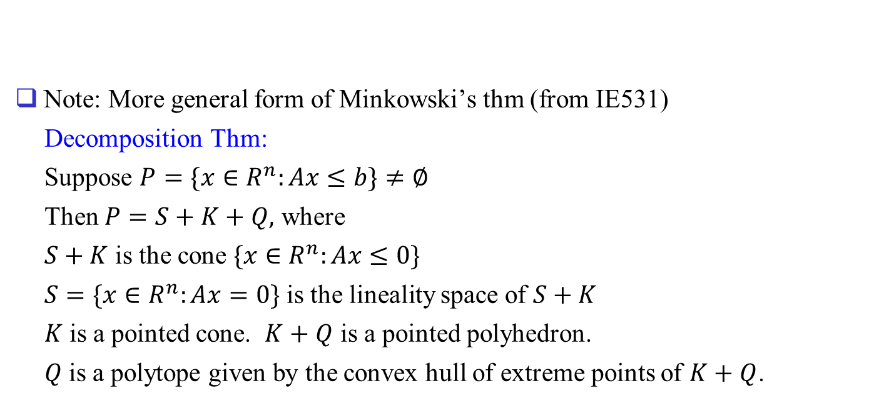
Note: More general form of Minkowski’s thm (from IE531)
Decomposition Thm:
Suppose $P=\{x∈R^{n}:Ax≤b\}≠∅$
Then $P=S+K+Q,$ where
$S+K$ is the cone $\{x∈R^{n}:Ax≤0\}$
$S=\{x∈R^{n}:Ax=0\}$ is the lineality space of $S+K$
$K$ is a pointed cone. $K+Q$ is a pointed polyhedron.
$Q$ is a polytope given by the convex hull of extreme points of $K+Q$.

Slide 14
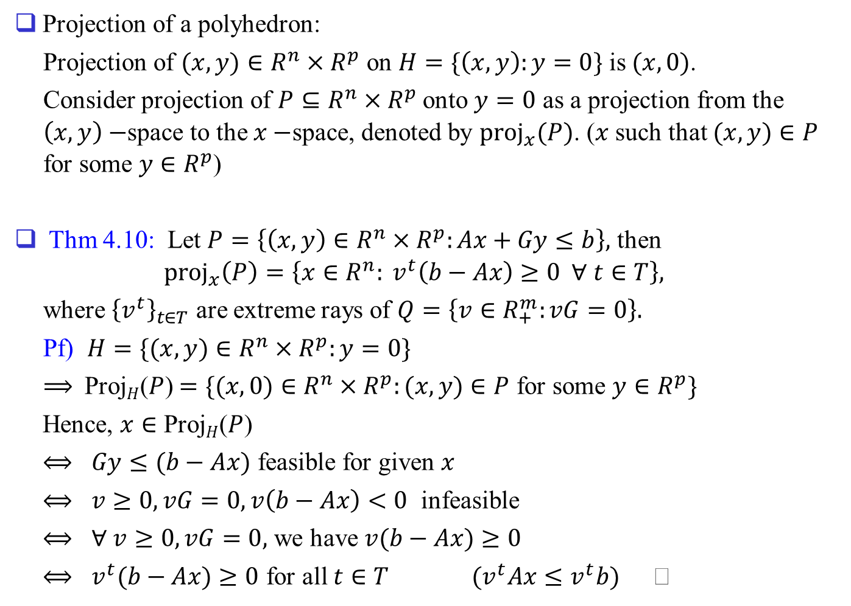
Projection of a polyhedron:
Projection of $(x,y)∈R^{n}×R^{p}$ on $H=\{\left(x,y\right):y=0\}$ is $(x,0)$.
Consider projection of $P⊆R^{n}×R^{p}$ onto $y=0$ as a projection from the $\left(x,y\right)−$space to the $x−$space, denoted by ${proj}_{x}(P)$. ($x$ such that $(x,y)∈P$ for some $y∈R^{p}$)
Thm 4.10: Let $P=\left\{\left(x,y\right)∈R^{n}×R^{p}:Ax+Gy≤b\right\},$ then
$${proj}_{x}\left(P\right)=\left\{x∈R^{n}: v^{t}\left(b−Ax\right)≥0 ∀ t∈T\right\},$$
where ${\left\{v^{t}\right\}}_{t∈T}$ are extreme rays of $Q=\left\{v∈R_{+}^{m}:vG=0\right\}.$
Pf) $H=\{(x,y)∈R^{n}×R^{p}:y=0\}$
$⟹$ Proj$H$($P$)$=\{(x,0)∈R^{n}×R^{p}:(x,y)∈P$ for some $y∈R^{p}\}$
Hence, $x∈$ Proj$H$($P$)
$⟺$ $Gy≤(b−Ax)$ feasible for given $x$
$⟺$ $v≥0, vG=0, v\left(b−Ax\right)<0$ infeasible
$⟺$ $∀ v≥0, vG=0,$ we have $v(b−Ax)≥0$
$⟺$ $v^{t}(b−Ax)≥0$ for all $t∈T$ $(v^{t}Ax≤v^{t}b)$

Slide 15
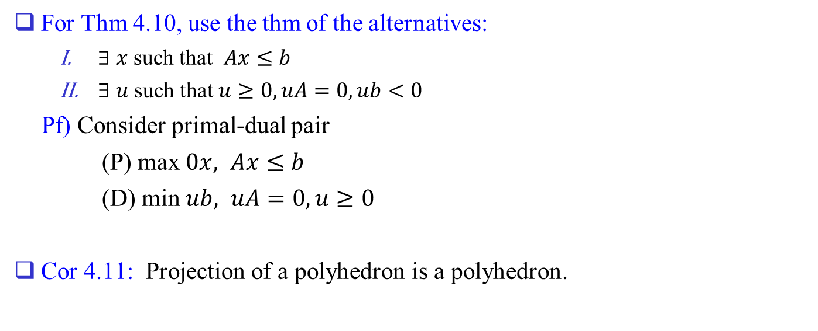
For Thm 4.10, use the thm of the alternatives:
  $∃ x$ such that $Ax≤b$
  $∃ u$ such that $u≥0, uA=0, ub<0$
Pf) Consider primal-dual pair
(P) max $0x,$ $Ax≤b$
(D) min $ub,$ $uA=0, u≥0$
Cor 4.11: Projection of a polyhedron is a polyhedron.

Slide 16
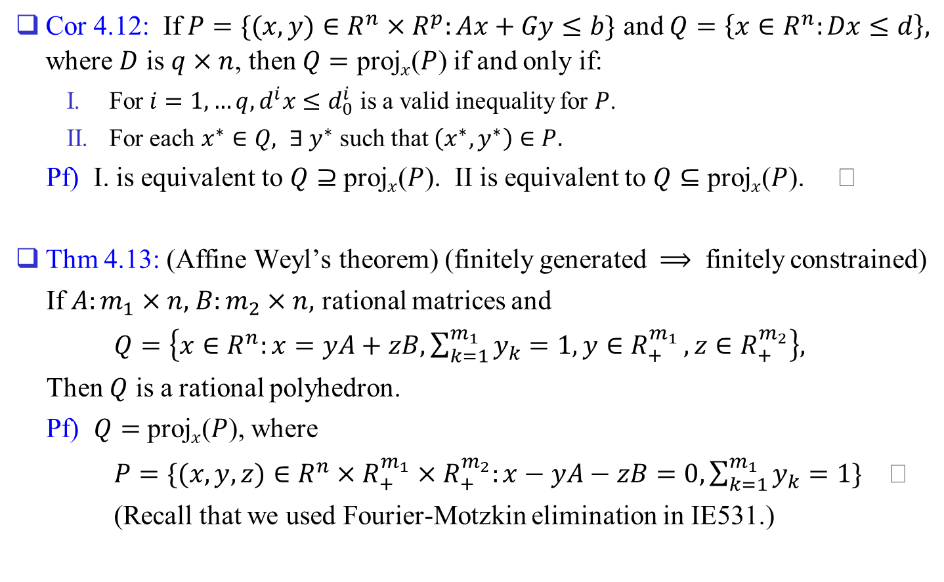
Cor 4.12: If $P=\{(x,y)∈R^{n}×R^{p}:Ax+Gy≤b\}$ and $Q=\left\{x∈R^{n}:Dx≤d\right\},$ where $D$ is $q×n$, then $Q=$ proj$x$($P$) if and only if:
  For $i=1,…q,d^{i}x≤d_{0}^{i}$ is a valid inequality for $P$.
  For each $x^{∗}∈Q,$ $∃ y^{∗}$ such that $\left(x^{∗},y^{∗}\right)∈P.$
Pf) I. is equivalent to $Q⊇$ proj$x$($P$). II is equivalent to $Q⊆$ proj$x$($P$).
Thm 4.13: (Affine Weyl’s theorem) (finitely generated $⟹$ finitely constrained)
If $A:m_{1}×n,$ $B:m_{2}×n,$ rational matrices and
$Q=\left\{x∈R^{n}:x=yA+zB, \sum_{k=1}^{m_{1}}{y_{k}=1, y∈R_{+}^{m_{1}}},z∈R_{+}^{m_{2}}\right\},$
Then $Q$ is a rational polyhedron.
Pf) $Q=$ proj$x$($P$), where
$P=\{(x,y,z)∈R^{n}×R_{+}^{m_{1}}×R_{+}^{m_{2}}:x−yA−zB=0, \sum_{k=1}^{m_{1}}{y_{k}}=1\}$
(Recall that we used Fourier-Motzkin elimination in IE531.)

