Slide 1
I.4 Polyhedral Theory (NW)

Slide 2
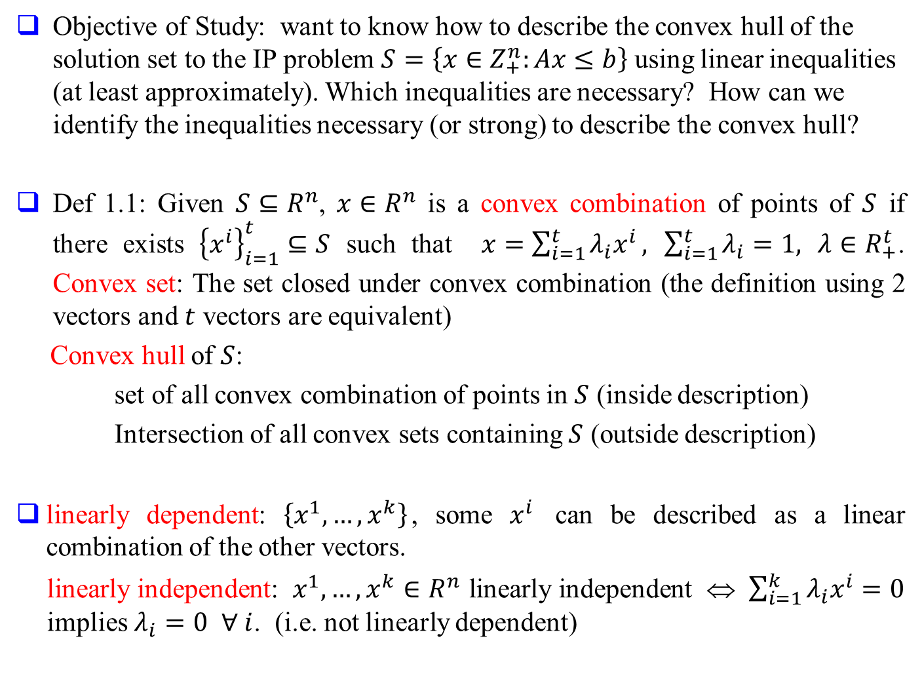
Objective of Study: want to know how to describe the convex hull of the solution set to the IP problem $S=\left\{x∈Z_{+}^{n}:Ax≤b\right\}$ using linear inequalities (at least approximately). Which inequalities are necessary? How can we identify the inequalities necessary (or strong) to describe the convex hull?
Def 1.1: Given $S⊆R^{n}$, $x∈R^{n}$ is a convex combination of points of $S$ if there exists ${\left\{x^{i}\right\}}_{i=1}^{t}⊆S$ such that $x=\sum_{i=1}^{t}{λ_{i}x^{i}},$ $\sum_{i=1}^{t}{λ_{i}}=1,$ $λ∈R_{+}^{t}$. Convex set: The set closed under convex combination (the definition using 2 vectors and $t$ vectors are equivalent)
Convex hull of $S$:
set of all convex combination of points in $S$ (inside description)
Intersection of all convex sets containing $S$ (outside description)
linearly dependent: $\left\{x^{1},…,x^{k}\right\}$, some $x^{i}$ can be described as a linear combination of the other vectors.
linearly independent: $x^{1},…,x^{k}∈R^{n}$ linearly independent ⇔ $\sum_{i=1}^{k}{λ_{i}x^{i}}=0$ implies $λ_{i}=0$ $∀ i$. (i.e. not linearly dependent)

Slide 3
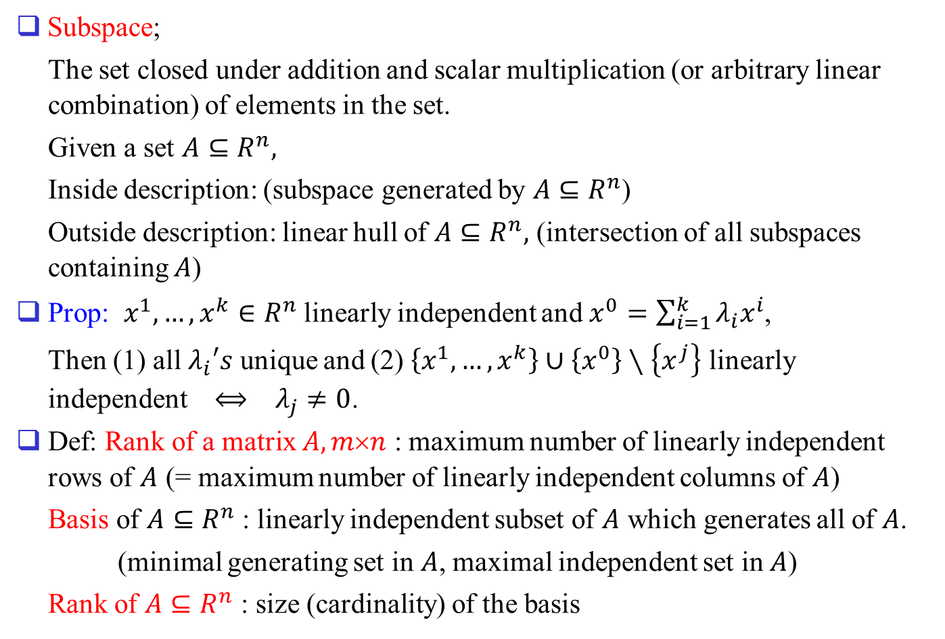
Subspace;
The set closed under addition and scalar multiplication (or arbitrary linear combination) of elements in the set.
Given a set $A⊆R^{n},$
Inside description: (subspace generated by $A⊆R^{n}$)
Outside description: linear hull of $A⊆R^{n},$ (intersection of all subspaces containing $A$)
Prop: $x^{1},…,x^{k}∈R^{n}$ linearly independent and $x^{0}=\sum_{i=1}^{k}{λ_{i}x^{i}}$,
Then (1) all $λ_{i}′s$ unique and (2) $\left\{x^{1},…,x^{k}\right\}∪\left\{x^{0}\right\}∖\left\{x^{j}\right\}$ linearly independent $⟺$ $λ_{j}≠0$.
Def: Rank of a matrix $A, mn$ : maximum number of linearly independent rows of $A$ (= maximum number of linearly independent columns of $A$)
Basis of $A⊆R^{n}$ : linearly independent subset of $A$ which generates all of $A$.
(minimal generating set in $A$, maximal independent set in $A$)
Rank of $A⊆R^{n}$ : size (cardinality) of the basis

Slide 4
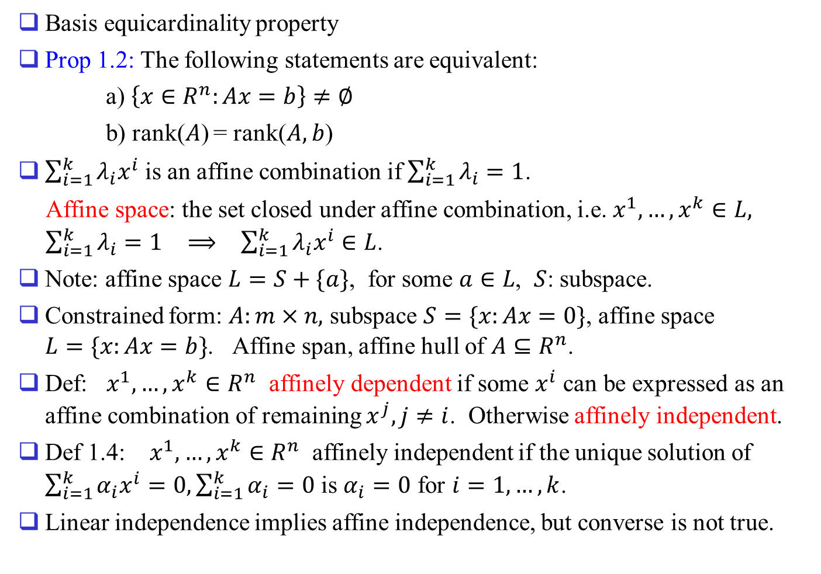
Basis equicardinality property
Prop 1.2: The following statements are equivalent:
a) $\left\{x∈R^{n}:Ax=b\right\}≠∅$
b) rank($A$) = rank($A, b$)
$\sum_{i=1}^{k}{λ_{i}x^{i}}$ is an affine combination if $\sum_{i=1}^{k}{λ_{i}}=1$.
Affine space: the set closed under affine combination, i.e. $x^{1},…,x^{k}∈L, \sum_{i=1}^{k}{λ_{i}}=1$ $⟹$ $\sum_{i=1}^{k}{λ_{i}x^{i}}∈L$.
Note: affine space $L=S+\{a\}$, for some $a∈L$, $S$: subspace.
Constrained form: $A:m×n,$ subspace $S=\{x:Ax=0\}$, affine space $L=\{x:Ax=b\}$. Affine span, affine hull of $A⊆R^{n}$.
Def: $x^{1},…,x^{k}∈R^{n}$ affinely dependent if some $x^{i}$ can be expressed as an affine combination of remaining $x^{j}, j≠i$. Otherwise affinely independent.
Def 1.4: $x^{1},…,x^{k}∈R^{n}$ affinely independent if the unique solution of $\sum_{i=1}^{k}{α_{i}x^{i}}=0, \sum_{i=1}^{k}{α_{i}}=0$ is $α_{i}=0$ for $i=1,…,k$.
Linear independence implies affine independence, but converse is not true.

Slide 5
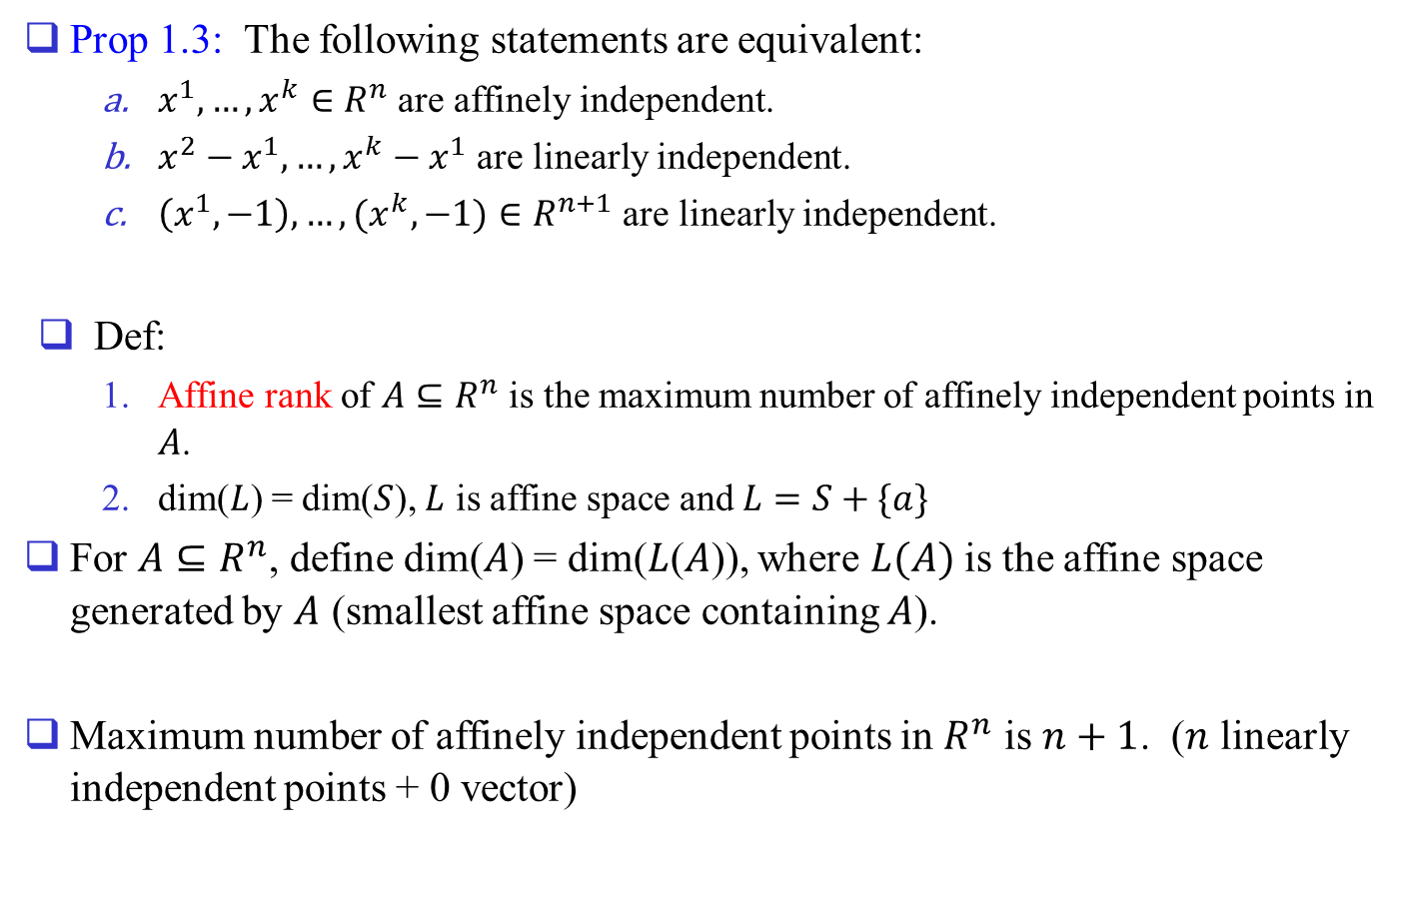
Prop 1.3: The following statements are equivalent:
  $x^{1},…,x^{k}∈R^{n}$ are affinely independent.
  $x^{2}−x^{1},…,x^{k}−x^{1}$ are linearly independent.
  $\left(x^{1},−1\right),…,(x^{k},−1)∈R^{n+1}$ are linearly independent.
Def:
  Affine rank of $A⊆R^{n}$ is the maximum number of affinely independent points in $A$.
  dim($L$) = dim($S$), $L$ is affine space and $L=S+\{a\}$
For $A⊆R^{n}$, define dim($A$) = dim($L$($A$)), where $L(A)$ is the affine space generated by $A$ (smallest affine space containing $A$).
Maximum number of affinely independent points in $R^{n}$ is $n+1$. ($n$ linearly independent points + 0 vector)

Slide 6
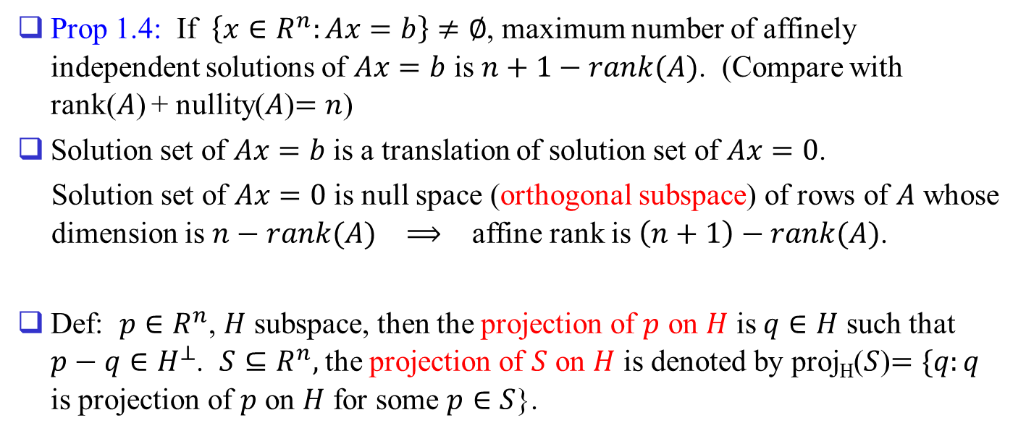
Prop 1.4: If $\left\{x∈R^{n}:Ax=b\right\}≠∅$, maximum number of affinely independent solutions of $Ax=b$ is $n+1−rank(A)$. (Compare with rank($A$) + nullity($A$)$=n$)
Solution set of $Ax=b$ is a translation of solution set of $Ax=0$.
Solution set of $Ax=0$ is null space (orthogonal subspace) of rows of $A$ whose dimension is $n−rank(A)$ $⟹$ affine rank is $\left(n+1\right)−rank(A)$.
Def: $p∈R^{n}$, $H$ subspace, then the projection of $p$ on $H$ is $q∈H$ such that $p−q∈H^{⊥}$. $S⊆R^{n},$ the projection of $S$ on $H$ is denoted by proj_{H}($S$)$=\{q:q$ is projection of $p$ on $H$ for some $p∈S$}.

Slide 7
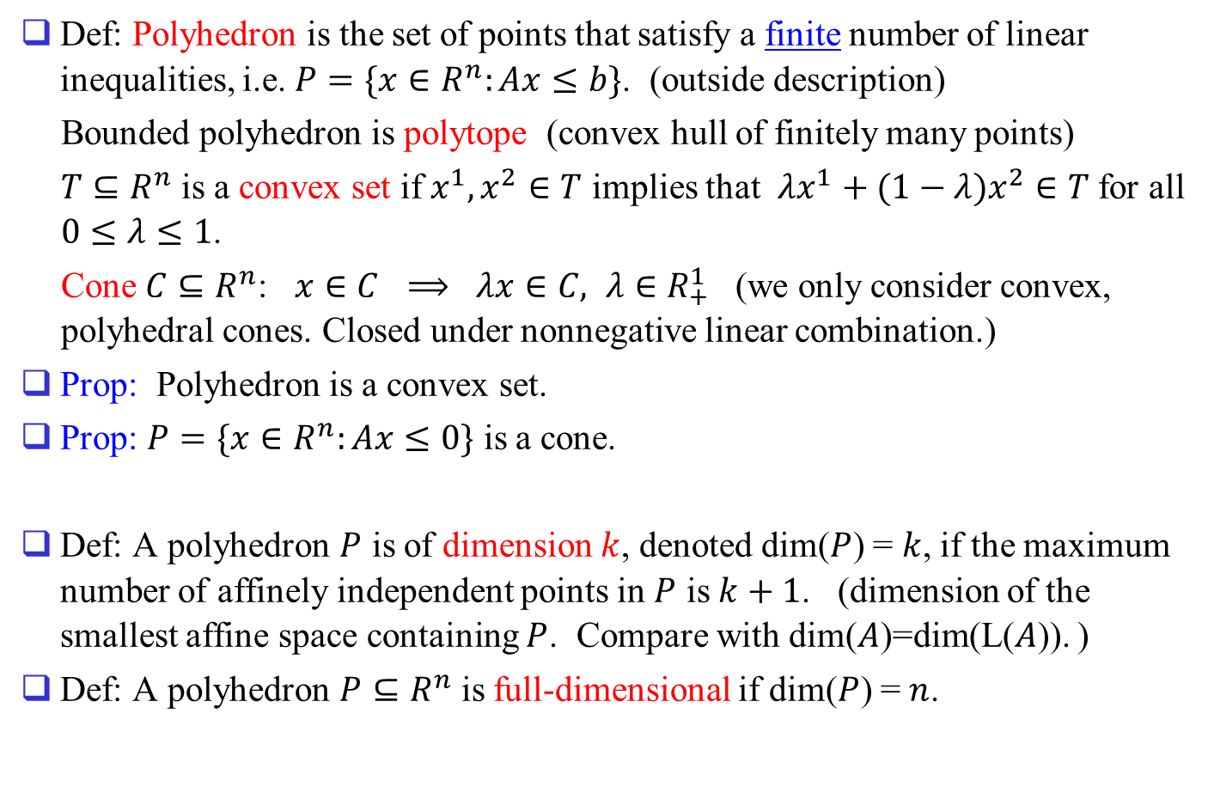
2.Definitions of Polyhedra and Dimension
Def: Polyhedron is the set of points that satisfy a finite number of linear inequalities, i.e. $P=\{x∈R^{n}:Ax≤b\}$. (outside description)
Bounded polyhedron is polytope (convex hull of finitely many points)
$T⊆R^{n}$ is a convex set if $x^{1},x^{2}∈T$ implies that $λx^{1}+(1−λ)x^{2}∈T$ for all $0≤λ≤1$.
Cone $C⊆R^{n}$: $x∈C$ $⟹$ $λx∈C, λ∈R_{+}^{1}$ (we only consider convex, polyhedral cones. Closed under nonnegative linear combination.)
Prop: Polyhedron is a convex set.
Prop: $P=\{x∈R^{n}:Ax≤0\}$ is a cone.
Def: A polyhedron $P$ is of dimension $k$, denoted dim($P$) = $k$, if the maximum number of affinely independent points in $P$ is $k+1$. (dimension of the smallest affine space containing $P$. Compare with dim($A$)=dim(L($A$)). )
Def: A polyhedron $P⊆R^{n}$ is full-dimensional if dim($P$) = $n$.

Slide 8
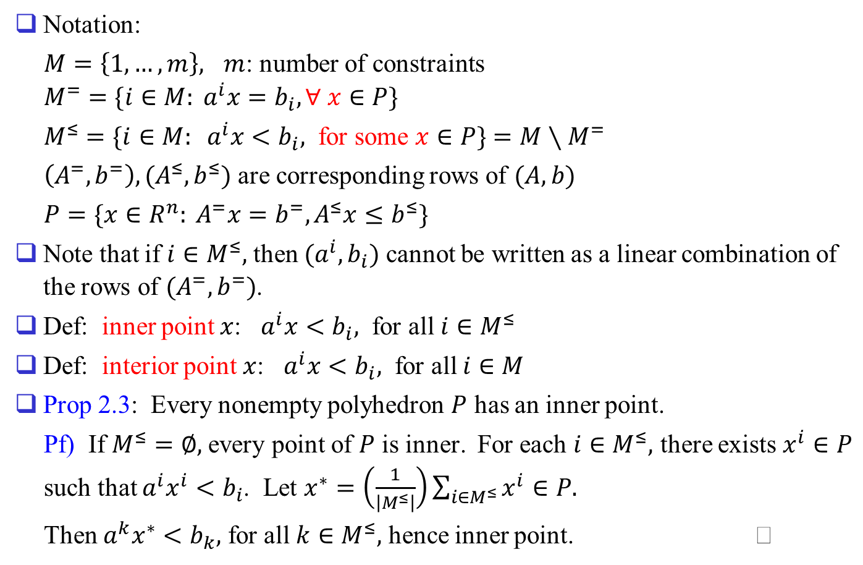
Notation:
$M=\left\{1,…,m\right\},$ $m$: number of constraints
$$M^{=}=\{i∈M: a^{i}x=b_{i}, ∀ x∈P\}$$
$M^{≤}=\{i∈M: a^{i}x<b_{i},$ for some $x∈P\}$ $=M∖M^{=}$
$\left(A^{=},b^{=}\right), (A^{≤},b^{≤})$ are corresponding rows of $(A,b)$
$P=\{x∈R^{n}: A^{=}x=b^{=}, A^{≤}x≤b^{≤}\}$
Note that if $i∈M^{≤},$ then $(a^{i},b_{i})$ cannot be written as a linear combination of the rows of $(A^{=},b^{=})$.
Def: inner point $x$: $a^{i}x<b_{i},$ for all $i∈M^{≤}$
Def: interior point $x$: $a^{i}x<b_{i},$ for all $i∈M$
Prop 2.3: Every nonempty polyhedron $P$ has an inner point.
Pf) If $M^{≤}=∅,$ every point of $P$ is inner. For each $i∈M^{≤},$ there exists $x^{i}∈P$ such that $a^{i}x^{i}<b_{i}$. Let $x^{∗}=\left(\frac{1}{\left|M^{≤}\right|}\right)\sum_{i∈M^{≤}}{x^{i}}∈P.$
Then $a^{k}x^{∗}<b_{k},$ for all $k∈M^{≤},$ hence inner point.

Slide 9
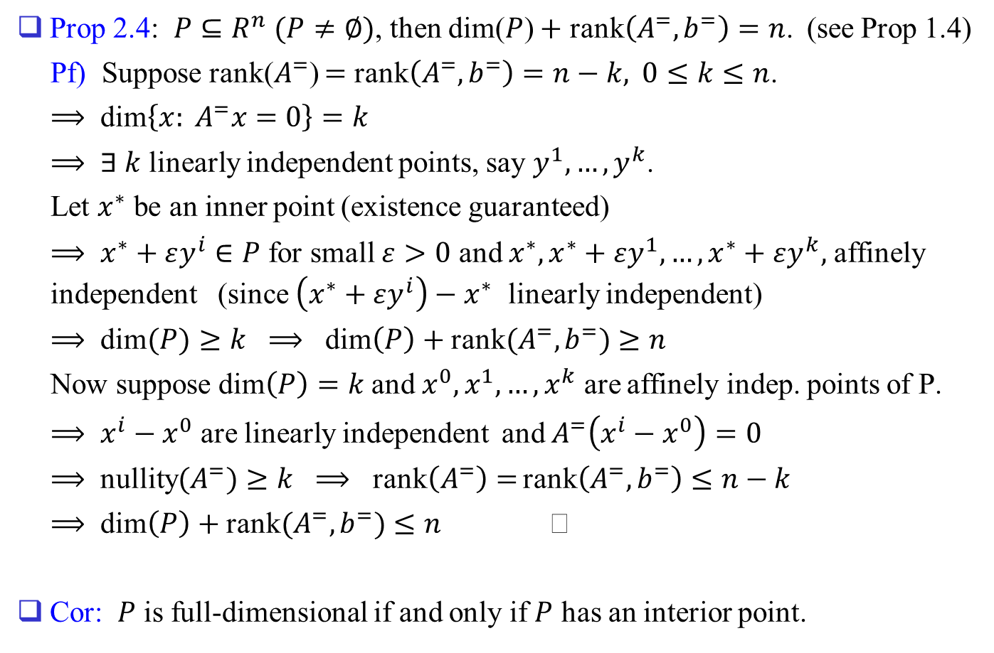
Prop 2.4: $P⊆R^{n}$ $(P≠∅)$, then dim($P$) $+$ rank$\left(A^{=},b^{=}\right)=n$. (see Prop 1.4)
Pf) Suppose rank($A^{=}$) $=$ rank$\left(A^{=},b^{=}\right)=n−k,$ $0≤k≤n$.
$⟹$ dim$\left\{x: A^{=}x=0\right\}=k$
$⟹$ $∃ k$ linearly independent points, say $y^{1},…,y^{k}$.
Let $x^{∗}$ be an inner point (existence guaranteed)
$⟹$ $x^{∗}+εy^{i}∈P$ for small $ε>0$ and $x^{∗},x^{∗}+εy^{1},…,x^{∗}+εy^{k},$ affinely independent (since $\left(x^{∗}+εy^{i}\right)−x^{∗}$ linearly independent)
$⟹$ dim$(P)≥k$ $⟹$ dim$\left(P\right)+$ rank$(A^{=},b^{=})≥n$
Now suppose dim$\left(P\right)=k$ and $x^{0},x^{1},…,x^{k}$ are affinely indep. points of P.
$⟹$ $x^{i}−x^{0}$ are linearly independent and $A^{=}\left(x^{i}−x^{0}\right)=0$
$⟹$ nullity$(A^{=})≥k$ $⟹$ rank$\left(A^{=}\right)=$ rank$\left(A^{=},b^{=}\right)≤n−k$
$⟹$ dim$\left(P\right)+$ rank$(A^{=},b^{=})≤n$
Cor: $P$ is full-dimensional if and only if $P$ has an interior point.

Slide 10
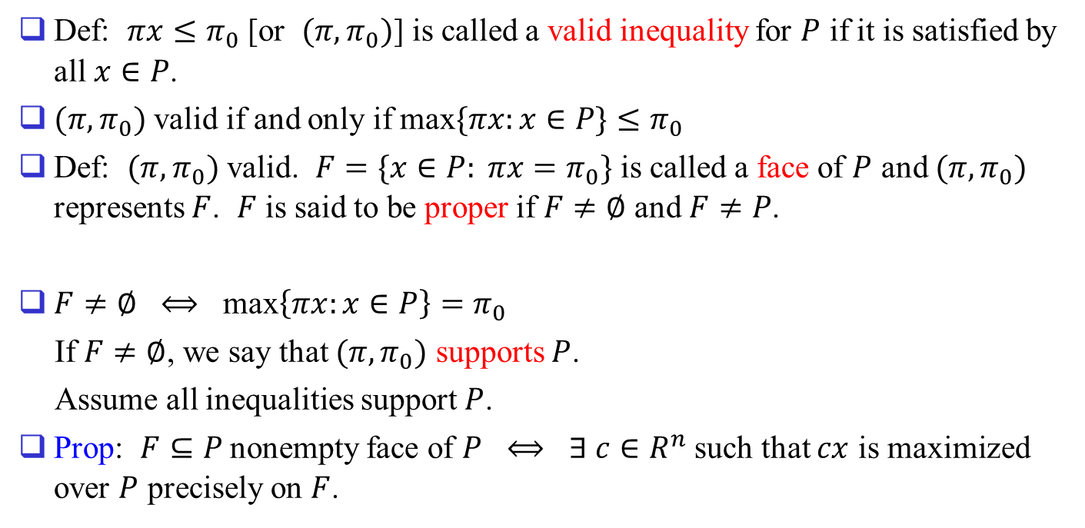
3. Describing Polyhedra by Facets
Def: $πx≤π_{0}$ [or $(π,π_{0})$] is called a valid inequality for $P$ if it is satisfied by all $x∈P$.
$(π,π_{0})$ valid if and only if max$\{πx:x∈P\}≤π_{0}$
Def: $(π,π_{0})$ valid. $F=\{x∈P: πx=π_{0}\}$ is called a face of $P$ and $(π,π_{0})$ represents $F$. $F$ is said to be proper if $F≠∅$ and $F≠P$.
$F≠∅$ $⟺$ max$\left\{πx:x∈P\right\}=π_{0}$
If $F≠∅$, we say that $(π,π_{0})$ supports $P$.
Assume all inequalities support $P$.
Prop: $F⊆P$ nonempty face of $P$ $⟺$ $∃ c∈R^{n}$ such that $cx$ is maximized over $P$ precisely on $F$.

Slide 11
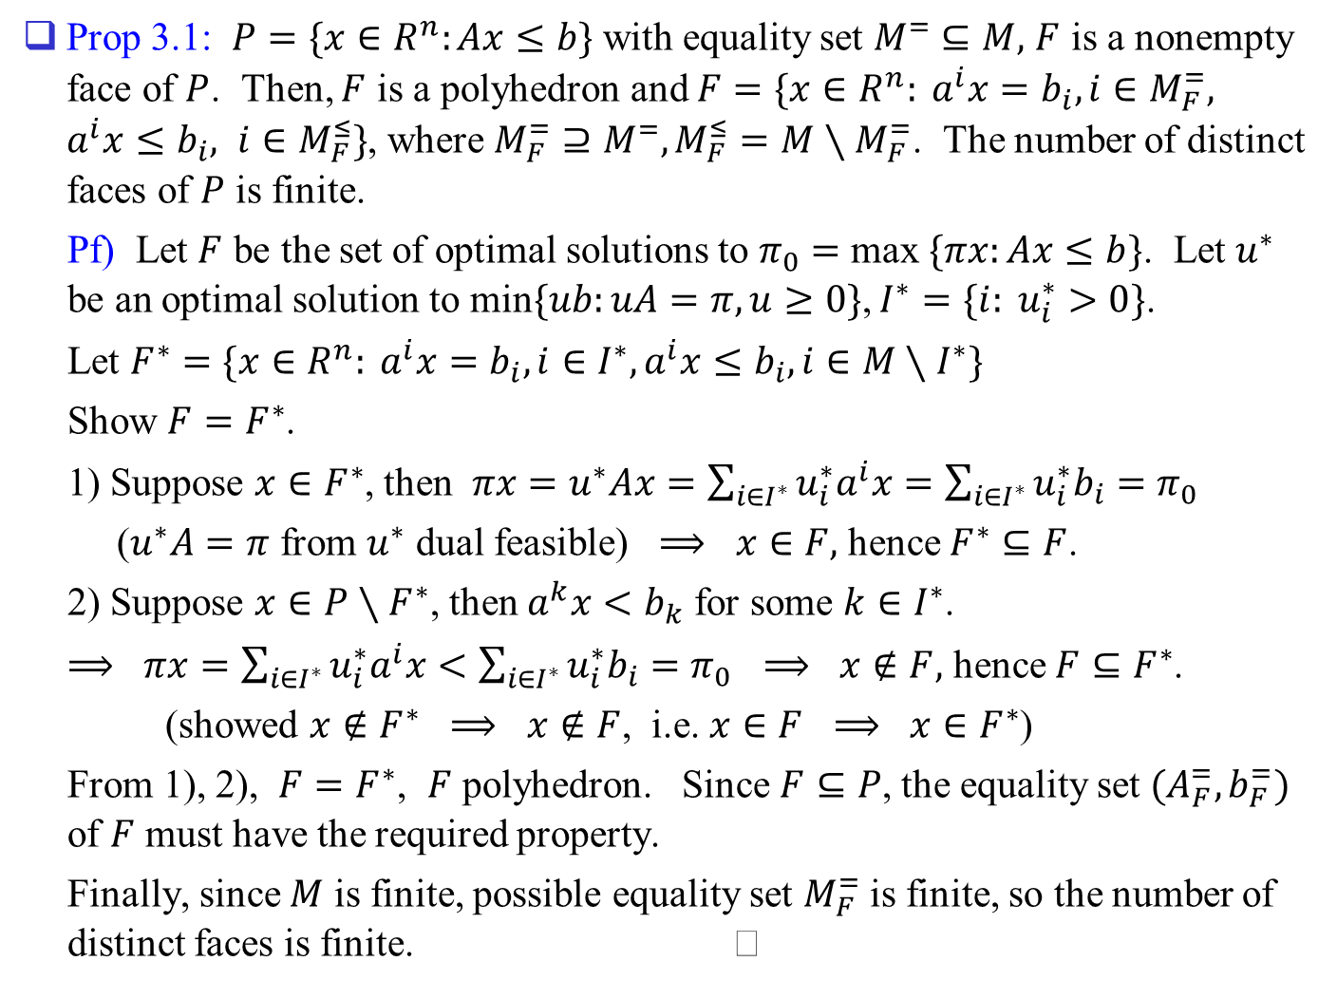
Prop 3.1: $P=\{x∈R^{n}:Ax≤b\}$ with equality set $M^{=}⊆M,$ $F$ is a nonempty face of $P$. Then, $F$ is a polyhedron and $F=\{x∈R^{n}: a^{i}x=b_{i}, i∈M_{F}^{=}, a^{i}x≤b_{i}, i∈M_{F}^{≤}\}$, where $M_{F}^{=}⊇M^{=}, M_{F}^{≤}=M∖M_{F}^{=}$. The number of distinct faces of $P$ is finite.
Pf) Let $F$ be the set of optimal solutions to $π_{0}=$ max $\{πx:Ax≤b\}$. Let $u^{∗}$ be an optimal solution to min$\{ub:uA=π, u≥0\}$, $I^{∗}=\{i: u_{i}^{∗}>0\}$.
Let $F^{∗}=\{x∈R^{n}: a^{i}x=b_{i}, i∈I^{∗}, a^{i}x≤b_{i}, i∈M∖I^{∗}\}$
Show $F=F^{∗}$.
1) Suppose $x∈F^{∗}$, then $πx=u^{∗}Ax=\sum_{i∈I^{∗}}{u_{i}^{∗}a^{i}x}=\sum_{i∈I^{∗}}{u_{i}^{∗}b_{i}}=π_{0}$
($u^{∗}A=π$ from $u^{∗}$ dual feasible) $⟹$ $x∈F,$ hence $F^{∗}⊆F$.
2) Suppose $x∈P∖F^{∗}$, then $a^{k}x<b_{k}$ for some $k∈I^{∗}$.
$⟹$ $πx=\sum_{i∈I^{∗}}{u_{i}^{∗}a^{i}x}<\sum_{i∈I^{∗}}{u_{i}^{∗}b_{i}}=π_{0}$ $⟹$ $x∉F,$ hence $F⊆F^{∗}$.
(showed $x∉F^{∗}$ $⟹$ $x∉F$, i.e. $x∈F$ $⟹$ $x∈F^{∗}$)
From 1), 2), $F=F^{∗}$, $F$ polyhedron. Since $F⊆P$, the equality set $(A_{F}^{=},b_{F}^{=})$ of $F$ must have the required property.
Finally, since $M$ is finite, possible equality set $M_{F}^{=}$ is finite, so the number of distinct faces is finite.

Slide 12
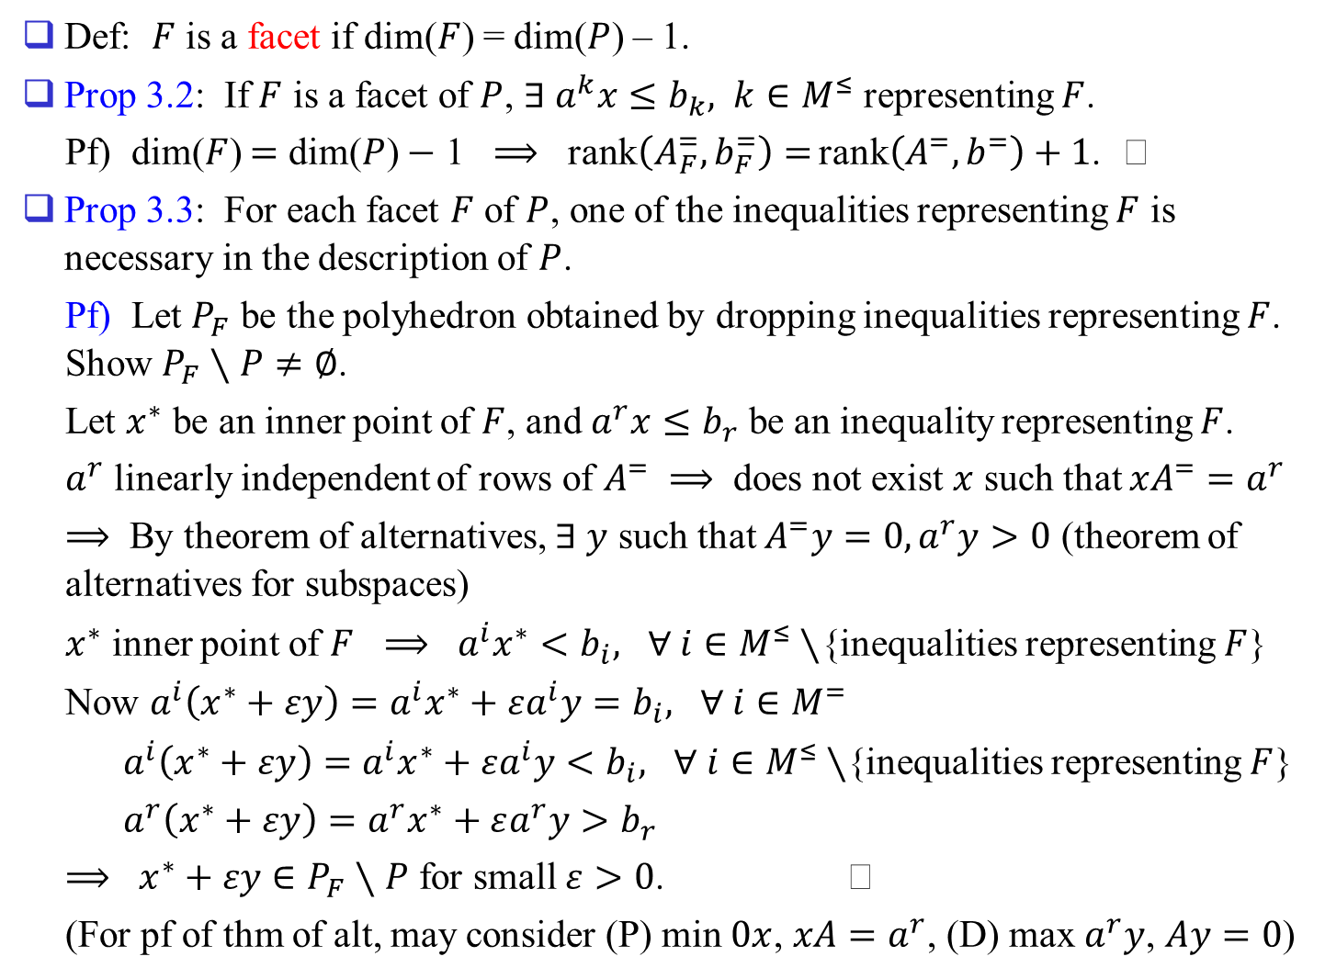
Def: $F$ is a facet if dim($F$) = dim($P$) – 1.
Prop 3.2: If $F$ is a facet of $P$, $∃ a^{k}x≤b_{k}, k∈M^{≤}$ representing $F$.
Pf) dim($F$) $=$ dim($P$) $−$ 1 $⟹$ rank$\left(A_{F}^{=},b_{F}^{=}\right)=$ rank$\left(A^{=},b^{=}\right)+1$.
Prop 3.3: For each facet $F$ of $P$, one of the inequalities representing $F$ is necessary in the description of $P$.
Pf) Let $P_{F}$ be the polyhedron obtained by dropping inequalities representing $F$. Show $P_{F}∖P≠∅$.
Let $x^{∗}$ be an inner point of $F$, and $a^{r}x≤b_{r}$ be an inequality representing $F$.
$a^{r}$ linearly independent of rows of $A^{=}$ $⟹$ does not exist $x$ such that $xA^{=}=a^{r}$
$⟹$ By theorem of alternatives, $∃ y$ such that $A^{=}y=0, a^{r}y>0$ (theorem of alternatives for subspaces)
$x^{∗}$ inner point of $F$ $⟹$ $a^{i}x^{∗}<b_{i},$ $∀ i∈M^{≤}∖${inequalities representing $F$}
Now $a^{i}\left(x^{∗}+εy\right)=a^{i}x^{∗}+εa^{i}y=b_{i},$ $∀ i∈M^{=}$
$a^{i}\left(x^{∗}+εy\right)=a^{i}x^{∗}+εa^{i}y<b_{i},$ $∀ i∈M^{≤}∖${inequalities representing $F$}
$a^{r}\left(x^{∗}+εy\right)=a^{r}x^{∗}+εa^{r}y>b_{r}$
$⟹$ $x^{∗}+εy∈P_{F}∖P$ for small $ε>0$.
(For pf of thm of alt, may consider (P) min $0x$, $xA=a^{r}$, (D) max $a^{r}y$, $Ay=0$)

Slide 13
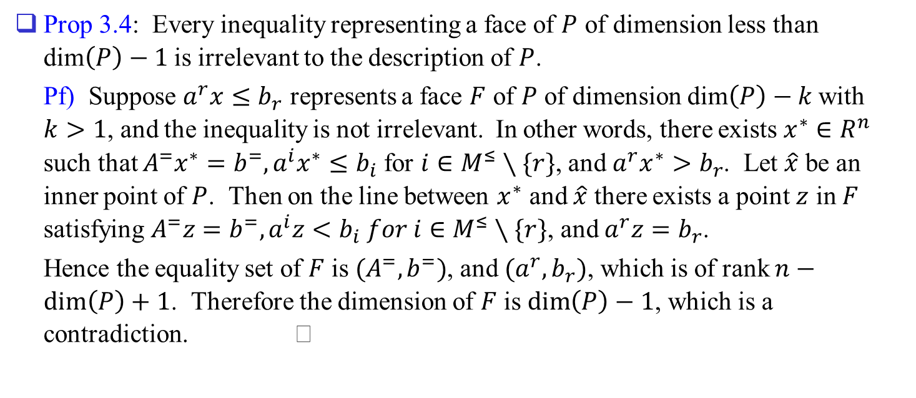
Prop 3.4: Every inequality representing a face of $P$ of dimension less than dim$\left(P\right)−1$ is irrelevant to the description of $P$.
Pf) Suppose $a^{r}x≤b_{r}$ represents a face $F$ of $P$ of dimension dim$\left(P\right)−k$ with $k>1$, and the inequality is not irrelevant. In other words, there exists $x^{∗}∈R^{n}$ such that $A^{=}x^{∗}=b^{=}, a^{i}x^{∗}≤b_{i}$ for $i∈M^{≤}∖\{r\}$, and $a^{r}x^{∗}>b_{r}$. Let $\hat{x}$ be an inner point of $P$. Then on the line between $x^{∗}$ and $\hat{x}$ there exists a point $z$ in $F$ satisfying $A^{=}z=b^{=}, a^{i}z<b_{i} for i∈M^{≤}∖\{r\}$, and $a^{r}z=b_{r}$.
Hence the equality set of $F$ is $(A^{=},b^{=})$, and $(a^{r},b_{r})$, which is of rank $n−\dim\left(P\right)+1$. Therefore the dimension of $F$ is $\dim\left(P\right)−1$, which is a contradiction.

Slide 14
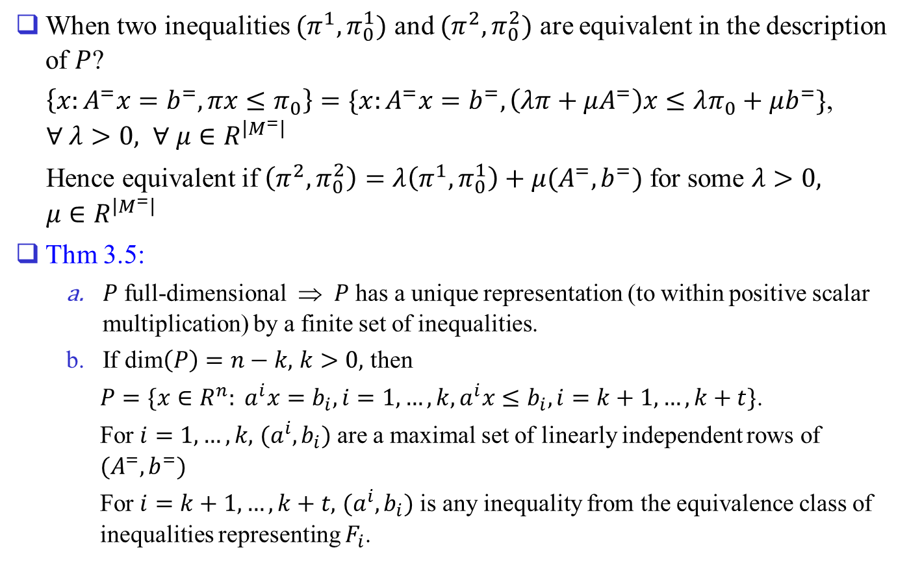
When two inequalities $(π^{1},π_{0}^{1})$ and $(π^{2},π_{0}^{2})$ are equivalent in the description of $P$?
$\left\{x:A^{=}x=b^{=},πx≤π_{0}\right\}=\{x:A^{=}x=b^{=},\left(λπ+μA^{=}\right)x≤λπ_{0}+μb^{=}\}$, $∀ λ>0, ∀ μ∈R^{\left|M^{=}\right|}$
Hence equivalent if $\left(π^{2},π_{0}^{2}\right)=λ\left(π^{1},π_{0}^{1}\right)+μ(A^{=},b^{=})$ for some $λ>0,$ $μ∈R^{\left|M^{=}\right|}$
Thm 3.5:
  $P$ full-dimensional ⇒ $P$ has a unique representation (to within positive scalar multiplication) by a finite set of inequalities.
  If dim$\left(P\right)=n−k,$ $k>0,$ then
  $P=\{x∈R^{n}: a^{i}x=b_{i}, i=1,…,k, a^{i}x≤b_{i}, i=k+1,…,k+t\}$.
  For $i=1,…,k,$ $(a^{i},b_{i})$ are a maximal set of linearly independent rows of $(A^{=},b^{=})$
  For $i=k+1,…,k+t,$ $(a^{i},b_{i})$ is any inequality from the equivalence class of inequalities representing $F_{i}$.

Slide 15
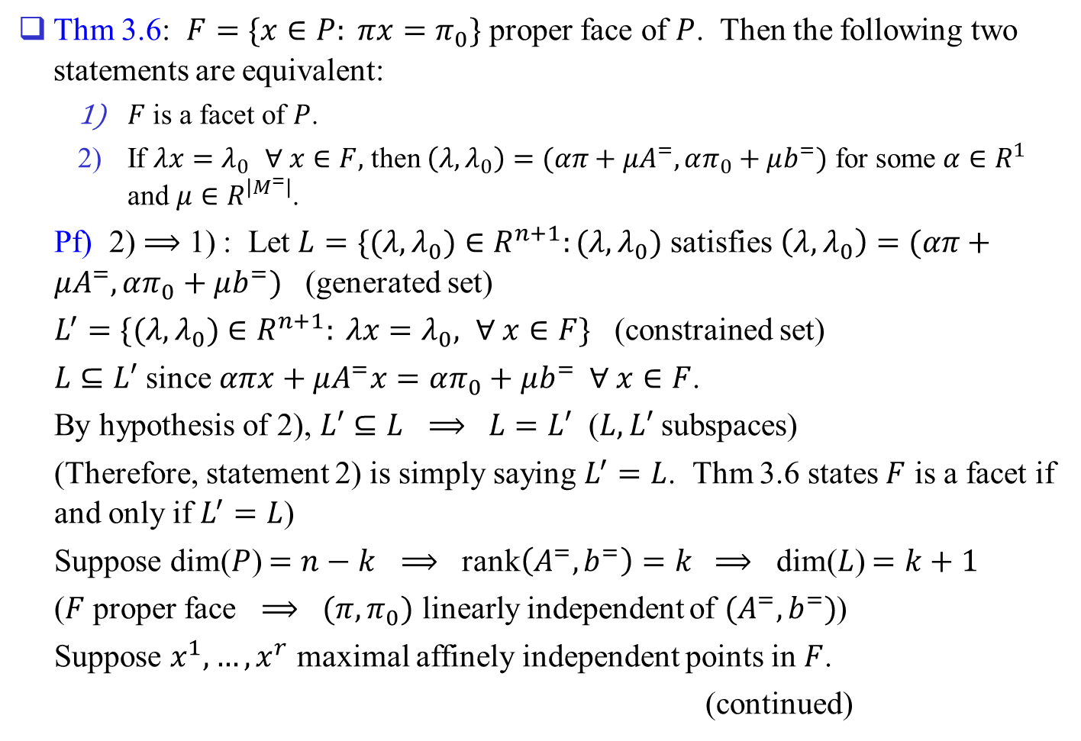
Thm 3.6: $F=\{x∈P: πx=π_{0}\}$ proper face of $P$. Then the following two statements are equivalent:
  $F$ is a facet of $P$.
  If $λx=λ_{0}$ $∀ x∈F,$ then $\left(λ,λ_{0}\right)=(απ+μA^{=}, απ_{0}+μb^{=})$ for some $α∈R^{1}$ and $μ∈R^{\left|M^{=}\right|}$.
Pf) 2) $⟹$ 1) : Let $L=\{(λ,λ_{0})∈R^{n+1}:(λ,λ_{0})$ satisfies $\left(λ,λ_{0}\right)=(απ+μA^{=}, απ_{0}+μb^{=})$ (generated set)
$L^{′}=\{(λ,λ_{0})∈R^{n+1}: λx=λ_{0}, ∀ x∈F\}$ (constrained set)
$L⊆L′$ since $απx+μA^{=}x=απ_{0}+μb^{=} ∀ x∈F$.
By hypothesis of 2), $L′⊆L$ $⟹$ $L=L′$ ($L, L′$ subspaces)
(Therefore, statement 2) is simply saying $L^{′}=L$. Thm 3.6 states $F$ is a facet if and only if $L^{′}=L$)
Suppose dim($P$) $=n−k$ $⟹$ rank$\left(A^{=},b^{=}\right)=k$ $⟹$ dim($L$) $=k+1$
($F$ proper face $⟹$ $(π,π_{0})$ linearly independent of $(A^{=},b^{=})$)
Suppose $x^{1},…,x^{r}$ maximal affinely independent points in $F$.
(continued)

Slide 16
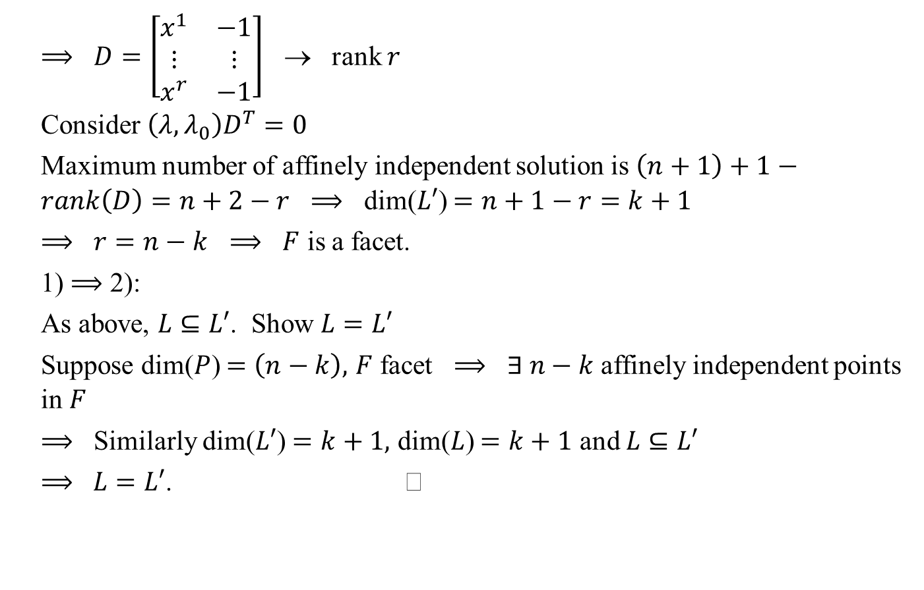
$⟹$ $D=\left[\begin{matrix}x^{1} & −1 \\ ⋮ & ⋮ \\ x^{r} & −1\end{matrix}\right]$ → rank $r$
Consider $\left(λ,λ_{0}\right)D^{T}=0$
Maximum number of affinely independent solution is $\left(n+1\right)+1−rank\left(D\right)=n+2−r$ $⟹$ dim($L′$) $=n+1−r=k+1$
$⟹$ $r=n−k$ $⟹$ $F$ is a facet.
1) $⟹$ 2):
As above, $L⊆L′$. Show $L=L′$
Suppose dim($P$) $=\left(n−k\right),$ $F$ facet $⟹$ $∃ n−k$ affinely independent points in $F$
$⟹$ Similarly dim($L′$) $=k+1,$ dim($L$) $=k+1$ and $L⊆L′$
$⟹$ $L=L′$.

