Slide 1
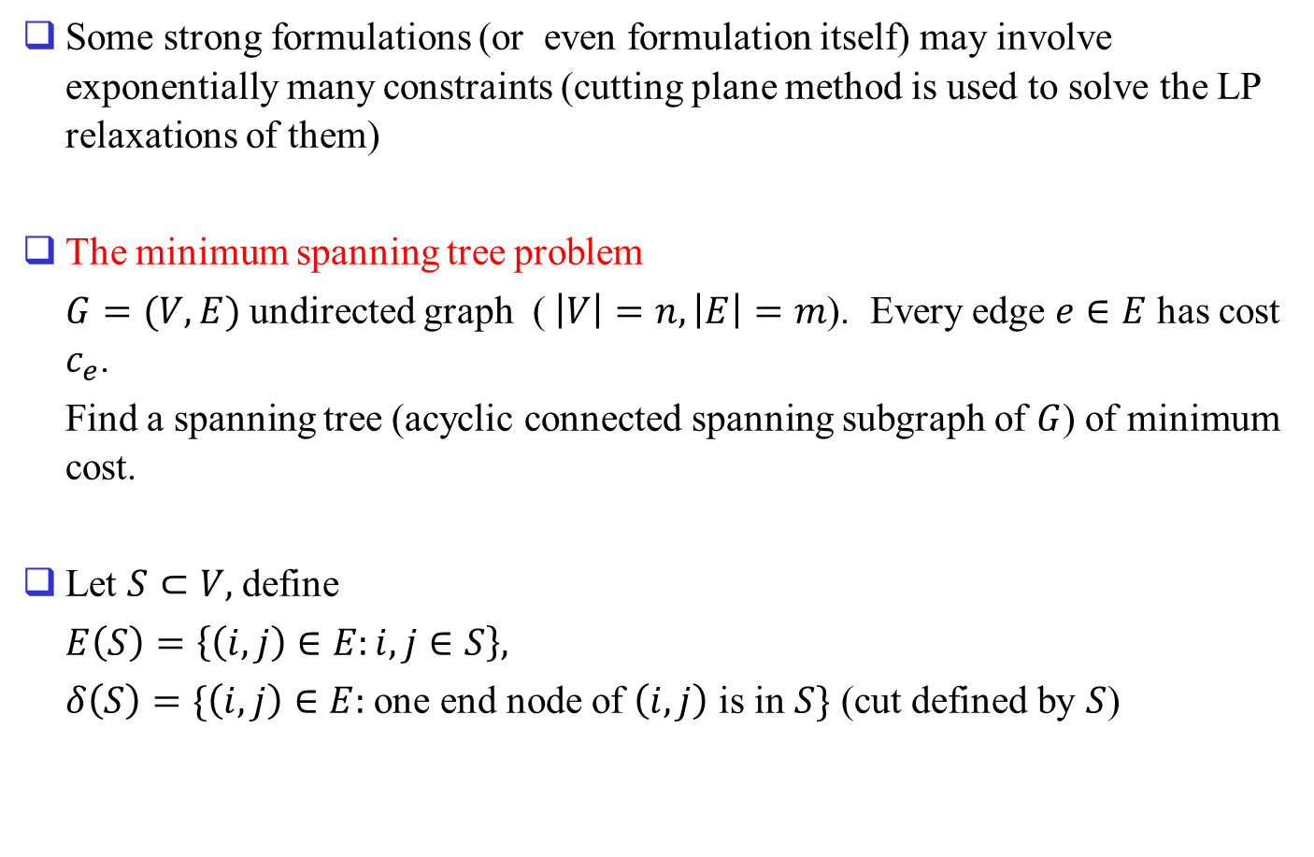
1.3 Modeling with exponentially many constr.
Some strong formulations (or even formulation itself) may involve exponentially many constraints (cutting plane method is used to solve the LP relaxations of them)
The minimum spanning tree problem
$G=(V,E)$ undirected graph ( $\left|V\right|=n, \left|E\right|=m$). Every edge $e∈E$ has cost $c_{e}$.
Find a spanning tree (acyclic connected spanning subgraph of $G$) of minimum cost.
Let $S⊂V,$ define
$E\left(S\right)=\left\{\left(i,j\right)∈E:i,j∈S\right\},$
$δ\left(S\right)=\{\left(i,j\right)∈E:$ one end node of $\left(i,j\right)$ is in $S\}$ (cut defined by $S$)

Slide 2
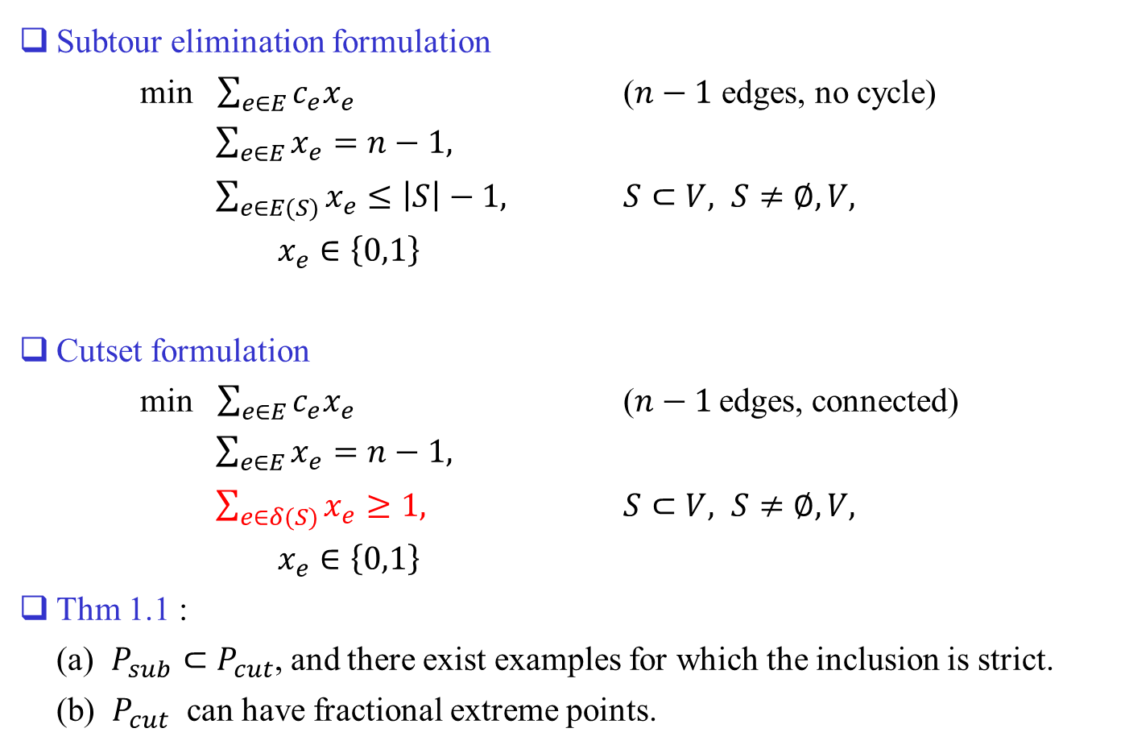
Subtour elimination formulation
min $\sum_{e∈E}{c_{e}x_{e}}$ ($n−1$ edges, no cycle)
$\sum_{e∈E}{x_{e}}=n−1,$
$\sum_{e∈E(S)}{x_{e}}≤\left|S\right|−1,$ $S⊂V, S≠∅, V,$
$x_{e}∈\left\{0,1\right\}$
Cutset formulation
min $\sum_{e∈E}{c_{e}x_{e}}$ ($n−1$ edges, connected)
$\sum_{e∈E}{x_{e}}=n−1,$
$\sum_{e∈δ(S)}{x_{e}}≥1,$ $S⊂V, S≠∅, V,$
$x_{e}∈\left\{0,1\right\}$
Thm 1.1 :
(a) $P_{sub}⊂P_{cut}$, and there exist examples for which the inclusion is strict.
(b) $P_{cut}$ can have fractional extreme points.

Slide 3
It can be shown that LP relaxation of subtour elimination formulation gives integer optimal solutions. (polymatroid)
Why consider IP formulation although there exist good algorithms (e.g., Kruskal, Prim)?
  Algorithms may fail if problem structure changed a little bit: degree constrained spanning tree problem, Shortest total path length spanning tree problem, Steiner tree problem, capacitated spanning tree problem, …
  Formulation of a basic problem may be used as part of a formulation for a larger complicated problem.
  Theoretical analysis, e.g. strength of 1-tree relaxation of TSP (Lagrangian relaxation).

Slide 4
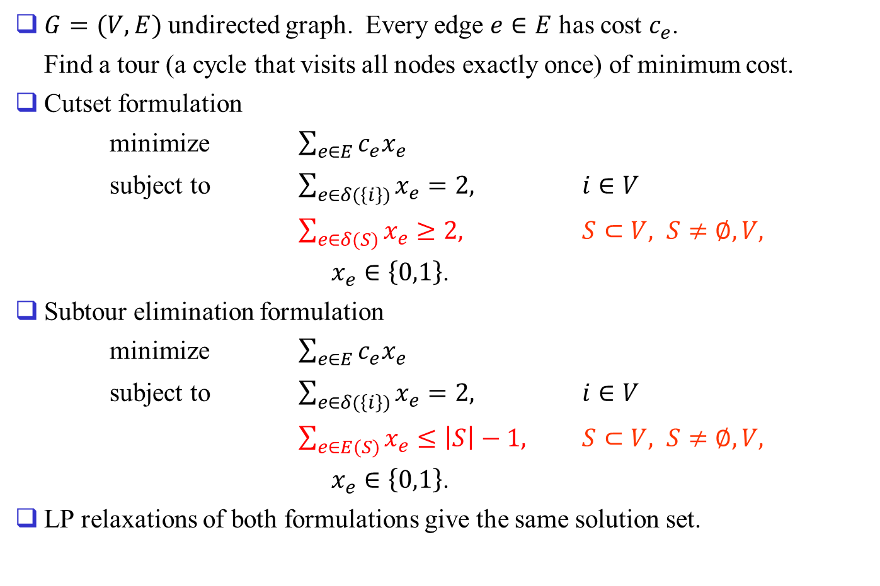
The traveling salesman problem
$G=(V,E)$ undirected graph. Every edge $e∈E$ has cost $c_{e}$.
Find a tour (a cycle that visits all nodes exactly once) of minimum cost.
Cutset formulation
minimize $\sum_{e∈E}{c_{e}x_{e}}$
subject to $\sum_{e∈δ(\left\{i\right\})}{x_{e}}=2,$ $i∈V$
$\sum_{e∈δ(S)}{x_{e}}≥2,$ $S⊂V, S≠∅, V,$
$x_{e}∈\left\{0,1\right\}$.
Subtour elimination formulation
minimize $\sum_{e∈E}{c_{e}x_{e}}$
subject to $\sum_{e∈δ(\left\{i\right\})}{x_{e}}=2,$ $i∈V$
$\sum_{e∈E(S)}{x_{e}}≤\left|S\right|−1,$ $S⊂V, S≠∅, V,$
$x_{e}∈\left\{0,1\right\}$.
LP relaxations of both formulations give the same solution set.

Slide 5
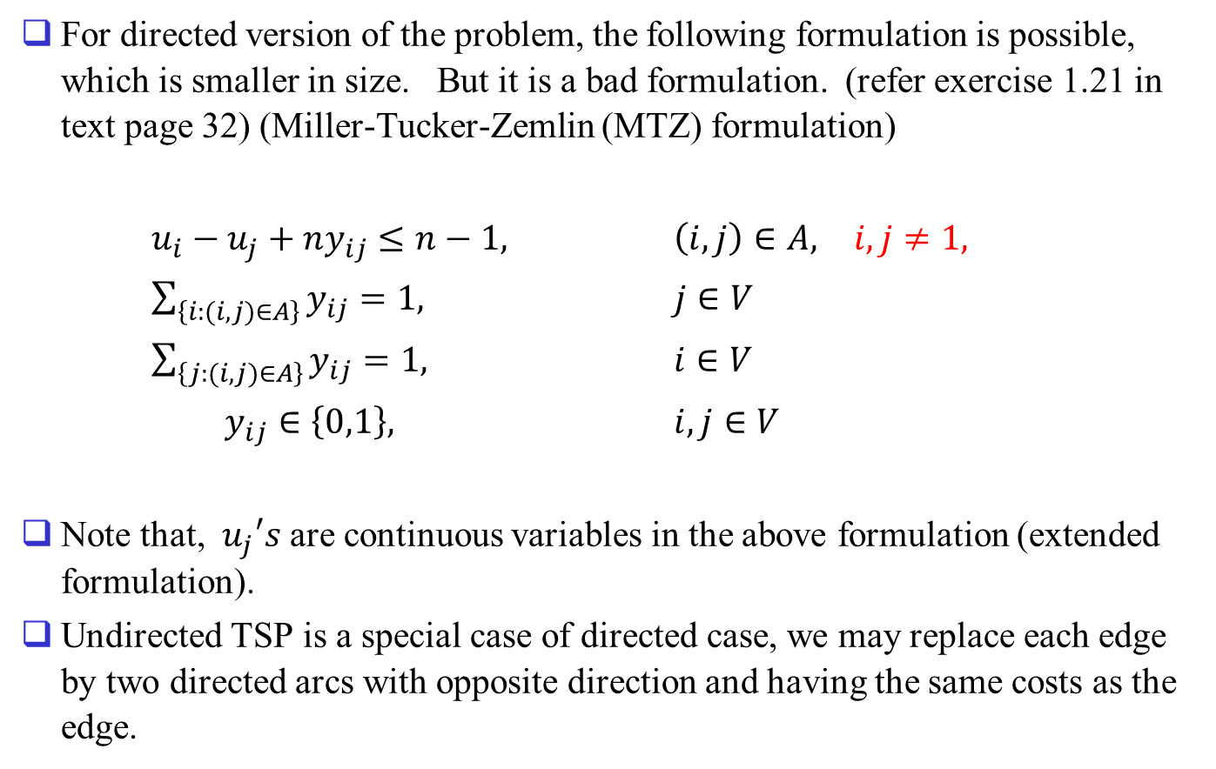
Remarks
For directed version of the problem, the following formulation is possible, which is smaller in size. But it is a bad formulation. (refer exercise 1.21 in text page 32) (Miller-Tucker-Zemlin (MTZ) formulation)
$u_{i}−u_{j}+ny_{ij}≤n−1,$ $\left(i,j\right)∈A,$ $i,j≠1,$
$\sum_{\left\{i:(i,j)∈A\right\}}{y_{ij}}=1,$ $j∈V$
$\sum_{\left\{j:(i,j)∈A\right\}}{y_{ij}}=1,$ $i∈V$
$y_{ij}∈\left\{0,1\right\},$ $i,j∈V$
Note that, $u_{j}′s$ are continuous variables in the above formulation (extended formulation).
Undirected TSP is a special case of directed case, we may replace each edge by two directed arcs with opposite direction and having the same costs as the edge.

Slide 6
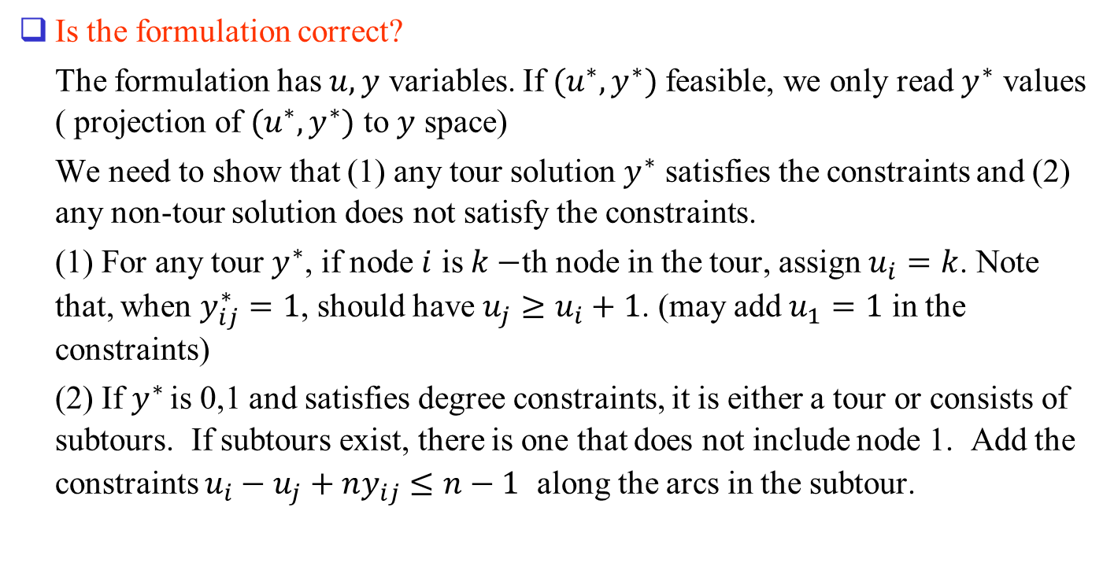
Is the formulation correct?
The formulation has $u,y$ variables. If $(u^{∗},y^{∗})$ feasible, we only read $y^{∗}$ values ( projection of $(u^{∗},y^{∗})$ to $y$ space)
We need to show that (1) any tour solution $y^{∗}$ satisfies the constraints and (2) any non-tour solution does not satisfy the constraints.
(1) For any tour $y^{∗}$, if node $i$ is $k−$th node in the tour, assign $u_{i}=k$. Note that, when $y_{ij}^{∗}=1$, should have $u_{j}≥u_{i}+1$. (may add $u_{1}=1$ in the constraints)
(2) If $y^{∗}$ is 0,1 and satisfies degree constraints, it is either a tour or consists of subtours. If subtours exist, there is one that does not include node 1. Add the constraints $u_{i}−u_{j}+ny_{ij}≤n−1$ along the arcs in the subtour.

Slide 7
Comparing the LP relaxation of the cutset formulation (A) (in directed case version) and the LP relaxation of the previous formulation (B): It can be shown that the projection of the polyhedron B onto y space gives a polyhedron which completely contains A (the inclusion can be strict), hence cutset formulation (or subtour elimination formulation) is stronger.
Although the previous formulation is not strong, it can be an alternative to use if you only have a generic IP software to use, not the sophisticated one to handle the cutset constraints.
If we include constraints for the arcs from/to node 1, feasible solutions are free of a directed cycle. (have applications)

Slide 8
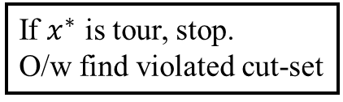
How to Solve the LP relaxation of the Cut-Set Formulation? (many constr.)
Solve LP relaxation
(w/o cut-set constraints)
If $x^{∗}$ is tour, stop.
O/w find violated cut-set
Solve LP after adding the
Cut-set constraint.
∃ violated cutset?
Y
N
Stop

Slide 9
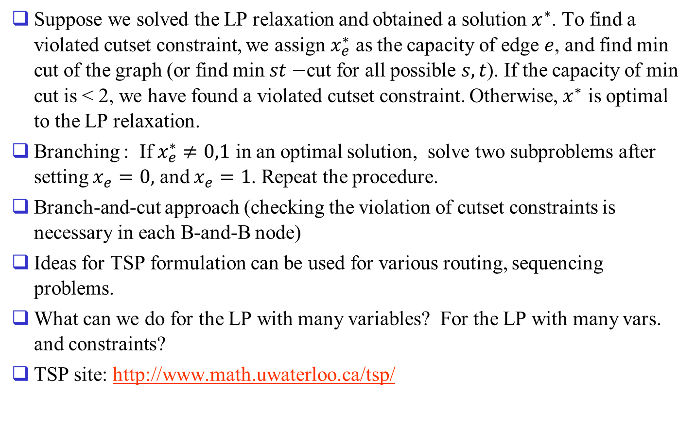
Suppose we solved the LP relaxation and obtained a solution $x^{∗}$. To find a violated cutset constraint, we assign $x_{e}^{∗}$ as the capacity of edge $e$, and find min cut of the graph (or find min $st−$cut for all possible $s,t$). If the capacity of min cut is < 2, we have found a violated cutset constraint. Otherwise, $x^{∗}$ is optimal to the LP relaxation.
Branching : If $x_{e}^{∗}≠0,1$ in an optimal solution, solve two subproblems after setting $x_{e}=0,$ and $x_{e}=1$. Repeat the procedure.
Branch-and-cut approach (checking the violation of cutset constraints is necessary in each B-and-B node)
Ideas for TSP formulation can be used for various routing, sequencing problems.
What can we do for the LP with many variables? For the LP with many vars. and constraints?
TSP site: http://www.math.uwaterloo.ca/tsp/

Slide 10
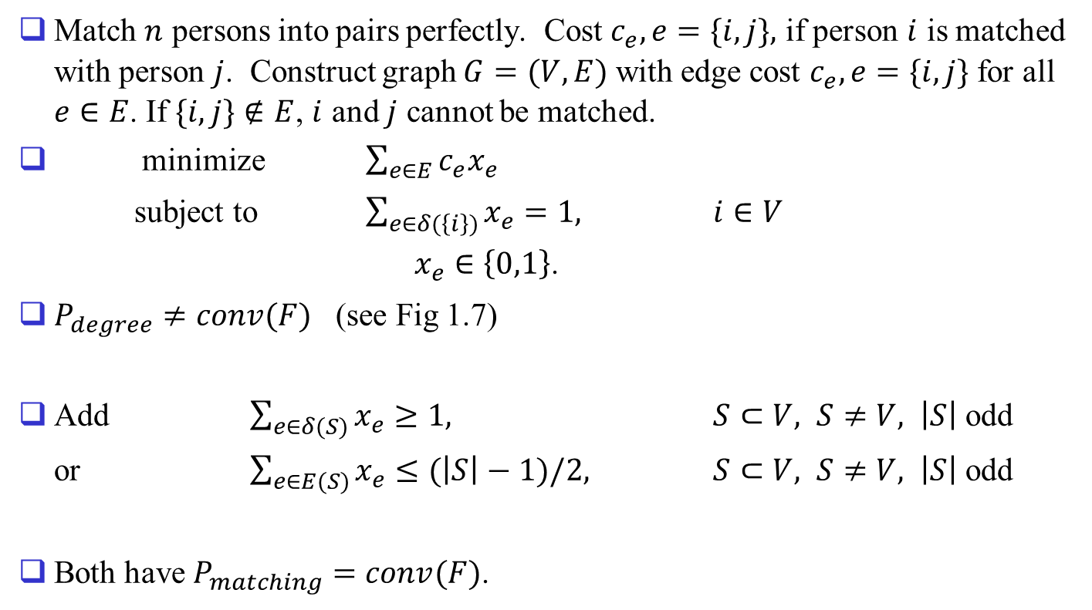
The perfect matching problem
Match $n$ persons into pairs perfectly. Cost $c_{e}, e=\{i,j\},$ if person $i$ is matched with person $j$. Construct graph $G=(V,E)$ with edge cost $c_{e},e=\{i,j\}$ for all $e∈E$. If $\{i,j\}∉E$, $i$ and $j$ cannot be matched.
minimize $\sum_{e∈E}{c_{e}x_{e}}$
subject to $\sum_{e∈δ(\left\{i\right\})}{x_{e}}=1,$ $i∈V$
$x_{e}∈\left\{0,1\right\}$.
$P_{degree}≠conv(F)$ (see Fig 1.7)
Add $\sum_{e∈δ(S)}{x_{e}}≥1,$ $S⊂V, S≠V,$ $\left|S\right|$ odd
or $\sum_{e∈E(S)}{x_{e}}≤(\left|S\right|−1)/2,$ $S⊂V, S≠V,$ $\left|S\right|$ odd
Both have $P_{matching}=conv(F)$.

Slide 11
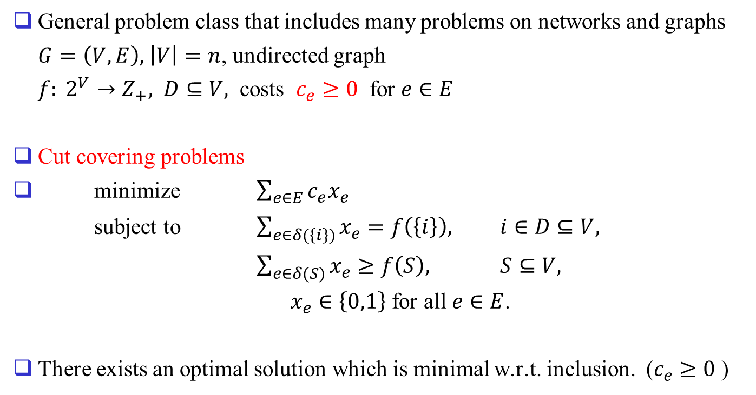
Cut covering problems
General problem class that includes many problems on networks and graphs
$G=\left(V,E\right),$ $\left|V\right|=n$, undirected graph
$f: 2^{V}→Z_{+},$ $D⊆V,$ costs $c_{e}≥0$ for $e∈E$
Cut covering problems
minimize $\sum_{e∈E}{c_{e}x_{e}}$
subject to $\sum_{e∈δ(\left\{i\right\})}{x_{e}}=f\left(\left\{i\right\}\right),$ $i∈D⊆V,$
$\sum_{e∈δ(S)}{x_{e}}≥f\left(S\right),$ $S⊆V,$
$x_{e}∈\left\{0,1\right\}$ for all $e∈E$.
There exists an optimal solution which is minimal w.r.t. inclusion. ($c_{e}≥0$ )

Slide 12
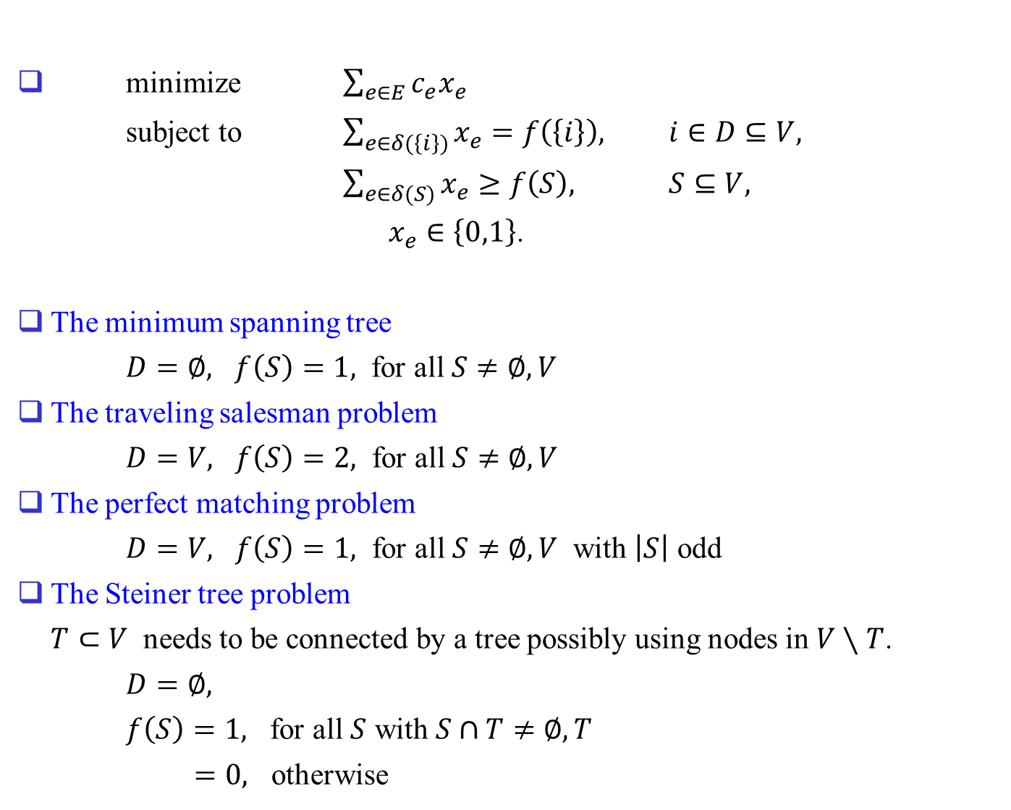
minimize $\sum_{e∈E}{c_{e}x_{e}}$
subject to $\sum_{e∈δ(\left\{i\right\})}{x_{e}}=f\left(\left\{i\right\}\right),$ $i∈D⊆V,$
$\sum_{e∈δ(S)}{x_{e}}≥f\left(S\right),$ $S⊆V,$
$x_{e}∈\left\{0,1\right\}$.
The minimum spanning tree
$D=∅,$ $f\left(S\right)=1,$ for all $S≠∅, V$
The traveling salesman problem
$D=V,$ $f\left(S\right)=2,$ for all $S≠∅, V$
The perfect matching problem
$D=V,$ $f\left(S\right)=1,$ for all $S≠∅, V$ with $\left|S\right|$ odd
The Steiner tree problem
$T⊂V$ needs to be connected by a tree possibly using nodes in $V∖T$.
$D=∅,$
$f\left(S\right)=1,$ for all $S$ with $S∩T≠∅, T$
$=0,$ otherwise

Slide 13
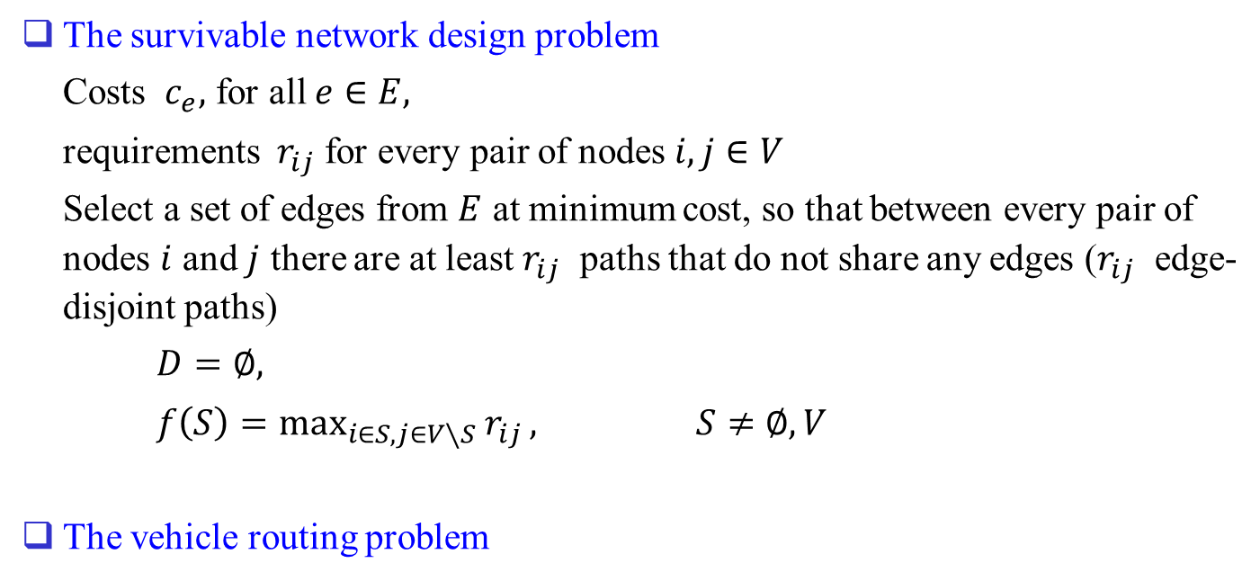
The survivable network design problem
Costs $c_{e},$ for all $e∈E,$
requirements $r_{ij}$ for every pair of nodes $i,j∈V$
Select a set of edges from $E$ at minimum cost, so that between every pair of nodes $i$ and $j$ there are at least $r_{ij}$ paths that do not share any edges ($r_{ij}$ edge-disjoint paths)
$D=∅,$
$f\left(S\right)=\max_{i∈S, j∈V∖S}{r_{ij}},$ $S≠∅, V$
The vehicle routing problem

Slide 14
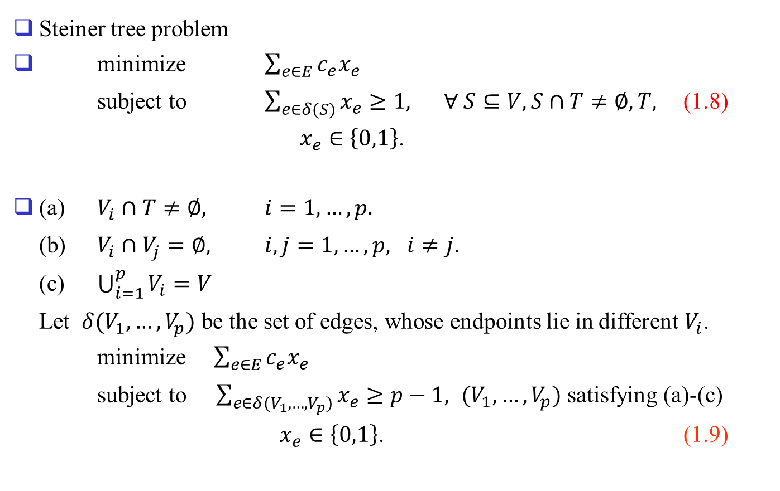
Dircted vs. undirected formulations
Steiner tree problem
minimize $\sum_{e∈E}{c_{e}x_{e}}$
subject to $\sum_{e∈δ(S)}{x_{e}}≥1,$ $∀ S⊆V, S∩T≠∅, T,$ (1.8)
$x_{e}∈\left\{0,1\right\}$.
(a) $V_{i}∩T≠∅,$ $i=1,…,p.$
(b) $V_{i}∩V_{j}=∅,$ $i,j=1,…,p, i≠j.$
(c) $\bigcup_{i=1}^{p}{V_{i}}=V$
Let $δ(V_{1},…,V_{p})$ be the set of edges, whose endpoints lie in different $V_{i}$.
minimize $\sum_{e∈E}{c_{e}x_{e}}$
subject to $\sum_{e∈δ(V_{1},…,V_{p})}{x_{e}}≥p−1,$ $(V_{1},…,V_{p})$ satisfying (a)-(c)
$x_{e}∈\left\{0,1\right\}$. (1.9)

Slide 15
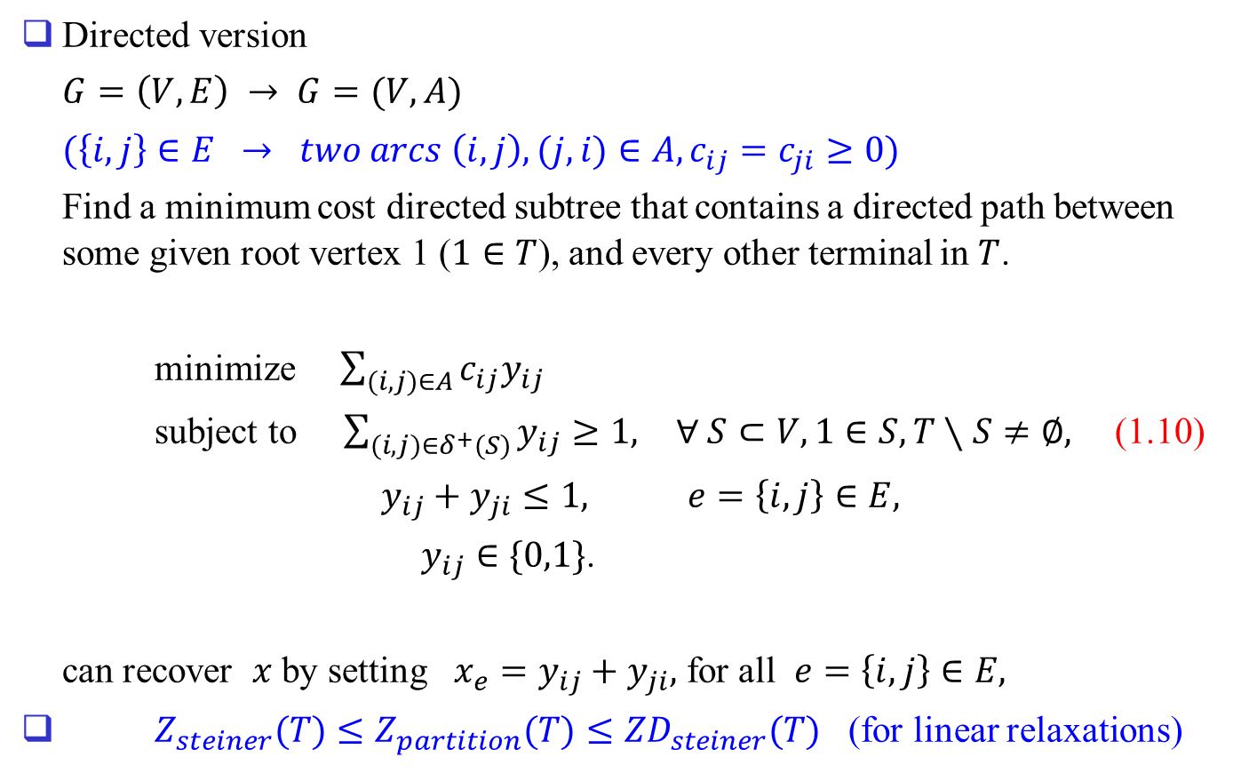
Directed version
$G=\left(V,E\right) → G=(V,A)$
$(\left\{i,j\right\}∈E → two arcs \left(i,j\right), (j,i)∈A, c_{ij}=c_{ji}≥0)$
Find a minimum cost directed subtree that contains a directed path between some given root vertex 1 ($1∈T$), and every other terminal in $T$.
minimize $\sum_{(i,j)∈A}{c_{ij}y_{ij}}$
subject to $\sum_{(i,j)∈δ^{+}(S)}{y_{ij}}≥1,$ $∀ S⊂V, 1∈S, T∖S≠∅,$ (1.10)
$y_{ij}+y_{ji}≤1,$ $e=\left\{i,j\right\}∈E,$
$y_{ij}∈\{0,1\}$.
can recover $x$ by setting $x_{e}=y_{ij}+y_{ji},$ for all $e=\left\{i,j\right\}∈E,$
$Z_{steiner}(T)≤Z_{partition}(T)≤{ZD}_{steiner}(T)$ (for linear relaxations)

Slide 16
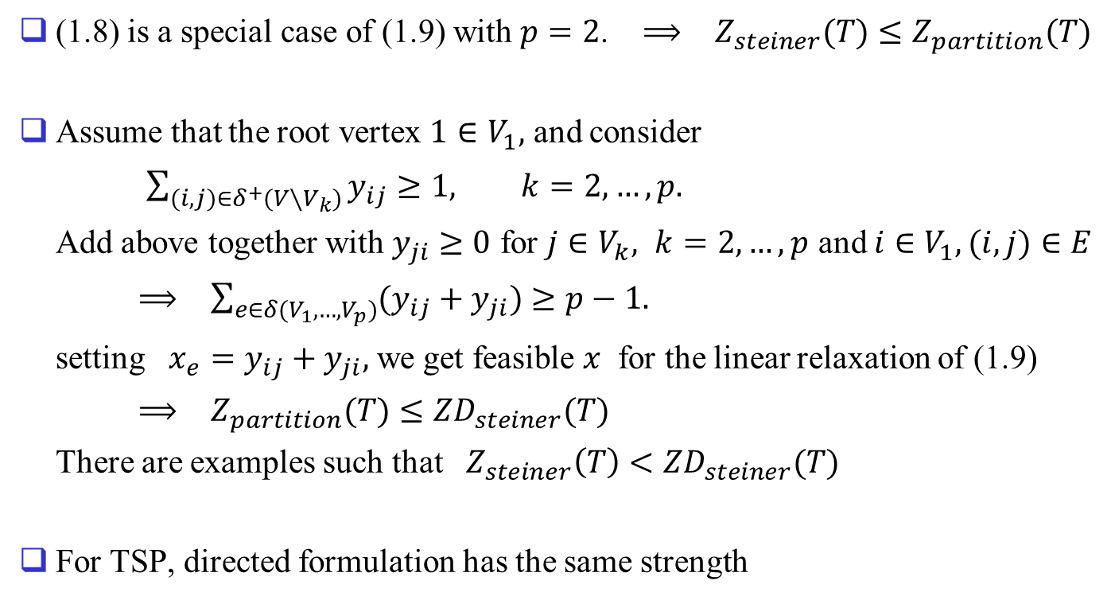
(1.8) is a special case of (1.9) with $p=2$. $⟹$ $Z_{steiner}(T)≤Z_{partition}(T)$
Assume that the root vertex $1∈V_{1},$ and consider
$\sum_{(i,j)∈δ^{+}(V∖V_{k})}{y_{ij}}≥1,$ $k=2,…,p.$
Add above together with $y_{ji}≥0$ for $j∈V_{k},$ $k=2,…,p$ and $i∈V_{1},(i,j)∈E$
$⟹$ $\sum_{e∈δ(V_{1},…,V_{p})}{(y_{ij}+y_{ji})}≥p−1.$
setting $x_{e}=y_{ij}+y_{ji},$ we get feasible $x$ for the linear relaxation of (1.9)
$⟹$ $Z_{partition}(T)≤{ZD}_{steiner}(T)$
There are examples such that $Z_{steiner}\left(T\right)<{ZD}_{steiner}(T)$
For TSP, directed formulation has the same strength

Slide 17
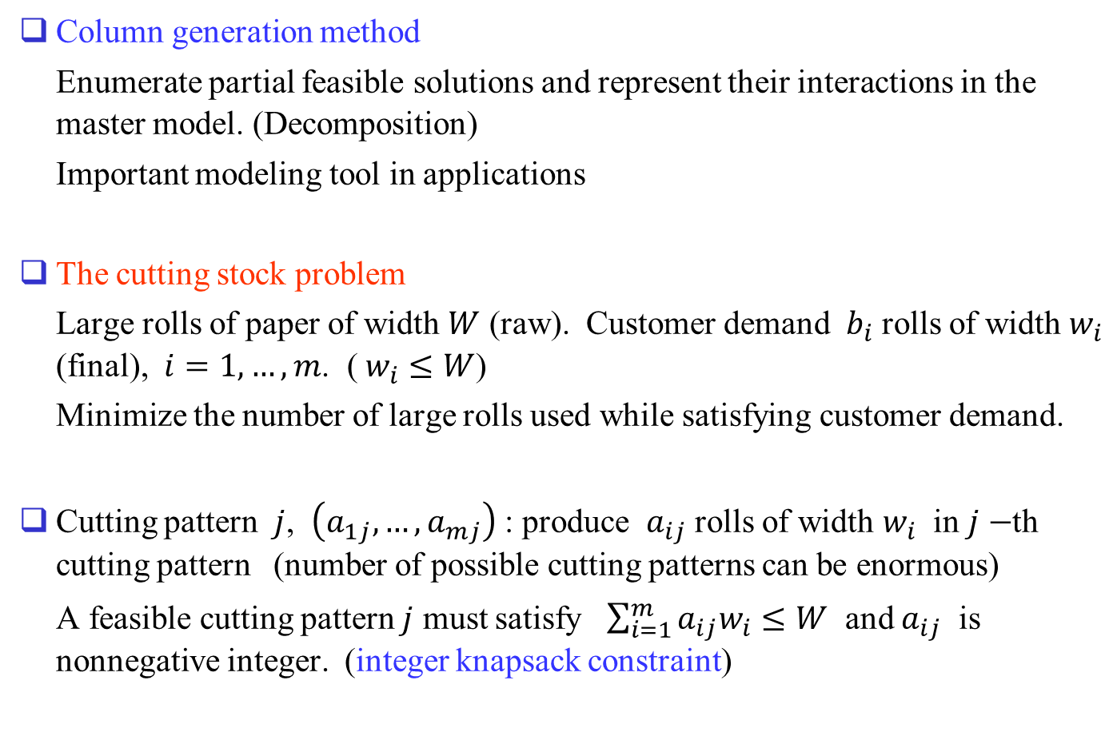
1.4 Modeling with exponentially many variables
Column generation method
Enumerate partial feasible solutions and represent their interactions in the master model. (Decomposition)
Important modeling tool in applications
The cutting stock problem
Large rolls of paper of width $W$ (raw). Customer demand $b_{i}$ rolls of width $w_{i}$ (final), $i=1,…,m$. ( $w_{i}≤W$)
Minimize the number of large rolls used while satisfying customer demand.
Cutting pattern $j$, $\left(a_{1j},…,a_{mj}\right)$ : produce $a_{ij}$ rolls of width $w_{i}$ in $j−$th cutting pattern (number of possible cutting patterns can be enormous)
A feasible cutting pattern $j$ must satisfy $\sum_{i=1}^{m}{a_{ij}w_{i}}≤W$ and $a_{ij}$ is nonnegative integer. (integer knapsack constraint)

Slide 18
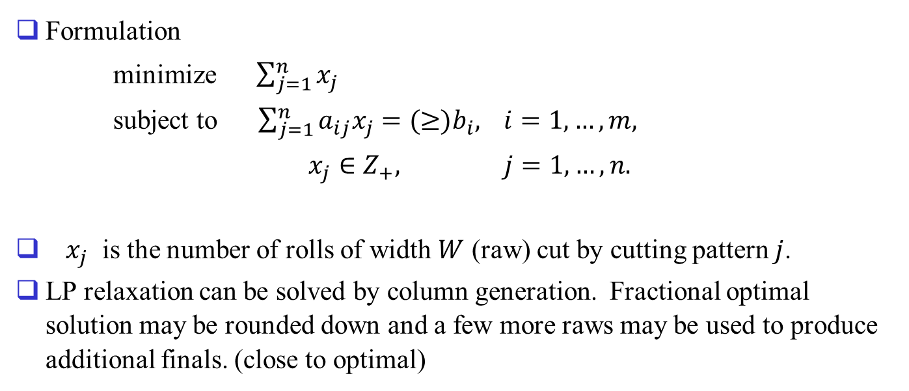
Formulation
minimize $\sum_{j=1}^{n}{x_{j}}$
subject to $\sum_{j=1}^{n}{a_{ij}x_{j}}=(≥)b_{i},$ $i=1,…,m,$
$x_{j}∈Z_{+},$ $j=1,…,n.$
$x_{j}$ is the number of rolls of width $W$ (raw) cut by cutting pattern $j$.
LP relaxation can be solved by column generation. Fractional optimal solution may be rounded down and a few more raws may be used to produce additional finals. (close to optimal)

Slide 19
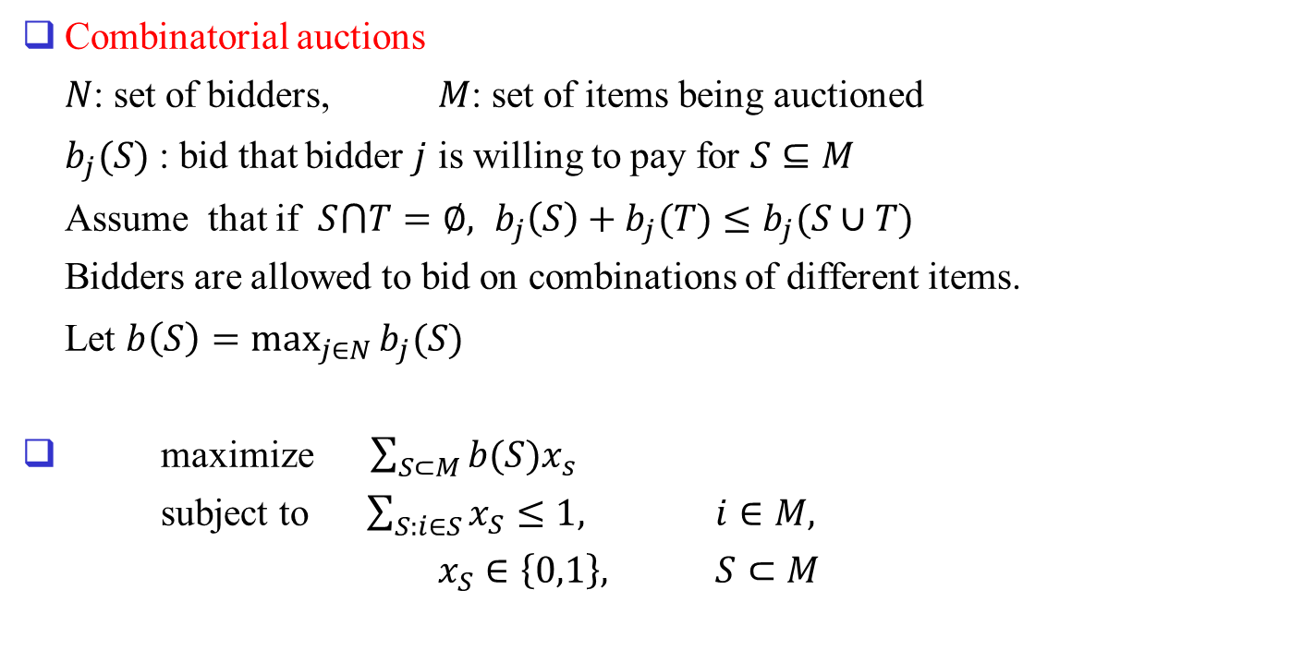
Combinatorial auctions
$N$: set of bidders, $M$: set of items being auctioned
$b_{j}(S)$ : bid that bidder $j$ is willing to pay for $S⊆M$
Assume that if $S⋂T=∅,$ $b_{j}\left(S\right)+b_{j}(T)≤b_{j}(S∪T)$
Bidders are allowed to bid on combinations of different items.
Let $b\left(S\right)=\max_{j∈N}{b_{j}(S)}$
maximize $\sum_{S⊂M}{b(S)x_{s}}$
subject to $\sum_{S:i∈S}{x_{S}}≤1,$ $i∈M,$
$x_{S}∈\left\{0,1\right\},$ $S⊂M$

Slide 20
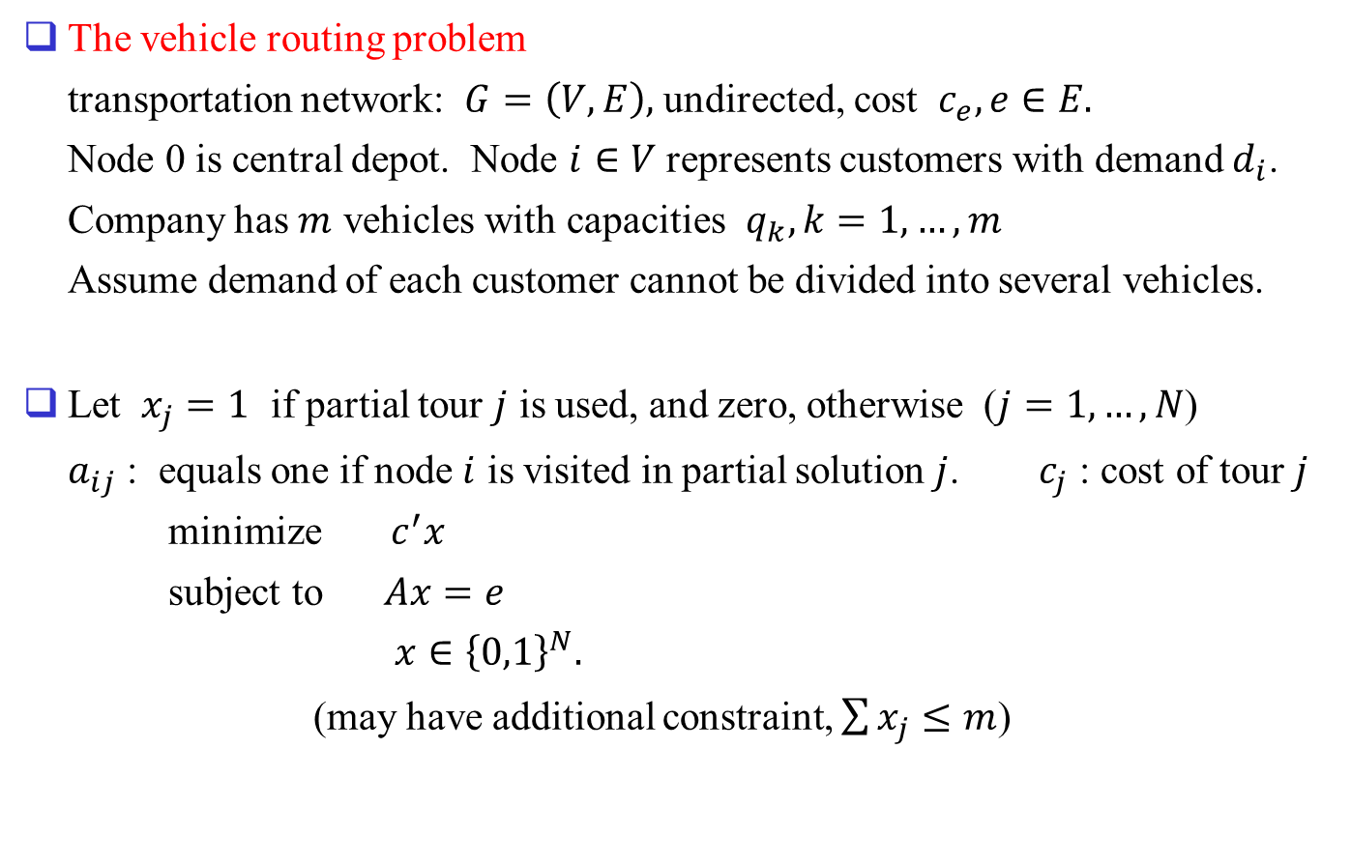
The vehicle routing problem
transportation network: $G=\left(V,E\right),$ undirected, cost $c_{e}, e∈E.$
Node 0 is central depot. Node $i∈V$ represents customers with demand $d_{i}$.
Company has $m$ vehicles with capacities $q_{k}, k=1,…,m$
Assume demand of each customer cannot be divided into several vehicles.
Let $x_{j}=1$ if partial tour $j$ is used, and zero, otherwise ($j=1,…,N$)
$a_{ij}$ : equals one if node $i$ is visited in partial solution $j$. $c_{j}$ : cost of tour $j$
minimize $c^{′}x$
subject to $Ax=e$
$x∈{\left\{0,1\right\}}^{N}.$
(may have additional constraint, $\sum{x_{j}≤m}$)

