Slide 1
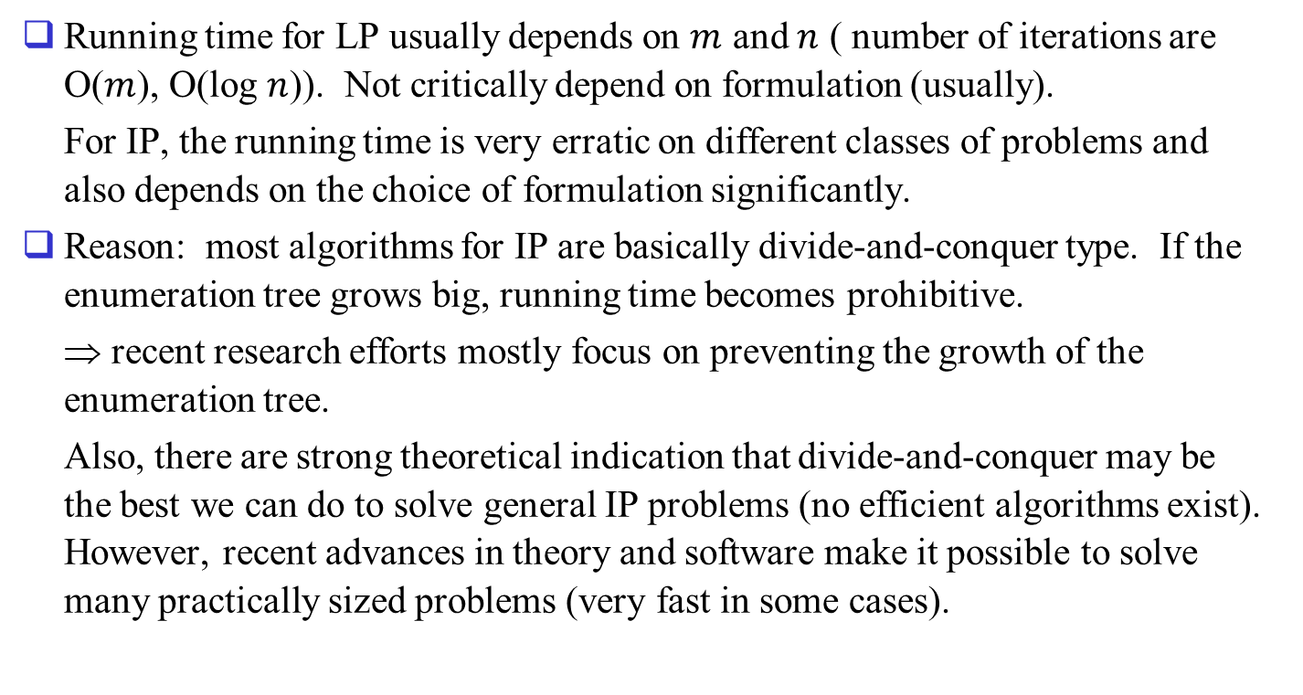
1.2 Guidelines for strong formulations
Running time for LP usually depends on $m$ and $n$ ( number of iterations are O($m$), O(log $n$)). Not critically depend on formulation (usually).
For IP, the running time is very erratic on different classes of problems and also depends on the choice of formulation significantly.
Reason: most algorithms for IP are basically divide-and-conquer type. If the enumeration tree grows big, running time becomes prohibitive.
⇒ recent research efforts mostly focus on preventing the growth of the enumeration tree.
Also, there are strong theoretical indication that divide-and-conquer may be the best we can do to solve general IP problems (no efficient algorithms exist). However, recent advances in theory and software make it possible to solve many practically sized problems (very fast in some cases).

Slide 2
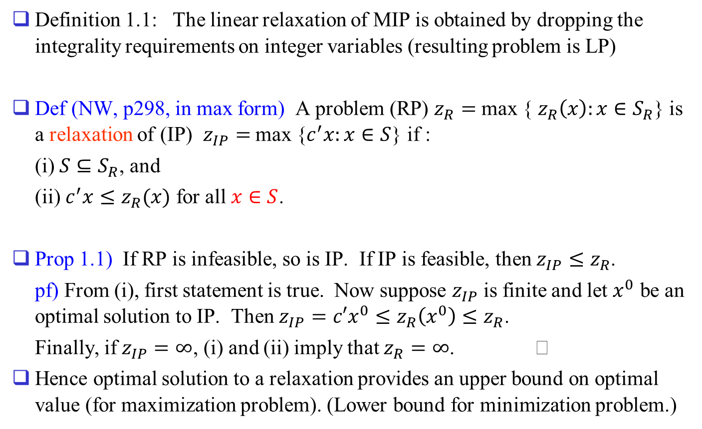
Definition 1.1: The linear relaxation of MIP is obtained by dropping the integrality requirements on integer variables (resulting problem is LP)
Def (NW, p298, in max form) A problem (RP) $z_{R}=$ max { $z_{R}\left(x\right):x∈S_{R}$} is a relaxation of (IP) $z_{IP}=$ max {$c^{′}x:x∈S$} if :
(i) $S⊆S_{R}$, and
(ii) $c^{′}x≤z_{R}(x)$ for all $x∈S$.
Prop 1.1) If RP is infeasible, so is IP. If IP is feasible, then $z_{IP}≤z_{R}$.
pf) From (i), first statement is true. Now suppose $z_{IP}$ is finite and let $x^{0}$ be an optimal solution to IP. Then $z_{IP}=c′x^{0}≤z_{R}\left(x^{0}\right)≤z_{R}$.
Finally, if $z_{IP}=∞$, (i) and (ii) imply that $z_{R}=∞$.
Hence optimal solution to a relaxation provides an upper bound on optimal value (for maximization problem). (Lower bound for minimization problem.)

Slide 3
(Back to minimization problem)
Typical methods to obtain lower bound
Relaxation
Dual problem
LP relaxation widely used, but there are other types of relaxations: Lagrangian relaxation, combinatorial relaxation, semidefinite relaxation, …
Purpose is to obtain lower bound (for min problem)
Upper bound usually obtained by finding a feasible solution.
If lower bound = upper bound, it is optimal value (we may need to find the solution itself additionally)
We usually use divide-and- conquer. If $z_{LP}$ is the lower bound for a subproblem, and $z′$ is the current best objective value we know (upper bound) and $z_{LP}≥z′$, then we can discard the subproblem since the subproblem does not have a better solution. So it is important to have a good (tight) lower bound to increase the possibility of pruning the subproblem early in the divide-and-conquer (branch-and-bound method).

Slide 4
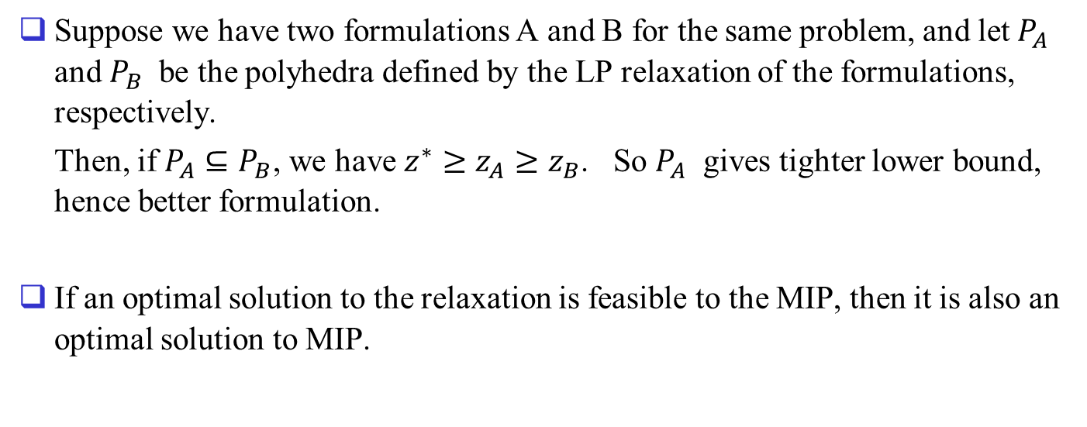
Suppose we have two formulations A and B for the same problem, and let $P_{A}$ and $P_{B}$ be the polyhedra defined by the LP relaxation of the formulations, respectively.
Then, if $P_{A}⊆P_{B}$, we have $z^{∗}≥z_{A}≥z_{B}$. So $P_{A}$ gives tighter lower bound, hence better formulation.
If an optimal solution to the relaxation is feasible to the MIP, then it is also an optimal solution to MIP.

Slide 5
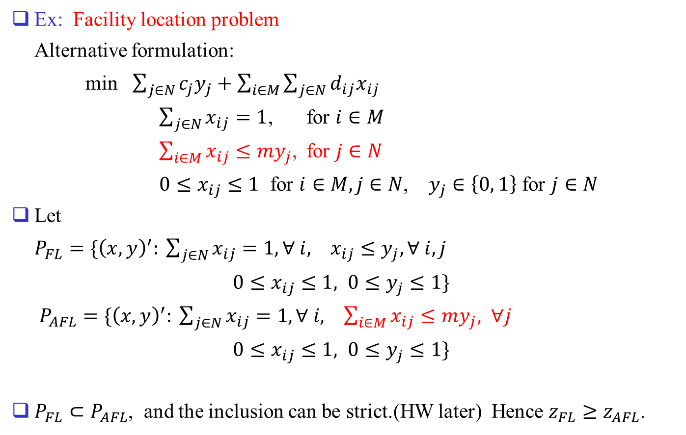
Ex: Facility location problem
Alternative formulation:
min $\sum_{j∈N}{c_{j}y_{j}}+\sum_{i∈M}{\sum_{j∈N}{d_{ij}x_{ij}}}$
$\sum_{j∈N}{x_{ij}}=1$, for $i∈M$
$\sum_{i∈M}{x_{ij}}≤my_{j}$, for $j∈N$
$0≤x_{ij}≤1$ for $i∈M, j∈N$, $y_{j}∈\left\{0, 1\right\}$ for $j∈N$
Let
$P_{FL}=\{{\left(x,y\right)}^{′}: \sum_{j∈N}{x_{ij}=1, ∀ i, x_{ij}≤y_{j}, ∀ i,j}$
$0≤x_{ij}≤1, 0≤y_{j}≤1\}$
$P_{AFL}=\{{\left(x,y\right)}^{′}: \sum_{j∈N}{x_{ij}=1, ∀ i, \sum_{i∈M}{x_{ij}}≤my_{j}, ∀j}$
$0≤x_{ij}≤1, 0≤y_{j}≤1\}$
$P_{FL}⊂P_{AFL}$, and the inclusion can be strict.(HW later) Hence $z_{FL}≥z_{AFL}$.

Slide 6
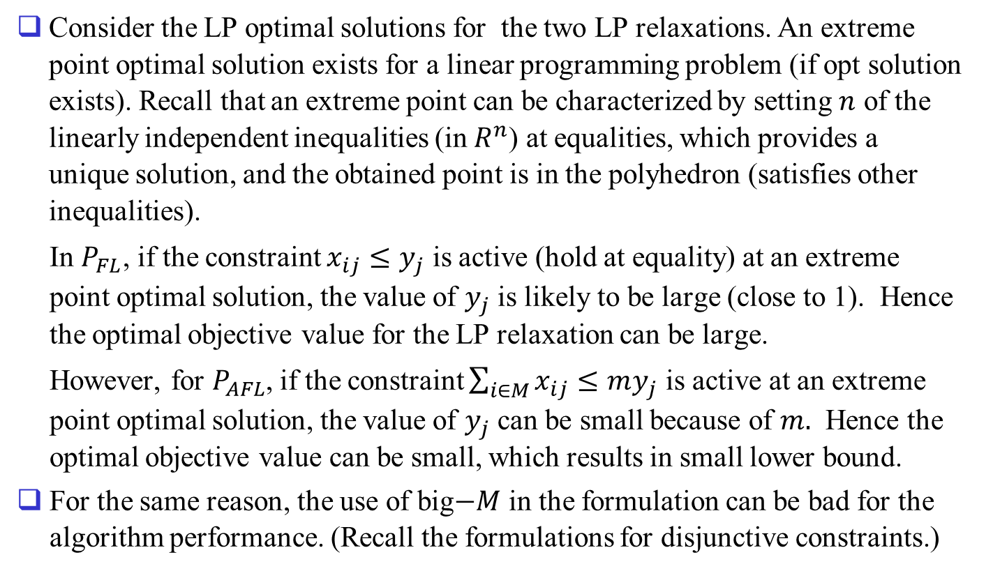
Consider the LP optimal solutions for the two LP relaxations. An extreme point optimal solution exists for a linear programming problem (if opt solution exists). Recall that an extreme point can be characterized by setting $n$ of the linearly independent inequalities (in $R^{n}$) at equalities, which provides a unique solution, and the obtained point is in the polyhedron (satisfies other inequalities).
In $P_{FL}$, if the constraint $x_{ij}≤y_{j}$ is active (hold at equality) at an extreme point optimal solution, the value of $y_{j}$ is likely to be large (close to 1). Hence the optimal objective value for the LP relaxation can be large.
However, for $P_{AFL}$, if the constraint $\sum_{i∈M}{x_{ij}}≤my_{j}$ is active at an extreme point optimal solution, the value of $y_{j}$ can be small because of $m.$ Hence the optimal objective value can be small, which results in small lower bound.
For the same reason, the use of big$−M$ in the formulation can be bad for the algorithm performance. (Recall the formulations for disjunctive constraints.)

Slide 7
P_{AFL}
P_{FL}
conv(F)

Slide 8
Ideal Formulation
Def: Let $P⊆R^{n}$ be a polyhedron. A vector $x∈P$ is an extreme point of P if we cannot find two vectors $y,z∈P$, both different from $x$, and a scalar $λ∈[0,1]$, such that $x=λy+\left(1−λ\right)z.$ (definition can be used for convex sets also)
Def: Given a set $X⊆R^{n}$, the convex hull of $X$, denoted conv($X$), is defined as: conv($X$)$=\{x:x=\sum_{i=1}^{t}{λ_{i}x^{i}, \sum_{i=1}^{t}{λ_{i}=1, λ_{i}≥0}}$ for $i=1,…,t$ over all finite subsets $\left\{x^{1},…,x^{t}\right\}$ of $X\}$
Assume $\left|X\right|$ finite, then
Prop 1.1: conv($X$) is a polyhedron. (polytope)
Pf) later
Prop 1.2: The extreme points of conv($X$) all lie in $X$.
Pf) HW for more general MIP case later.
Props also hold for unbounded integer sets $X=\{x:Ax≤b,x≥0 and integer\}$, and mixed integer sets $X=\left\{\left(x,y\right):Ax+Gy≤b,x≥0,y≥0 and integer\right\}$ with $A,G,b$ rational. (later)

Slide 9
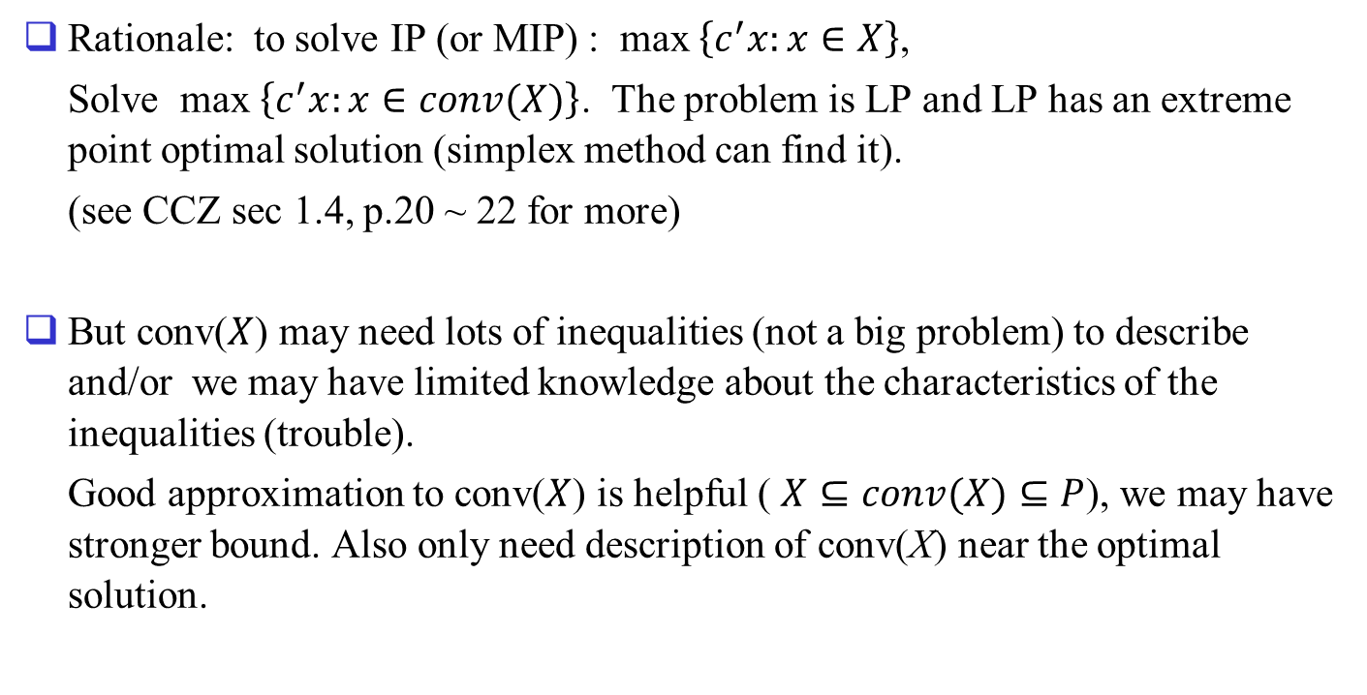
Rationale: to solve IP (or MIP) : max $\left\{c^{′}x:x∈X\right\}$,
Solve max $\left\{c^{′}x:x∈conv(X)\right\}$. The problem is LP and LP has an extreme point optimal solution (simplex method can find it).
(see CCZ sec 1.4, p.20 ~ 22 for more)
But conv($X$) may need lots of inequalities (not a big problem) to describe and/or we may have limited knowledge about the characteristics of the inequalities (trouble).
Good approximation to conv($X$) is helpful ( $X⊆conv(X)⊆P$), we may have stronger bound. Also only need description of conv(X) near the optimal solution.

Slide 10
Ex : The pigeon hole principle
Place $n+1$ pigeons into $n$ holes in such a way that no two pigeons share the same hole. (impossible)
Formulations: ( $x_{ij}=1:$ pigeon $i$ occupies hole $j$)
(1.3) $\sum_{j=1}^{n}{x_{ij}}=1,$ $i=1,…,n+1,$
$x_{ij}+x_{kj}≤1,$ $j=1,…,n, i≠k, i,k=1,…,n+1,$
$x_{ij}∈\left\{0,1\right\},$ $i=1,…,n+1, j=1,…,n$
(1.4) $\sum_{j=1}^{n}{x_{ij}}=1,$ $i=1,…,n+1,$
$\sum_{i=1}^{n+1}{x_{ij}}≤1,$ $j=1,…,n,$
$x_{ij}∈\left\{0,1\right\},$ $i=1,…,n+1, j=1,…,n$
$x_{ij}=1/n$ for all $i,j$ satisfies LP relaxation of (1.3), but LP relaxation of (1.4) infeasible.

